Slide 2
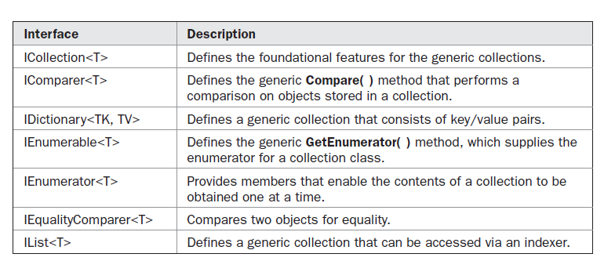
The Generic Interfaces

Slide 3
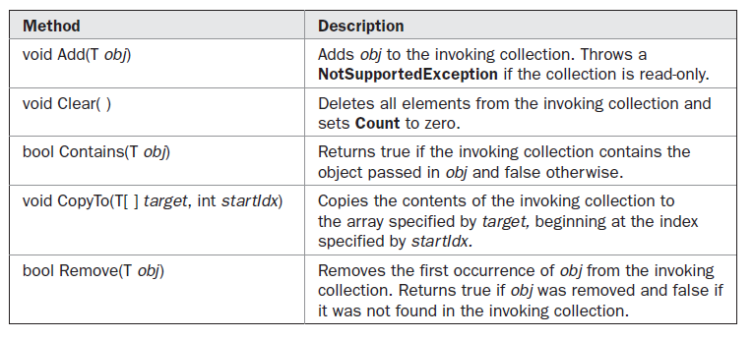
Icollection<T>-methods

Slide 4
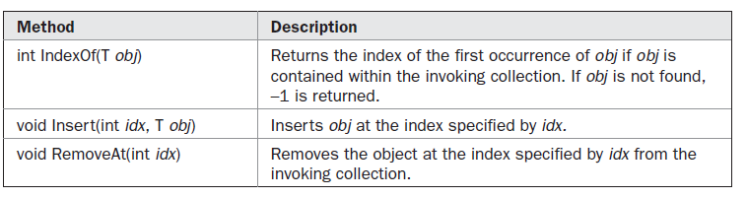
The IList<T> Interface
The IList<T> interface defines the behavior of a generic collection that allows elements to be accessed via a zero-based index.

Slide 5
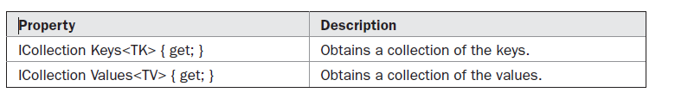
The IDictionary<TK, TV> Interface
Thread Safety

Slide 6
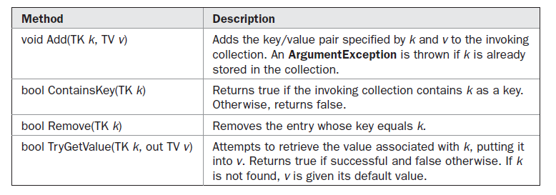
IEnumerable<T> and IEnumerator<T>

Slide 7
The IComparer<T> interface is the generic version of IComparer described earlier
The IEqualityComparer<T> interface is the equivalent of its non-generic relative

Slide 8
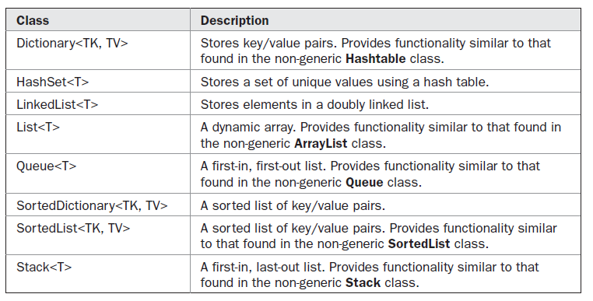
Generic Collection class

