Slide 2
Reflection
Reflection is the feature that enables you to obtain information about a type.
The term reflection comes from the way the process works: A Type object mirrors the underlying type that it represents. To obtain information, you ask the Type object questions, and it returns (reflects) the information associated with the type back to you. Reflection is a powerful mechanism because it allows you to learn and use the capabilities of types that are known only at runtime.

Slide 3
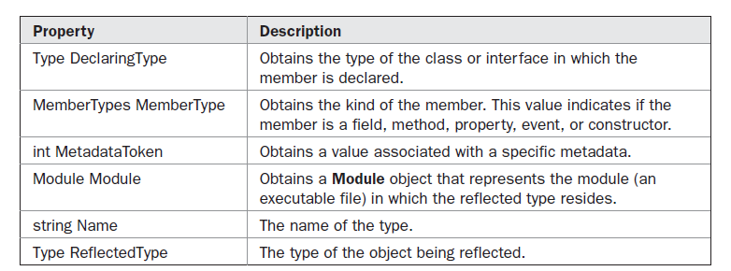
Type is derived from an abstract class called System.Reflection.MemberInfo
MemberInfo defines the following read-only properties:

Slide 4
Notice that the return type of MemberType is MemberTypes. MemberTypes is an
enumeration that defines values that indicate the various member types
MemberTypes.Constructor
MemberTypes.Method
MemberTypes.Field
MemberTypes.Event
MemberTypes.Property
Thus, the type of a member can be determined by checking MemberType. For example, if
MemberType equals MemberTypes.Method, then that member is a method.

Slide 5
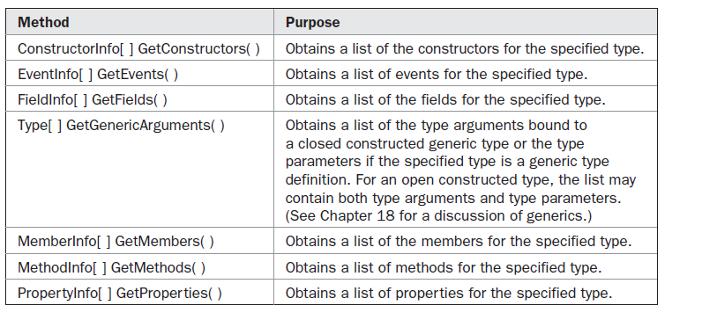
here are several commonly used methods defined by Type

Slide 6
