Slide 1
typecast

Slide 2
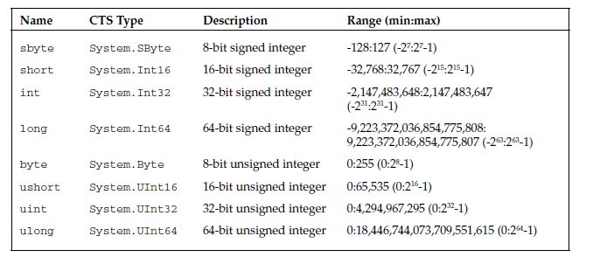

Slide 3
The checked and unchecked Operators
Range of byte is 0-255
byte b = 255;
b++;
Console.WriteLine(b.ToString());
When you try to run this code, you will get an error message like this:
Unhandled Exception: System.OverflowException: Arithmetic operation resulted in an
overflow.
at Wrox.ProCSharp.Basics.OverflowTest.Main(String[] args)

Slide 4
If you want to suppress overflow checking, you can mark the code as unchecked :
byte b = 255;
unchecked
{
b++;
}
Console.WriteLine(b.ToString());
In this case, no exception will be raised, but you will lose data — because the byte type cannot hold a
value of 256, the overflowing bits will be discarded, and your b variable will hold a value of zero (0)

Slide 5
Note that unchecked is the default behavior. The only time you are likely to need to explicitly use the
unchecked keyword is if you need a few unchecked lines of code inside a larger block that you have
explicitly marked as checked .

Slide 6
The is Operator
int i = 10;
if (i is object) //true
{
Console.WriteLine(“i is an object”);
}

Slide 7
The as Operator
object o1 = “Some String”;
object o2 = 5;
string s1 = o1 as string; // s1 = “Some String”
string s2 = o2 as string; // s2 = null
The as operator is used to perform explicit type conversions of reference types. If the type being converted is compatible with the specified type, conversion is performed successfully. However, if the
types are incompatible, the as operator returns the value null
The as operator allows you to perform a safe type conversion in a single step without the need to first
test the type using the is operator and then perform the conversion.

Slide 8
The typeof Operator
The typeof operator returns a System.Type object representing a specified type. For example,
typeof(string) will return a Type object representing the System.String type. This is useful when
you want to use reflection to find information about an object dynamically

Slide 9
Boxing and Unboxing
int myIntNumber = 20;
object myObject = myIntNumber; // Box the int
int mySecondNumber = (int)myObject; // Unbox it back into an int

Slide 10
The ReferenceEquals() Method
ReferenceEquals() is a static method that tests whether two references refer to the same instance of
a class, specifically whether the two references contain the same address in memory
As a static method, it is not possible to override
SomeClass x, y;
x = new SomeClass();
y = new SomeClass();
bool B1 = ReferenceEquals(null, null); // returns true
bool B2 = ReferenceEquals(null,x); // returns false
bool B3 = ReferenceEquals(x, y); // returns false because x and y
// point to different objects

Slide 11
The virtual Equals() Method
The System.Object implementation of the virtual version of Equals() also works by comparing
references. However, because this method is virtual, you can override it in your own classes in order to
compare objects by value. In particular, if you intend instances of your class to be used as keys in a
dictionary, you will need to override this method to compare values. Otherwise, depending on how you
override Object.GetHashCode() , the dictionary class that contains your objects will either not work at
all or will work very inefficiently

Slide 12
The static Equals() Method
The static version of Equals() actually does the same thing as the virtual instance version. The
difference is that the static version takes two parameters and compares them for equality. This method is
able to cope when either of the objects is null , and, therefore, provides an extra safeguard against
throwing exceptions if there is a risk that an object might be null . The static overload first checks
whether the references it has been passed are null . If they are both null , it returns true (because null
is considered to be equal to null ). If just one of them is null , it returns false . If both references actually
refer to something, it calls the virtual instance version of Equals() . This means that when you override
the instance version of Equals() , the effect is as if you were overriding the static version as well.

Slide 13
Comparison Operator (==)
It is best to think of the comparison operator as an intermediate option between strict value comparisonand strict reference comparison. In most cases, writing the following means that you are comparing
References: bool b = (x == y); // x, y object references
However, it is accepted that there are some classes whose meanings are more intuitive if they are treated as values. In those cases, it is better to override the comparison operator to perform a value comparison.
Overriding operators is discussed next, but the obvious example of this is the System.String class for which Microsoft has overridden this operator to compare the contents of the strings rather than their references.

Slide 14
When comparing value types for equality, the same principles hold as for reference types:
ReferenceEquals() is used to compare references,
Equals() is intended for value comparisons, and the comparison operator is viewed as an intermediate case. However, the big difference is that value types need to be boxed in order to be converted to references so that methods can be executed on them.
In addition, Microsoft has already overloaded the instance Equals() method in the System.ValueType class in order to test equality appropriate to value types. If you call sA.Equals(sB) where sA and sB are instances of some struct, the return value will be true or false , according to whether sA and sB contain the same values in all their fields.
On the other hand, no overload of == is available by default for your own structs. Writing (sA == sB) in any expression will result in a compilation error unless you have provided an overload of == in your code for the struct in question.
Another point is that ReferenceEquals() always returns false when applied to value types because, to call this method, the value types will need to be boxed into objects. Even if you write the following, you will still get the answer of false :
bool b = ReferenceEquals(v,v); // v is a variable of some value type
The reason for this is that v will be boxed separately when converting each parameter, which means you get different references. Because of this, there really is no reason to call ReferenceEquals() to compare value types because it doesn ’ t make much sense.

Slide 15
User - Defined Casts
int I = 3;
long l = I; // implicit
short s = (short)I; // explicit
Because C# allows you to define your own data types (structs and classes), it follows that you will need
the facility to support casts to and from those data types. The mechanism is that you can define a cast as
a member operator of one of the relevant classes. Your cast operator must be marked as either implicit
or explicit to indicate how you are intending it to be used

Slide 16
public static implicit operator float (Currency value)
{
// processing
}
casts must be declared as both public and static .

