Slide 1
Introduction to Concurrency
Doing more than one thing at a time.
End-user applications use concurrency to respond to user input while writing to a database.
Server applications use concurrency to respond to a second request while finishing the first request

Slide 2
Concurrency
Multithreading
asynchronous programming
Parallelprocessing
reactive programming

Slide 3
Multithreading
A form of concurrency that uses multiple threads of execution
multithreading is one form of concurrency, but certainly not the only one
Thread or BackgroundWorker types; they have been replaced with superior alternatives.
But don’t get the idea that multithreading is dead!
Multithreading lives on in the thread pool, a useful place to queue work that automatically adjusts itself according to demand.
In turn, the thread pool enables another important form of concurrency: parallelprocessing.

Slide 4
parallelprocessing.
Doing lots of work by dividing it up among multiple threads that run concurrently
Parallel processing (or parallel programming) uses multithreading to maximize the use of multiple processors.
Modern CPUs have multiple cores, and if there’s a lot of work to do, then it makes no sense to just make one core do all the work while the others sit idle.
Parallel processing will split up the work among multiple threads, which can each run independently on a different core.

Slide 5
asynchronous programming.
A form of concurrency that uses futures or callbacks to avoid unnecessary threads.
A future (or promise) is a type that represents some operation that will complete in the future.
The modern future types in .NET are Task and Task<TResult>.
Older asynchronous APIs use callbacks or events instead of futures.
Asynchronous programming is centered around the idea of an asynchronous operation
some operation that is started that will complete some time later. While the operation is in progress, it does not block the original thread; the thread that starts the operation is free to do other work.
The async and await support in VS2012 make asynchronous
programming almost as easy

Slide 6
reactive programming
A declarative style of programming where the application reacts to events.
Reactive programming is not necessarily concurrent, but it is closely related to concurrency,
reactive programming is extremely powerful. Reactive programming allows you to treat a stream of events like a stream of data.
As a rule of thumb, if you use any of the event arguments passed to an event, then your code would benefit from using Rx instead of a regular event handler.
Reactive programming is based around the notion of observable streams. When you subscribe to an observable stream, you’ll receive any number of data items (OnNext) and then the stream may end with a single error (OnError) or “end of stream” notification(OnCompleted).
Reactive code ends up looking very much like LINQ; you can think of it as “LINQ to events
The main difference is that LINQ to Objects and LINQ to Entities use a “pull” model, where the enumeration of a LINQ query pulls the data through the query, while LINQ to events (Rx) uses a “push” model, where the events arrive and travel through the query by themselves.

Slide 7
Introduction to Dataflows
TPL Dataflow is an interesting mix of asynchronous and parallel technologies. It is useful when you have a sequence of processes that need to be applied to your data.
For example, you may need to download data from a URL, parse it, and then process it in parallel with other data.
TPL Dataflow is commonly used as a simple pipeline, where data enters one end and travels until it comes out the other.

Slide 8
Most concurrent technologies have one similar aspect:they are functional in nature.
One principle of functional programming is purity (that is, avoiding side effects). Each piece of the solution takes some value(s) as input and produces some value(s) as output.
As much as possible, you should avoid having these pieces depend on global (or shared) variables or update global (or shared) data structures
Another principle of functional programming is immutability. Immutability means that
a piece of data cannot change. One reason that immutable data is useful for concurrent
programs is that you never need synchronization for immutable

Slide 9
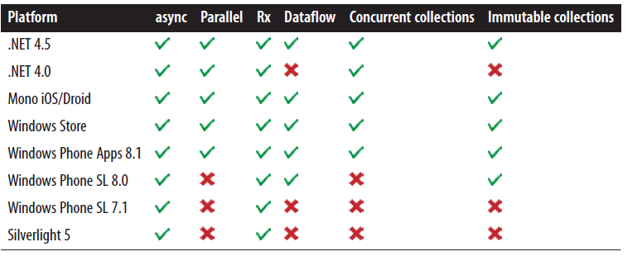

Slide 10
There are two forms of parallelism
data parallelism and
task parallelism
Data parallelism is when you have a bunch of data items to process, and the processing of each piece of data is mostly independent from the other pieces.
Task parallelism is when you
have a pool of work to do, and each piece of work is mostly independent from the other
pieces. Task parallelism may be dynamic; if one piece of work results in several additional
pieces of work, they can be added to the pool of work.

Slide 11
Parallel.ForEach
Parallel.For
Or
PLINQ (Parallel LINQ), which provides an AsParallel extension method for LINQ queries.
Parallel is more resource friendly than PLINQ;
Parallelwill play more nicely with other processes in the system, while
PLINQ will (by default)attempt to spread itself over all CPUs.
The downside to Parallel is that it is moreexplicit;
PLINQ has more elegant code in many cases
Note: The chunks of work should be as independent from each other as possible

Slide 12
As long as your chunk of work is independent from all other chunks, you maximizeyour parallelism.
As soon as you start sharing state between multiple threads, you have to synchronize access to that shared state, and your application becomes less parallel

