Slide 1
Indian Institute of Technology, Kharagpur
High Performance Computer Architecture (CS60003)
gem5 Simulator - Tutorial
Anirban Chakraborty
Teaching Assistant
anirban.chakraborty@iitkgp.ac.in
gem5 Simulator - Tutorial
High Performance Computer Architecture (CS60003) – IIT Kharagpur
<number>

Slide 2
Outline
What is gem5?
Key Features
System Requirements
Build and Run
gem5 Architecture
Example Scripts
Understanding gem5 output
Additional material
gem5 Simulator - Tutorial
High Performance Computer Architecture (CS60003) – IIT Kharagpur
<number>

Slide 3
What is gem5?
Michigan m5 + Wisconsin GEMS = gem5
“The gem5 simulator is a modular platform for computer-system architecture research, encompassing system-level architecture as well as processor microarchitecture.”
Nathan Binkert, Bradford Bechmann, Gabriel Black, Steven K. Reinhardt, Ali Saidi, Arkaprava Basu, Joel Hestness, Derek R. Hower, Tushar Krishna, Somayeh Sardashti, Rathijit Sen, Korey Sewell, Muhammad Shoaib, Nilay Vaish, Mark D. Hill and David A. Wood. 2011. The gem5 simulator. SIGARCH Computer Architecture News 39, 2 (August 2011), 1-7.
gem5 Simulator - Tutorial
High Performance Computer Architecture (CS60003) – IIT Kharagpur
<number>

Slide 4
Key Features
Execution modes: System-call Emulation (SE), Full System (FS)
Available binaries: gem5.debug, gem5.opt, gem5.prof, gem5.perf, gem5.fast
ISAs: ALPHA, ARM, MIPS, POWER, RISC-V, SPARC, x86 and NULL
CPU models: AtomicSimple, TimingSimple, InOrder, O3
Memory models: Classic, Ruby
Interconnection Networks: Simple, Garnet
gem5 Simulator - Tutorial
High Performance Computer Architecture (CS60003) – IIT Kharagpur
<number>

Slide 5
System Requirements
Platforms
Linux, BSD, MacOS, Solaris
64 bit machine is an advantage
Dependencies
Git / Mercurial
Gcc/ g++ 4.8+
Python 2.7+
Scons 0.98.1+
SWIG 2.0.4+
M4
Zlib
gem5 Simulator - Tutorial
High Performance Computer Architecture (CS60003) – IIT Kharagpur
<number>

Slide 6
Build and Run
Install Dependencies (Ubuntu)
sudo apt install build-essential git m4 scons zlib1g zlib1g-dev libprotobuf-dev protobuf-compiler libprotoc-dev libgoogle-perftools-dev python-dev python
Get gem5
git clone https://gem5.googlesource.com/public/gem5
Build gem5
scons build/X86/gem5.opt -j9
gem5 Simulator - Tutorial
High Performance Computer Architecture (CS60003) – IIT Kharagpur
<number>

Slide 7
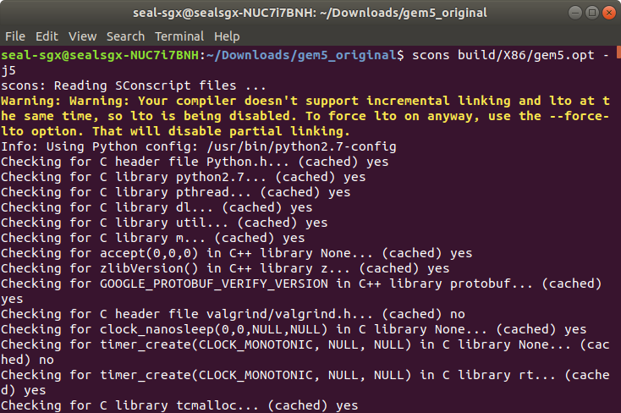
Build and Run (contd.)
gem5 Simulator - Tutorial
High Performance Computer Architecture (CS60003) – IIT Kharagpur
<number>

Slide 8
The Build Process
> scons build/X86/gem5.opt –j9
scons: the build system that gem5 uses (similar to make)
build/X86/gem5.opt: “parameter” passed to scons. Gem5’s Sconscript interprets this.
X86: specifies the default build options for x86 ISA.
opt: version of executable to compile (other types are debug, perf, fast, etc.)
gem5 Simulator - Tutorial
High Performance Computer Architecture (CS60003) – IIT Kharagpur
<number>

Slide 9
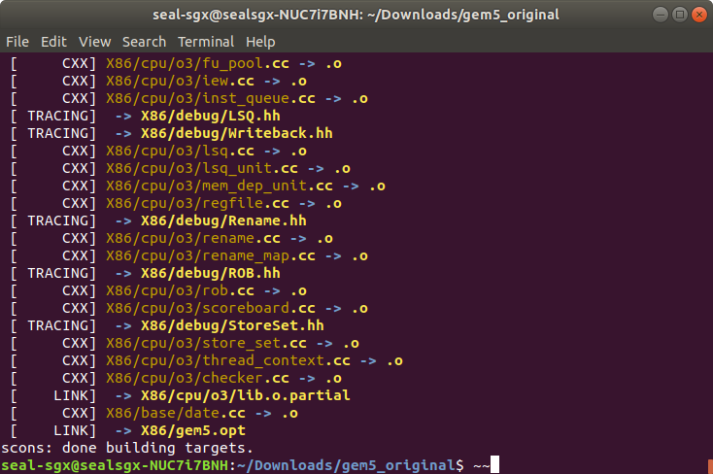
Build and Run (contd.)
gem5 Simulator - Tutorial
High Performance Computer Architecture (CS60003) – IIT Kharagpur
<number>

Slide 10
gem5 architecture
gem5 consists of “SimObjects”
most C++ objects in gem5 inherit from class SimObjects
represent physical system components
gem5 completely controlled by Python scripts
All (C++) SimObjects are exposed to Python
gem5 Simulator - Tutorial
High Performance Computer Architecture (CS60003) – IIT Kharagpur
<number>

Slide 11
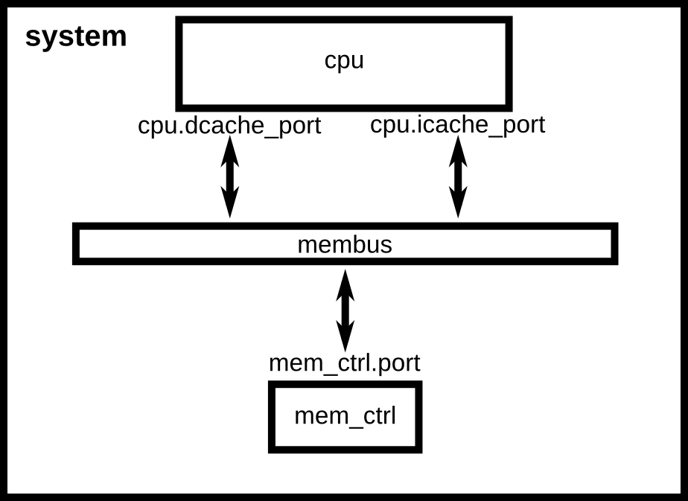
Our 1st config script
Simple CPU connected to a memory bus (without cache)
gem5 Simulator - Tutorial
High Performance Computer Architecture (CS60003) – IIT Kharagpur
<number>

Slide 12
Running config script
> build/X86/gem5.opt configs/tutorial/simple.py
build/X86/gem5.opt: the gem5 binary to run
configs/[…]/simple.py: the configuration script
gem5 Simulator - Tutorial
High Performance Computer Architecture (CS60003) – IIT Kharagpur
<number>

Slide 13
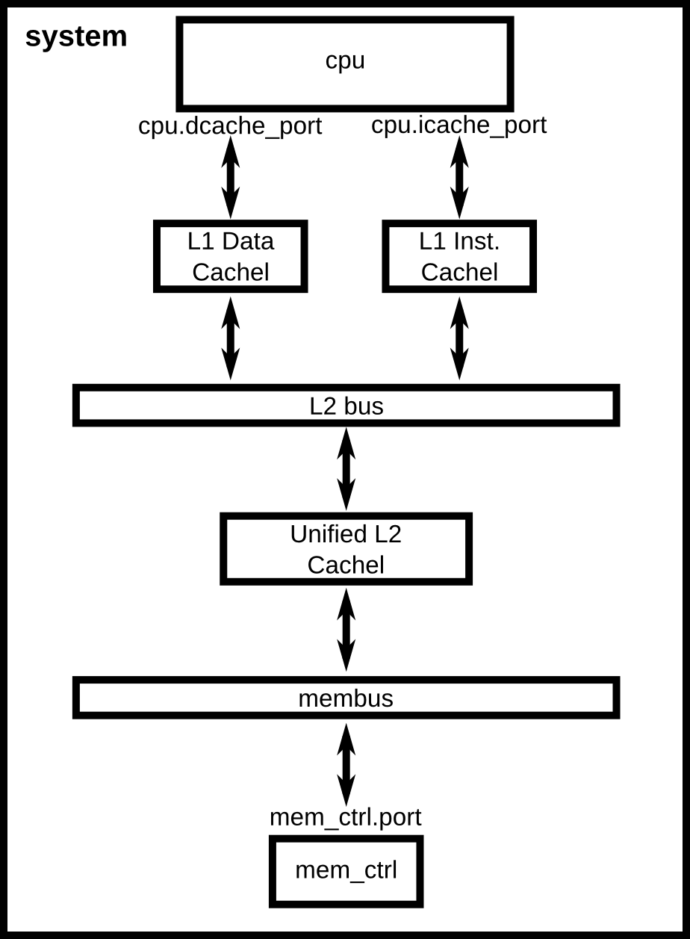
2nd config script
Adding two levels of cache memories into our simple script
gem5 Simulator - Tutorial
High Performance Computer Architecture (CS60003) – IIT Kharagpur
<number>

Slide 14
Understanding gem5 output
m5out
config.ini: dumps all the parameters of all SimObjects used. This shows exactly what you simulated
config.json: same as config.ini, but in json format
stats.txt: detailed statistics output. Each SimObject defines and update statistics. They are printed here at the end of the simulation
gem5 Simulator - Tutorial
High Performance Computer Architecture (CS60003) – IIT Kharagpur
<number>

Slide 15
Conclusion
Additional material
http://learning.gem5.org/book/index.html
gem5 Simulator - Tutorial
High Performance Computer Architecture (CS60003) – IIT Kharagpur
<number>

