Slide 1
IBM University Engagement Project Submission
“Exploring the Power of Agentic AI with IBM Granite and LangFlow”

Slide 2

Project Tile – Smart Study Generator Agent
Domain of Project – Education
Student Name | Recent Passport Photo | Email ID | Mobile number [WhatsApp]
Mugdha Mahajan |  | mahajanmugdha2005@gmail.com | 9137804689

Slide 3
Problem Statement -
Problem Statement : Smart Study Generator Agent
The Challenge
Students today face an overwhelming flood of information—lecture notes, textbooks, research papers, YouTube tutorials, and online resources. This content is scattered, unorganized, and often not personalized to their learning pace or style. As a result, students struggle with finding the right study material, summarizing key concepts, and staying exam-ready. Traditional study tools only provide static notes or flashcards, failing to adapt dynamically to student needs. The challenge is to move beyond static resources toward an intelligent, adaptive study companion.
The Objective
Build an agentic AI-powered Smart Study Generator that personalizes and streamlines learning for students. The solution should:
Fuse Learning Resources: Aggregate content from class notes, textbooks, research articles, and online tutorials into structured, easy-to-digest study material.
Enable Multimodal Input: Allow students to upload notes, voice queries, or images (e.g., textbook pages), and generate concise summaries, flashcards, or concept maps.
Create a Predictive & Agentic Layer: Recommend personalized study plans, highlight important topics based on syllabus or past exams, and provide predictive alerts (e.g., “Focus on Topic X—frequently asked in exams”).
Visualize Study Progress: Offer a real-time dashboard showing learning milestones, weak areas, practice quizzes, and performance forecasts.

Slide 4
Proposed Solution -
The proposed solution is a multi-agent AI-powered Smart Study Generator Agent built using LangFlow, Google AI Studio, and Google Gemini 3.5 Flash to provide personalized and adaptive learning support. The system addresses challenges such as scattered study materials, inefficient revision, and lack of personalized guidance through an intelligent, modular architecture.
At its core, the solution uses a Retrieval-Augmented Generation (RAG) pipeline to retrieve relevant information from uploaded study materials such as lecture notes, textbooks, PDFs, and research papers. These documents are converted into embeddings and stored in a vector database, enabling accurate retrieval, summarization, and question answering.
The system consists of four key agents:
Knowledge Processing Agent retrieves, organizes, and summarizes study materials using the RAG pipeline.
Learning Assistant Agent explains concepts, answers academic questions, and personalizes learning based on the student's goals and learning style.
Study Planner Agent creates personalized study schedules based on exam dates, available study time, and weak topics.
Assessment & Feedback Agent generates quizzes, flashcards, revision notes, and provides performance analysis with improvement suggestions.
The solution includes a user-friendly dashboard (Streamlit or React) where students can upload study materials, view summaries, track learning progress, and access personalized study plans and assessments.
LangFlow orchestrates the multi-agent workflow, while Google AI Studio provides access to Google Gemini 3.5 Flash, which powers reasoning, summarization, question answering, and personalized study recommendations.
Overall, the solution delivers an intelligent study assistant that helps students organize learning resources, improve understanding, and prepare effectively for exams through AI-powered personalized learning.

Slide 5
Technology Used
LangFlow Platform - Used to visually design and orchestrate the Smart Study Generator Agent workflow.
Google AI Studio - Provides secure API access to the Google Gemini 3.5 Flash model for AI-powered study assistance.
Google Gemini 3.5 Flash - Used for natural language understanding, reasoning, concept explanation, summarization, quiz generation, flashcard creation, and personalized study planning.

Slide 6
Langflow component Used -
Chat Input – Interface where students enter their academic queries, study goals, or upload learning-related prompts for the Smart Study Generator Agent.
Agent – Processes user queries using the Google Gemini 3.5 Flash model and follows the defined system prompt to generate personalized study plans, concept explanations, summaries, flashcards, quizzes, and learning recommendations.
Google Gemini 3.5 Flash – A fast and efficient large language model used for natural language understanding, reasoning, summarization, question answering, and personalized study assistance.
Chat Output – Displays AI-generated responses such as study summaries, concept explanations, revision notes, flashcards, quizzes, and personalized study plans.
Agent Instructions (System Prompt) – Defines the Smart Study Generator Agent's behavior, communication style, personalization rules, study material generation, and response format to ensure accurate and consistent academic assistance.

Slide 7
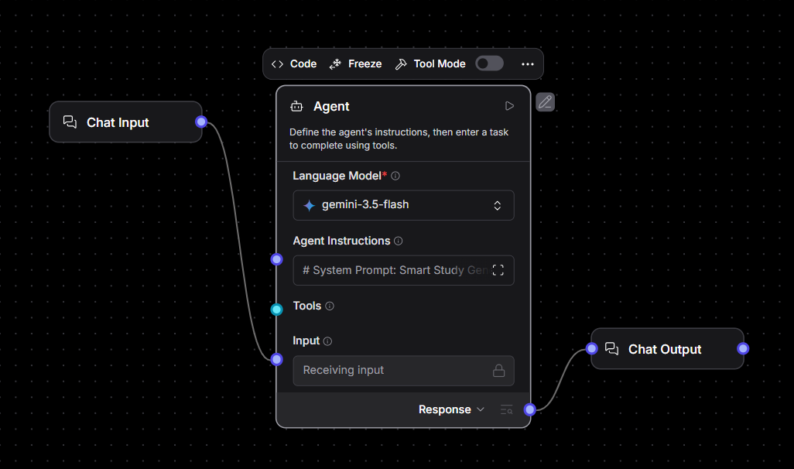
Langflow workflow -

Slide 8
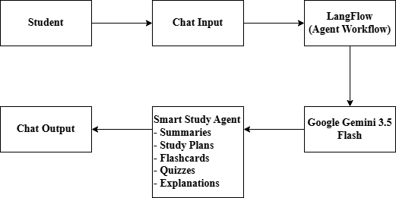
Architecture blueprint -

Slide 9

Role of Agentic AI in the solution
Agentic AI enables the Smart Study Generator Agent to function as an intelligent, autonomous learning assistant rather than a simple chatbot. Using LangFlow and Google Gemini 3.5 Flash, it coordinates multiple specialized agents to deliver personalized learning support.
Each agent performs a specific role—such as organizing study materials, explaining concepts, generating study plans, and creating quizzes and flashcards—while working collaboratively. This multi-agent approach ensures efficient task execution and provides accurate, personalized learning resources.
Agentic AI also provides context awareness by understanding the student's academic level, subject, learning goals, weak areas, and exam timeline to generate tailored study recommendations. It continuously adapts its responses based on user interactions, helping students stay focused and improve their understanding.
Additionally, the agents work together to deliver organized study content, personalized revision strategies, and continuous learning support.
Overall, Agentic AI makes the system intelligent, adaptive, and student-centric, acting as a smart study companion that helps students learn effectively and prepare confidently for exams.

Slide 10
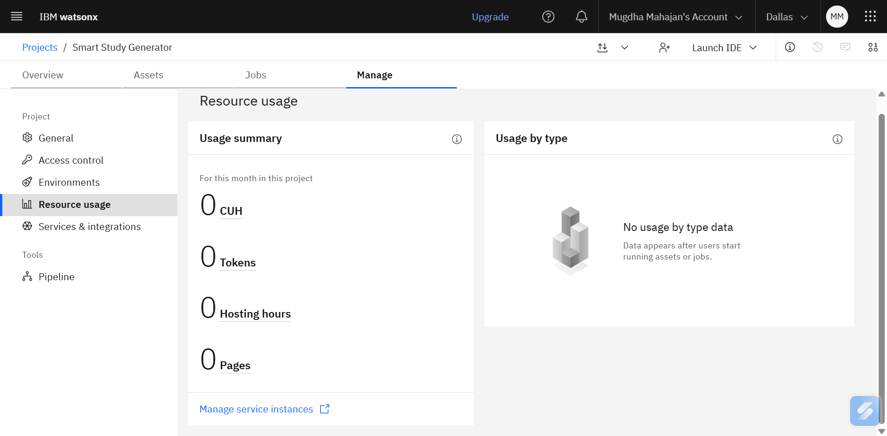
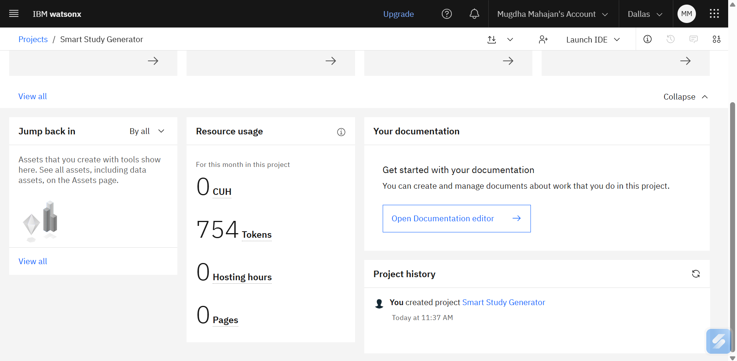
Token Usage
754 token are used
Before Prompt
After the Prompt

Slide 11
Novelty and Uniqueness
The proposed Smart Study Generator Agent stands out by combining Agentic AI, Generative AI, and personalized learning into a single intelligent system.
Multi-Agent Intelligence – Multiple specialized agents collaborate to organize study materials, explain concepts, generate study plans, and create quizzes, ensuring efficient and context-aware learning support.
Personalized Learning – Adapts study plans, explanations, and revision strategies based on the student's academic level, learning goals, weak areas, and exam timeline.
Adaptive Study Planning – Generates realistic study schedules by prioritizing important topics and available study time to maximize exam readiness.
Interactive Learning Support – Creates summaries, flashcards, practice quizzes, and concept explanations to improve understanding and retention.
Multimodal Input – Supports text, images, voice queries, and uploaded study materials for a seamless learning experience.
Context-Aware Responses – Understands previous interactions and student preferences to provide relevant and personalized academic assistance.
Scalable & Efficient – Built using LangFlow and Google Gemini 3.5 Flash through Google AI Studio, enabling fast, accurate, and intelligent study assistance.
This makes the solution a smart, adaptive, and personalized digital study companion rather than just a basic question-answering chatbot.

Slide 12
Git Hub Link
This project presents an AI-Powered Smart Study Generator Agent developed using LangFlow and Google Gemini 3.5 Flash, designed to help students generate personalized study plans, concise summaries, flashcards, quizzes, and concept explanations from multiple learning resources. The complete project, including source files and documentation, is available at the following GitHub Repository.
·
·
·

Slide 13
Future Scope
Advanced Document Understanding with RAG – The system can be enhanced by integrating a Retrieval-Augmented Generation (RAG) pipeline with a vector database. This will enable the agent to retrieve information directly from uploaded textbooks, research papers, lecture notes, and PDFs, providing more accurate, context-aware, and personalized study assistance.
AI-Powered Voice Assistant & Multilingual Support – The system can be extended with a voice-enabled assistant and multilingual support, allowing students to ask questions and receive explanations in their preferred language. This will improve accessibility and make the Smart Study Generator Agent more inclusive for students from diverse linguistic and educational backgrounds.
·
·
·

Slide 14
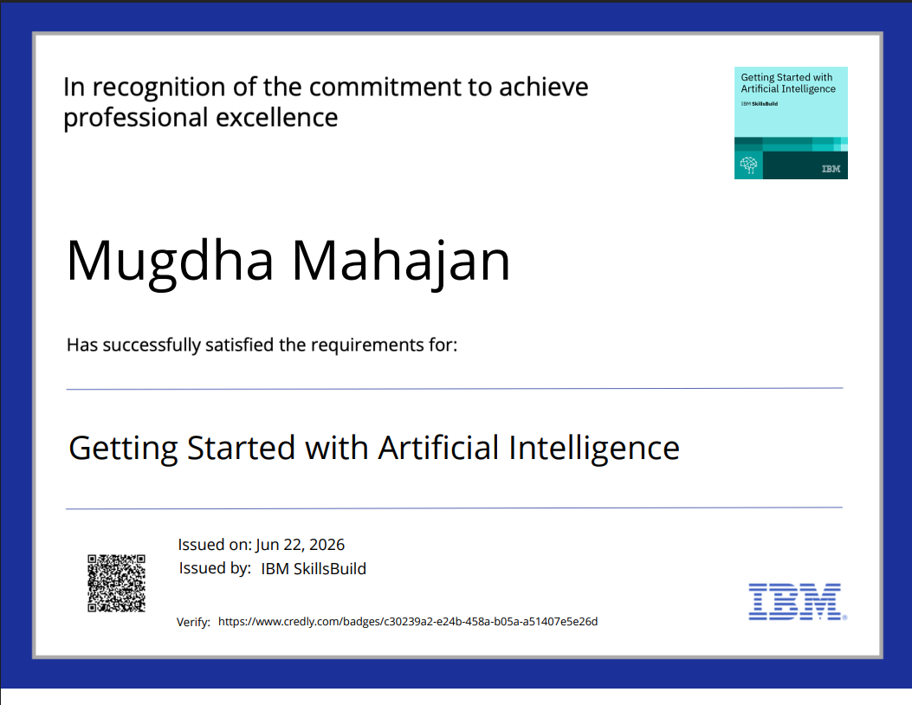
Certificates Earned:

Slide 15
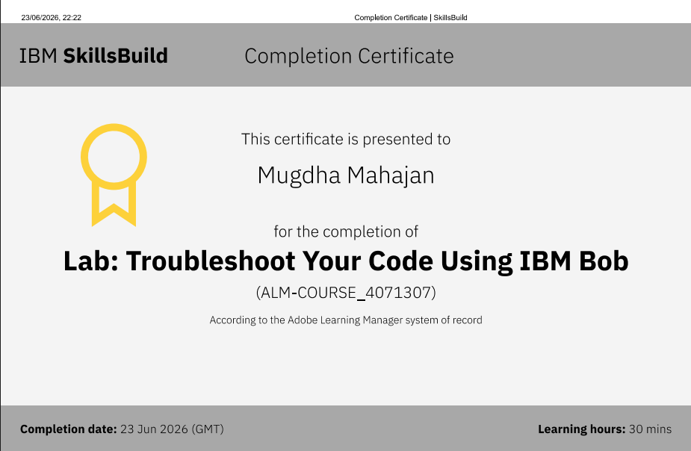
Certificates Earned:​

Slide 16


