Slide 1

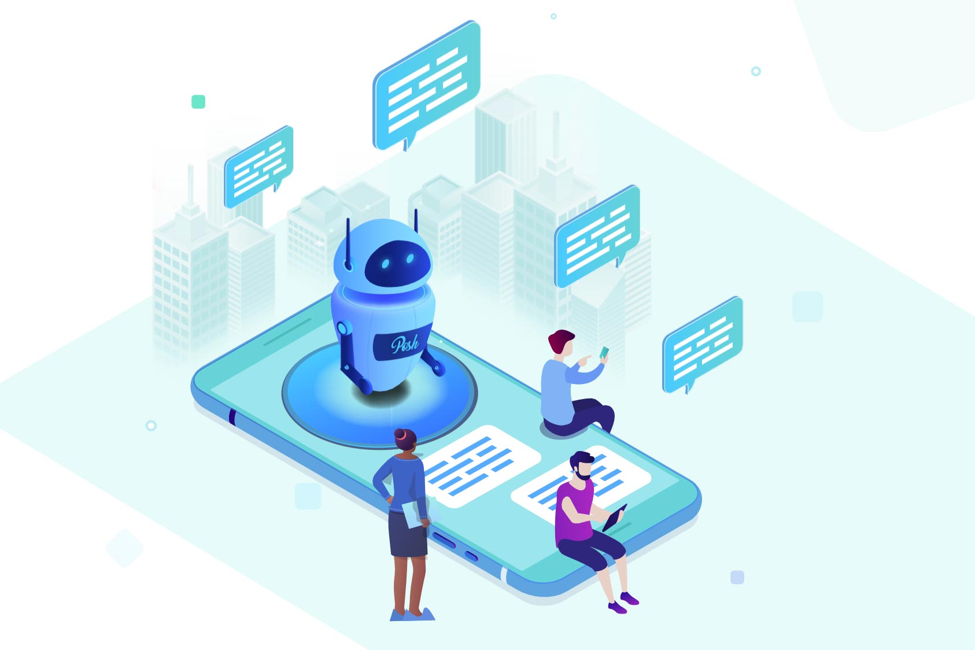
Python ChatBot Application
Project by: Mahak Mishra
UID: 11905862

Slide 2
Chatbot
A chatbot is a software application used to conduct an on-line chat conversation via text or text-to-speech, in lieu of providing direct contact with a live human agent.Designed to convincingly simulate the way a human would behave as a conversational partner, chatbot systems typically require continuous tuning and testing.

Slide 3
Artificial Intelligence
AI was coined by John McCarthy, an American computer scientist, in 1956 at The Dartmouth Conference where the discipline was born. Today, it is an umbrella term that encompasses everything from robotic process automation to actual robotics. It has gained prominence recently due, in part, to big data, or the increase in speed, size and variety of data businesses are now collecting. AI can perform tasks such as identifying

Slide 4
REQUIREMENTS AND SPECIFICATION
Hardware Requirements (minimum) :
Processor : Pentium IV / Catelina OS Hard Disk : 8GB RAM : 256MB (minimum)
Software Requirements:
MacOs/Windows/Linux : Pycharm CE (python 3)

Slide 5
Libraries To be Installed
1.1 Chatterbot 1.2 Chatterbot.Corpus 1.3 python -m spacy download (“en”)

Slide 6
PROPOSED SOLUTION
from chatterbot import ChatBot from chatterbot.trainers import ChatterBotCorpusTrainer
chatbot = ChatBot(‘bot')

Slide 7
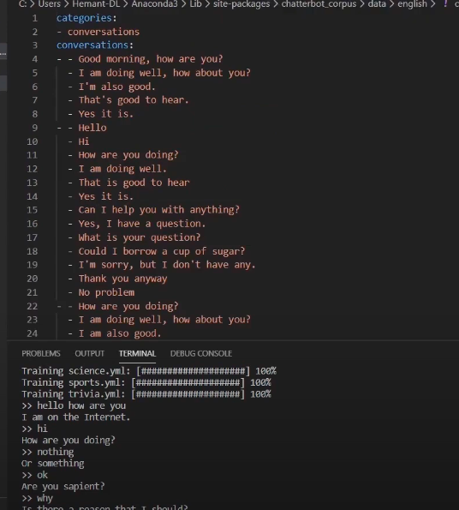
PROPOSED SOLUTION
trainer = ChatterBotCorpusTrainer(chatbot) trainer.train(‘chatterbot.corpus.english' )

Slide 8
PROPOSED SOLUTION
1.while True : 2. quary = str(input(">> ")) 3. print(chatbot.get_response(quary))
4. if "exit" in quary:
5. break

Slide 9
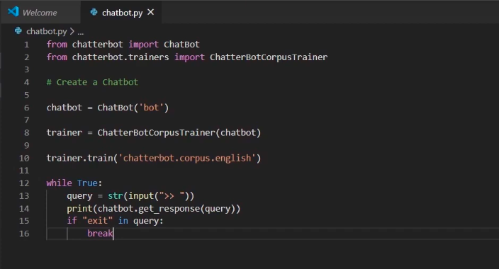

Slide 10
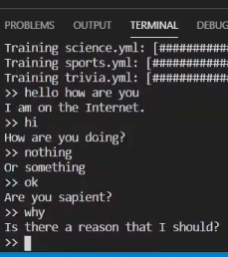
OUTPUT
>> hello how are you I am on the Internet. >> hi How are you doing?
>> nothing
or something
>> ok
Are you sapient?
>> why
Is there a reason that I should?
>>

Slide 11
Advantages
1. Accessibleanytime:
I’m sure most of you are always kept on hold while operators connect you to a customer care executive. On an average people spend around 7 minutes until they are assigned to a person. Gone are the frustrating days of waiting in a queue for the next available operative. They are replacing live chat and other forms of slower contact methods such as emails and phone calls. Since chatbots are basically virtual robots they never get tired and continue to obey your command. They will continue to operate every day throughout the year without requiring to take a break. This improves your customer UX and helps you rank highly in your sector. Another advantage of this instant response is that you can also skillfully craft your chatbot to maintain your image and brand.
2. Handling Capacity:
Unlike humans who can only communicate with one human at a time, chat bots can simultaneously have conversations with thousands of people. No matter what time of the day it is or how many people are contacting you, every single one of them will be answered immediately.
Imagine you own a restaurant, and you have a good reputation for your food of which most of your revenues come from delivery. As the demand keeps rising, you will have more customers to take orders from but very few staff to attend them all. Having a chatbot would eliminate such problem and cater to each and every person and ensure that no order is missed. Companies like Taco Bell and Dominos are already using chatbots to arrange delivery of parcels.

Slide 12
Disadvantages
1.Too many functions
Most of developers strive to create a universal chatbot that will become a fully-fledged assistant to user. But in practice functional bots turn out not to cope with the majority of queries. They often do not understand the user, forget what they were told 5 minutes earlier, and have many other disadvantages. And that is no wonder, as the development of a universal bot, which would understand natural language and could evaluate context, takes years of hard work for a team of experienced programmers. And even in this case, such programs should be constantly improved while in service.
However, modern technologies allow building rather useful bots to perform specific actions such as booking train tickets or providing support to bank customers.
2.Primitive algorithms
There are two types of bots: based on artificial intelligence, being able to learn in the process of communication; programmed for specific behavior scenarios. Artificial intelligence chatbots are considered to be better, as they can respond depending on the situation and context. But the development of complex algorithms is required for this purpose. Meanwhile, only IT giants and few developers possess such powerful technological base. Therefore, it would be better for ordinary companies to focus on the second variant of bots, as they are more reliable and simpler. Namely for the reason they do not possess intelligence, they will not be able to adopt rude communication patterns and get beyond the control of creators.

Slide 13
CONCLUSION AND FUTURE SCOPE
Chatbots are the new Apps! As we have discussed in the above deliverables, this project brings the power of chatbots to Yioop and enriches its usability. Chatbots in Yioop can give a human like touch to some aspects and make it an enjoying conversation. And they are focused entirely on providing information and completing tasks for the humans they interact with. The above mentioned functionality in all the deliverables is implemented and pushed in to Yioop code. By implementing the above mentioned deliverables I was able to add a basic chatbot functionality in to the Yioop. I.e., configuring and creating accounts for bot users with bot settings which is mentioned in deliverable 2, activating a bot whenever a user asks for it via post in a thread which is discussed in deliverable 3 and as I discussed in deliverable 4, I have implemented a simple weather chatbot that gives weather information whenever a user ask and Fig. 3 tells that I was also able to converse with the bot in Yioop.

Slide 14
Thank You
Mahak Mishra 11905862-K19JF

