Slide 1
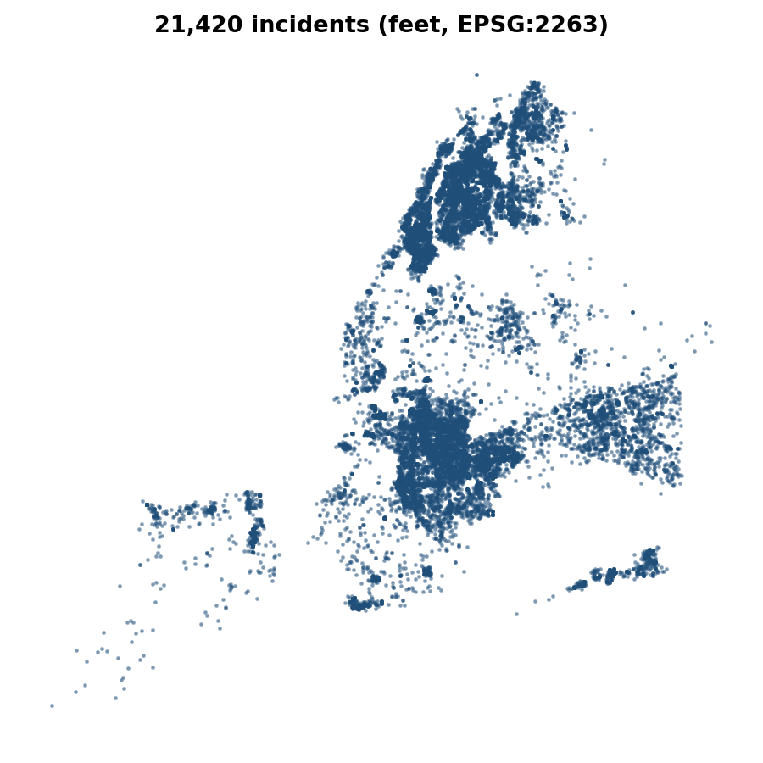
SPATIAL CLUSTER ANALYSIS
Where Do Shootings Concentrate in New York City?
K-Means vs DBSCAN vs HDBSCAN on NYPD Shooting Incident Data, 2006–2022
Machine Learning Project | Mahak Maurya
Notes:
Introduce the question: can clustering find where shootings concentrate, and does a density-based method describe this better than K-Means? Data is the NYPD historic shooting file, 2006-2022.

Slide 2
DATA & APPROACH
27,312 victim records collapse into 21,420 unique shooting incidents
WORKFLOW
1. Load NYPD data
27,312 rows × 21 columns, 2006–2022
2. Check quality
Missing values, duplicates, coordinates
3. Build incident table
One row per INCIDENT_KEY, keep N_VICTIMS
4. Cluster locations
K-Means → DBSCAN → HDBSCAN
Each row is one victim: 5,892 extra rows share an incident key with another row (not data errors).
3,521 incidents (16.44%) had more than one victim, so victim count is kept as a severity weight.
Goal: compare partition-based and density-based clustering on incident locations.
5. Profile hotspots
Time, severity, stability, density
KEY TAKEAWAY The unit of analysis is the incident, not the victim, and the whole project is built on that choice.
2 / 12
Notes:
Key structural fact: the data is victim-level. 27,312 rows but only 21,420 incidents. We keep N_VICTIMS before deduplicating so severity is not lost.

Slide 3
DATA QUALITY & PREPARATION
Location fields are almost complete, so the analysis can rely on coordinates
WORKFLOW
Missing values
Descriptive fields mostly empty
Duplicate check
0 duplicate rows; 5,892 repeated keys
Consistency test
Repeated keys: 0 conflicts in date, time, X, Y, borough, precinct
Coordinates
10 rows lack lat/lon, X/Y are 100% present
Location description and perpetrator fields are too sparse to model.
Because repeated keys never disagree, keeping the first row per incident is lossless for location and time.
Latitude/longitude are angles, so X/Y in feet are used for clustering (1,250 ft ≈ 381 m).
Use X/Y in feet
Distances become physical (no standardising)
KEY TAKEAWAY Projected X/Y coordinates (feet) are complete, so no incident had to be dropped.
3 / 12
Notes:
Explain why X and Y in feet: distance-based clustering needs a metric space. Standardising would distort ground distance by a factor of 1.72 between axes.

Slide 4
EXPLORATORY ANALYSIS
Shootings fell until 2019, doubled in 2020, and peak late at night
WORKFLOW
Borough view
Brooklyn 10,933 · Bronx 7,937 · Queens 4,094
Trend over time
Monthly records, 2006–2022
Hour of day
Peak 23:00, low around 09:00
Victim profile
Ages 25–44 and 18–24 dominate
2019 was the low point (967 records); 2020 jumped to 1,948, back near 2006 levels.
Activity climbs from about 10:00 to a peak at 23:00 (2,304 records).
Victims skew young: 25–44 (12,281) and 18–24 (10,086).
Geographic scatter
Dense interior, separate landmasses
KEY TAKEAWAY Time and place both matter: the pattern is city-wide but not evenly spread across the map.
4 / 12
Notes:
These charts are at victim level. Demographics are only valid at victim level, spatial analysis uses the incident table.

Slide 5
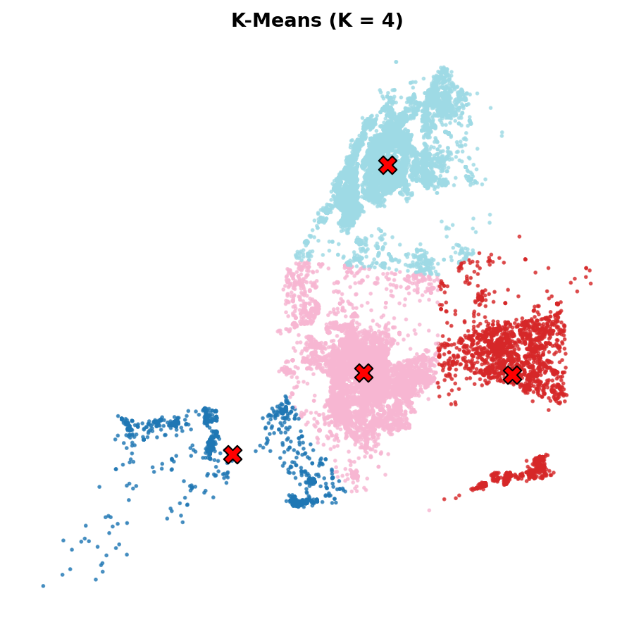
BASELINE: K-MEANS
K-Means splits the city into 4 regions, but they mostly follow borough lines
WORKFLOW
Test K = 2 to 10
Silhouette peaks at K = 4 (0.6135)
Elbow check
No sharp elbow, drops shrink gradually
Fit K = 4
Clusters hold 5%, 12%, 42%, 41% of incidents
Stability
ARI = 1.0 across 5 random seeds
Cluster 1 is 100% Queens, cluster 2 is 92% Brooklyn, cluster 3 is 68% Bronx.
Cluster 0 mixes Staten Island (57%) and south Brooklyn (43%).
K-Means labels every incident, so it has no way to flag isolated ones as noise.
Compare to boroughs
ARI vs BORO = 0.695
KEY TAKEAWAY A stable, clean partition, yet it says little beyond geography, which motivates density-based methods.
5 / 12
Notes:
Silhouette is only used to compare K within K-Means. The straight boundaries cutting through dense areas are what a partition method must produce.

Slide 6
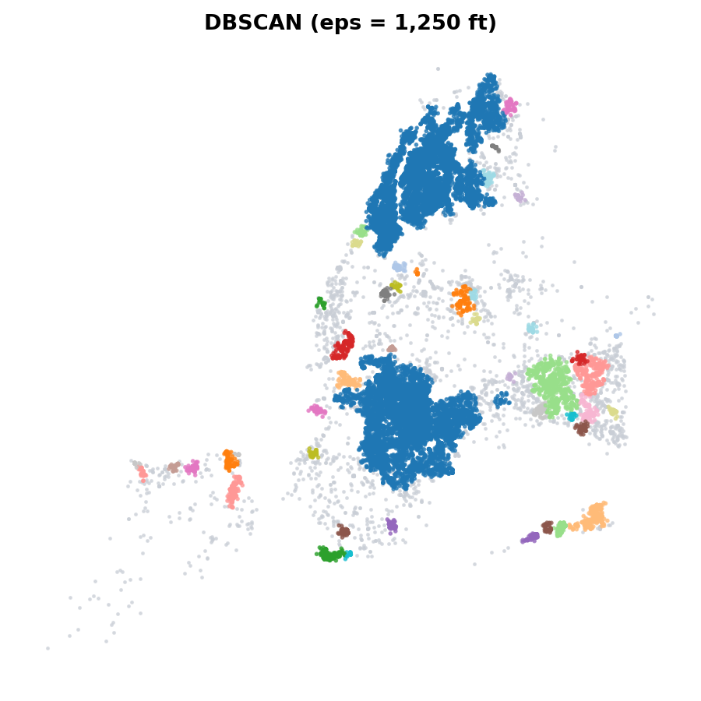
DENSITY-BASED: DBSCAN
One global distance threshold chains together most of the city
WORKFLOW
k-distance plot
min_samples = 20, knee near 1,000–2,000 ft
Sweep eps 500 → 2,000 ft
Noise falls, clusters merge
Fit eps = 1,250 ft (381 m)
49 clusters, 9.67% noise
Chaining test
Two clusters = 80.8% of points
Only eps = 500 ft avoids one giant cluster, but then half the incidents are noise and 176 clusters appear.
From 750 ft upward the largest cluster stays at 36–41%: chaining, not hotspots.
A single eps cannot fit both dense Brooklyn/Bronx and sparse Staten Island.
Conclusion
Need a method with varying density
KEY TAKEAWAY At eps = 1,250 ft the top two clusters hold 80.8% of clustered points, so DBSCAN cannot isolate hotspots.
6 / 12
Notes:
Silhouette for DBSCAN (0.06) is not comparable with K-Means because noise is excluded and shapes are non-convex. The chaining diagnostic is the more meaningful test.

Slide 7
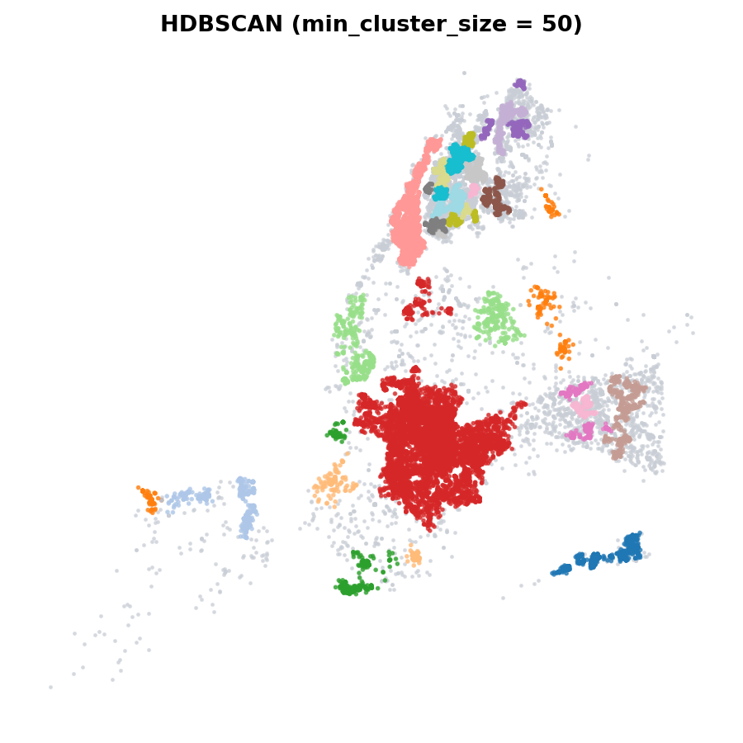
DENSITY-BASED: HDBSCAN
HDBSCAN finds 56 hotspots and marks 18% of incidents as noise
WORKFLOW
Sweep min_cluster_size
25 to 200, min_samples = 10
Choose 50
56 clusters, 18.27% noise, median size 117
Largest cluster
8,074 incidents (46.1%) in Brooklyn
Try leaf selection
119 clusters, 40.56% noise, largest 2.9%
Small values (25) over-fragment into 216 clusters and 38% noise; large values (75+) merge into a few big blobs.
The leaf method breaks up the mega-cluster but discards 40% of incidents and no longer matches boroughs (ARI 0.05).
Trade-off: default HDBSCAN keeps 82% coverage; leaf gives finer detail.
Final model
HDBSCAN (default), borough ARI 0.748
KEY TAKEAWAY It handles varying density better, but the default setting still leaves one very large cluster.
7 / 12
Notes:
Be upfront: Hotspot 19 in Brooklyn is still a very large cluster (46% of clustered points). The leaf method is the alternative if finer hotspots are needed.

Slide 8
MODEL COMPARISON
HDBSCAN is the chosen model: varying density and noise handling, but still borough-aligned
COMPARISON CRITERIA
Model | Setting | Clusters | Noise | ARI vs BORO
K-Means | K = 4 | 4 | 0% | 0.695
DBSCAN | eps 1,250 ft | 49 | 9.67% | 0.732
HDBSCAN | min size 50 | 56 | 18.27% | 0.748
ARI vs borough
How closely clusters follow borough lines
Noise handling
Can sparse incidents stay unassigned?
K-Means: stable but assigns every point and mirrors boroughs.
DBSCAN: fewer noise points but chains into two giant clusters.
HDBSCAN: 56 hotspots at varying density, with sparse incidents kept as noise.
Cluster size balance
Too large or too fragmented?
Interpretability
Easy to describe on a map?
Fit to the question
Local spatial concentrations
KEY TAKEAWAY Internal metrics are not comparable across algorithms, so models are judged on structure, noise and purpose.
8 / 12
Notes:
Silhouette values (K-Means 0.61, DBSCAN 0.06, HDBSCAN 0.33) are reported in the notebook but deliberately not used to rank the models.

Slide 9
HOTSPOT PROFILE
Two mega-clusters hold most incidents; the Bronx has the most small hotspots
PROFILING STEPS
Assign HDBSCAN labels
56 hotspots + noise
Count incidents & victims
Ranked by total victims
Dominant borough
Purity 99–100% for top clusters
Peak hour
Most peak late night or after midnight
Hotspot 19 (Brooklyn): 8,074 incidents, 9,991 victims, radius 3.1 km, too broad to be a "neighbourhood".
Hotspots by borough: Bronx 28, Queens 14, Brooklyn 6, Manhattan 4, Staten Island 4.
Coverage: Brooklyn 97% of incidents in hotspots, Queens 61%, Bronx 66%.
Spatial extent
RMS radius, 0.4 km to 3.1 km
KEY TAKEAWAY 82% of incidents (17,507) fall inside a hotspot, but the biggest clusters cover very large areas.
9 / 12
Notes:
Cluster IDs are labels, not ranks. Ranking here is by total victims only for reporting. Hotspot 19 shows the limit of the default HDBSCAN setting.

Slide 10
TIME PATTERNS & STABILITY
The 2020 surge hit every region, and hotspots partly persist across two eras
TEMPORAL ANALYSIS
Annual view by cluster
All four regions dip to 2019, jump in 2020
Seasonal view
July peaks (2,499 incidents), February low
Hourly view
Highest 23:00–01:00, lowest 07:00–09:00
Split 2006–13 vs 2014–22
Cluster each period on its own
The seasonal and hourly shapes are similar across regions: a city-wide rhythm.
Period 1 found 45 clusters, period 2 only 18 (11,406 vs 10,014 incidents).
Several period-1 centres sit within 44–277 m of a period-2 centre, so some hotspots persist.
Compare centres
Nearest-centre distances in metres
KEY TAKEAWAY Timing is city-wide; spatial structure is real but not identical from the first period to the second.
10 / 12
Notes:
Stability is evidence, not proof: cluster IDs are meaningless across periods, so matching is done by proximity of centres. Bronx/Manhattan region 3 rose in 2021.

Slide 11
SEVERITY & DENSITY
Small Bronx hotspots are the densest, even though Brooklyn has the largest cluster
SEVERITY WORKFLOW
Severity
Victims per incident and murder flag
Murder-flagged incidents
3,706 of 21,420 (17.3%)
Cluster footprint
Approx. area from RMS radius
Density proxy
Incidents per km² (not a risk rate)
Hotspots 51 and 52 (Bronx): about 420–435 incidents per km² vs 262 for the large Brooklyn cluster.
Murder-flagged share is 15–23% in the top clusters; hotspot 14 (Queens) is highest of these at 22.6%.
Density is a descriptive proxy only; it is not adjusted for population.
Limitation
No population denominator in data
KEY TAKEAWAY Victim burden per incident is similar everywhere (1.2–1.5); what differs is how tightly incidents pack.
11 / 12
Notes:
Be explicit that the density measure uses a circular approximation from the RMS radius and is not a population-based risk rate.

Slide 12
CONCLUSIONS & LIMITATIONS
Density-based clustering finds finer hotspots than K-Means, but the largest clusters need care
WHAT WE FOUND
Key conclusions
21,420
56
Incident-level data (with victim counts kept) is the correct base for spatial analysis.
K-Means is a stable baseline but reproduces boroughs and cannot flag noise.
DBSCAN chains through dense areas; HDBSCAN handles varying density better.
Timing is city-wide (summer, late night, 2020 surge); hotspots partly persist over time.
incidents from 27,312 victim records
HDBSCAN hotspots covering 81.7% of incidents
Limitations & next steps
0.695
80.8%
Hotspot 19 (Brooklyn) is still very large; try the leaf method or larger sub-clustering.
No population denominator, so no risk rates. Results are descriptive, not causal.
Next: add population data and test sub-clustering inside the mega-clusters.
K-Means vs borough ARI: mostly borough lines
DBSCAN points in just two chained clusters
KEY TAKEAWAY Use HDBSCAN for local hotspots, refine the mega-cluster, and read results as descriptive, not causal.
12 / 12
Notes:
Close by stressing that clustering describes where incidents concentrate; it does not explain why, and cannot estimate individual risk.

