Slide 1
Quora Question Pair Similarity Problem
Giridhar S Mtech (CSE) IIITD giridhar21026@iiitd | Mahak Sharma Mtech (CSE) IIITD mahak21047@iiitd.ac.in | Palani Vigneshwar Mtech (CSE) IIITD palani21062@iiitd

Slide 2
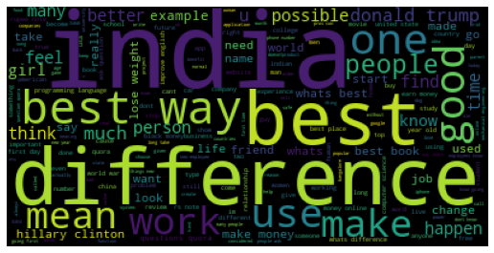

Preprocessing on dataset
Removing punctuation’s, stopword’s, Removing tags Url’s and numbers , Lower-casing the letters and converting the words to vectors using Word2vec and Glove was done .

Slide 3
baselines
Two baselines are used in the project with the following results–
Model | Train acc | Test acc | Train Loss | Test Loss | Train precision | Test precision | Train recall | Test recall | Train fscore | Test fscore
Decision Tree | 0.977 | 0.74 | 0.0047 | 8.8197 | 1.0 | 1.0 | 1.0 | 1.0 | 1.0 | 1.0
Logistic Regresson | 0.65 | 0.65 | 0.585 | 0.6011 | 0.61 | 0.59 | 0.59 | 0.61 | 0.59 | 0.59

Slide 4
Final models
The final models used in the project are –
Decision tree with cost complexity parameter ccpalpha = 0.000029
XGBoost classifier with depth = 10 and no. of estimators = 80
Logistic Regression with C=0.3 and max iterations = 600
Random Forest classifier with depth=40 and no. of estimators = 65
Linear SVM using SGD
SVM using rbf kernel by using RBF sampler
Multi layer perceptron with hidden layer sizes=300 and max iterations = 250
Long Short Term Memory(LSTM)
The following slides shows the results of each model after grid search have been performed and the best model obtained

Slide 5
Model | Train Acc | Test Acc | Train Loss | Test Loss
Decision Tree | 0.8043 | 0.7519 | 0.4133 | 0.5193
XGBoost | 0.9496 | 0.8059 | 0.1934 | 0.3922
Logistic Regression | 0.7309 | 0.7300 | 0.5188 | 0.5209
Random Forest | 0.9968 | 0.8088 | 0.1210 | 0.4096
Linear SVM | 0.7359 | 0.7347 | 0.5212 | 0.5232
RBF SVM | 0.7622 | 0.7592 | 0.4756 | 0.4798
Multi Layer Perceptron | 0.7598 | 0.7587 | 0.4712 | 0.4743
LSTM | 0.8209 | 0.7946 | 0.3870 | 0.41(Kaggle log loss)

Slide 6
Model | Train Precision | Train Recall | Train Fscore | Test Precision | Test Recall | Test Fscore
Decision Tree | 0.79 | 0.79 | 0.79 | 0.73 | 0.73 | 0.73
XGBoost | 1.00 | 1.00 | 1.00 | 0.8 | 0.78 | 0.79
Logistic Regression | 0.71 | 0.69 | 0.70 | 0.71 | 0.69 | 0.70
Random Forest | 1.0 | 1.0 | 1.0 | 0.8 | 0.78 | 0.79
Linear SVM | 0.72 | 0.69 | 0.70 | 0.72 | 0.69 | 0.70
RBF SVM | 0.75 | 0.73 | 0.74 | 0.74 | 0.73 | 0.73
Multi Layer Perceptron | 0.75 | 0.72 | 0.73 | 0.75 | 0.72 | 0.73
LSTM | 0.76 | 0.74 | 0.75 | 0.727 | 0.706 | 0.716

Slide 7
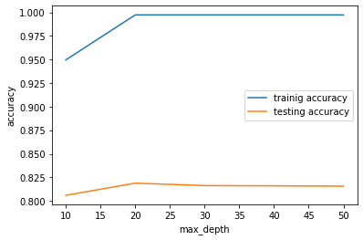
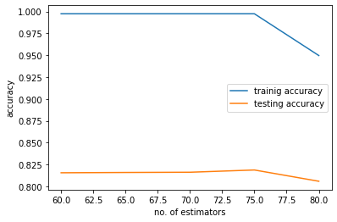
XGBOOST GRID SEARCH:
Depth | Estimator | Train Acc | Test Acc | Train Loss | Test Loss
10 | 80 | 0.9496 | 0.8059 | 0.1934 | 0.3922
20 | 75 | 0.9974 | 0.8188 | 0.0116 | 0.4368
30 | 70 | 0.9974 | 0.8162 | 0.0102 | 0.4447
40 | 65 | 0.9974 | 0.8159 | 0.0105 | 0.4424
50 | 60 | 0.9974 | 0.8156 | 0.0112 | 0.4426

Slide 8
Selected Model
From our observations on 8 different models , we found out that XGBoost is the best model in terms of log loss efficiency, precision, recall and fscore. It prrovided an test accuracy of 0.805, test log loss of 0.39 and fscore of 0.79.
Blog Posted
https://medium.com/@palani21062/quora-question-pair-similarity-problem-using-machine-learning-models-18a8419eb8c4
Thank you

