Slide 1

SVKM's NMIMS | Mukesh Patel School of Technology Management & Engineering
Machine Learning | B.Tech Semester V | AY 2026-27
DemandIQ
Machine learning for product demand and stockout risk prediction
Forecast what will sell • warn what will run out • say how much to order • explain why
Yash Shah
Mahak Wadhawan
Yash Patil
Varshita Vaan
L056
L074
L043
L069
Guide: Prof. Abhay Kolhe
Notes:
Good morning. We are presenting DemandIQ, a classical machine-learning system that forecasts demand, predicts stockouts, recommends order quantities and explains every number. No deep learning is used.

Slide 2
THE PROBLEM
Every store asks one question: how much should we stock?
↓
Too little stock
↑
Too much stock
8.3%
• The shelf runs empty - the sale is lost
• The customer often goes to a competitor
• Empty shelves damage trust in the store
• Cash is locked up in goods
• Storage and handling costs keep adding up
• Old stock is discounted or thrown away
of items are out of stock on an average day in retail worldwide
Gruen, Corsten & Bharadwaj (2002)
Root cause: nobody knows tomorrow's demand. Rules like "order last month's sales plus a bit" ignore promotions, holidays and weekdays - so stores run short exactly when demand jumps.
DemandIQ | NMIMS MPSTME | Machine Learning, Sem V
2
Notes:
Both mistakes cost money. A worldwide study found 8.3% of items out of stock on a normal day. The root cause is uncertainty about demand, and simple ordering rules ignore the things that drive it.

Slide 3
OBJECTIVES
Four objectives, each building on the last
1
2
3
4
Predict demand
Predict stockout risk
Recommend the order
Explain + what-if
Daily sales per store for the next 7 days, with a P10-P90 range
Probability of running out in the next 3 days
Order-up-to level from forecast + uncertainty; emergency order if risk is high
SHAP reasons for every number; test promotion, holiday, competitor, price
e.g. store 262, Mon 1 Jun: 24,078
e.g. store 122: 30% → MEDIUM
e.g. order up to 26,856
e.g. promotion: +29% to +45%
Supporting objective: group the 935 stores into segments with K-Means so one plan does not have to fit all.
DemandIQ | NMIMS MPSTME | Machine Learning, Sem V
3
Notes:
Objective one is the forecast. Objective two uses it with current stock to give a risk probability. Objective three turns both into an order quantity. Objective four explains each number and lets the user play what-if. Clustering is a supporting objective.

Slide 4
LITERATURE SURVEY
What 20 books and 15 research papers told us
20
1
ML beats statistics on retail data
M5 competition: LightGBM-based methods won on Walmart data Makridakis et al., 2022
2
Promotions and special days need explicit features
reference books
forecasting, inventory theory,
ML, explainability, causality
Regression trees with promo flags; calendar special days Gür Ali 2009; Huber 2020
3
Stockout prediction is rare - and needs stock + forecast
1.6 M SKUs: stock level and near-term forecast matter most Liu et al., 2025
15
A more accurate forecast is not always a better decision
4
Weak link between accuracy and inventory cost on M5 Theodorou et al., 2025
research papers
mostly 2019 - 2026,
IJF, EJOR, NeurIPS, IEEE Access
5
Explanations stop at the forecast
LightGBM + SHAP/ICE explain demand, not risk or orders Mishra et al., 2026
DemandIQ | NMIMS MPSTME | Machine Learning, Sem V
4
Notes:
We read 20 textbooks for foundations and 15 papers for the state of the art. Five lessons shaped the design: ML wins on retail data, promotions need features, stockout prediction needs stock plus forecast, accuracy is not the same as a good decision, and explanations usually stop at the forecast.

Slide 5
RESEARCH GAPS
Six gaps - and how DemandIQ answers each one
Forecast, risk and ordering studied separately
Explanations end at the forecast
G1
G2
→ One pipeline: forecast → risk → order
→ SHAP for the demand AND the risk model
Accuracy is not decision quality
What-if read as cause and effect
G3
G4
→ Judge on stockouts, fill rate, stock and cost
→ Every what-if labelled as model behaviour
One policy for very different stores
No public data has stock on hand
G5
G6
→ K-Means segments; uplift per segment
→ Calibrated inventory replay over real sales
DemandIQ | NMIMS MPSTME | Machine Learning, Sem V
5
Notes:
Each gap links back to specific papers in the report. G1 and G2 are the main contribution: one pipeline that is explained end to end. G6 is a practical gap: public data does not contain stock levels.

Slide 6
DATASET
Real sales from 1,115 Rossmann drugstores, 2013 - 2015
1.02 M
942
935
27
daily store records
days of history
stores with complete history
leak-free features
Split strictly by date - never shuffled
Training
Validation
Test
Jan 2013 - Mar 2015
Apr - May
Jun - Jul 2015
Why Rossmann? Real retail data with exactly the drivers we need - promotions, public and school holidays, weekday, season, competition and store format. Public, free and a well-known benchmark.
Cleaning: dropped 180 stores with a 6-month refurbishment gap, re-indexed every store to a full calendar, every sales feature is at least 7 days old.
DemandIQ | NMIMS MPSTME | Machine Learning, Sem V
6
Notes:
The data is public Rossmann data. We keep 935 stores with complete history. The split is by time: train to March 2015, validate April-May, test June-July. The test window is used once, at the end.

Slide 7
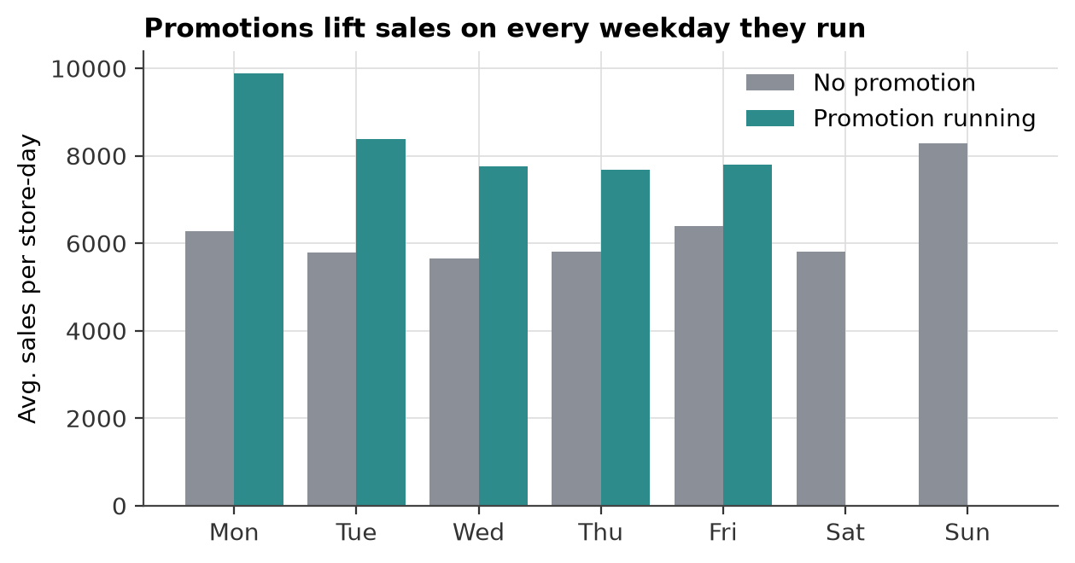
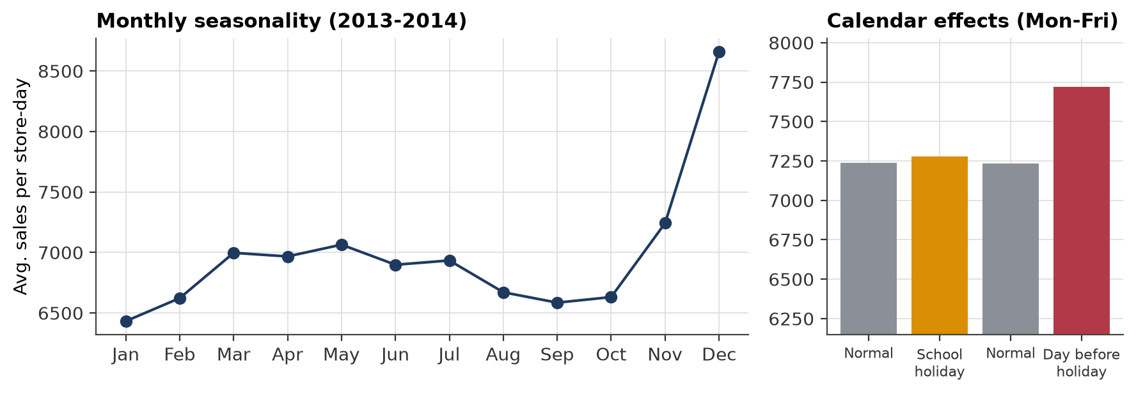
EXPLORATORY ANALYSIS
Promotions add 40% - and timing matters
Promotions
Weekly rhythm
Calendar
run on 45% of trading days and lift sales by about 40%
Monday is the busiest day; most stores close on Sunday
December peak; extra sales in school holidays and before public holidays
DemandIQ | NMIMS MPSTME | Machine Learning, Sem V
7
Notes:
Three patterns drive demand: promotions, the weekly rhythm and the calendar. A rule that only looks at last month's average misses all three.

Slide 8
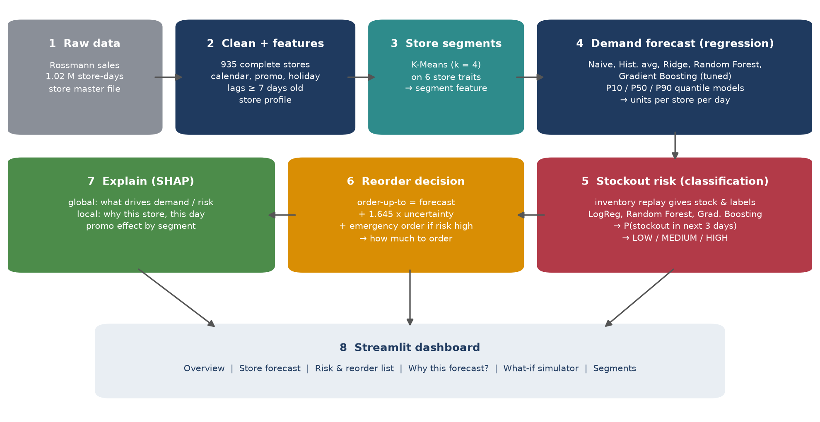
SYSTEM DESIGN
Eight steps from raw sales to an explained order
DemandIQ | NMIMS MPSTME | Machine Learning, Sem V
8
Notes:
Each box is one Python script. Clean and build features, segment stores, forecast demand, replay inventory and predict risk, decide the order, explain with SHAP, and show it in the dashboard.

Slide 9
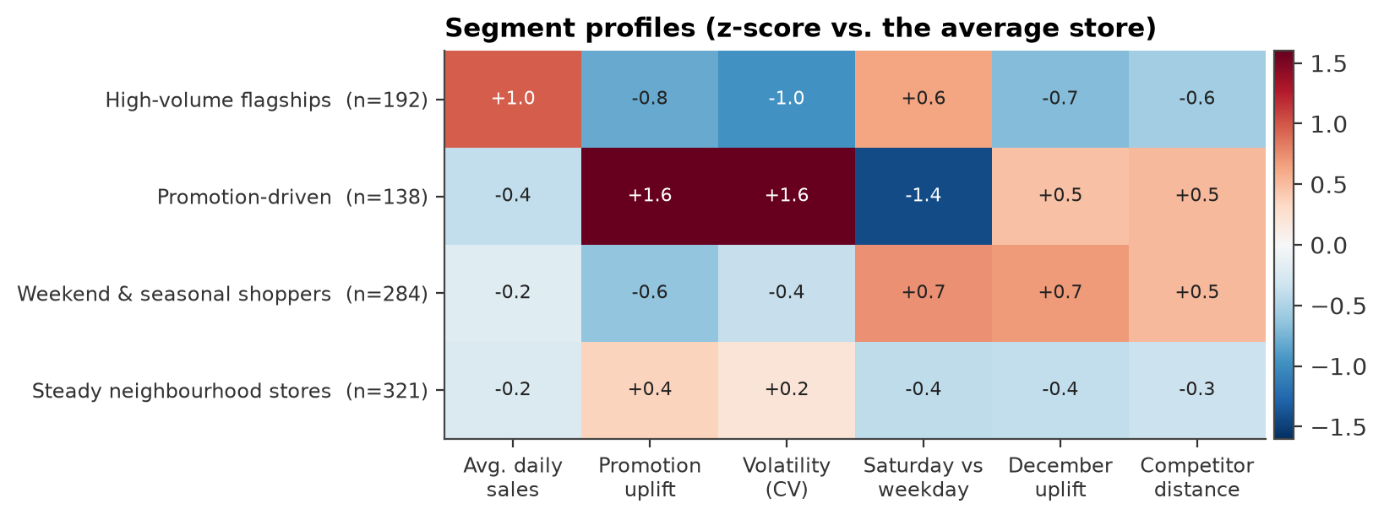
UNSUPERVISED LEARNING
K-Means finds four kinds of stores
1
High-volume flagships (192)
9,292/day, steady, close competitors
2
Promotion-driven (138)
+72% on promotion days, most volatile
3
Weekend & seasonal (284)
strong Saturdays and December
4
Steady neighbourhood (321)
close to average on every trait
Why it matters: the same promotion lifts a promotion-driven store far more than a flagship, so one promotion plan and one safety buffer do not fit all stores. The segment is also a feature for both models.
DemandIQ | NMIMS MPSTME | Machine Learning, Sem V
9
Notes:
We cluster stores on six traits measured on the training window. Silhouette scores are low for every k, so stores form a continuum; we chose k equals 4 because the elbow flattens and the groups are easy to act on.

Slide 10
DEMAND FORECASTING
Gradient Boosting cuts forecast error to 8.0%
0.941
R² on the test window
+0.4%
bias - almost no systematic over- or under-forecast
73%
of days inside the P10-P90 range (target 80%)
DemandIQ | NMIMS MPSTME | Machine Learning, Sem V
10
Notes:
The naive forecast is poor because promotions alternate weekly. The historical average is a strong baseline at 10.2%. Ridge is worse because it cannot model interactions. Gradient Boosting was best on validation and reaches 7.96% on the test window, R-squared 0.941.

Slide 11
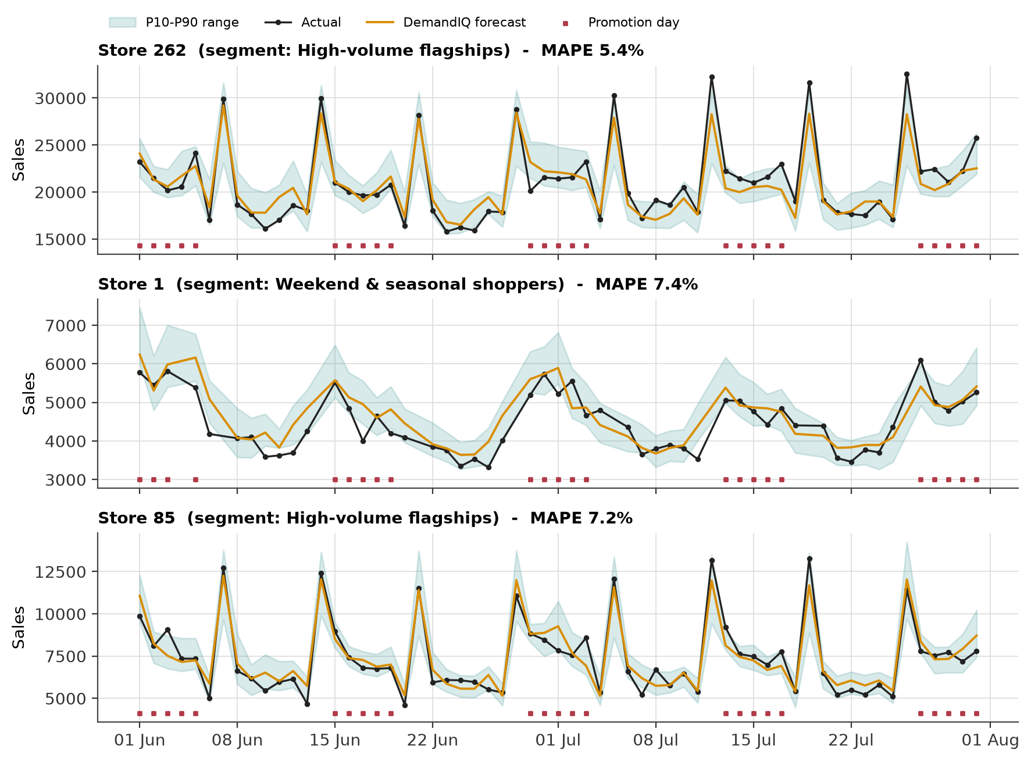
DEMAND FORECASTING
The forecast follows promotions and Monday peaks
Leak-free by design
Every sales feature is at least 7 days old, so one model forecasts the whole coming week.
Uncertainty, not just a number
Quantile models give P10 and P90; the band feeds the safety stock.
Honest tuning
Grid search on Apr-May; the test window was opened only once.
DemandIQ | NMIMS MPSTME | Machine Learning, Sem V
11
Notes:
Black dots are actual sales, the orange line is our forecast and the band is the P10 to P90 range. Red squares mark promotion days, and the forecast jumps with them.

Slide 12
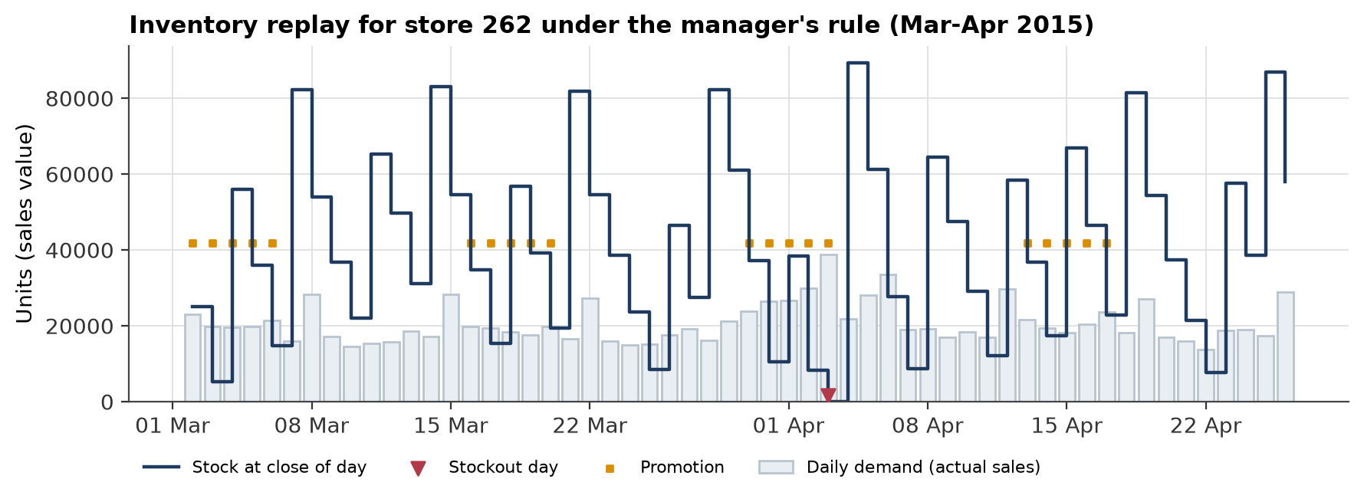
CREATING STOCK DATA
Rossmann has no stock data - so we replayed it
1
Morning
deliveries arrive - 20% of them late
2
Day
customers buy; if the shelf is empty the sale is lost
3
Evening
Mon & Thu: order up to a target level
8.6%
stockout days under the manager's rule (last 4 weeks' average + 20%). We calibrated the buffer so the replay matches the 8.3% out-of-stock rate measured in real stores. Promotion days: 14% stockouts, other days 4%.
DemandIQ | NMIMS MPSTME | Machine Learning, Sem V
12
Notes:
No public dataset has stock levels. We replay a realistic ordering process over the real sales, with late deliveries, and calibrate it to the 8.3% stockout rate found in real stores. This gives stock levels and stockout labels.

Slide 13
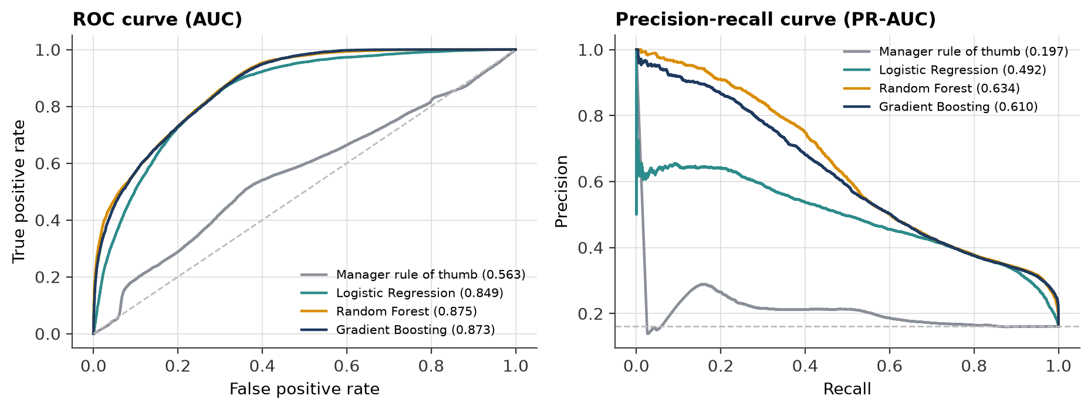
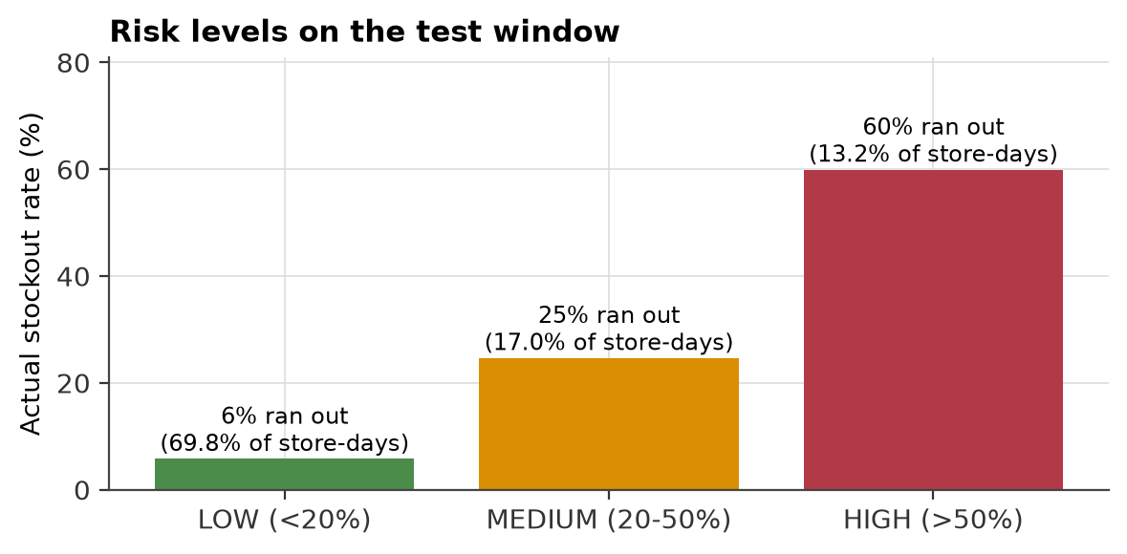
STOCKOUT RISK (CLASSIFICATION)
Spotting a stockout three days before it happens
0.873
ROC-AUC (rule of thumb: 0.56)
0.61
PR-AUC - over 3x the 16% base rate
HIGH stores really ran out 60% of the time; LOW only 6%.
60%
of stockouts caught at the tuned threshold
DemandIQ | NMIMS MPSTME | Machine Learning, Sem V
13
Notes:
The classifier sees stock, deliveries due, the forecast and promotions ahead. The manager's rule of thumb is barely better than chance because it ignores promotions and late deliveries. Our model reaches ROC-AUC 0.873. Risk is shown as LOW, MEDIUM or HIGH.

Slide 14
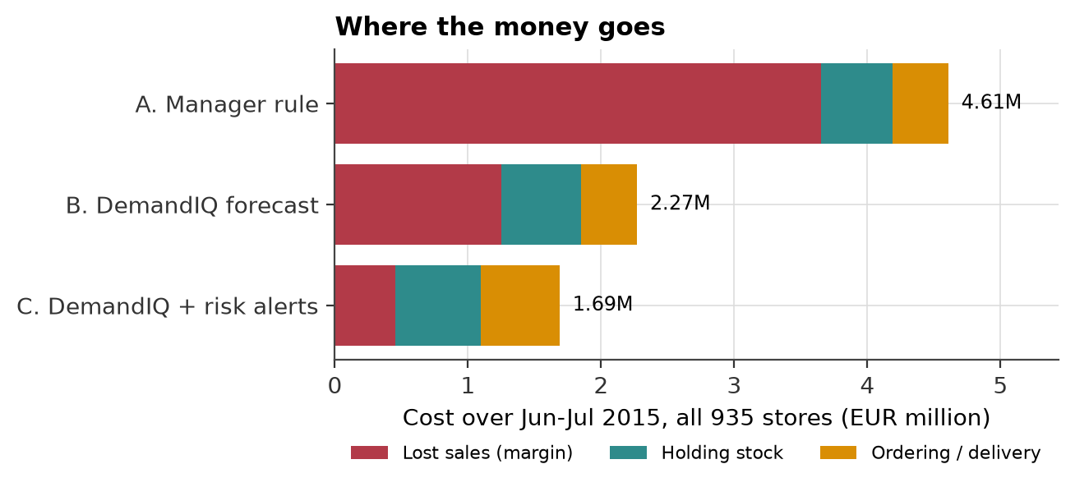
FROM PREDICTION TO DECISION
80% fewer stockout days, 63% lower cost
Policy | Fill rate | Stock (days) | Cost vs A
A | 96.57% | 1.93 | +0%
B | 98.82% | 2.15 | -51%
C | 99.58% | 2.32 | -63%
A better forecast removes most stockouts; risk-triggered emergency orders remove much of the rest.
DemandIQ | NMIMS MPSTME | Machine Learning, Sem V
14
Notes:
All three policies face the same real demand and the same late deliveries. The manager rule gives 7.51% stockout days. Using our forecast gives 2.66%. Adding risk-triggered emergency orders gives 1.50%, and total cost falls by 63%. Lost margin is the biggest cost for the manager.

Slide 15
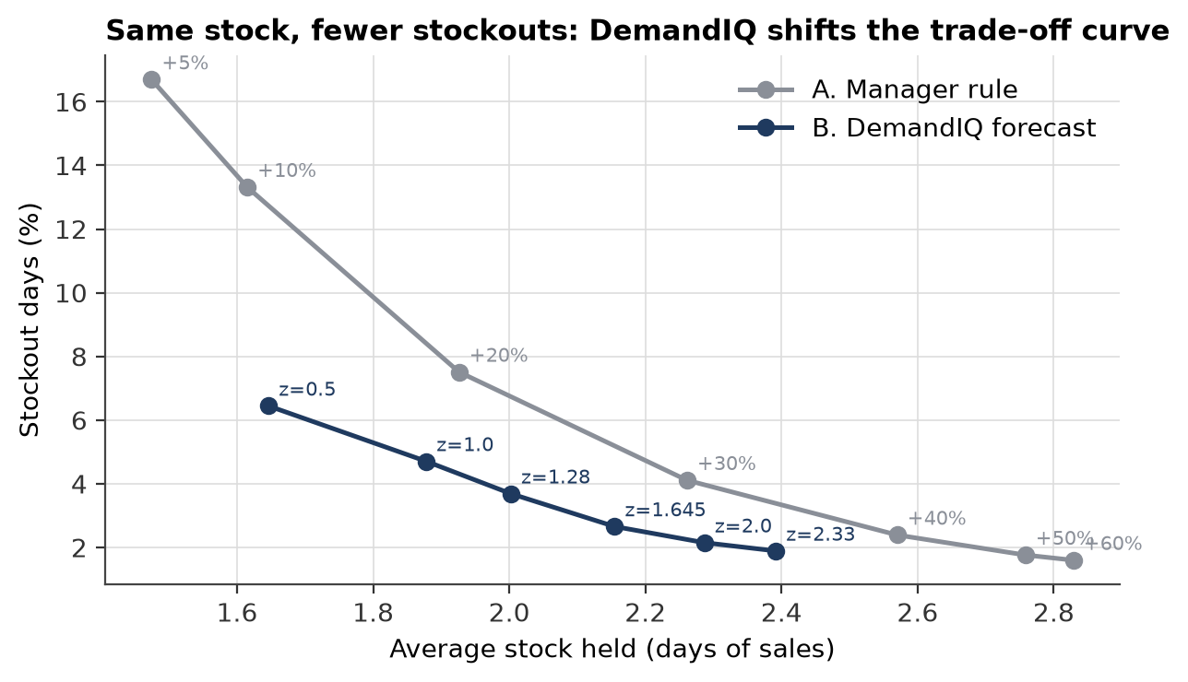
FAIR COMPARISON
Same stock, fewer stockouts - it is not just "buy more"
The question
Could the manager do just as well by keeping a bigger buffer?
The test
Replay both policies at many buffer and service-level settings.
The answer
At every level of stock, DemandIQ has fewer stockout days - it puts the stock on the right days, before promotions and holidays.
DemandIQ | NMIMS MPSTME | Machine Learning, Sem V
15
Notes:
This is our answer to the obvious objection. Each dot is one setting. The DemandIQ curve is below the manager's curve everywhere: for the same stock, fewer stockouts.

Slide 16
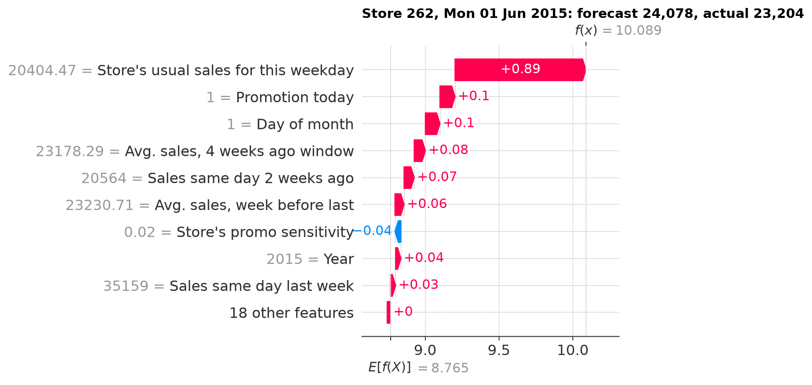
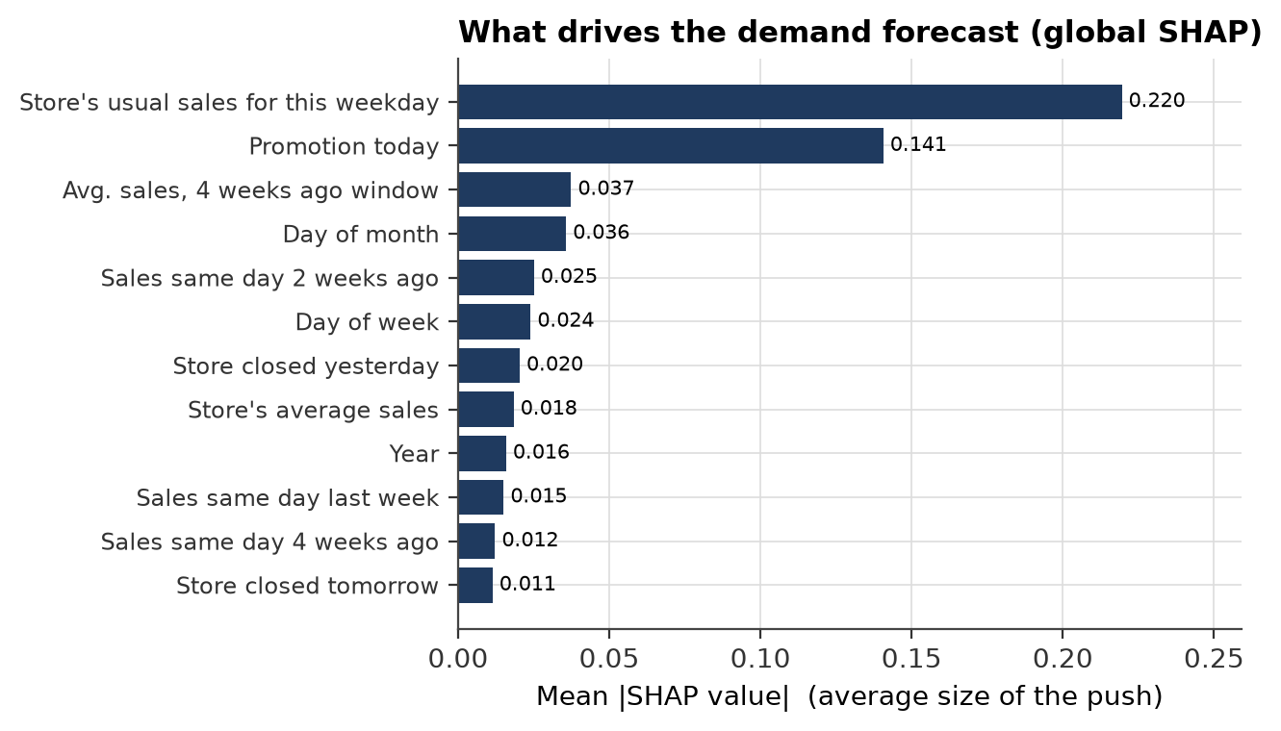
EXPLAINABILITY (SHAP)
Every number comes with its reasons
Global: what drives demand across all stores
Local: why store 262 got 24,078 on Mon 1 Jun (actual 23,204)
What-if with the model: switching a promotion on lifts the forecast by 29% to 45% depending on the store segment. Shown as model behaviour, not proof of cause and effect.
DemandIQ | NMIMS MPSTME | Machine Learning, Sem V
16
Notes:
SHAP splits each prediction into the push from each input. On the left, the global view. On the right, one forecast: start from the average day, and each bar pushes it up or down. SHAP values here are exact and add up to the prediction.

Slide 17
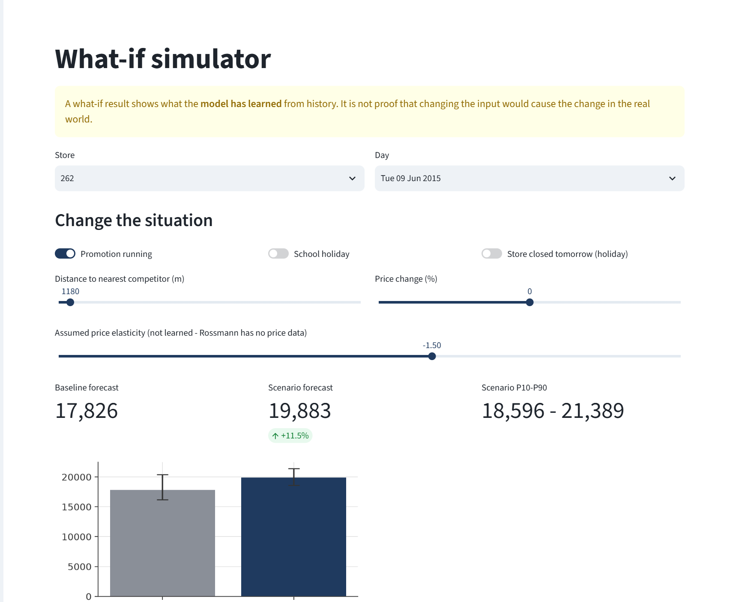
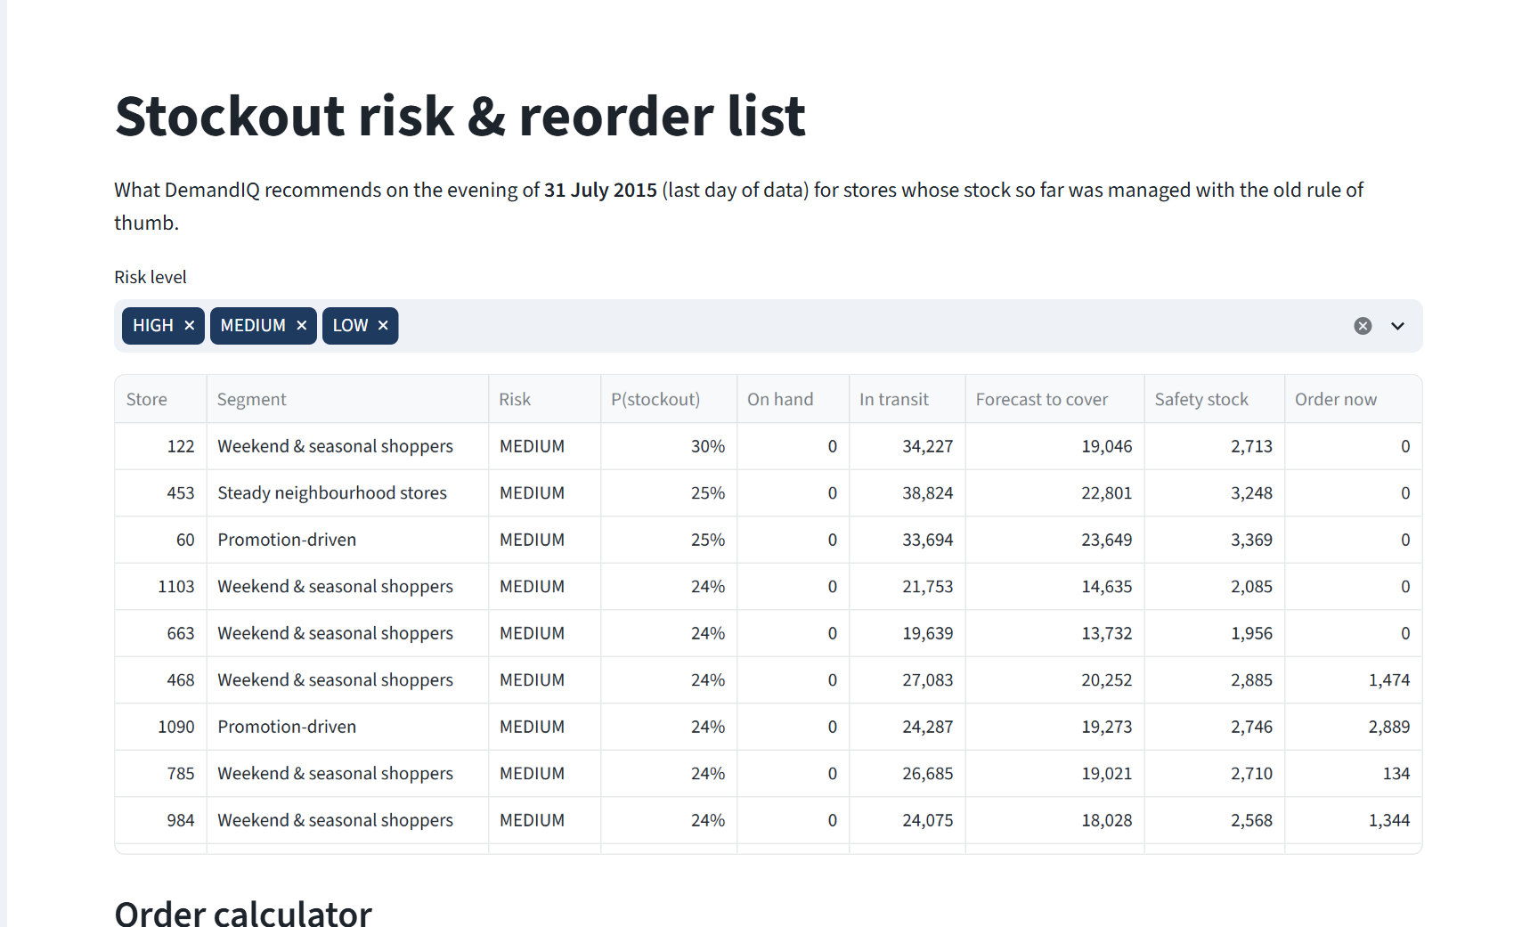
DASHBOARD
A six-page Streamlit app that managers can use
Overview • Store forecast • Risk & reorder list • Why this forecast? • What-if simulator • Store segments
DemandIQ | NMIMS MPSTME | Machine Learning, Sem V
17
Notes:
Live demo: pick a store, switch on a promotion in the what-if page, and see the forecast and order change. The risk page lists stores by risk with a recommended order.

Slide 18
LIMITATIONS AND FUTURE SCOPE
What we would do next
Limitations
Future scope
1
Stock is simulated, not observed
1
Validate on data with real stockout labels (FreshRetailNet-50K)
2
Store level, not product (SKU) level
2
Indian retail with a festival calendar
3
No price data - price lever uses a stated elasticity
3
Causal price effect with double/debiased ML
4
P10-P90 band covers 73%, not 80%
4
Weekly retraining and an evening HIGH-risk alert
DemandIQ | NMIMS MPSTME | Machine Learning, Sem V
18
Notes:
We state limitations openly. The biggest is that stock levels are simulated; the next step is a dataset with real stockout labels and product-level demand.

Slide 19
CONCLUSION
A forecast creates value only when it becomes an explained decision
8.0%
0.87
80%
63%
demand forecast error (MAPE)
ROC-AUC for 3-day stockout risk
fewer stockout days than the manager rule
lower total inventory cost
Classical ML only • Random Forest, Gradient Boosting, Logistic Regression, K-Means • SHAP • Streamlit
Thank you - questions?
Yash Shah (L056) | Mahak Wadhawan (L074) | Yash Patil (L043) | Varshita Vaan (L069)
Notes:
To summarise: an accurate forecast, a calibrated risk score, a transparent order rule and SHAP explanations together cut stockout days sharply at lower cost. Thank you, we are happy to take questions.

