Slide 1
DATA WRANGLING GROUP PROJECT
Breathe India
What really drives air pollution in Indian cities?
26
5½ years
4
3
cities
of daily data, 2015 to 2020
sources joined
machine-learning models
Mahak Wadhawan (L074) · Yash Shah (L056)
Notes:
Good morning. We are Mahak and Yash. Our project asks one question: how much of a city's daily air pollution comes from weather and season, and how much from people? We used five and a half years of government data for 26 Indian cities, joined it with weather from a public API, and used the 2020 lockdown as a natural experiment.

Slide 2
THE ANSWER, UP FRONT
A third of the lockdown's “clean air” was actually the weather
−41%
−28%
75%
PM2.5 change in spring 2020 vs 2019: the headline everyone quoted
the real lockdown effect once our model removes the weather
of next-day air-quality categories predicted exactly (baseline 72%)
Also: cleaning changed the story. Officially, Ahmedabad is India's most polluted city. It isn't: a sensor column was copied.
Breathe India · Mahak Wadhawan (L074) · Yash Shah (L056)
2
Notes:
Our three headline answers. First, pollution did fall in the 2020 lockdown, 41 percent for fine particles compared with 2019. But spring 2020 also had kinder weather. Once our model takes the weather out, the real lockdown effect is 28 percent, so about a third of the headline drop was weather. Second, tomorrow's air-quality category is predictable 75 percent of the time. Third, the wrangling itself changed the story, which we'll show next.

Slide 3
DATA AND PIPELINE
Four sources, one star schema, three storage formats
CPCB air quality
SQLite
Kaggle download · 29,531 city-days, 108,035 station-days
keys + read-back checks
Open-Meteo weather API
Clean fact table
Parquet
52,234 city-days of ERA5 weather · rate-limited, cached
28,260 city-days × 61 columns
23 logged cleaning decisions
Validated joins, lags, rolling means
partitioned by year
Open-Meteo geocoding API
Power BI
26 cities located · names checked by state
5-page dashboard
Event calendar
Models A, B, C
Lockdown phases and Diwali dates
scikit-learn
Everything reruns end to end in about 8 minutes from one notebook: github.com/mahak2604/breathe-india
Breathe India · Mahak Wadhawan (L074) · Yash Shah (L056)
3
Notes:
We used four sources. The core is the Central Pollution Control Board's daily data, downloaded from Kaggle. Weather came from the Open-Meteo API. It rate-limited us after seven cities, so we added pauses, back-off and a cache. City locations came from a geocoding API, where we had to check every match by state, because 'Amaravati' exists three times in India. Everything lands in one clean fact table, then goes into SQLite with key checks, year-partitioned Parquet, the dashboard and the models.

Slide 4
CLEANING
The raw data was wrong in ways a quick look would miss
1
A copied column
2
Impossible pairs
Ahmedabad's CO equals its NO on 94% of days, although the units differ 1000×. It drove 95% of the city's “Severe” days.
PM2.5 above PM10 on 256 days. We assumed PM10 was wrong; the data showed PM2.5 was the faulty one 94% of the time.
3
Broken sensors
4
Gaps and limits
A sensor stuck at 11.00 for 16 days, and 918 µg/m³ in Shillong, the cleanest city. 197 readings removed, with Diwali spikes kept.
AQI up to 2,049 on a 0–500 scale, exact zeros, 61% of one column empty. Short gaps interpolated, the rest left honest.
Breathe India · Mahak Wadhawan (L074) · Yash Shah (L056)
4
Notes:
These are the four ways the raw data misled us. One: Ahmedabad's carbon monoxide column is a copy of its nitric oxide column, identical on 94 percent of days. Two: on 256 days fine particles exceeded coarse particles, which is physically impossible. We first assumed the PM10 sensor was wrong; the data told us it was PM2.5, so we changed our rule. Three: broken sensors, including Shillong 'reading' 918. Four: impossible AQI values and big gaps. Every decision, 23 in all, is in our cleaning log with its reason.

Slide 5
INSIGHT 1
Cleaning moved Ahmedabad from India's most polluted city to 7th
384 → 125
Ahmedabad's median AQI, official vs cleaned
Every other city barely moves.
Without this one fix, any ranking, map or model would have named the wrong city.
Median daily AQI, 2015–2020, top 7 cities on official numbers
Breathe India · Mahak Wadhawan (L074) · Yash Shah (L056)
5
Notes:
This chart is the result of that first cleaning step. Grey is the official ranking: Ahmedabad is far ahead of everyone, at a median AQI of 384. Blue is after cleaning: 125, seventh place. Every other city barely moves. This is why we spent so much effort on wrangling: one copied column would have named the wrong city in every chart and model.

Slide 6
INSIGHTS 2 AND 3
North India's winter air carries 3.3× the PM2.5 of its monsoon air
148 vs 44
µg/m³: North India in Nov–Jan vs Jun–Sep. Coastal cities swing only 2.2×.
23%, not 65%
how much cleaner a heavy-rain day really is, once we compare the same city in the same month
Median PM2.5 (µg/m³) by month, 2015–2020 · India's 24-hour limit is 60
Breathe India · Mahak Wadhawan (L074) · Yash Shah (L056)
6
Notes:
Season sets the baseline. In North India the typical winter day has about 148 micrograms of fine particles, two and a half times the national limit, against 44 in the monsoon. Coastal cities swing much less. And a non-obvious one: a raw comparison says heavy-rain days are 65 percent cleaner. But heavy rain mostly falls in the monsoon, which is clean anyway. Comparing the same city in the same month, the real washout effect is 23 percent. Always control for season before crediting the weather.

Slide 7
MACHINE LEARNING · CLASSIFICATION
Model A warns a day ahead and catches 92% of Poor-or-worse days
Gradient Boosting beats “same as today” on accuracy (75% vs 72%) and is right 35% of the time when the category changes, where the baseline is always wrong.
Honest caveat: in the lockdown its macro F1 fell to 0.59, below the baseline's 0.65. The rules it learned stopped applying.
Unseen test period Jan 2019 – Mar 2020 · time-ordered split, time-series cross-validation
Breathe India · Mahak Wadhawan (L074) · Yash Shah (L056)
7
Notes:
Model A predicts tomorrow's AQI category, six classes, as an early warning. The baseline is 'tomorrow will be like today', which is hard to beat because air quality is persistent. We split by time, never randomly, because a random split leaks the future. Gradient Boosting wins on macro F1 and catches 92 percent of Poor-or-worse days. Its real value is on the days the category changes. And honestly: during the lockdown it did worse than the baseline, which shows its limits under a sudden shock.

Slide 8
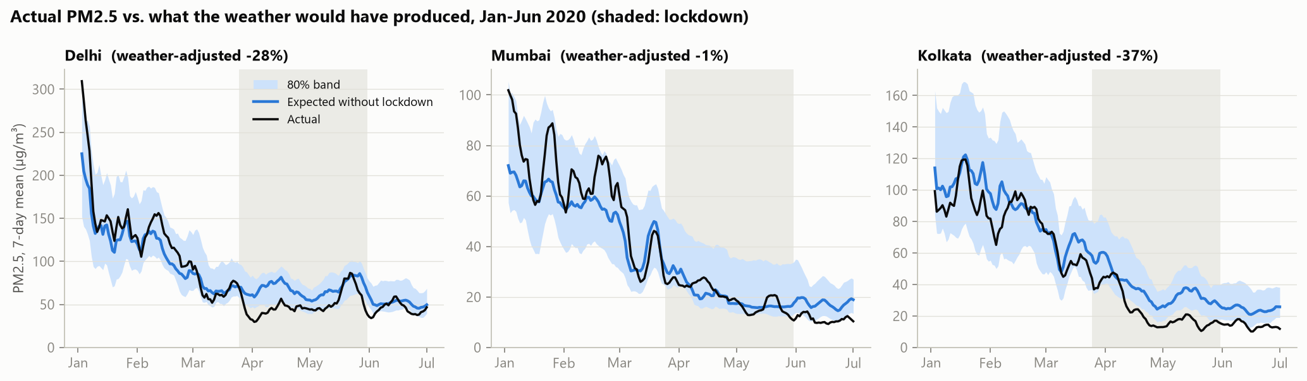
MACHINE LEARNING · MODEL B COUNTERFACTUAL
Weather removed, the lockdown cut PM2.5 by 28%, not 41%
−41% → −28%
−47% → −46%
R² 0.55
PM2.5: naive vs weather-adjusted, median of 17 cities
NO₂ (mostly traffic): a real drop either way
placebo test on spring 2019, when nothing happened
Breathe India · Mahak Wadhawan (L074) · Yash Shah (L056)
8
Notes:
Model B is our most original part. It predicts pollution from weather, season, day of week, trend and city only, never from pollution itself. Fed the real spring-2020 weather, it tells us what pollution should have been without a lockdown. The black line is reality, blue is the expectation. Delhi tracks the expectation until 25 March, then falls below it. We trusted it because it passed a placebo test on spring 2019. Result: PM2.5 fell 28 percent because of the lockdown, not 41. NO2, which comes from traffic, fell about 46 percent either way.

Slide 9
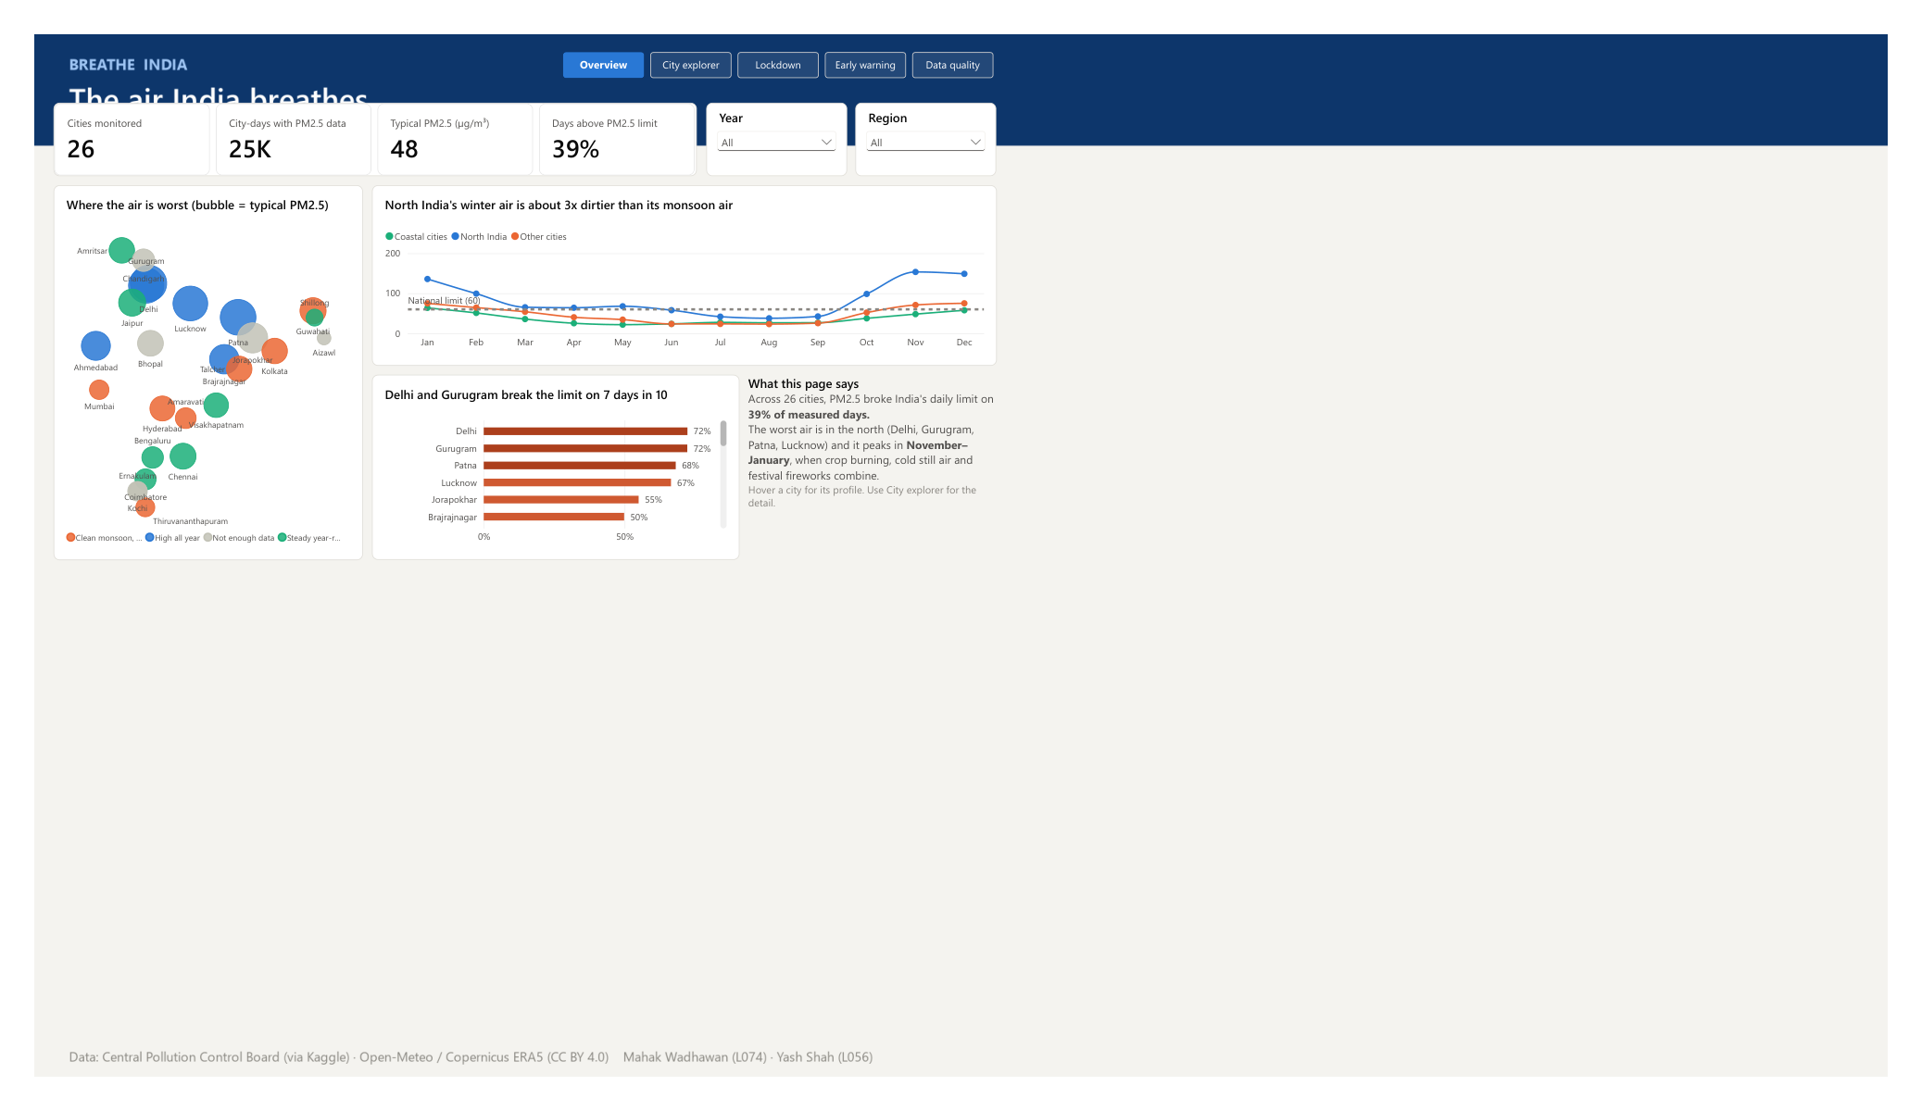
POWER BI
The dashboard turns this into five questions a non-expert can explore
1
Overview
where and when the air is worst
2
City explorer
one city's year, stations, AQI bands
3
Lockdown
actual vs expected, pick any city
4
Early warning
model vs baseline, switch periods
5
Data quality
every cleaning decision and why
Live demo: Breathe_India.pbix · hover a city, drill into Delhi, switch Test → Lockdown
Breathe India · Mahak Wadhawan (L074) · Yash Shah (L056)
9
Notes:
Now the live demo. On the Overview, 39 percent of days broke the limit; hover a city for its own profile. On City explorer, pick Delhi: its winters turn dark every year, and Anand Vihar is the worst station. On Lockdown, switch Delhi to Mumbai: Mumbai barely changed once weather is removed. On Early warning, switch Test to Lockdown and watch the model fall below the baseline. And the Data quality page shows every cleaning decision.

Slide 10
LIMITATIONS AND CONCLUSION
What we can say, and what we can't
Limitations
Takeaways
Monitors cover parts of 26 cities, not everyone's exposure
Our AQI corrections are recalculations, not CPCB's own
Model A uses actual weather as a forecast stand-in
Model B assumes 2015–19 “normal” would have held in 2020
Data ends 1 July 2020
Season sets the baseline: winter is the problem in the north
People still matter: −28% PM2.5 and −46% NO₂ without traffic
Wrangling changed the answer: check the data before trusting a ranking
Contribution: Mahak led transformation, the models and the dashboard; Yash led extraction, cleaning and storage; insights, report and deck together.
Thank you. Questions?
Breathe India · Mahak Wadhawan (L074) · Yash Shah (L056)
10
Notes:
To close: our data covers monitored parts of 26 cities and ends in mid-2020, and our corrections are assumptions we documented. Three takeaways: season sets the baseline; people still matter, the lockdown really cut particles by 28 percent and NO2 by 46; and wrangling changed the answer. Thank you, we're happy to take questions.

