Slide 1
MAHAKAVIYA K
KEY LOGGER
3/21/2024 Annual Review

Slide 2
KEY LOGGER
A keylogger, short for "keystroke logger," is a type of software or hardware device designed to monitor and record keystrokes made on a computer keyboard. The primary purpose of a keylogger is to capture and log all keyboard inputs entered by a user, including text, passwords, and other sensitive information.
3/21/2024 Annual Review

Slide 3


AGENDA
Introduction
Problem Statement
Project Overview
End Users
Solution Proposition
Key Features
Modeling
Results
Conclusion
3/21/2024 Annual Review

Slide 4

PROBLEM STATEMENT
In the contemporary digital landscape, safeguarding personal and confidential information stands as an imperative.
Regrettably, conventional security measures often overlook the vulnerabilities inherent in unauthorized keyboard usage.
Our project is poised to rectify this oversight by devising a system capable of monitoring keyboard activity and discerning suspicious patterns.
Through the identification and mitigation of unauthorized keyboard usage, our aim is to fortify overall security protocols and safeguard sensitive data.
3/21/2024 Annual Review

Slide 5

PROJECT OVERVIEW
Leveraging Python libraries such as pynput and smtplib, our project orchestrates the monitoring of keyboard inputs and dispatches logs via email.
The primary objective of our project is to furnish a dependable and proficient solution for monitoring keyboard activity.
Throughout the implementation phase, paramount emphasis was laid on the tenets of simplicity, efficacy, and security.
Our solution, endowed with real-time monitoring capabilities and discreet operation, is positioned to cater to a myriad of applications.
3/21/2024 Annual Review

Slide 6

WHO ARE THE END USERS?
Our envisioned user base encompasses individuals and entities with vested interests in mitigating unauthorized access to sensitive information.
Parents stand to benefit from our solution as a means of monitoring their children's online interactions and ensuring their safety.
Likewise, employers can deploy our system to oversee employee utilization of company resources and safeguard proprietary data.
Recognizing the imperative of tailoring our solution to meet end-user requisites, ethical and privacy considerations were accorded due diligence
3/21/2024 Annual Review

Slide 7

YOUR SOLUTION AND ITS VALUE PROPOSITION
Our solution entails the real-time monitoring of keyboard inputs and the secure transmission of logs via email.
This functionality is underpinned by the utilization of the pynput library for keyboard monitoring and smtplib for email notifications.
The inherent simplicity and efficacy of our solution render it an apt choice for an array of monitoring applications.
With its unobtrusive operation and expeditious alerting mechanisms, our solution proffers a robust proposition for enhancing security paradigms.
3/21/2024 Annual Review

Slide 8

THE WOW IN YOUR SOLUTION
Distinguished by its real-time monitoring capabilities, our solution furnishes users with instantaneous insights into keyboard activity.
The practical applications of our solution are multifaceted, spanning from parental oversight to corporate governance and beyond.
A salient feature of our solution lies in its discreet nature, affording users the option of covert monitoring if warranted.
Looking ahead, we envisage further enhancements and extensions to fortify our solution's efficacy in combating evolving security threats.
3/21/2024 Annual Review

Slide 9
MODELLING
Teams cam add wireframes
The conceptualization of our solution entailed the formulation of a resilient and scalable architectural framework.
Threaded implementation was adopted to facilitate uninterrupted monitoring, thereby minimizing the impact on system performance.
Our solution integrates efficient data structures and algorithms for log management, optimizing both storage and retrieval processes.
The modeling phase was undergirded by meticulous considerations pertaining to scalability, performance, and security imperatives.
3/21/2024 Annual Review

Slide 10
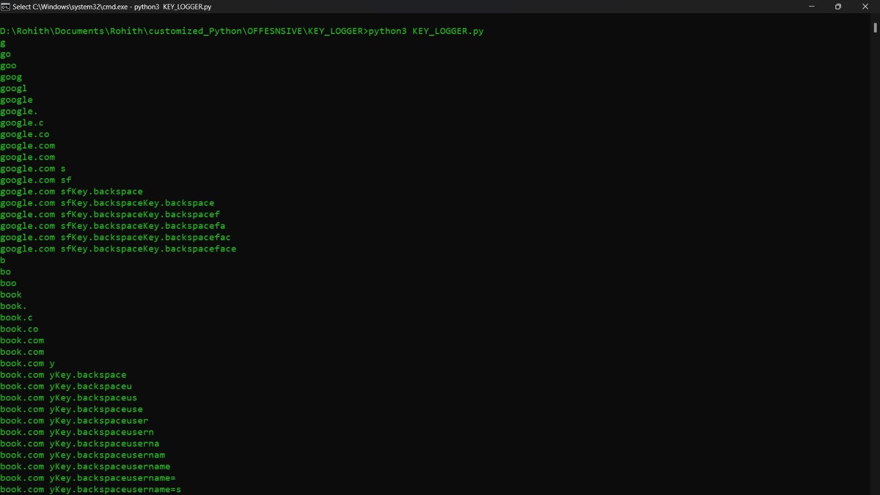
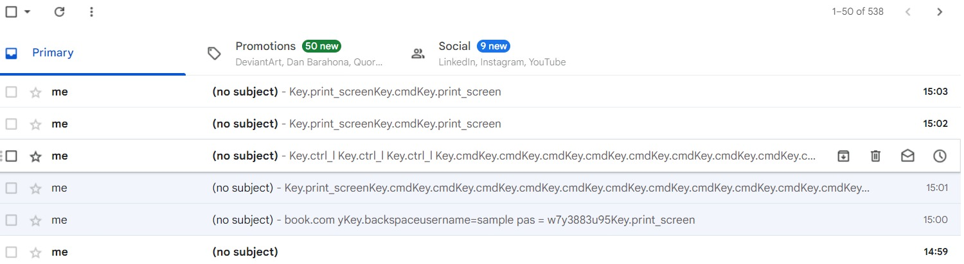
RESULTS
Our testing endeavors culminated in favorable outcomes, underscoring the efficacy of our solution in capturing keyboard inputs and shared to mail.
Project Link
3/21/2024 Annual Review

