Slide 1
Digital Portfolio
STUDENT NAME: Kavitha M
REGISTER NO AND NMID: 30324U18050/6F420652451E4BAA0C44535ECA9A055F
DEPARTMENT: B.SC computer Science
COLLEGE: COLLEGE/ UNIVERSITY:Arcot Sri Mahaalakshmi Womens College/Thiruvalluvar University

Slide 2
PROJECT TITLE
student portfolio : B.Sc Computer Science
1."Personal Portfolio Website using HTML & CSS“
2."Student Profile Presentation using PowerPoint“
3."Web-Based Student Portfolio“
4."My Digital Resume – A Web Project“
5."Responsive Portfolio Design for Students"
6."Showcasing Myself: A Personal Branding Project“
7."IT Student Portfolio – Skills & Vision”

Slide 3


AGENDA
Problem Statement
Project Overview
End Users
Tools and Technologies
Portfolio design and Layout
Features and Functionality
Results and Screenshots
Conclusion
Github Link
3/21/2024 Annual Review

Slide 4

PROBLEM STATEMENT
Many students struggle to present their academic achievements, skills, and goals in a structured and digital format.
Traditional resumes and handwritten files are less engaging and hard to update. There is a need for a simple, digital portfolio system that helps students showcase their identity, technical skills, and career goals effectively.

Slide 5

PROJECT OVERVIEW
This project is a Student Portfolio designed to showcase my personal, academic, and technical profile in a professional format. It includes details like my name, education, skills, projects, hobbies, and career goals. The portfolio is created using basic tools like HTML, CSS, and PowerPoint, making it easy to present and update. The aim is to build a structured digital identity that can be used for academic reviews, internships, or job opportunities.

Slide 6

WHO ARE THE END USERS?
1.Students – To present their academic and technical profile clearly.
2.Teachers/Lecturers – To evaluate student progress, skills, and achievements.
3.Recruiters/HR Professionals – To review the student’s portfolio for internships or job opportunities.
4.College Placement Cell – For maintaining student records and showcasing talent.
5.Self (You) – For self-assessment and future improvement.

Slide 7

TOOLS AND TECHNIQUES
Tools Used: - HTML & CSS: To create and style the portfolio website. PowerPoint: To design presentation slides for showcasing the portfolio. Code Editor: Such as Visual Studio Code or Notepad++ for writing code. Browser: To test and view the portfolio website (e.g., Chrome, Firefox). Techniques Used: - Responsive Design: Ensuring the portfolio looks good on different devices. Basic Web Development: Structuring content with HTML and styling with CSS. Content Organization: Clear sections like About Me, Skills, Projects, and Contact. Visual Design: Using colors, fonts, and images to enhance presentation.

Slide 8
POTFOLIO DESIGN AND LAYOUT
1.Clean and Simple: Use a neat, uncluttered design that makes information easy to read.
2. Organized Sections: Divide the portfolio into clear sections like: About Me - Education - Skills - Projects- Hobbies - Contact.
3. Consistent Colors and Fonts: Choose 2-3 colors and fonts that look professional and are easy on the eyes.
4.Visual Elements: Add images, icons, or small graphics to make it attractive but not overwhelming.
5.Responsive Layout: Design it so it looks good on desktops, tablets, and mobiles (if it’s a website).
6. Easy Navigation: Include a menu or buttons to jump between sections smoothly
8

Slide 9
FEATURES AND FUNCTIONALITY
1.Personal Information Display - Shows name, course, contact details clearly. 2.Educational Background Section - Lists qualifications with dates and percentages. 3.Skills Showcase - Highlights technical and soft skills with visual indicators.
4. Project Gallery - Displays projects with descriptions and images/screenshots. 5.Hobbies & Interests - Shares personal interests to show well-rounded personality. 6.Career Goals - States short-term and long-term professional objectives. Responsive 7.Design - Portfolio looks good on both computers and mobile devices. Easy 8.Navigation - Clear menu or sections for smooth browsing. Contact Section – 9.Includes email and social media links for easy communication.
10.User-Friendly Layout - Clean, organized, and visually appealing design.

Slide 10
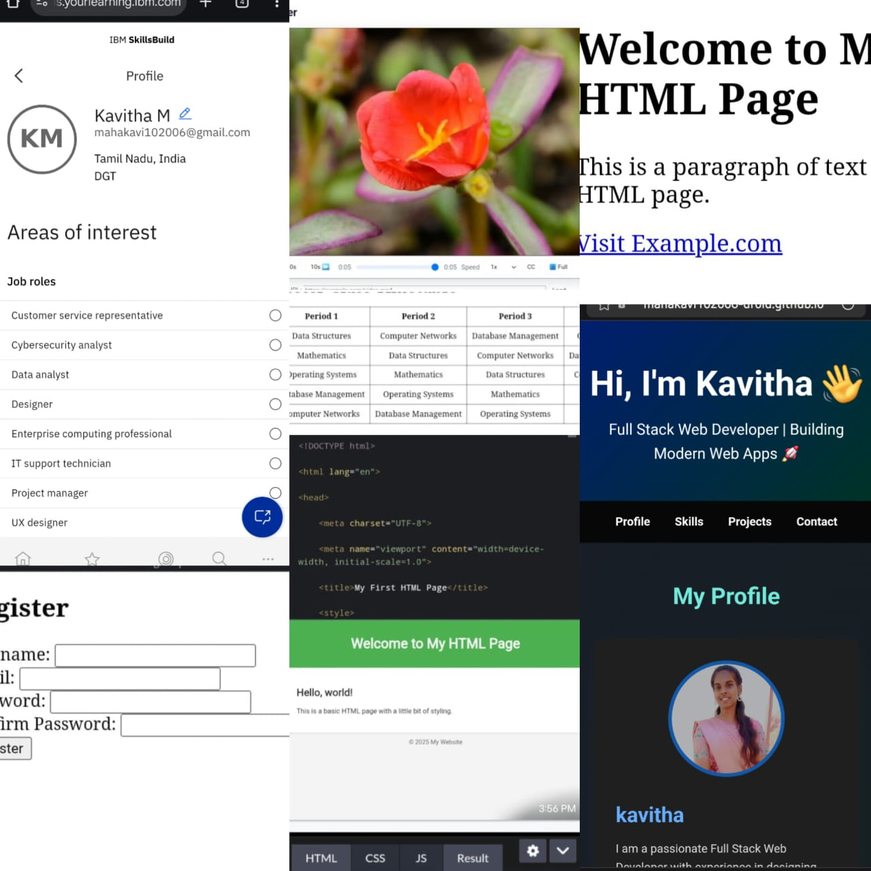

RESULTS AND SCREENSHOTS
3/21/2024 Annual Review
10

Slide 11
CONCLUSION
This student digital portfolio project helped me to showcase my personal, academic, and technical details in a structured format. By creating a portfolio using HTML and CSS, I gained basic web development knowledge and improved my presentation skills. It also gave me confidence to express myself professionally and prepare for future opportunities like internships or jobs. This portfolio reflects my learning journey, skills, and career goals as a computer science student.
11

Slide 12
GITHUB LINK
https://mahakavi102006-droid.github.io/potential-eureka/

