Slide 1
How I would manage the meeting
The presentation itself should take only about 15–18 minutes, even though the script is detailed. Don't deliver every sentence mechanically. The script gives you material to draw from depending on how engaged the group is.
I would allocate roughly 30–40 minutes total: 3 minutes opening/context, 5 minutes Slides 2–3, 5 minutes prototype/live website, 4 minutes Upserv + KRISS AI, 3 minutes implementation and pricing, then use the remaining time for discussion.
Most importantly, don't measure success only by whether Doc Ton says “yes, let's buy it” during the meeting. There are three concrete outcomes worth securing:
1. Direction: Does UASHMC agree that the website/digital-front-door approach makes sense?
2. Ownership: Who is your day-to-day UASHMC contact for content and approvals?
3. Next action: What specifically happens after Friday — revised prototype, content submission, formal proposal/quotation, Execom/Board presentation, or commercial approval?

Slide 2


UASHMC DIGITAL FRONT DOOR
Upserv + KRISS AI
A better online experience. Stronger connections. Better care.
“Excellence in every life we touch.”
7 Marcos Highway, Antipolo City • (02) 8248 3460
Notes:
Good morning, Doc Ton, and everyone. Thank you for giving us the opportunity to present this.
What we'd like to show today is not simply a proposal for a new website. We'd like to look at the bigger opportunity for UASHMC: how your digital presence can support the hospital as it continues to build awareness, credibility and patient census.
UASHMC is still a relatively new hospital, so there is an advantage here. Rather than inherit an old website and try to modernize it later, you have the opportunity to build the digital foundation correctly from the beginning.
And I particularly like UASHMC's line, “Excellence in every life we touch.”
Our thinking is: increasingly, one of those first touchpoints happens online — sometimes before the patient has ever called or entered the hospital.
So the question behind this presentation is very simple:
How do we extend that UASHMC experience into the digital patient journey?
Transition
And that starts with understanding what happens before the patient ever reaches UASHMC.

Slide 3
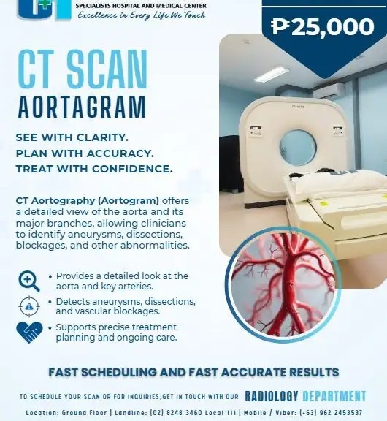
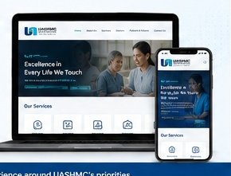
FROM AWARENESS TO PATIENT ACTION
SEE
SEARCH
FIND
ACT
→
→
→
Patient discovers a UASHMC service on Facebook
“Do you have the doctor or service I need?”
Doctors • Services • HMOs • Patient Information
Call • Inquire • Visit • Book
SOCIAL MEDIA
UASHMC WEBSITE
Creates awareness and interest.
→
Turns interest into information and action.
Facebook creates interest. The website turns that interest into action.
Notes:
Today, social media already plays an important role for UASHMC.
You post your services, facilities, doctors, health information and announcements, and that helps create awareness.
But awareness is only the beginning of the patient journey.
Someone sees a post about a service and becomes interested. The next questions are usually practical:
Do you have the specialist I need? Do you accept my HMO? What other services do you offer? How do I make an appointment? Where exactly are you located?
That's where the website becomes important.
Facebook helps people discover UASHMC. The website gives them an official place to investigate and validate UASHMC. And from there, we want to make it very easy for them to take action.
So the journey we're designing for is:
Awareness → Website → Patient Action.
For a growing hospital, I believe that is why the website should be viewed not simply as a corporate requirement, but as part of the hospital's patient-acquisition infrastructure.
Discussion prompt
Doc, does this generally reflect how you see UASHMC's digital presence today — that Facebook is creating awareness, but there isn't yet one central online destination for patients?
Transition
If we look at it from the patient's side, the requirements become even simpler.

Slide 4
WHAT PATIENTS NEED MOST
Patients arrive with a question. The website should make the answer easy to find.
01
FIND THE RIGHT DOCTOR
02
CHECK A SERVICE
Who should I see?
Does UASHMC offer it?
“I NEED TO…”
FIND AN ANSWER
03
CHECK COVERAGE
04
PREPARE FOR MY VISIT
Do you accept my HMO?
What do I need to know?
05
GET URGENT HELP
06
GET THERE
What do I do now?
Where is UASHMC?
Design the website around what patients are trying to accomplish — not around the hospital’s internal structure.
Notes:
Patients usually search the website because they need something.
Can I find a doctor?
Does UASHMC offer the service I need?
Do you accept my HMO or PhilHealth?
What do I need to know before coming to the hospital?
What do I do in an emergency?
How do I get there?
If we can answer these six needs clearly and quickly — especially on mobile — we've already created a useful patient experience.
And this is important for the design. We don't want the website organized primarily around what makes sense internally to the hospital. We want it organized around what patients are trying to accomplish.
Discussion prompt
I'd actually like your team's input here. Of these six, which are the most important for UASHMC right now?
And is there anything important missing that your patients frequently ask about?
Transition
With those patient needs in mind, this is the direction we've started exploring.

Slide 5

A PREVIEW OF YOUR NEW WEBSITE
1
CLEAN & EASY
Mobile-friendly.
2
FIND IT FASTER
Doctors, services and HMOs.
3
BUILT FOR ACTION
Clear next steps for patients.
We’ll shape the final experience around UASHMC’s priorities.
Notes:
CHANGE WITH THE ACTUAL HERO OF THE WEBSITE PROTOTYPE What you're seeing here is a working direction, this is not yet a draft for approval.
We created it so that instead of discussing a website theoretically, you have something concrete to react to.
The design principles are straightforward:
Clean and easy.
Mobile-friendly.
Important information should be easy to find.
And every important page should help the patient understand what to do next.
We also want the visual character to feel like UASHMC — professional and medically credible, but not cold or overly institutional. It should be warm and welcoming
That's why your feedback today is important. The prototype should eventually reflect your priorities, your services, your patients and your brand.
At this point, I would leave PowerPoint and show Allan's live prototype.
Say:
Rather than explain it through slides, let me show you what we've started building.
Then navigate only through the strongest parts. Don't do a long website tour. Around 3–5 minutes is enough.
Afterward:
Again, we're not presenting that as the finished website. We're showing you what is possible and giving the team something tangible to improve.
What I'd particularly like to hear from you is: does this feel like the direction UASHMC should take?
Then ask about:
overall look and feel;
priority services;
patient actions;
photos/branding;
content owner.
Transition
And there's another reason we're recommending that the website be built this way from the beginning.

Slide 6
UPSERV + KRISS AI: ONE DIGITAL FRONT DOOR
WEBSITE (UPSERV)
KRISS AI
Patients FIND.
Patients ASK.
Doctors • Services HMOs • Patient Information
“Do you accept my HMO?” “Do you have a cardiologist?”
Notes:
RESEARCH WHAT ARE THE PAIN POINTS OF UASHMC? This is where the website and KRISS AI fit together.
The distinction is very simple:
The website allows patients to FIND.
KRISS AI allows patients to ASK.
A traditional website assumes the patient knows where to look.
With KRISS AI, the patient doesn't necessarily have to understand the website structure. They can simply ask:
“Do you accept my HMO?”
“Do you have a cardiologist?”
“What diagnostic services are available?”
“How do I contact the hospital?”
KRISS AI then uses UASHMC-approved information to help guide the patient.
That's why our recommendation isn't to build a website today and then someday discover that it has to be redesigned for AI.
We can make the foundation AI-ready from the beginning.
The website remains useful on its own. KRISS AI simply adds the conversational patient-engagement layer.
Important positioning line
So we're not proposing AI for the sake of saying UASHMC has AI. We're asking where AI can remove friction from the actual patient journey.
Discussion prompt
From your experience, what questions does your team repeatedly receive from patients that you think should be answered immediately online?
That question is useful because their answers become KRISS AI use cases.

Slide 7
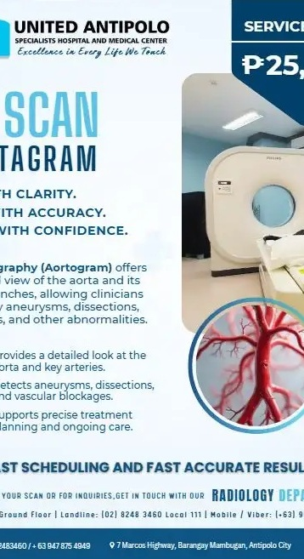
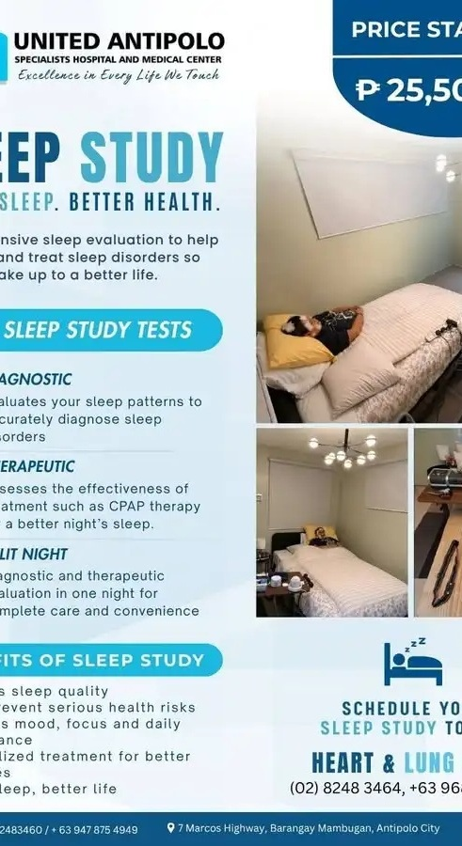

FROM FACEBOOK TO A SEARCHABLE PATIENT RESOURCE
Awareness today. Searchable patient information tomorrow.
CT SCAN
SLEEP STUDY
LAPAROSCOPIC SURGERY
Actual UASHMC service posts become organized, searchable website content.
Notes:
These are examples from UASHMC's own social-media content.
And actually, this demonstrates that you already have a lot of the raw material.
You're already communicating about services such as CT Scan, Sleep Study and surgery.
The problem isn't necessarily that the information doesn't exist.
The problem is that social-media content is chronological. A useful post eventually moves down the feed.
A patient looking for a particular service shouldn't have to search through months of Facebook posts to determine whether UASHMC offers it.
On the website, we can take this information and turn it into a structured, permanent and searchable patient resource.
Facebook can continue doing what Facebook does well — creating awareness and engagement.
The website becomes the hospital's authoritative digital home.
Key line
So we are not proposing replacing Facebook. We're giving all that good social-media work somewhere permanent to lead patients.
Discussion prompt
Which services would you most want us to prioritize on the website — particularly the services UASHMC wants to grow?
This is one of the most commercially useful questions in the presentation. Give them time to answer.

Slide 8
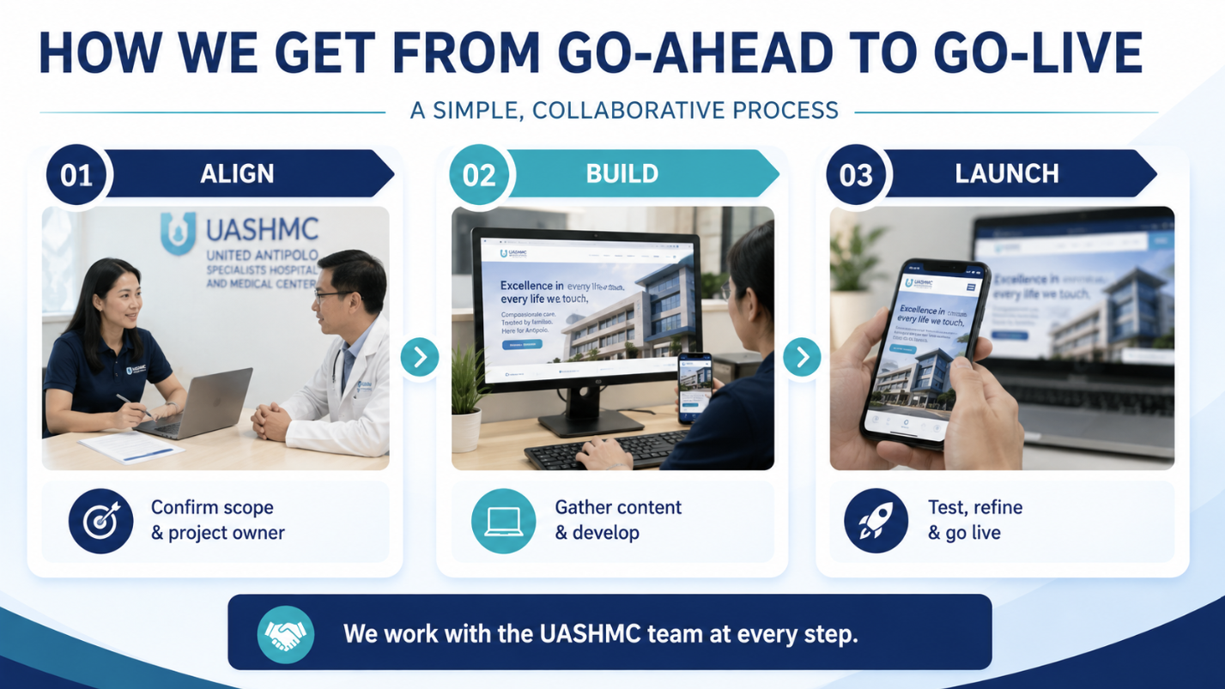
HOW WE GET FROM GO-AHEAD TO GO-LIVE
01
02
03
ALIGN
BUILD
LAUNCH
→
→
Confirm scope & project owner
Gather content & develop
Test, refine & go live
We work with the UASHMC team at every step.
Notes:
If UASHMC decides to proceed, we've deliberately kept the process simple.
There are really only three phases.
First: Align.
We confirm the scope and identify one UASHMC project owner or point person.
Second: Build.
We gather the available content and materials and begin development. Importantly, we don't need to wait until every single piece of information is perfect before we start.
We can build in parallel while UASHMC validates doctors, services, HMOs, photos and patient information.
Third: Launch.
We test everything with your team, refine it based on feedback, and then go live once UASHMC is comfortable.
Our team handles the technical work. What we need from UASHMC is primarily direction, approved information and timely validation.
Critical next-step question
If we proceed, who would be the best person on the UASHMC side for us to coordinate with on the website content and approvals?
This is where I would try to get the project owner named during the meeting, rather than chasing one afterward.
Transition
Finally, let me show you the commercial structure we've prepared.

Slide 9
INVESTMENT OPTIONS
RECOMMENDED
WEBSITE + KRISS AI
WEBSITE
KRISS AI
$1,500
$1,000
$1,000
SETUP PROMO
SETUP
SETUP
$250 / month
$150 / month
$199 / month
Promo until Nov. 30, 2026
20% discount on recurring fees when paid annually upfront.
Notes:
We've structured this so UASHMC can choose how far it wants to go initially.
But based on where the hospital is today, our recommendation is the integrated Website + KRISS AI package.
That gives UASHMC the digital foundation and patient-engagement layer together.
The regular combined setup is US$2,000, but because UASHMC is a new hospital and we're hoping to help you establish this foundation early, we received approval for a special early-commitment rate:
US$1,500 one-time setup, if confirmed on or before November 30, 2026.
The recurring fee is US$250 per month, including the website maintenance and KRISS AI subscription.
There is also a 20% discount on recurring fees when paid annually upfront.
If UASHMC prefers to start smaller, that's perfectly possible.
Website development alone is US$1,000 setup plus US$150 monthly maintenance.
KRISS AI alone is US$1,000 setup plus US$199 monthly, although that requires an existing website for integration.
So commercially, we're giving UASHMC the flexibility to start where you're comfortable.
Strategically, however, I would recommend building the website and AI layer together, because it avoids having to revisit the digital architecture later.
Then stop talking.
Don't immediately justify the price further. Let Doc Ton and the team react.
If they ask why the integrated package is recommended:
Because the website solves discovery and credibility, while KRISS AI solves access to information and navigation. For UASHMC's stage of growth, those two functions reinforce each other.
If they say they only want the website:
Absolutely. The website itself is already an important step forward. We would simply build it AI-ready so that when UASHMC is ready for KRISS AI, we don't have to rebuild the foundation.
That keeps the KRISS AI opportunity alive without resisting their preferred starting point.

Slide 10

EXCELLENCE IN EVERY LIFE WE TOUCH.
Now extending to every digital patient touchpoint.
Website + KRISS AI
Better experience. Stronger connections. Better care.
Notes:
I'd like to end where we started — with UASHMC's own promise:
“Excellence in every life we touch.”
What we're proposing is really an extension of that promise.
Today, some of the earliest interactions a patient has with a hospital happen before they ever enter the building.
They search.
They look for a doctor.
They check a service.
They ask whether their HMO is accepted.
They try to understand where to go and what to do next.
Those are already patient touchpoints.
Our goal is to help UASHMC make those digital touchpoints reflect the same standard of experience you want patients to receive when they arrive at the hospital.
Better experience. Stronger connections. Better care.
So rather than end with another presentation, I'd like to ask one practical question:
Based on what you've seen today, do you feel this is a direction worth moving forward with for UASHMC?
Then stop and allow them to respond.

