Slide 1
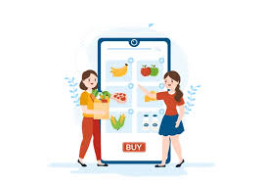
GROCERY WEBAPP
TEAM MEMBERS:
LATHA SHRI R S(211521205073)
JOTHIKA K(211521205058)
LAVANYA D(211521205075)
MAHALAKSHMI B(211521205078)

Slide 2
Abstract
Grocery Mart is a comprehensive, user-friendly app designed to streamline the online grocery shopping experience.
It offers an intuitive interface, allowing users to easily browse and purchase a wide variety of products across multiple categories, such as household essentials, pantry staples, fresh produce, and snacks.
The app uses smart algorithms to provide personalized recommendations based on user preferences, enhancing the shopping experience.
It also supports coupon applications for additional savings, making shopping both cost-effective and convenient

Slide 3
Introduction
Grocery Mart is an innovative and user-centric online platform that serves as a one-stop solution for all grocery shopping needs. Designed with convenience in mind, Grocery Mart aims to provide a seamless and enjoyable shopping experience for users. The platform offers a wide range of high-quality products across diverse categories, including household essentials, pantry staples, fresh produce, and snacks.
The app features intuitive navigation, making it easy for users to find what they need with just a few taps.
Additionally, personalized recommendations are generated using smart algorithms, ensuring that users are presented with products that align with their preferences and shopping habits.

Slide 4
Proposed System
The app is designed to provide a seamless shopping experience through:
Intuitive Navigation: Simple browsing through categories like household essentials, pantry staples, fresh produce, and snacks.
Personalized Recommendations: Tailored suggestions based on user preferences.
Easy Cart Management: Features like one-click additions, quantity adjustments, and real-time updates.
Convenient Checkout and Delivery Options: Options like same-day delivery, standard, and scheduled delivery​.
Hassle-free Checkout: The checkout process is designed to be smooth, with secure payment options and easy management of delivery details. Users can apply coupons and discounts directly in the cart for additional savings.

Slide 5
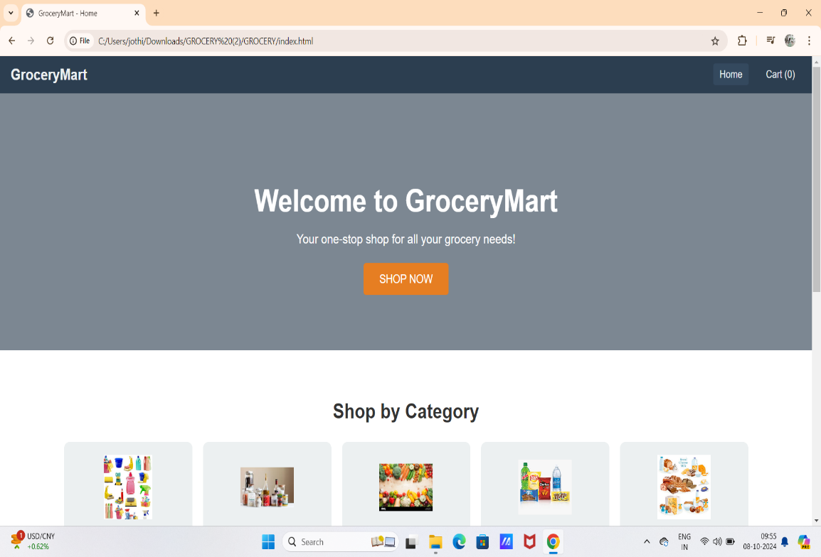
Proposed Model

Slide 6
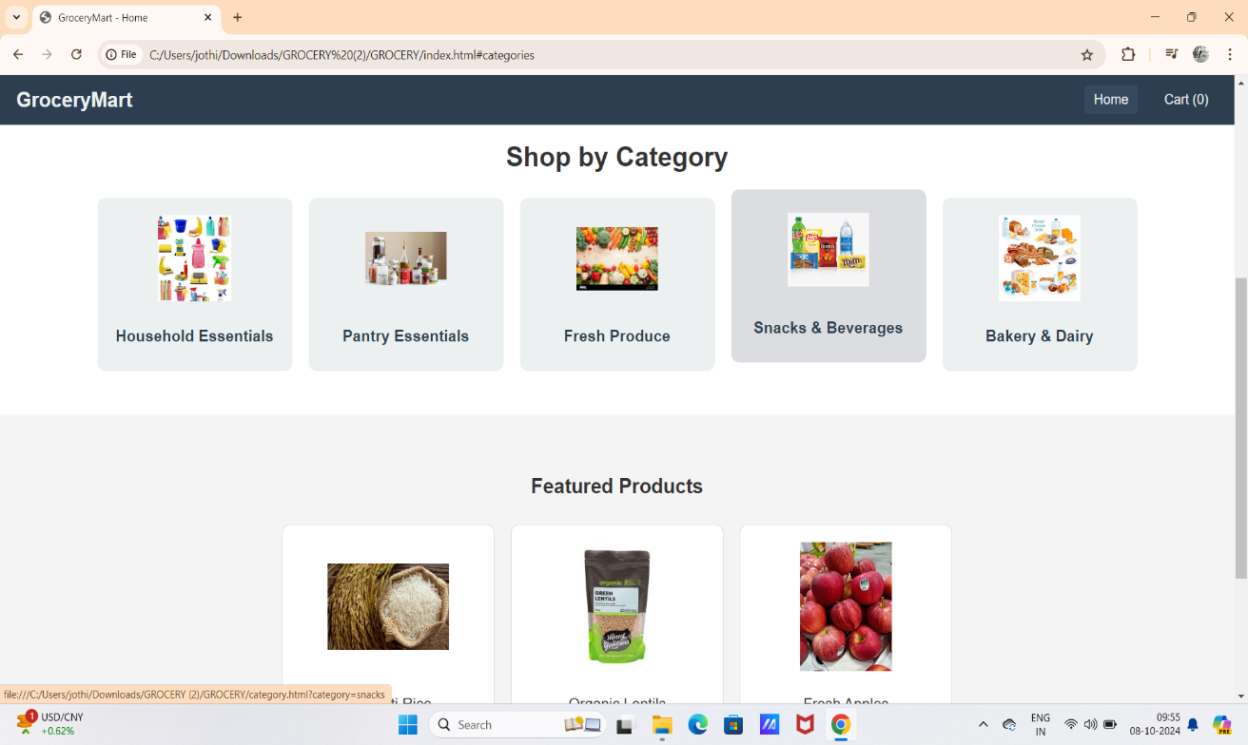

Slide 7
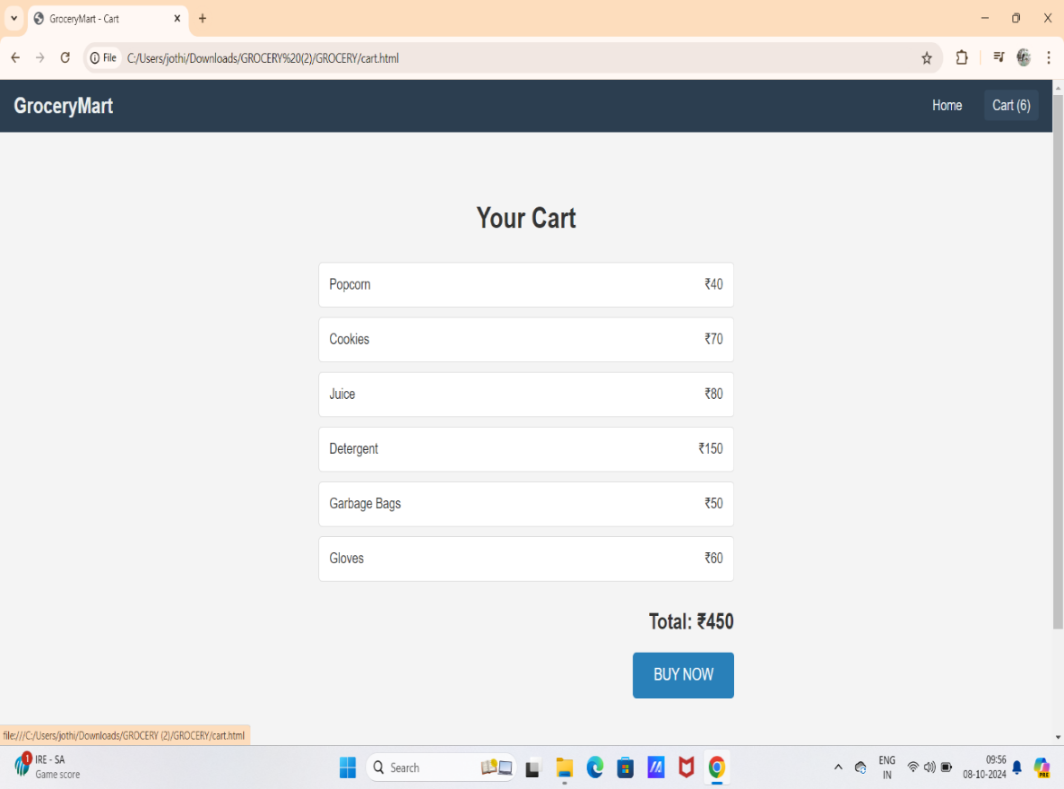

Slide 8
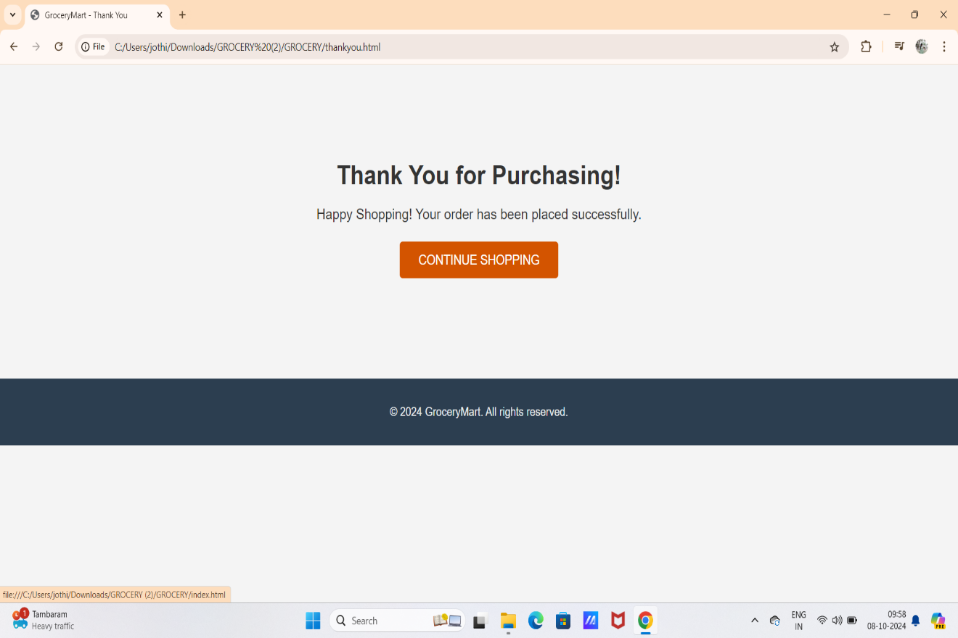

Slide 9
Frontend Development
The front-end of our grocery app was built using HTML, CSS, and JavaScript, providing an intuitive and user-friendly interface. The goal was to create a seamless shopping experience with a clean design and responsive layout.
HTML was used to structure the content and create the foundation of the app’s interface.
CSS enabled us to style the app with modern, visually appealing layouts, ensuring it adapts smoothly across various screen sizes and devices.
JavaScript added dynamic functionality, allowing users to interact with the app, such as adding items to the cart, updating quantities, and navigating between pages.

Slide 10
Backend Development
The back-end of our grocery app was developed to efficiently handle data management, user requests, and communication between the database and front-end interface.
Server-Side Logic: We used Node.js to manage API calls, process user requests, and ensure secure data flow.
Database Management: MongoDB was integrated to store essential data, including product information, user accounts, order history, and transaction records.
API Integration: We built RESTful APIs to manage product listings, cart management, and order processing, ensuring that the app responds quickly and efficiently to user actions.

Slide 11
Integration
The integration process of our grocery app focused on seamlessly connecting the front-end, back-end, and third-party services to ensure a smooth and efficient user experience. This unified approach was crucial in delivering a responsive, reliable, and fully functional application.
Front-End & Back-End Integration: The front-end, developed using HTML, CSS, and JavaScript, was integrated with the back-end server via RESTful APIs. This allowed for real-time communication between the user interface and the server, enabling dynamic product listing updates, cart management, and order processing.

Slide 12
Database Integration: Our chosen database MongoDB was connected to the back-end, enabling smooth data handling for product inventory, user accounts, and order history. This ensured that user actions like adding items to the cart or checking out were accurately reflected in the system.
Payment Gateway Integration: A secure payment gateway was integrated to facilitate safe transactions. This ensured encrypted and seamless payment processing for users.
Overall, the integration of the various components ensured that our app worked as a cohesive system, offering a streamlined and secure shopping experience for the users.

Slide 13
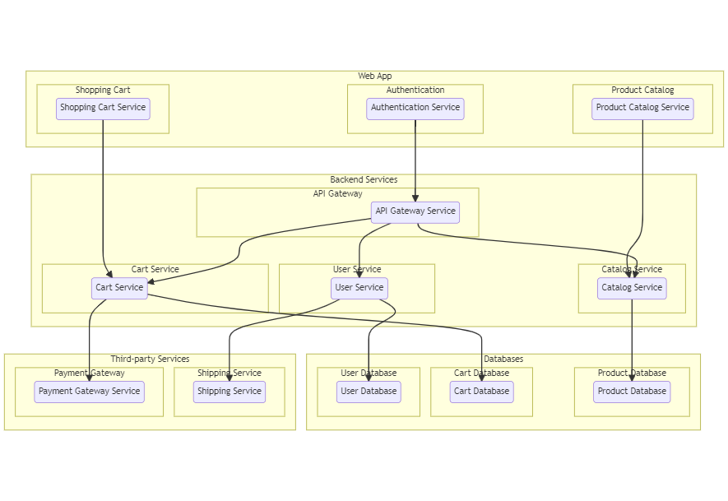
Architecture Diagram

Slide 14
Grocery Mart stands out for its unparalleled convenience, exceptional selection of high-quality products, and superior customer service. The platform promises to offer a seamless shopping experience that meets the needs of modern consumers. Grocery Mart is more than just an online grocery shopping app-it's a smart, user-focused platform designed to meet the evolving needs of modern consumers. Offering unparalleled convenience through its seamless navigation, personalized recommendations, and flexible delivery options, Grocery Mart ensures a superior shopping experience.
Conclusion

Slide 15
THANK YOU

