Slide 1

BUILDING A CHATBOT USING AMAZON LEX AND LAMBDA

Slide 2


TEAM MEMBERS:
2210040122-Shiva
2210040118-Mahalakshmi
2210040139-Pranathi
2210040031-Anusha
Under the Guidance:
Ms. Saritha Mam

Slide 3
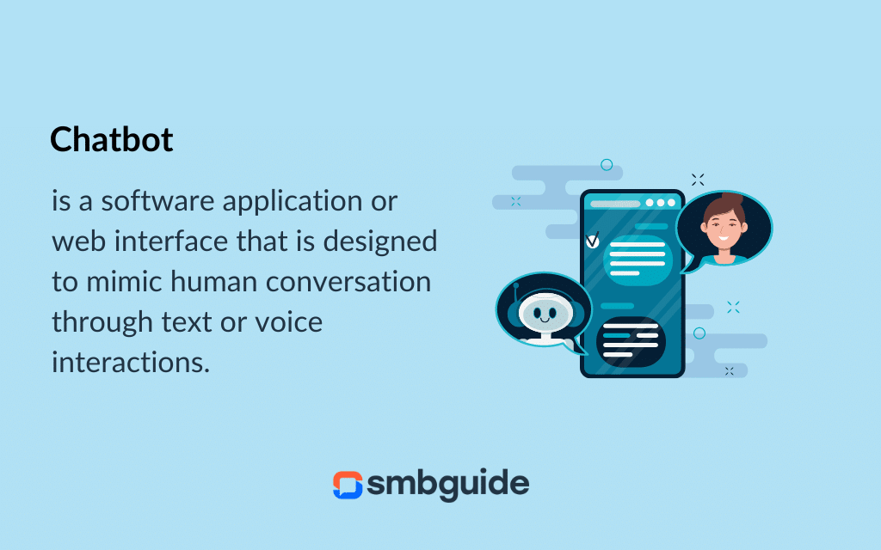
INTRODUCTION:
INTRODUCTION:

Slide 4
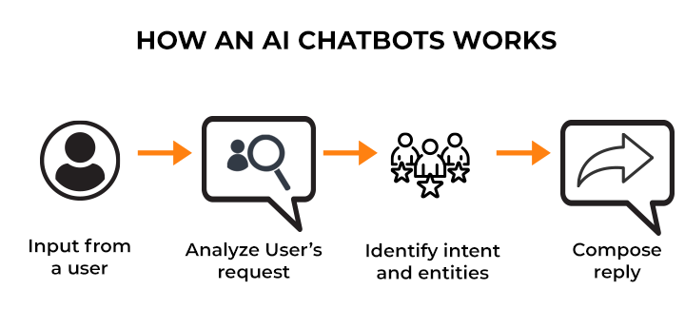

Slide 5

AMAZON LEX BENEFITS:
Easy to use
High quality lex and speech recognition understanding
Seamlessly deploy and scale
Build-In integration with AWS platform
Cost-effective

Slide 6


