Slide 1
IMMO ELIZA · BELGIAN RESIDENTIAL MARKET
Where — and what — to buy
for the best return
A data-driven guide for the buy-to-let investor
18,686
listings analysed
565
municipalities
Yield + Growth
= total ROI
Notes:
[Presenter 1 · 0:15] Welcome. Immo Eliza wants to be Belgium's #1 real-estate services provider. Today: a market read for one client — the buy-to-let investor — ending with exactly where and what to buy for the best total return.

Slide 2
01
THE CLIENT & THE VALUE QUESTION
Who we're advising, and what drives price
What makes a Belgian property valuable?
Presenter: Maha
Notes:
[Presenter 1 · 0:05] Hand-off into section 1.

Slide 3
SECTION 1 · THE CLIENT
Meet the investor we're advising
LÉA · 42
Buy-to-let property investor
“Therefore the yield — how the buying price relates to the rent price — is decisive.”
— Immo Eliza customer brief
GOAL
Grow her capital by buying property to rent out.
DECISION RULE
Yield = rent ÷ buy price. The cheaper the buy versus the rent it earns, the better.
PAIN POINT
A great rental can still be a poor investment if its value stalls.
So we answer two things for Léa:
1. What makes a property valuable?
2. Where & what gives the best TOTAL return = rental yield + price growth?
KEY INSIGHT
We rank every Belgian municipality on total ROI — rent today plus value tomorrow — so Léa knows exactly where, and what, to buy.
Immo Eliza · Belgian residential market
Stéphane · 3
Notes:
[Presenter 1 · 0:55] Meet Léa, our investor. Her rule: yield = rent ÷ price. But a cheap rental that never appreciates is a trap — so we judge every area on TOTAL ROI: rent today plus value tomorrow. Two questions frame the deck: what drives price, and where/what to buy.

Slide 4
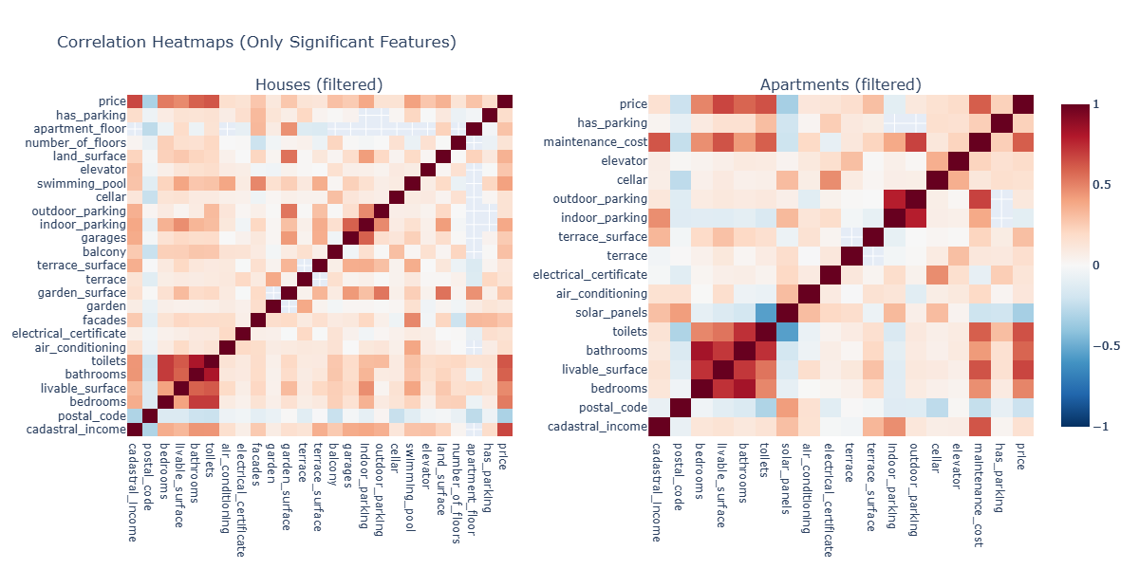
SECTION 1 · PRICE DRIVERS
What actually drives a property's price?
Living area
strongest price driver
Bathrooms · Bedrooms · Toilets
size of the home
Location
postal code & cadastral income
KEY INSIGHT
Size & sanitary rooms — living area, bathrooms, bedrooms, toilets — drive price most; location next. Amenities barely move it.
Immo Eliza · Belgian residential market
Stéphane · 4
Notes:
[Presenter 1 · 1:20] Correlation of every feature with price (houses left, flats right). The hot band is size & sanitary rooms — living area, bathrooms, bedrooms, toilets. Location matters; most amenities barely move price. So 'value' = a well-sized home in the right place. Hand to Maha for where that plays out.

Slide 5
02
THE MARKET
Prices, supply & energy efficiency
Where is value concentrated — and what commands a premium?
Presenter: Alex
Notes:
[Presenter 2 · 0:05] Section 2 — the market.

Slide 6
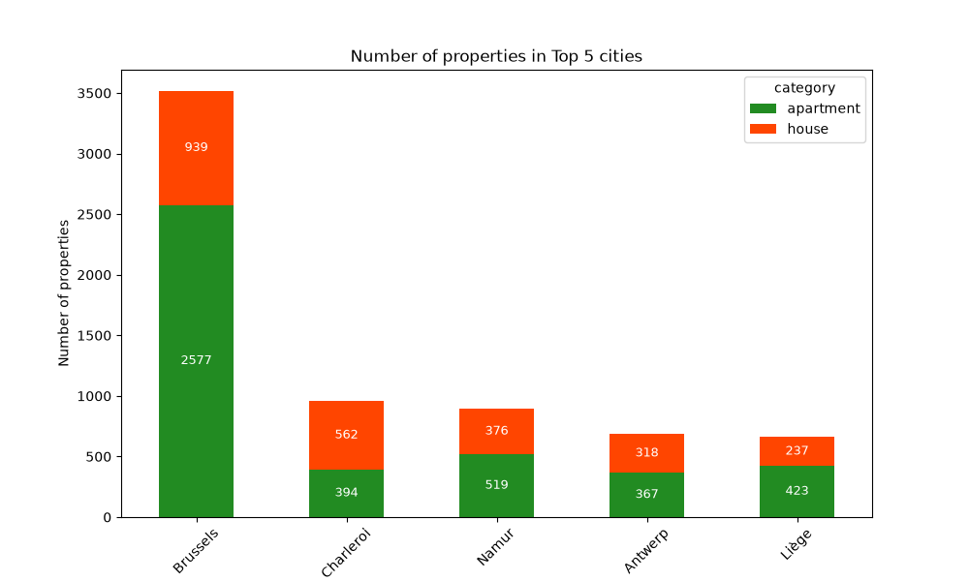
SECTION 1 · PRICE DRIVERS
What actually drives a property's price?
5 urban area on the market
Total properties in the area of 5 cities
6,712
Apartments: 4,280
Houses:2,432
KEY INSIGHT
Size & sanitary rooms — living area, bathrooms, bedrooms, toilets — drive price most; location next. Amenities barely move it.
Immo Eliza · Belgian residential market
Stéphane · 4
Notes:
[Presenter 1 · 1:20] Correlation of every feature with price (houses left, flats right). The hot band is size & sanitary rooms — living area, bathrooms, bedrooms, toilets. Location matters; most amenities barely move price. So 'value' = a well-sized home in the right place. Hand to Maha for where that plays out.

Slide 7
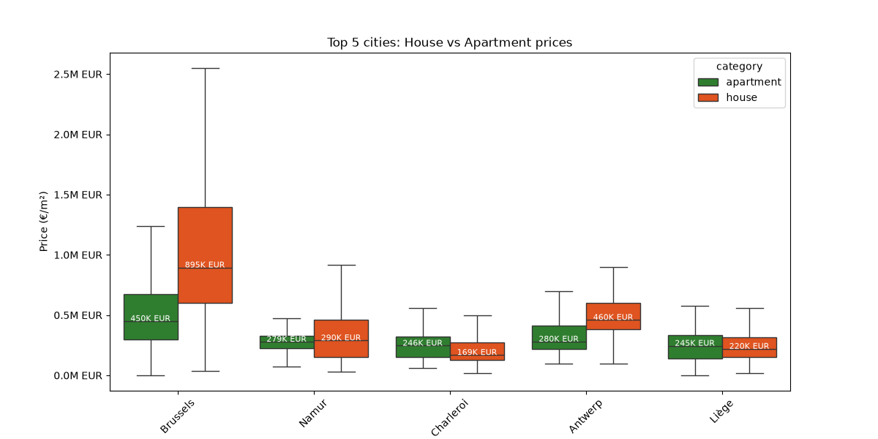
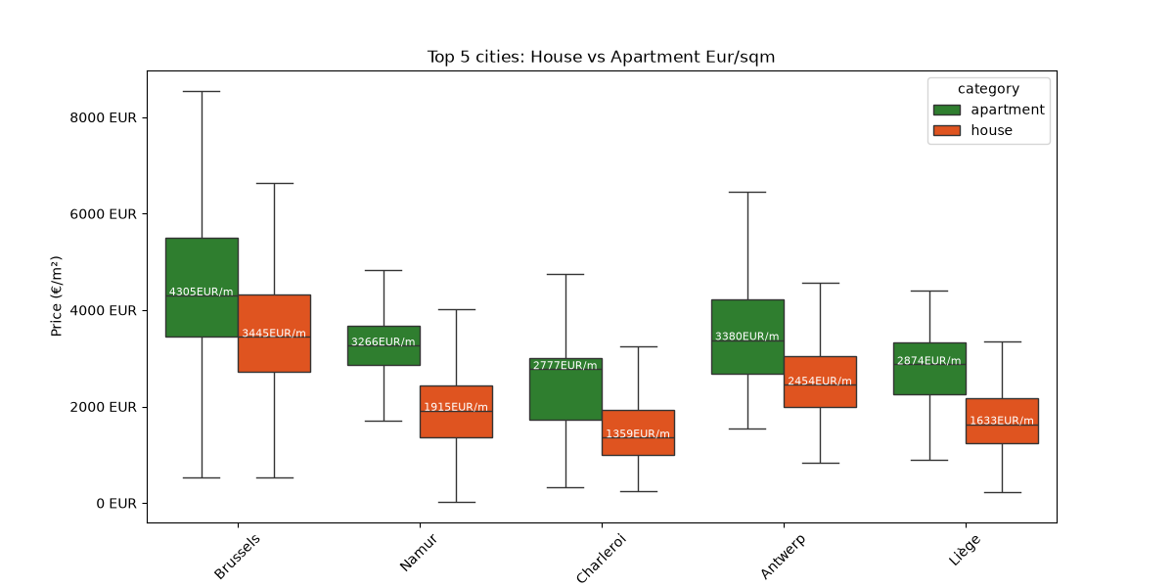
SECTION 2 · THE MARKET BY CITY
Brussels is deepest & priciest — the provinces are where yield hides
KEY INSIGHT
Brussels dominates price AND supply (3,516 listings; houses ~€895K). Provincial cities are far cheaper — Charleroi houses ~€169K — and cheap-to-buy is where high yield lives.
Immo Eliza · Belgian residential market
Maha · 6
Notes:
[Presenter 2 · 1:35] Left: house vs flat prices in the five biggest markets — Brussels is in a league of its own (house median ~€895K) while Charleroi houses sit near €169K. Right: Brussels is also the deepest market by far (3,516 listings). For an investor, the cheap provincial markets are the interesting ones — remember that for the yield section.

Slide 8
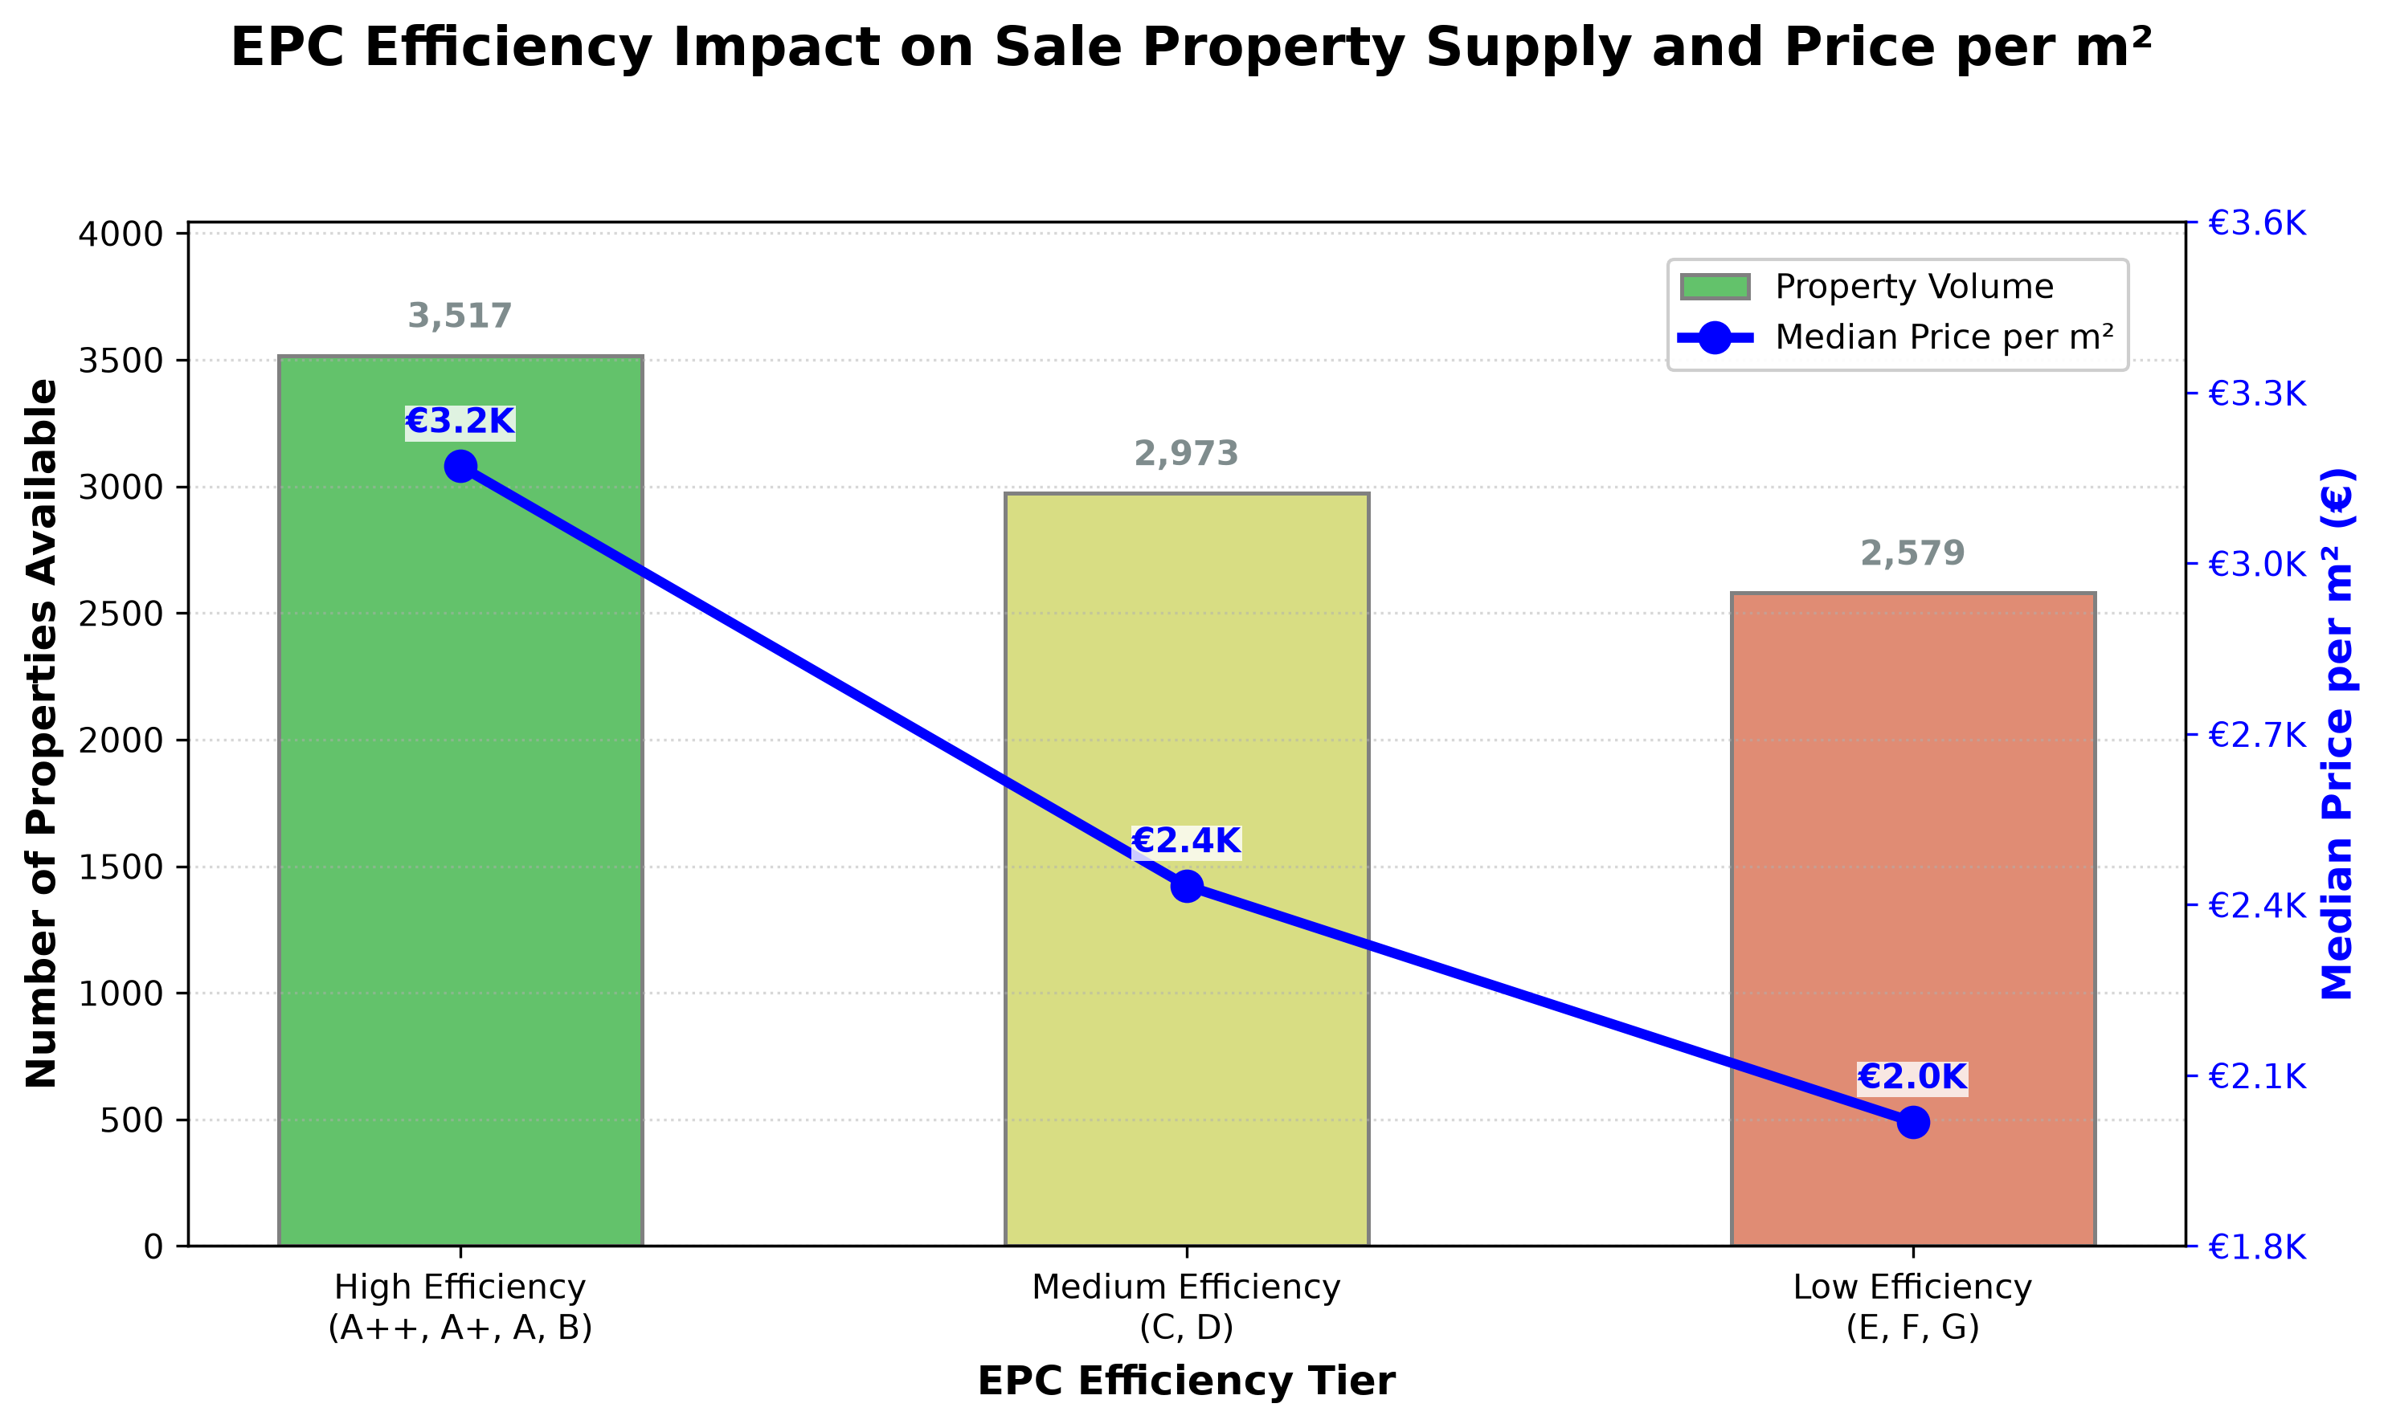
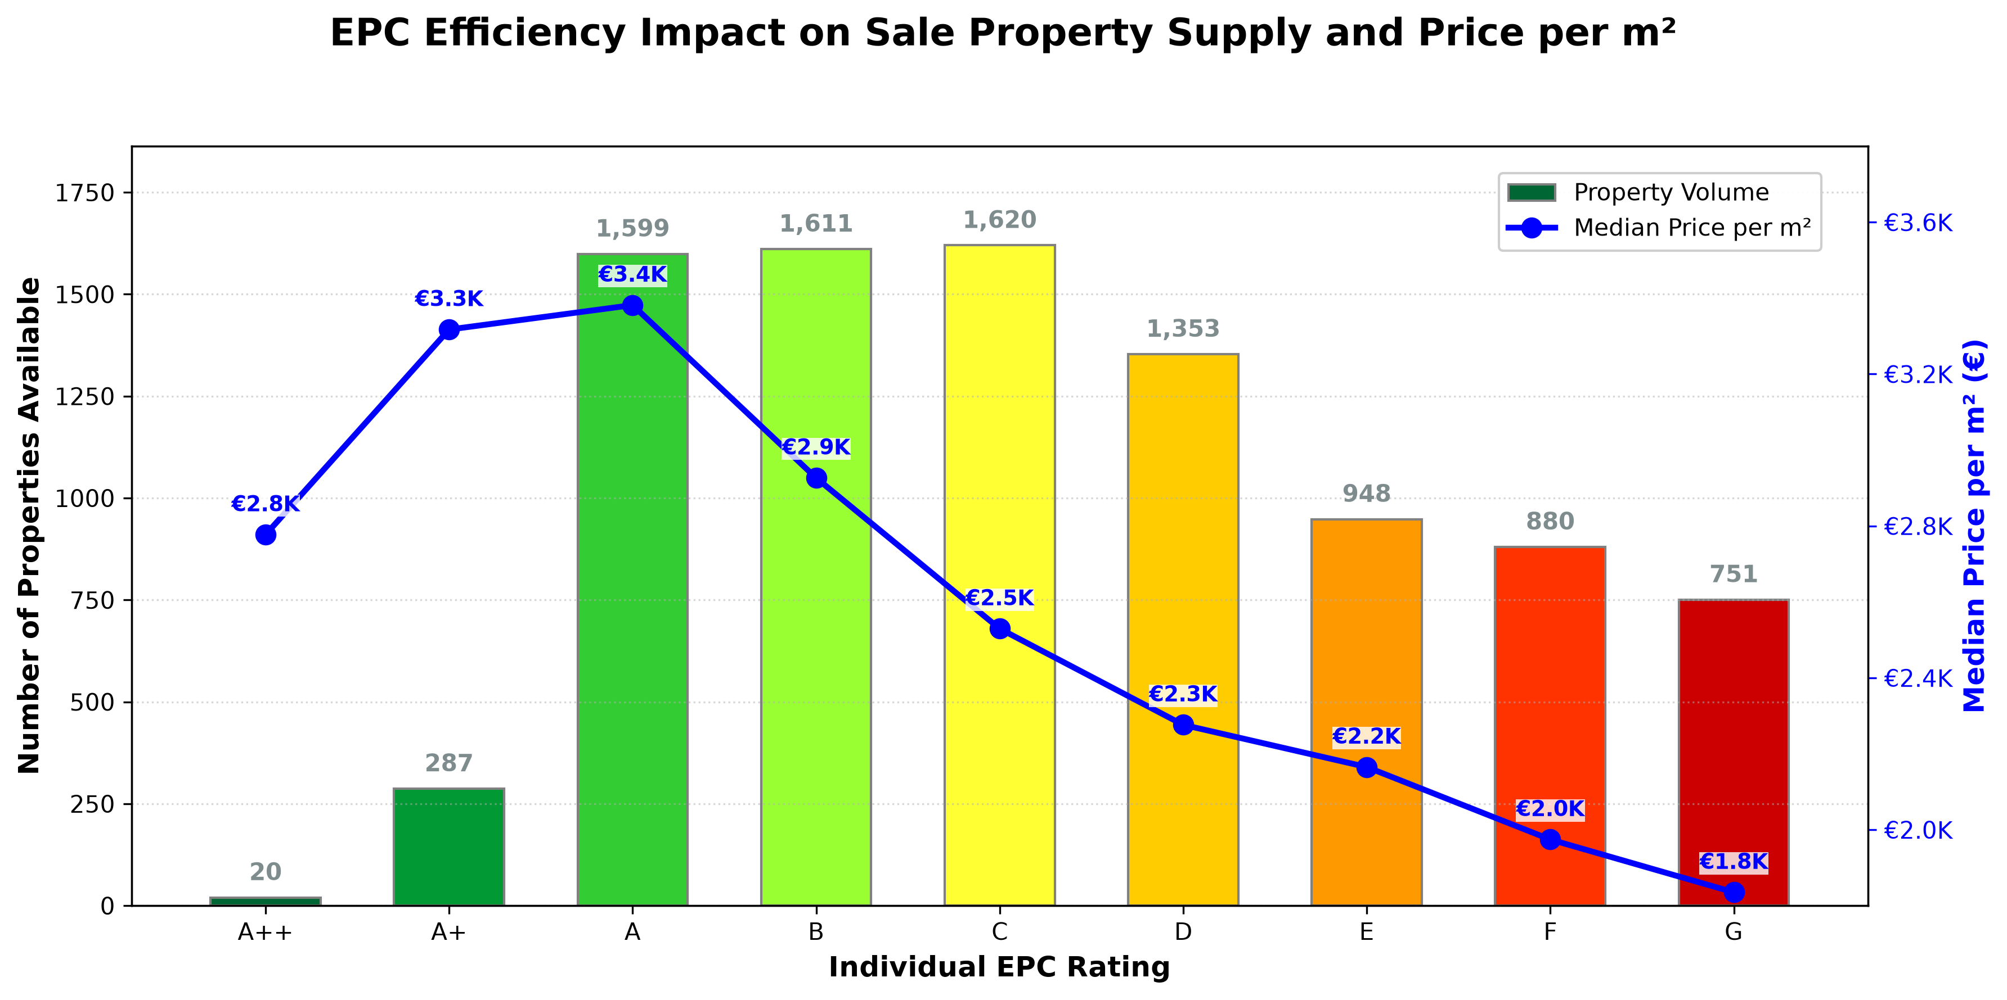
SECTION 2 · ENERGY EFFICIENCY
Energy rating is priced in — and it's a lever for investors
KEY INSIGHT
Top-rated homes fetch ~€3.4K/m² vs ~€1.8K/m² for the worst — a ~90% premium. Cheap, low-EPC stock = higher gross yield now, with renovation upside later.
Immo Eliza · Belgian residential market
Maha · 7
Notes:
[Presenter 2 · 1:25] Energy efficiency tracks price almost perfectly: high-efficiency homes ~€3.2K/m², low ~€2.0K/m² (left); rating by rating it runs from ~€3.4K at A to ~€1.8K at G — roughly a 90% premium (right). Investor angle: a cheaper low-EPC property lifts gross yield today and offers renovation upside as efficiency rules tighten. Over to Alex.

Slide 9
03
THE INVESTOR'S PAYOFF
From rental yield to total ROI
Where — and what — delivers the best total return over time?
Presenter: Stephane
Notes:
[Presenter 3 · 0:05] Section 3 — the payoff.

Slide 10
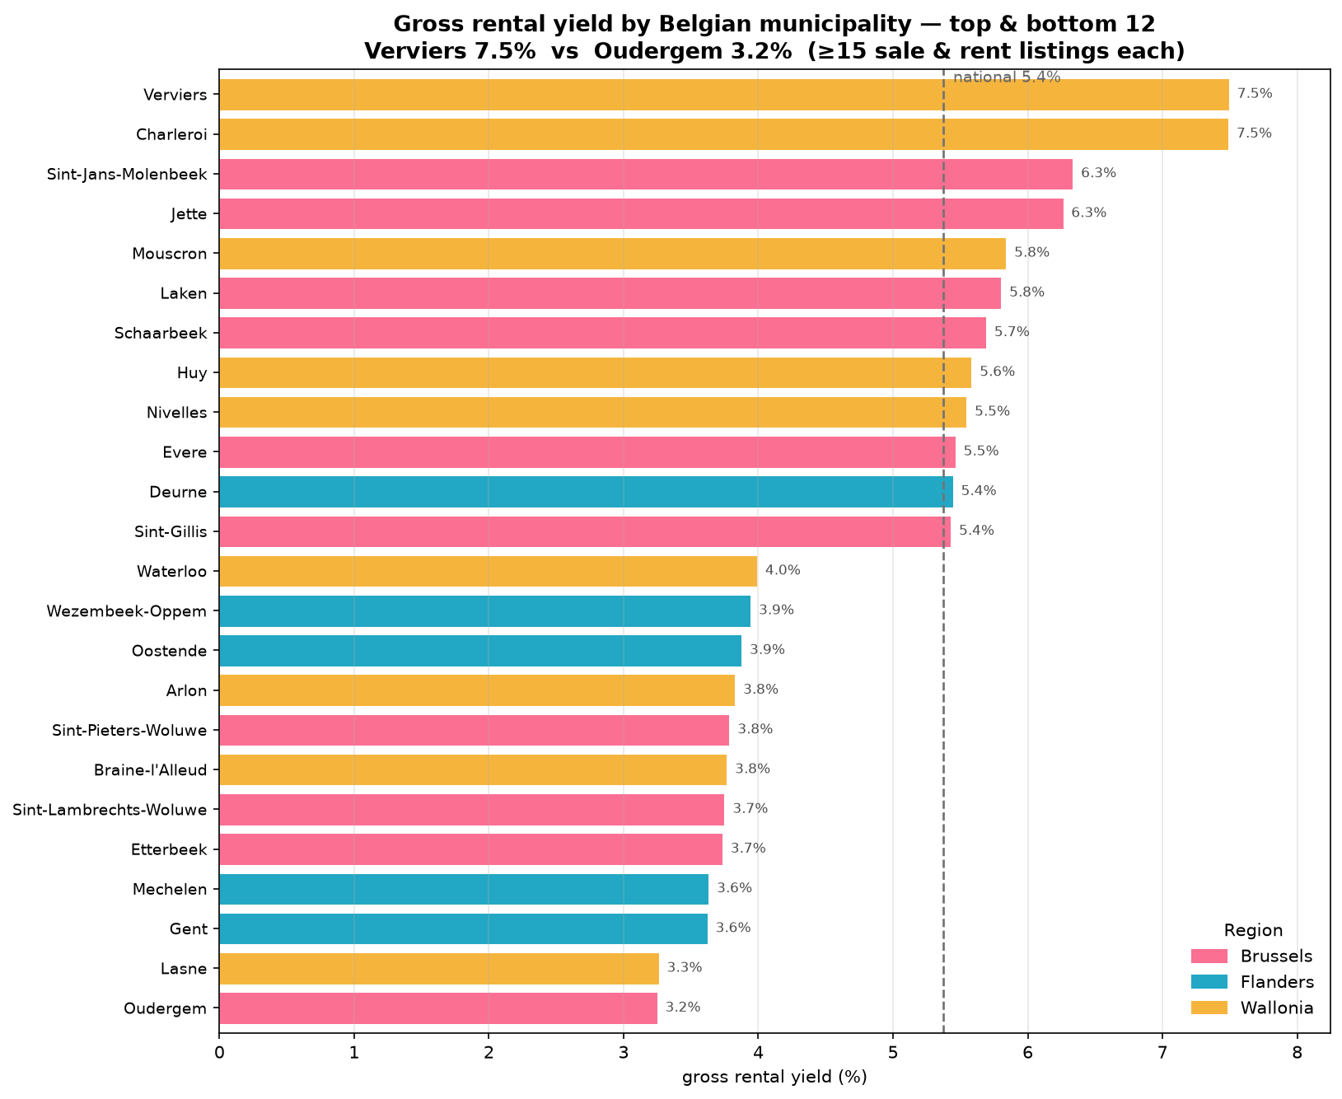
SECTION 3 · RENTAL YIELD
Gross rental yield: 3% in Brussels to 7.5% in Wallonia
up to ~7.5%
best (e.g. Verviers)
6.8%
Charleroi
~5.4% / ~3.2%
national / affluent Brussels
KEY INSIGHT
Best yields are in affordable Walloon cities and outer-Brussels; affluent central Brussels yields least.
Immo Eliza · Belgian residential market
Alex · 9
Notes:
[Presenter 3 · 1:15] Gross yield = rent ÷ price, per municipality. It spans ~3% to 7.5%. The top is Walloon industrial cities and outer-Brussels communes (cheap to buy, decent rents); the bottom is affluent Brussels. So yield alone already points to Wallonia.

Slide 11
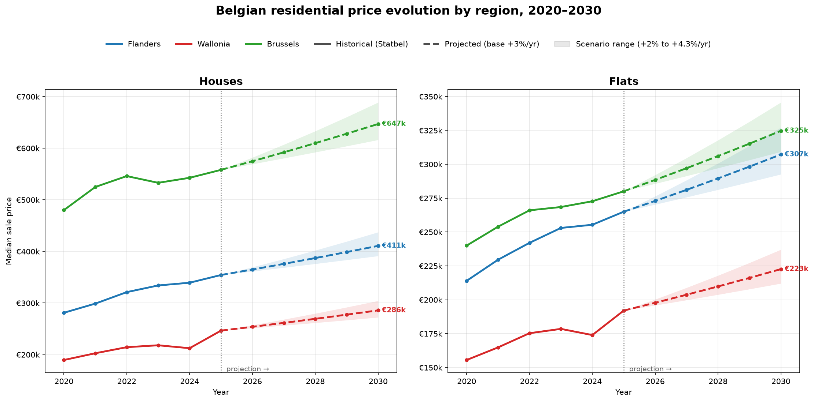
SECTION 3 · CAPITAL GROWTH
But yield isn't everything — prices also appreciate
+71%
2010 → 2025
~3.6%/yr
long-run growth
€558K / €247K
Brussels / Wallonia house, 2025
KEY INSIGHT
Prices rose ~71% in 15 years (~3.6%/yr). Where you buy shapes the capital gain too — so combine both forces.
Immo Eliza · Belgian residential market
Alex · 10
Notes:
[Presenter 3 · 0:55] The second engine of return: prices. Houses and flats by region, last 5 years plus a 5-year projection. Belgian prices rose ~71% over 15 years, about 3.6%/yr. Levels differ a lot by region. Yield tells you income; this tells you capital gain. Now combine them.

Slide 12
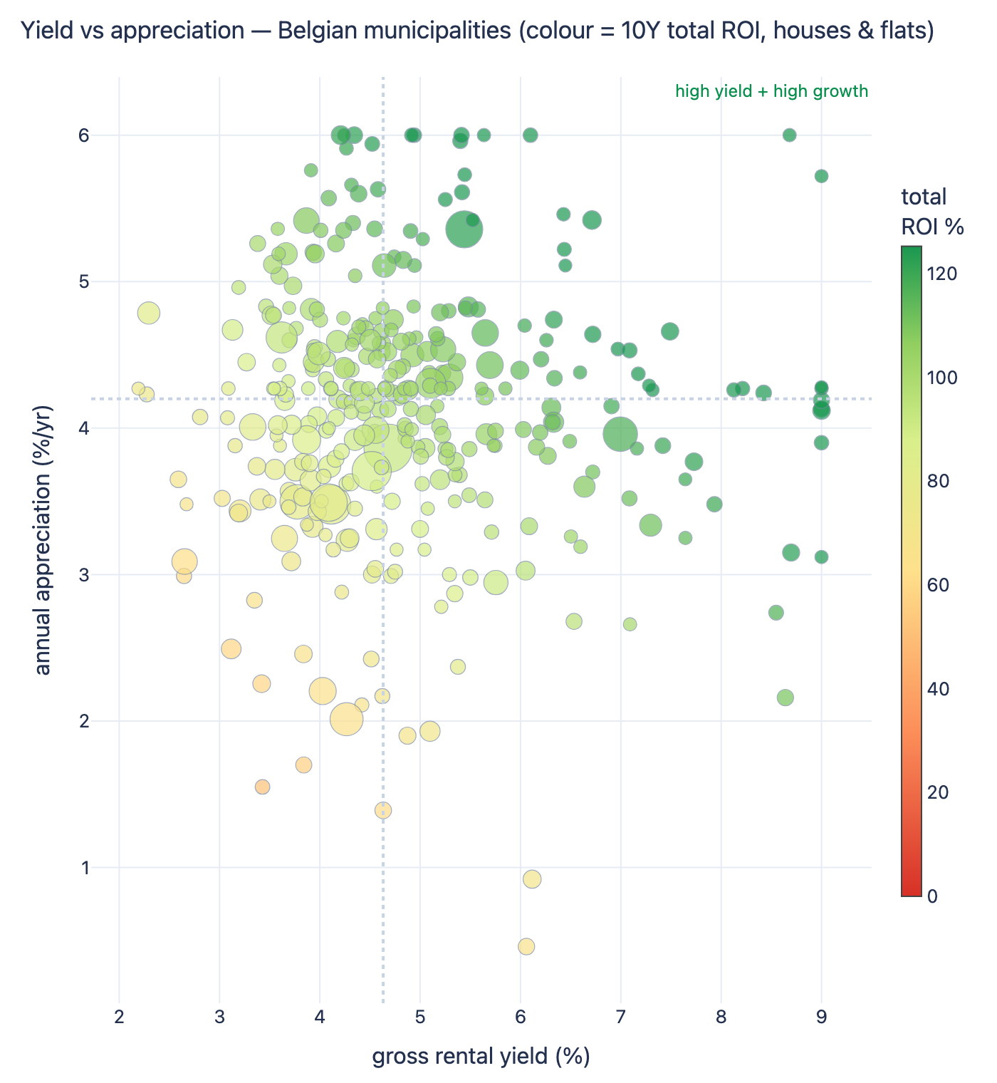
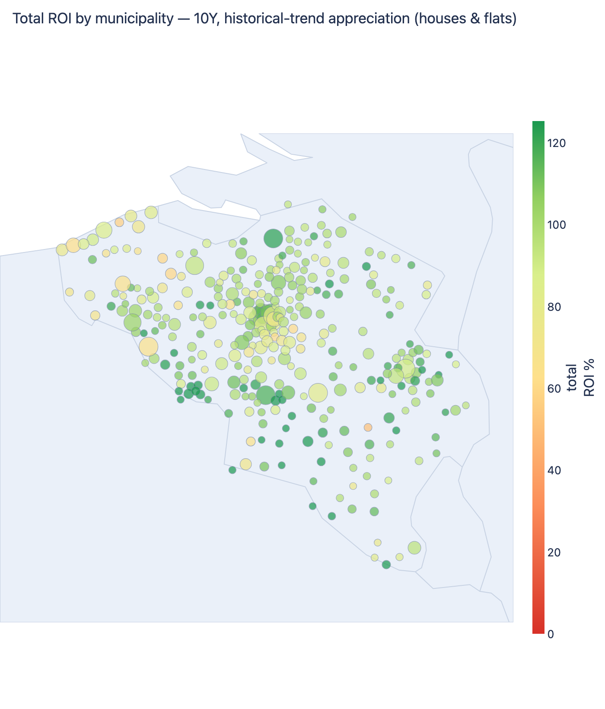
SECTION 3 · TOTAL ROI
Total ROI = rental yield + price appreciation
KEY INSIGHT
The winners sit top-right — high yield AND high growth — and they cluster in affordable Walloon markets. Greener on the map = better total ROI.
Immo Eliza · Belgian residential market
Alex · 11
Notes:
[Presenter 3 · 1:20] Putting it together. Left: every municipality on yield (x) vs appreciation (y), coloured by total ROI — top-right is the sweet spot. Right: the same total ROI on the map of Belgium — the greenest municipalities are the best buys. Both point to affordable Walloon markets.

Slide 13
SECTION 3 · RECOMMENDATION
Where & what to buy for the best total ROI
Top 5 municipality + property type by 10-year total ROI (rental yield + historical-trend appreciation)
1
Vresse-sur-Semois
House · Wallonia
166%
yield 8.6% · +6.0%/yr
KEY INSIGHT
Buy affordable HOUSES in high-yield, steadily-appreciating Walloon markets — then check liquidity before committing.
2
Florennes
House · Wallonia
164%
yield 9.0% · +5.7%/yr
3
Virton
House · Wallonia
152%
yield 7.2% · +6.0%/yr
4
Cerfontaine
House · Wallonia
142%
yield 9.0% · +4.3%/yr
EXPLORE LIVE
Interactive dashboard with drill-down by region, city & horizon:
reports/totalroi.html
5
Momignies
House · Wallonia
142%
yield 9.0% · +4.3%/yr
Immo Eliza · Belgian residential market
Alex · 12
Notes:
[Presenter 3 · 0:55] The answer for Léa: the best 10-year total ROI is in affordable Walloon houses where strong yield meets steady appreciation — led by Vresse-sur-Semois, Florennes and Virton (140–165% total ROI). Caveat: these are small markets, so check liquidity; larger cities like Charleroi and Namur also rank well. Everything is explorable in the interactive dashboard. Thank you.

Slide 14
Thank you
Total ROI = rental yield + property-value growth.
Explore every municipality: reports/totalroi.html
Questions?
Notes:
[All · 0:05] Q&A.

Slide 15
Appendix
Supporting detail charts

Slide 16
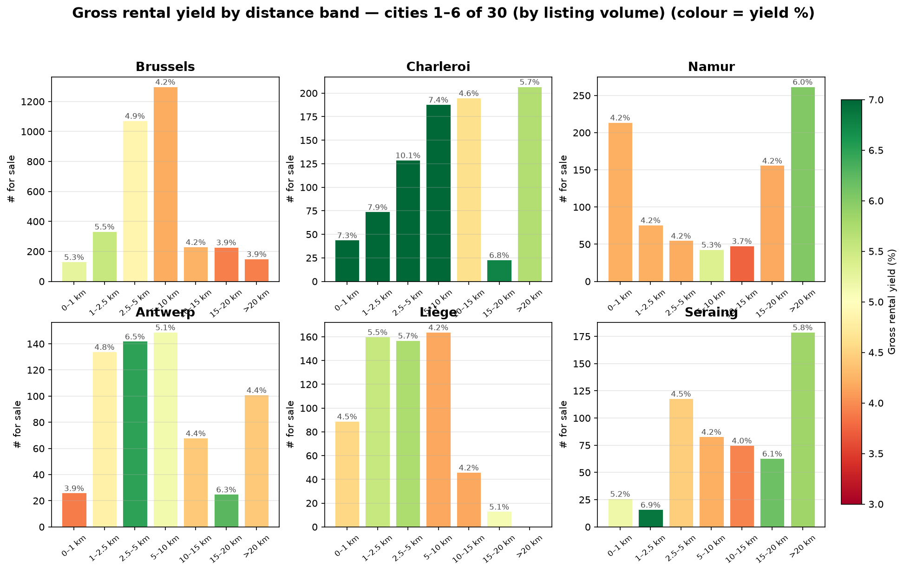
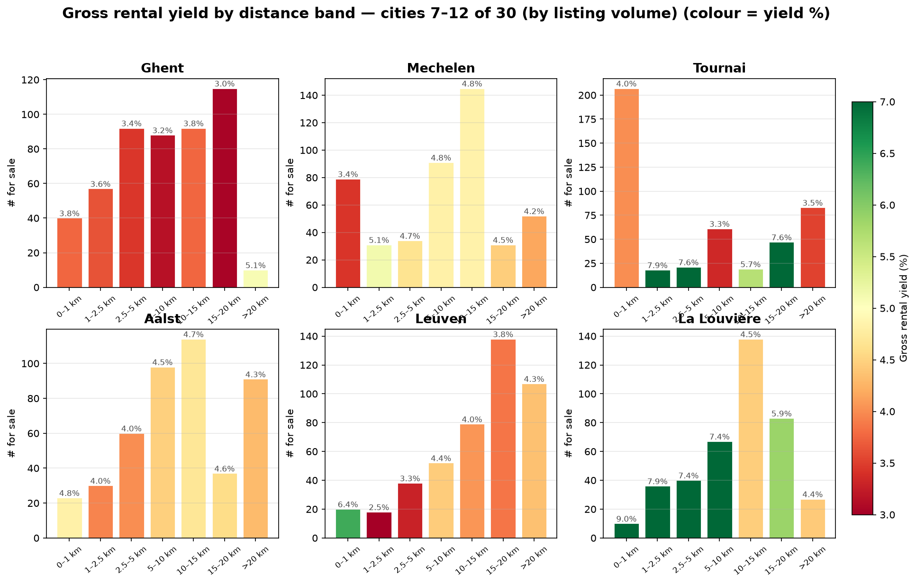
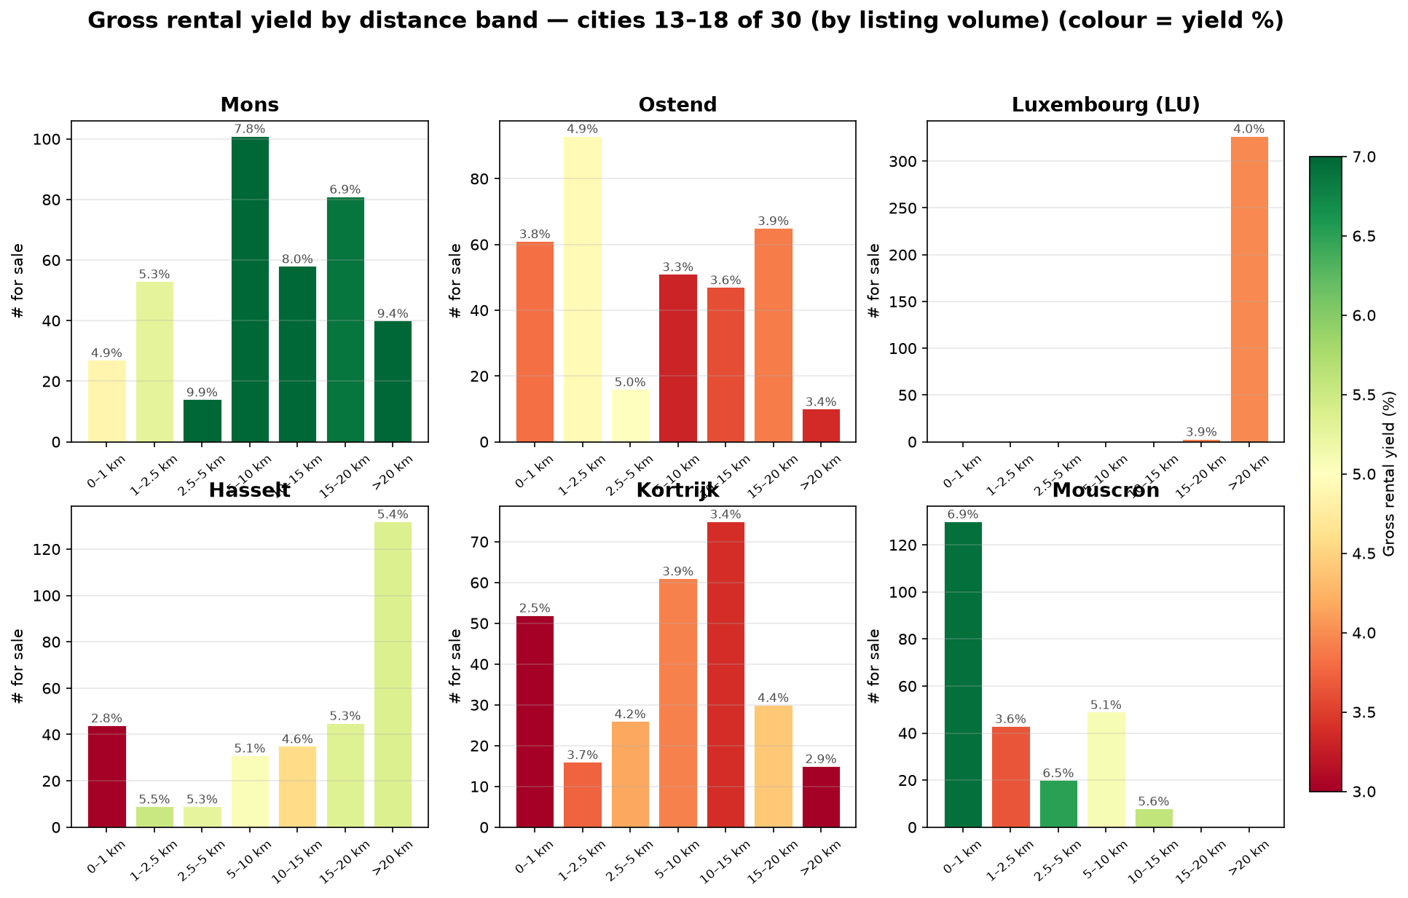
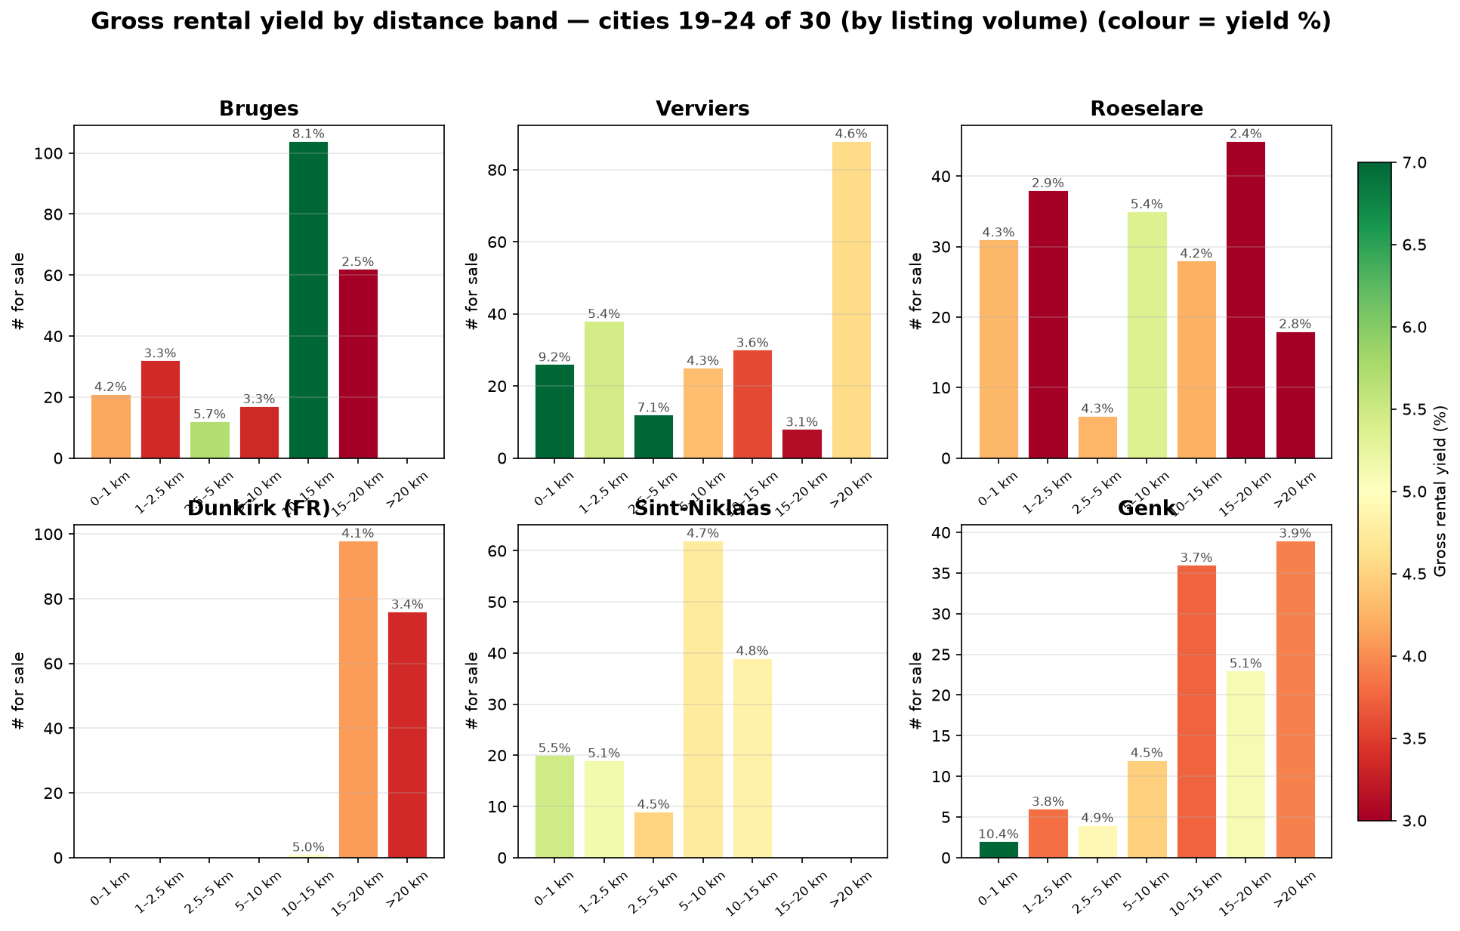
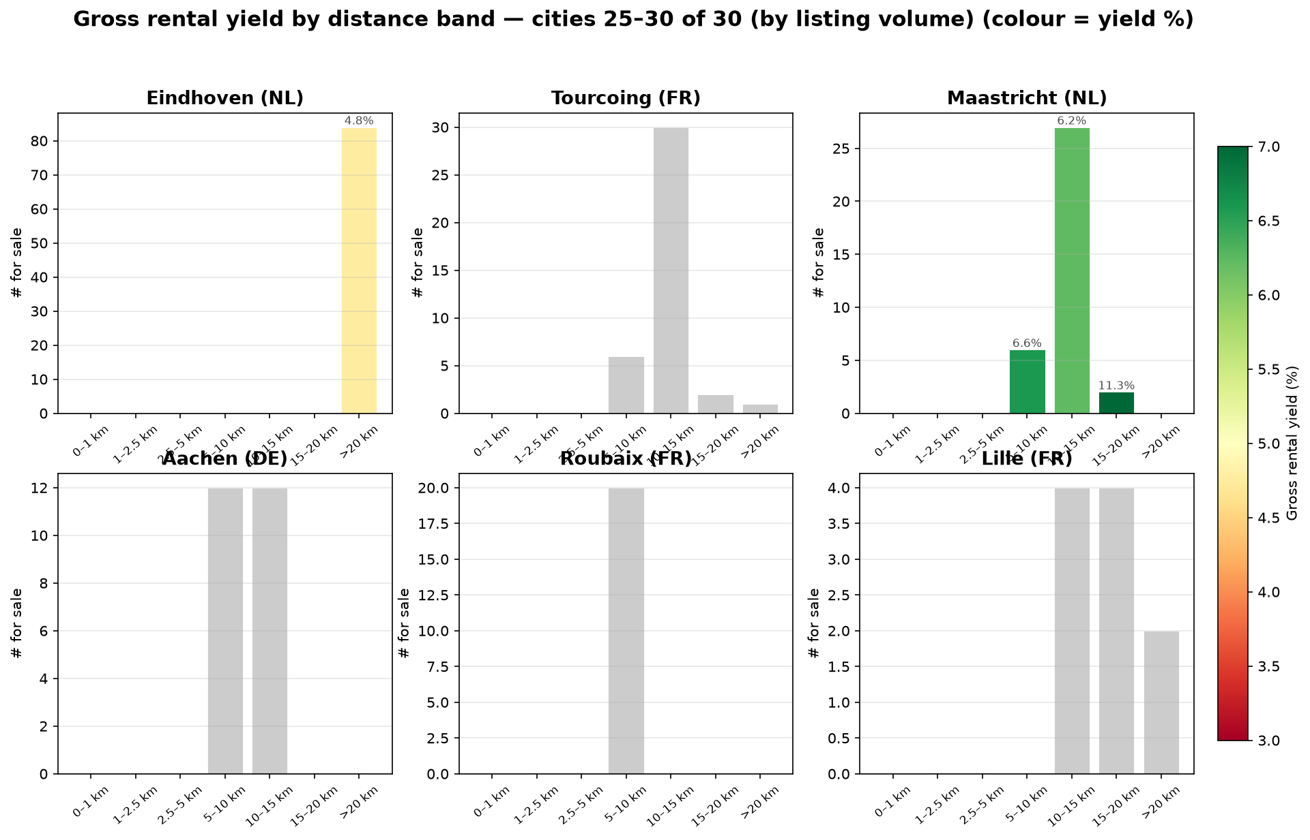
APPENDIX
Yield by distance band — all 30 nearest cities
Immo Eliza · Belgian residential market
— · A2

Slide 17
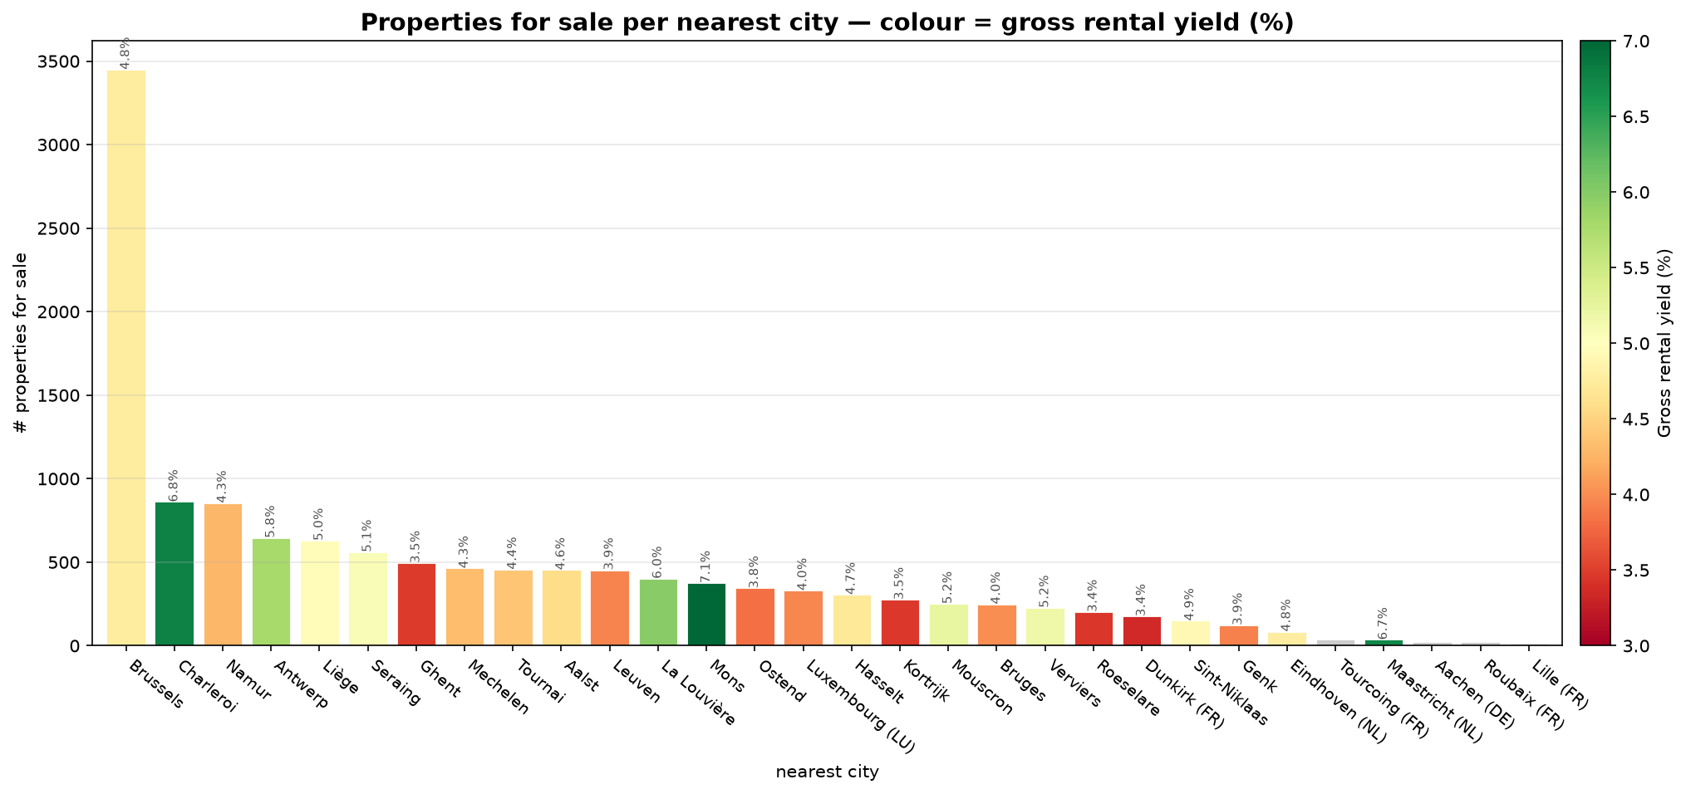
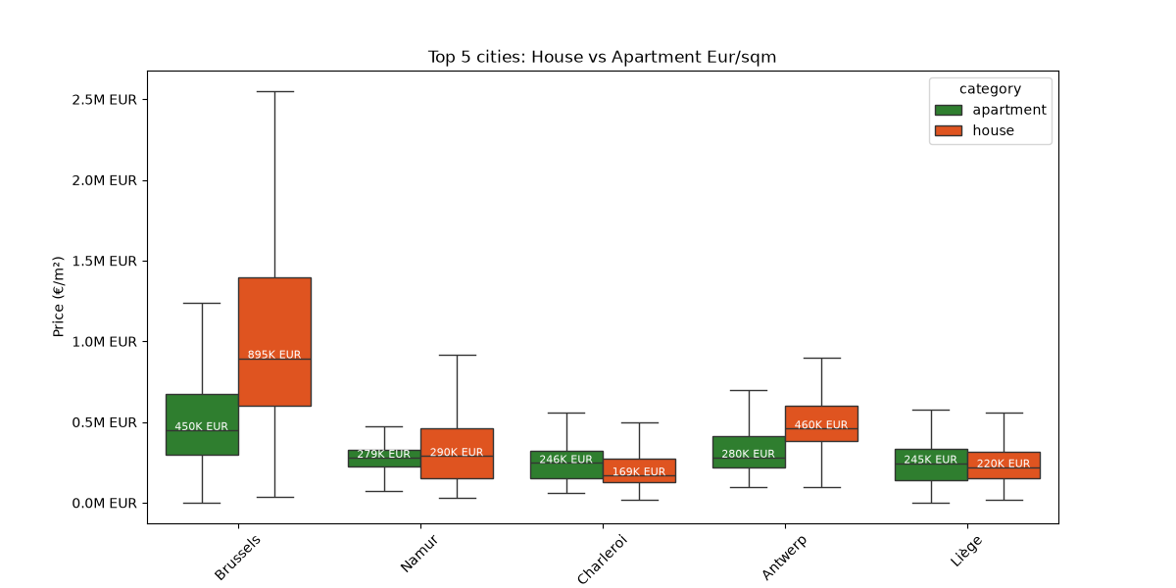
APPENDIX
Supporting market views
Immo Eliza · Belgian residential market
— · A3

