Slide 1
KEYLOGGER PROJECT
CAPSTONE PROJECT
Presented By:
B.MAHALAKSHMI - CEG(College of Engineering Guindy)
ROLL.NO: 2021115058

Slide 2
OUTLINE
Problem Statement
Proposed System/Solution
System Development Approach
Algorithm & Deployment
Result (Output Image)
Conclusion
Future Scope
References

Slide 3
Problem Statement
Example: In today's digital age, where cybersecurity threats loom large, one of the significant concerns is the proliferation of keyloggers, stealthy software tools designed to monitor and record keystrokes on a user's computer without their knowledge. Keyloggers pose a severe threat to individuals and organizations as they can capture sensitive information such as passwords, credit card details, and other personal data, leading to identity theft, financial loss, and privacy breaches.

Slide 4
Proposed Solution
Design and Planning:
Clearly define the objectives and scope of the keylogger system, including its intended use and ethical considerations.
Determine the target platform(s) for the keylogger (e.g., Windows, macOS, Linux) and the programming language to be used (e.g., Python, C++).
Data Collection:
Identify the data to be captured by the keylogger, such as keystrokes, timestamps, and window titles.
Implement functions to capture and store the collected data securely, considering privacy and security concerns.
Data Preprocessing:
Clean and preprocess the captured data to remove any sensitive or irrelevant information.
Encrypt the stored data to ensure confidentiality and integrity.
Stealth Mode Implementation:
Implement techniques to run the keylogger in stealth mode to avoid detection by users and antivirus software.
Hide the keylogger process from task managers and system monitoring tools.

Slide 5
Proposed Solution
Logging and Storage:
Develop a logging mechanism to store the captured data locally or remotely, depending on the requirements.
Implement features to periodically upload the logged data to a secure server or cloud storage for remote access.
Error Handling and Reliability:
Implement robust error handling mechanisms to handle exceptions and ensure the reliability of the keylogger.
Monitor system resources and disk space to prevent crashes or data loss due to resource exhaustion.
Testing and Evaluation:
Conduct extensive testing of the keylogger in various scenarios to ensure its functionality and reliability.
Evaluate the performance of the keylogger in terms of data capture accuracy, stealthiness, and resource usage.
Documentation and Compliance:
Document the keylogger system thoroughly, including its design, implementation details, and usage instructions.
Ensure compliance with relevant laws and regulations governing the creation and use of keyloggers, including obtaining proper authorization and consent.

Slide 6
System Approach
The "System Approach" section outlines the overall strategy and methodology for developing and implementing the rental bike prediction system. Here's a suggested structure for this section:
System requirements
Library required to build the model
python idle
module -pynput,jsonlib

Slide 7
Algorithm & Deployment
This Python code creates a basic keylogger using the pynput library and a simple GUI built with tkinter. Let's break down the algorithm and approach used in this code:
Import Required Libraries:
The code imports necessary libraries including tkinter for GUI, keyboard from pynput for capturing keyboard events, and json for handling JSON data.
Global Variables:
keys_used: List to store information about the pressed, held, and released keys.
flag: Boolean variable to track whether a key is being held.
keys: String variable to store the sequence of keys pressed.
Functions:
generate_text_log(key): Writes the pressed keys to a text file named "key_log.txt".
generate_json_file(keys_used): Writes the captured keys to a JSON file named "key_log.json".
on_press(key): Callback function invoked when a key is pressed. It adds the pressed or held key to the keys_used list and generates the JSON file.
on_release(key): Callback function invoked when a key is released. It adds the released key to the keys_used list, updates the keys string, and generates both text and JSON log files.
start_keylogger(): Initiates the keylogger by starting the listener and updating the GUI.
stop_keylogger(): Stops the keylogger by stopping the listener and updating the GUI.

Slide 8
GUI Creation:
Creates a simple GUI window using tkinter with two buttons: "Start" and "Stop", and a label to display the keylogger status.
Main Functionality:
When the "Start" button is clicked, it starts the keylogger by calling start_keylogger().
When the "Stop" button is clicked, it stops the keylogger by calling stop_keylogger().
Event Handling:
The keylogger captures keyboard events using the pynput library's Listener class.
The on_press() and on_release() functions are invoked when a key is pressed and released, respectively.

Slide 9
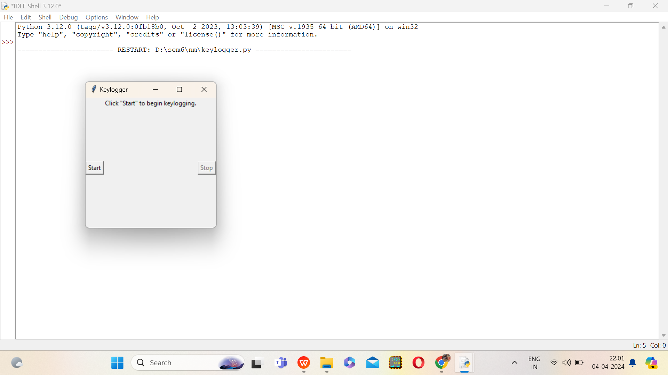
Result

Slide 10
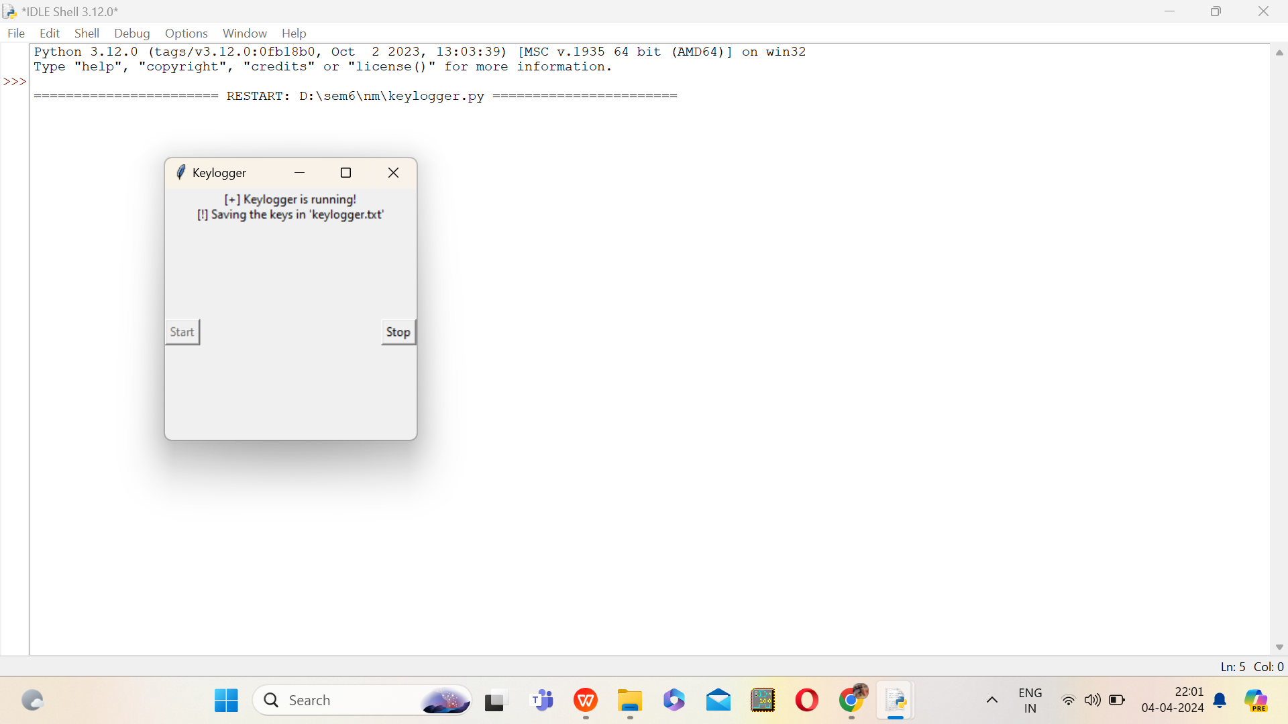
starting the keylogger

Slide 11
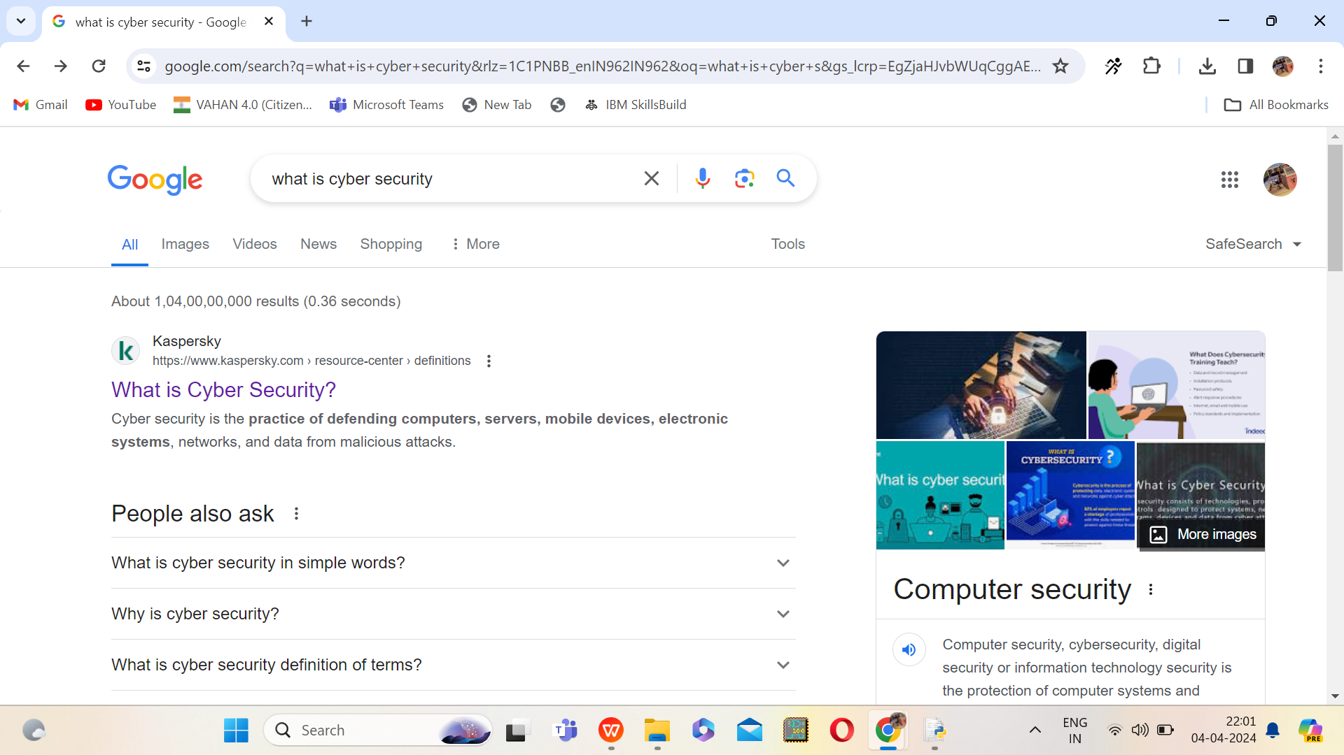
searching in the web using input from keyboard

Slide 12
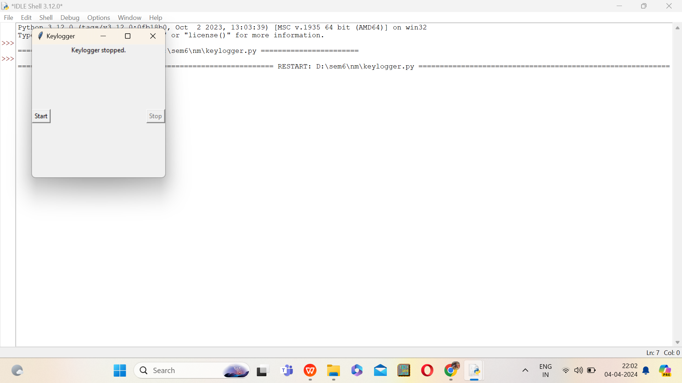
stopping the keylogger

Slide 13
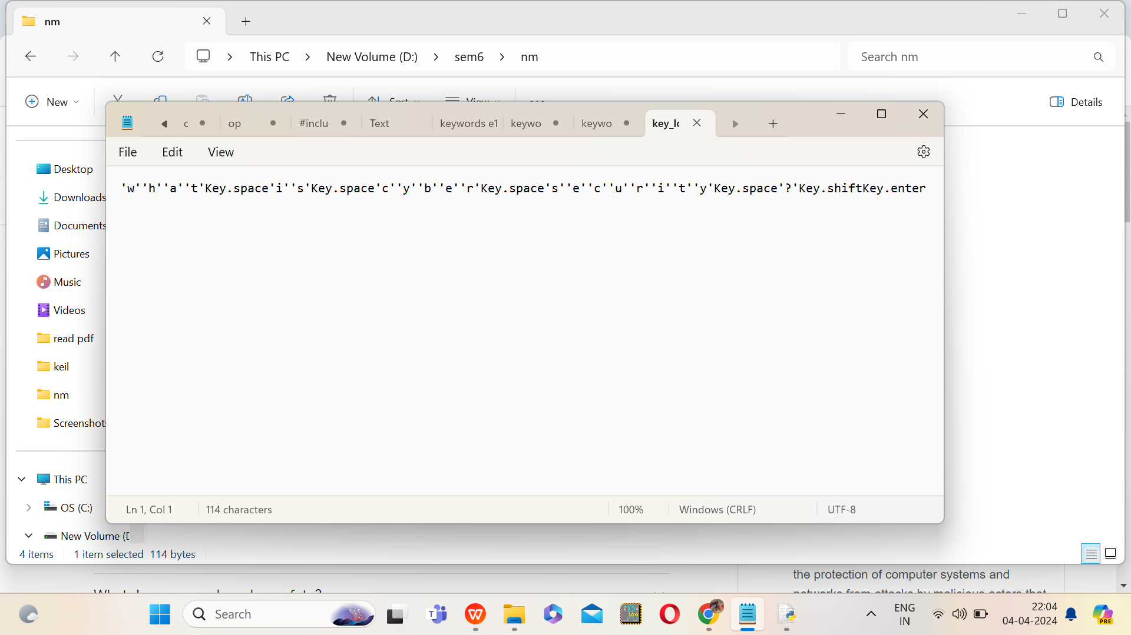
checking the keylog text file that has stored the keyboard values

Slide 14
Conclusion
The provided Python code presents a basic implementation of a keylogger using the pynput library for capturing keyboard events and tkinter for creating a simple GUI interface. The keylogger effectively records pressed, held, and released keys, storing the data in both text and JSON formats. It offers functionality to start and stop the keylogging process through the GUI, providing users with a straightforward means of controlling the logger.
While the current implementation fulfills its primary objective of logging keystrokes, there are several areas for improvement and expansion to enhance its functionality and usability.

Slide 15
Future scope
Enhanced Stealth Mode: Implement advanced techniques to make the keylogger more discreet, such as hiding its presence from antivirus software, using rootkit-like methods, or encrypting its executable file.
Remote Monitoring: Extend the keylogger's capabilities to enable remote monitoring of captured keystrokes. Implement functionality to transmit logged data securely to a remote server, allowing users to access the data from anywhere.
User Activity Logging: Expand the keylogger to capture additional user activity beyond keystrokes, such as mouse clicks, clipboard contents, or application usage.
Data Analysis and Visualization: Integrate data analysis and visualization capabilities to provide users with insights into their typing behavior, frequency of key presses, or most commonly used applications.
Security Enhancements: Implement robust security measures to protect the logged data from unauthorized access or tampering, including encryption, access control, and secure transmission protocols.
Cross-Platform Support: Extend the keylogger's compatibility to support multiple operating systems, such as macOS and Linux, in addition to Windows.

Slide 16
References
Research Papers and Journals:
"A survey of keyloggers, detection and defence mechanisms" by Fadia Al Banaa and Thomas Owens (Journal of Information Security and Applications, Volume 39, 2018)
"Keylogging attacks and defences: A survey" by Alan Bartlett, Shirley Atkinson, and John N. Davies (Journal of Cyber Security Technology, Volume 1, 2017)
"A Comprehensive Review on Keyloggers and Their Detection Techniques" by Rana Moustafa and Sherif Elfayoumy (International Journal of Computer Applications, Volume 108, 2014)

Slide 17
THANK YOU

