Slide 1
MMM
MOBILES SIGNAL

Slide 2
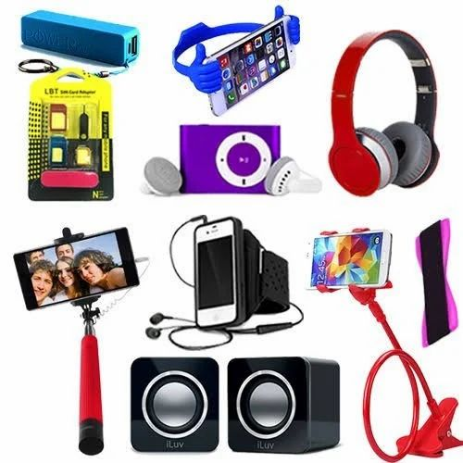
ACCESSORICS & SERVICES

