Slide 1


Kuna:
Building a Competitive C Decompiler Through Autonomous AI Research
Zion Leonahenahe Basque
Assistant Professor, University of Georgia

Slide 2

BUG ARE EVERYHWHERE!!1!

Slide 3
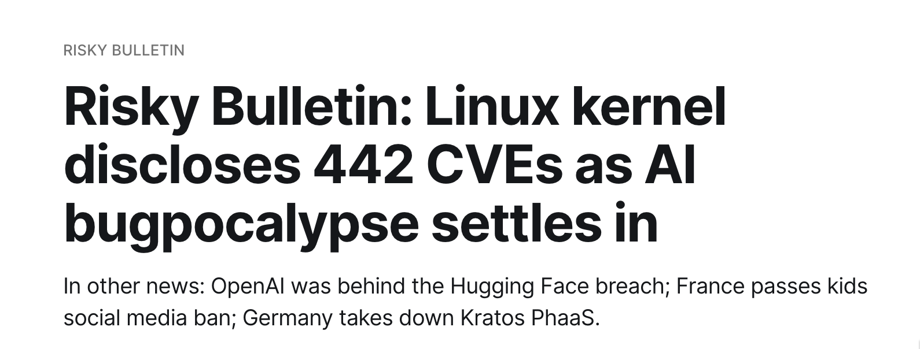

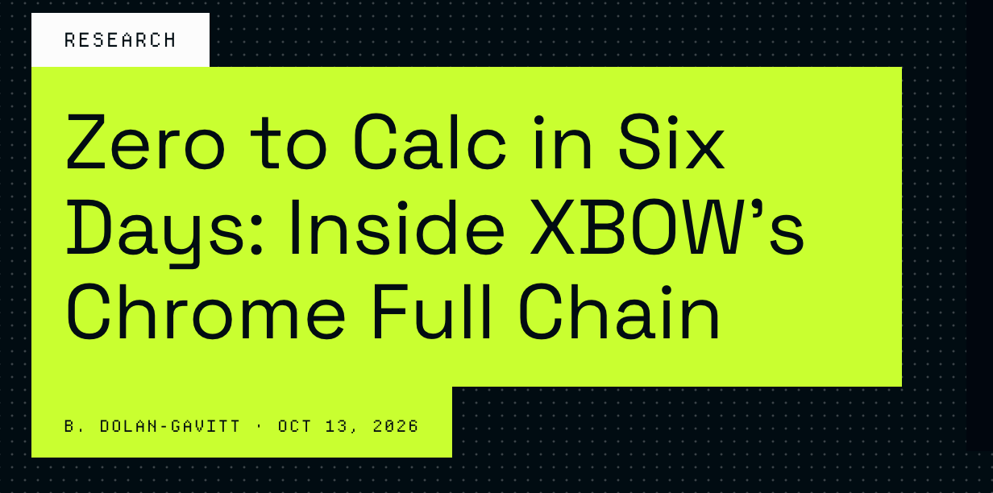
LLMs and Source Code

Slide 4

What About Closed-Source Binaries?

Slide 5



What About Closed-Source Binaries?

Slide 6
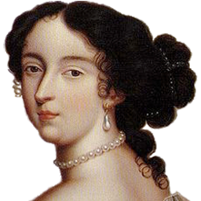



LLMs and Binaries
Decompiler
Binary

Slide 7
LLMs and Binaries and Less Bugs ☹
Decompiler
Binary

Slide 8

LLMs and Decompilers
DARPA AIxCC Nginx Dataset
gpt-5

Slide 9
Decompilers are flawed!

Slide 10
Source Code
Modern Decompilation
int main (int argc, char **argv) { // ... switch (optchar) { default: // ... case 'c': // ... case 's': // ... case 't': // ... case 'u': // ... case 'w': // ... case 'g': // ... case 'p': // ... case_GETOPT_HELP_CHAR; // ... case_GETOPT_VERSION_CHAR(...); // ... } // ... }
int __cdecl main(int a1, int *a2, int *a3) { // ... if ( v8 == 112 ) { // ... } else if ( v8 <= 112 ) { if ( v8 == -130 ) // ... if ( v8 <= -130 ) { if ( v8 == -131 ) { // ... } LABEL_53: // ... } if ( v8 == 99 ) { // ... } else { if ( v8 != 103 ) goto LABEL_53; // ... } }

Slide 11
else if ( v8 == 116 ) { // ... } else if ( v8 <= 116 ) { if ( v8 != 115 ) goto LABEL_53; // ... } else if ( v8 == 117 ) { // ... } else { if ( v8 != 119 ) goto LABEL_53; // ... } // ... }

Slide 12
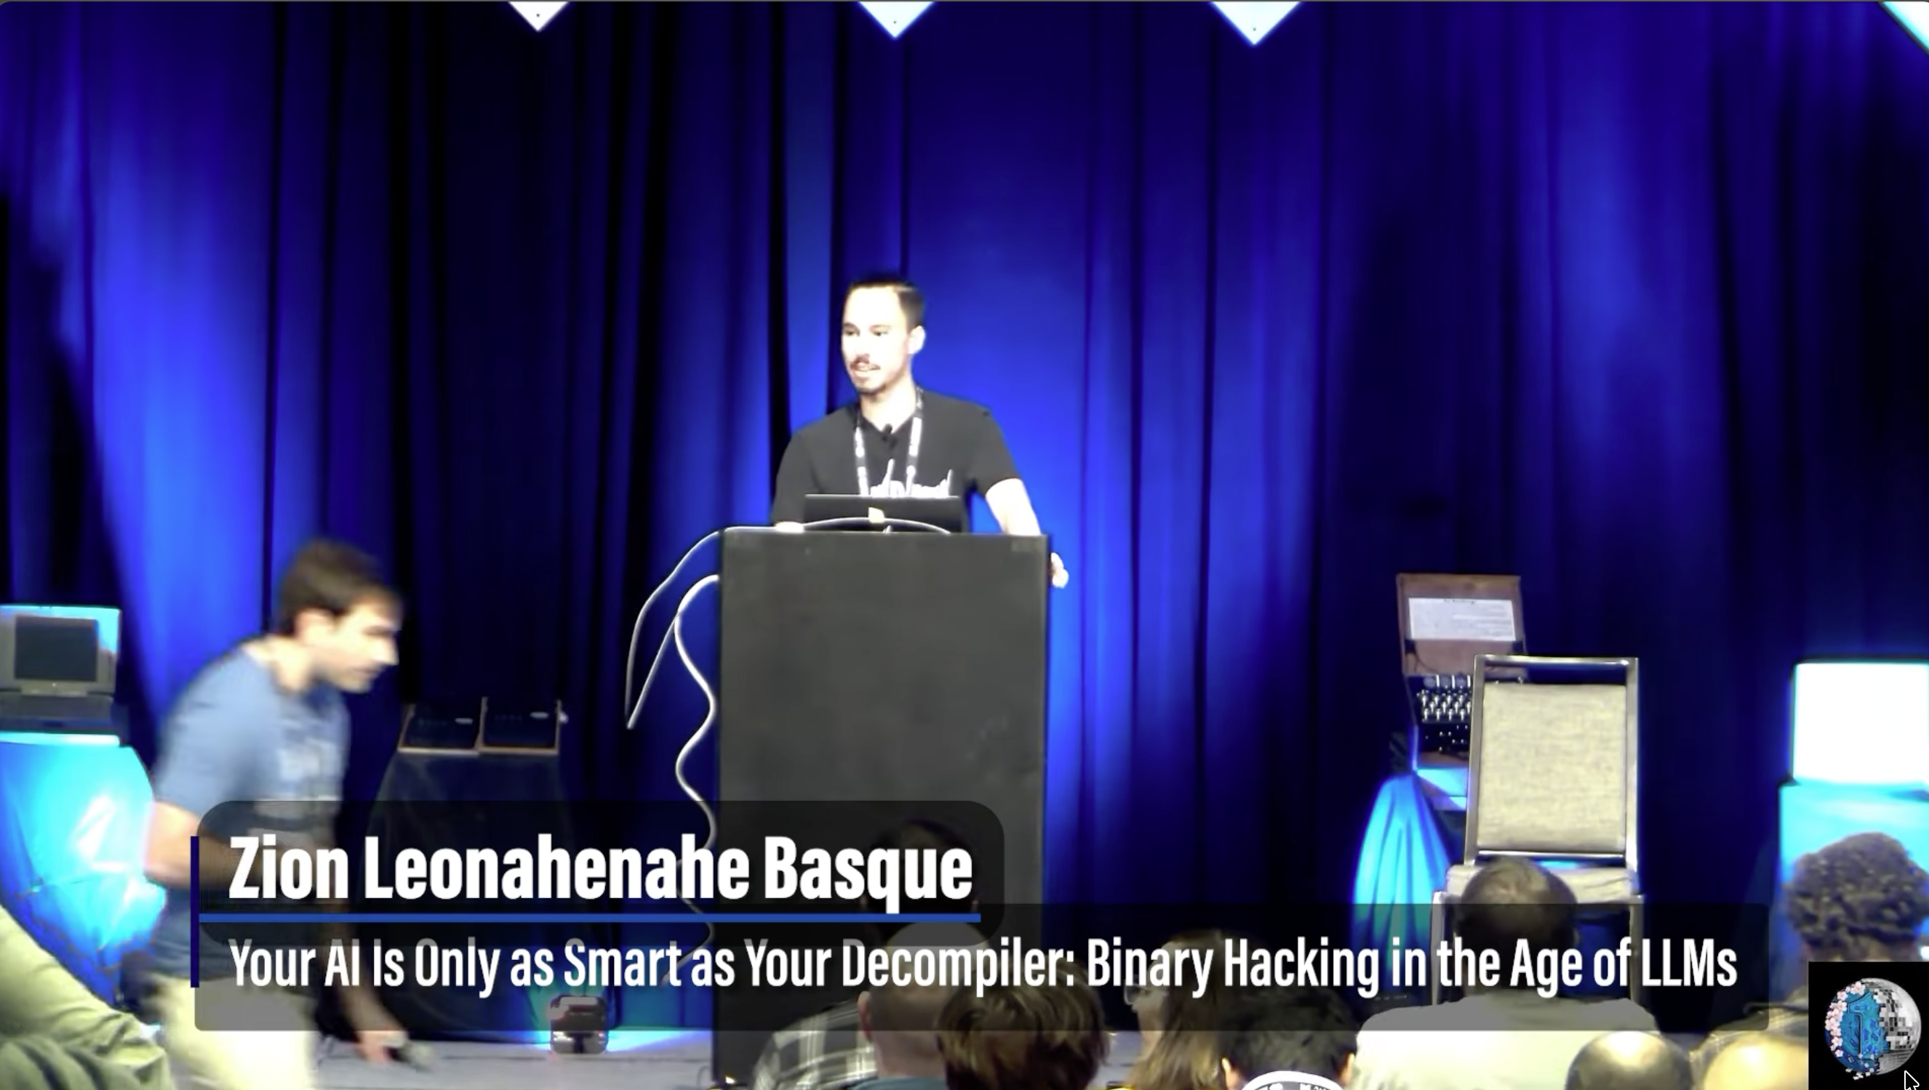
else if ( v8 == 116 ) { // ... } else if ( v8 <= 116 ) { if ( v8 != 115 ) goto LABEL_53; // ... } else if ( v8 == 117 ) { // ... } else { if ( v8 != 119 ) goto LABEL_53; // ... } // ... }
https://www.youtube.com/watch?v=ncYo6ZqSRLw

Slide 13
else if ( v8 == 116 ) { // ... } else if ( v8 <= 116 ) { if ( v8 != 115 ) goto LABEL_53; // ... } else if ( v8 == 117 ) { // ... } else { if ( v8 != 119 ) goto LABEL_53; // ... } // ... }
https://www.youtube.com/watch?v=ncYo6ZqSRLw
NP-Hard

Slide 14


Can we do better with
AI Agents?

Slide 15


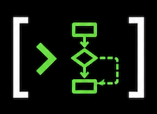
Autonomous Refinement
1. Agent Friendly Base
2. Dataset Hill Climbing
Dataset
Targeted Edits
Scoring
(distance to source)
350k Lines of Rust
(Kuna v0)
https://decbench.com

Slide 16

Source
if (!x) return -1; if (!foo(x)) return -2; return 0;

Slide 17
Source
Decompiler
if (!x) v1 = -1; if (!foo(x)) v1 = -2; v1 = 0 return v1;
if (!x) return -1; if (!foo(x)) return -2; return 0;

Slide 18
Source
Decompiler
if (!x) v1 = -1; if (!foo(x)) v1 = -2; v1 = 0 return v1;
if (!x) return -1; if (!foo(x)) return -2; return 0;
2 Edits

Slide 19
Source
Decompiler
if (!x) v1 = -1; if (!foo(x)) v1 = -2; v1 = 0 return v1;
if (!x) return -1; if (!foo(x)) return -2; return 0;
2 Edits

Slide 20
”Get our decompiler to a 0 distance”
Source
Decompiler
if (!x) v1 = -1; if (!foo(x)) v1 = -2; v1 = 0 return v1;
if (!x) return -1; if (!foo(x)) return -2; return 0;
2 Edits

Slide 21
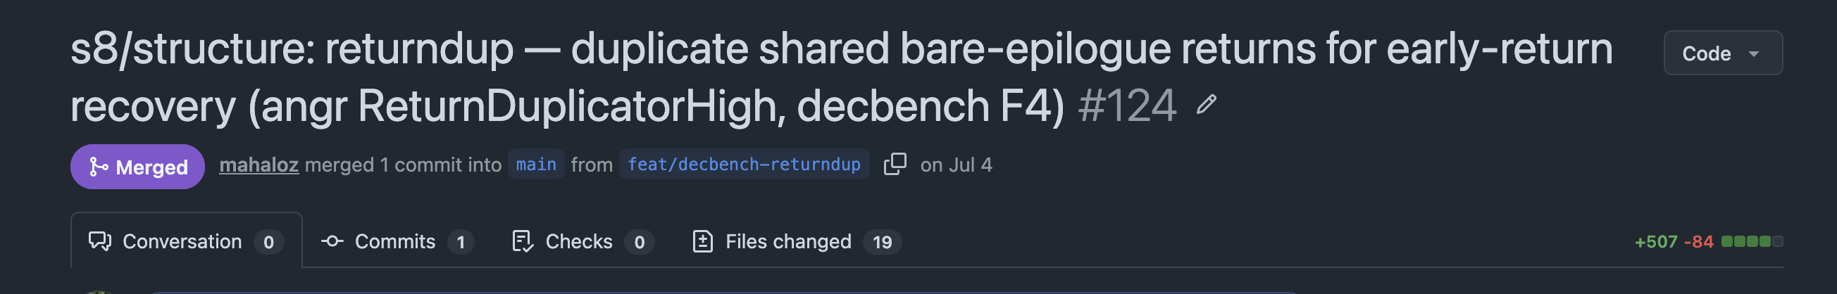
”Get our decompiler to a 0 distance”
Source
Decompiler
if (!x) return -1; if (!foo(x)) return -2; return 0;
if (!x) return -1; if (!foo(x)) return -2; return 0;
2 Edits
1 PR

Slide 22
Results

Slide 23

Exact Source Recovery on 34k C Samples

Slide 24
Exact Source Recovery on 34k C Samples
20 years?
10 years
30 years

Slide 25
Exact Source Recovery on 34k C Samples
20 years?
10 years
30 years
5 months

Slide 26
Exact Source Recovery on 34k C Samples
20 years?
10 years
30 years
5 months
37% Improvement

Slide 27
Exact Source Recovery on 34k C Samples
20 years?
10 years
Novelty?
30 years
5 months
37% Improvement

Slide 28
Adoption
2k Monthly Web GUI Users
2.5k Monthly CLI Installs
Adopted by REA (https://github.com/morluto/rea)
Adopted by other orgs that can’t be listed (yet!)

Slide 29
DEMO

Slide 30
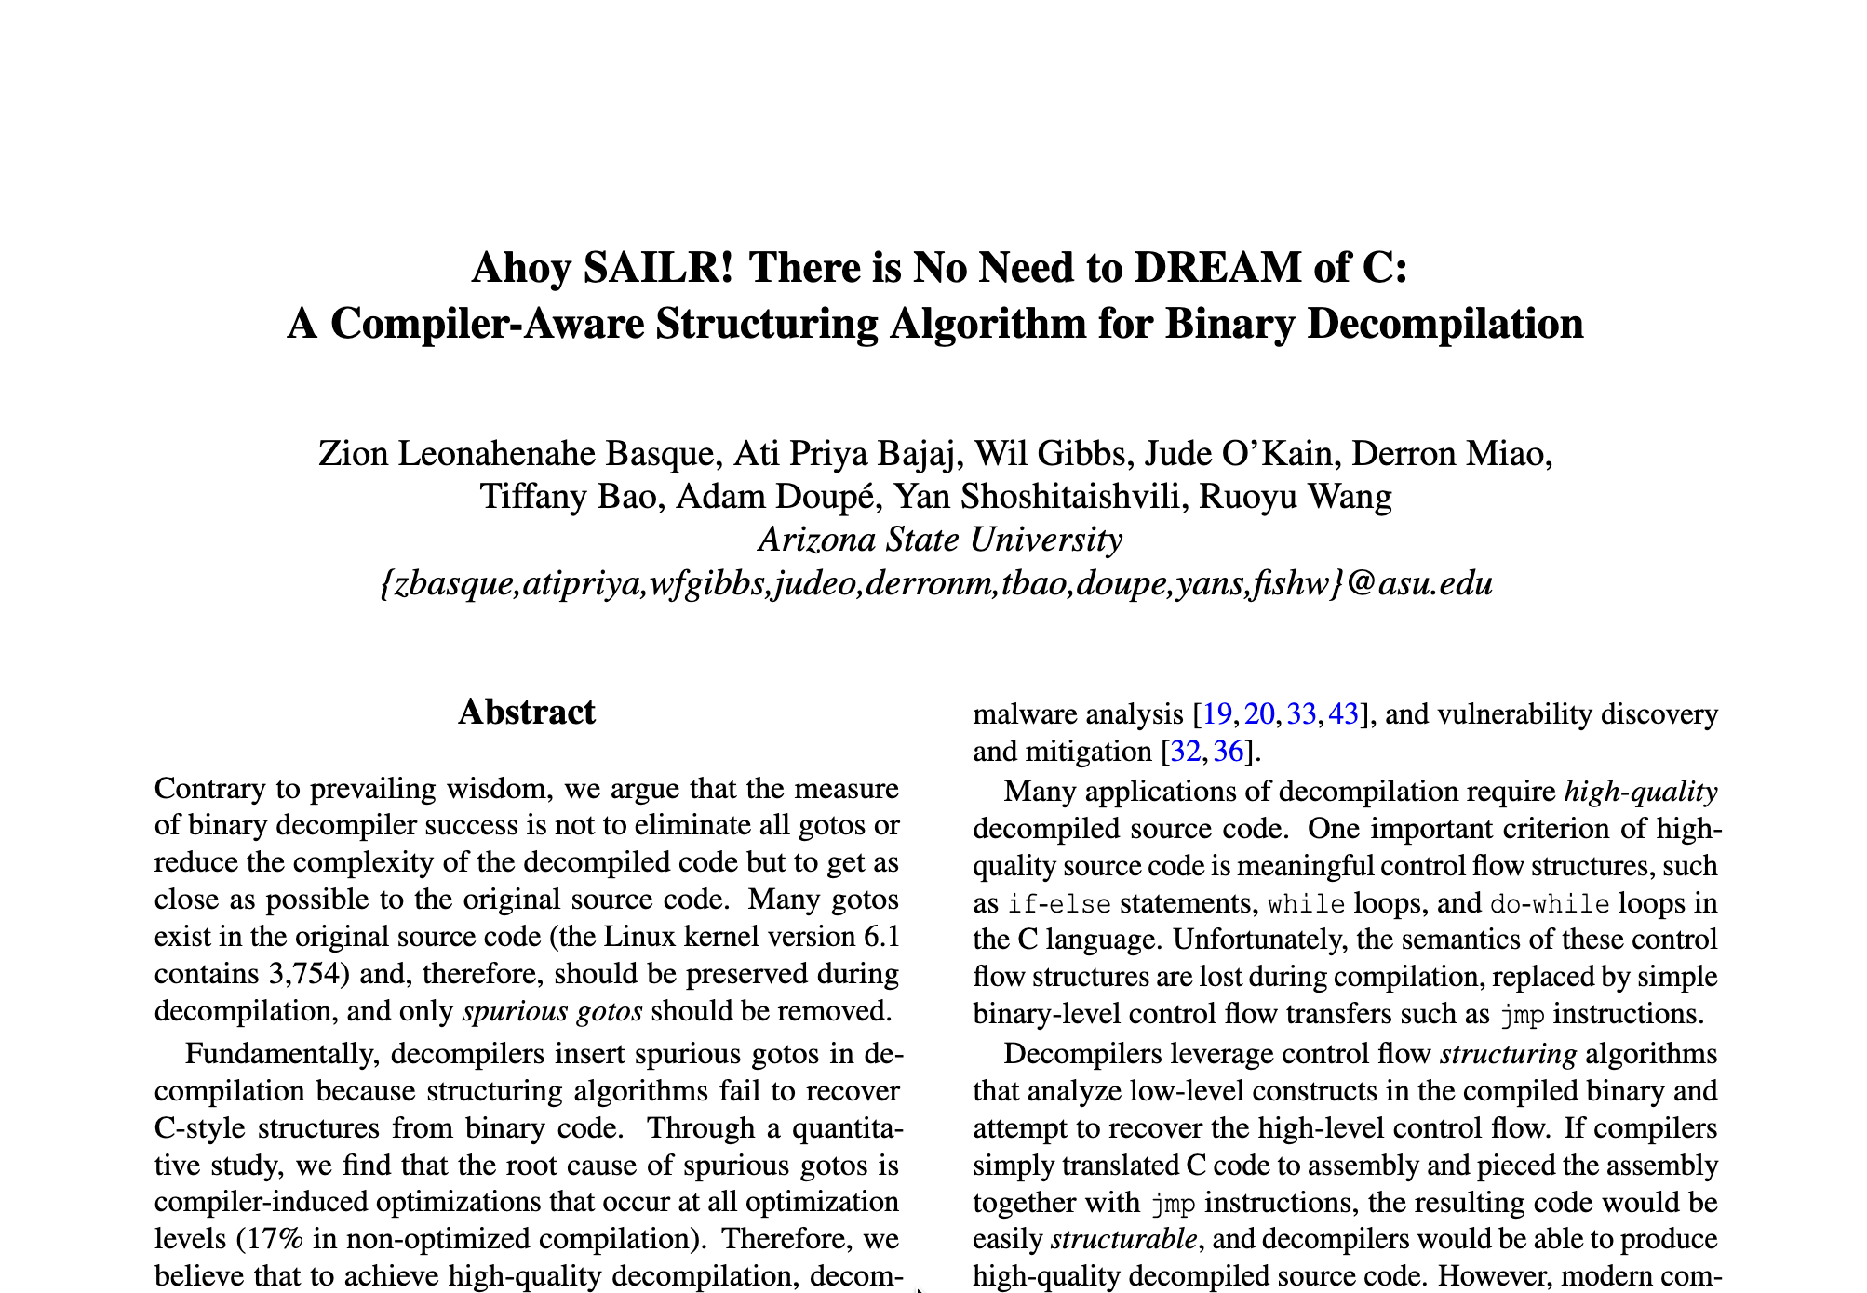
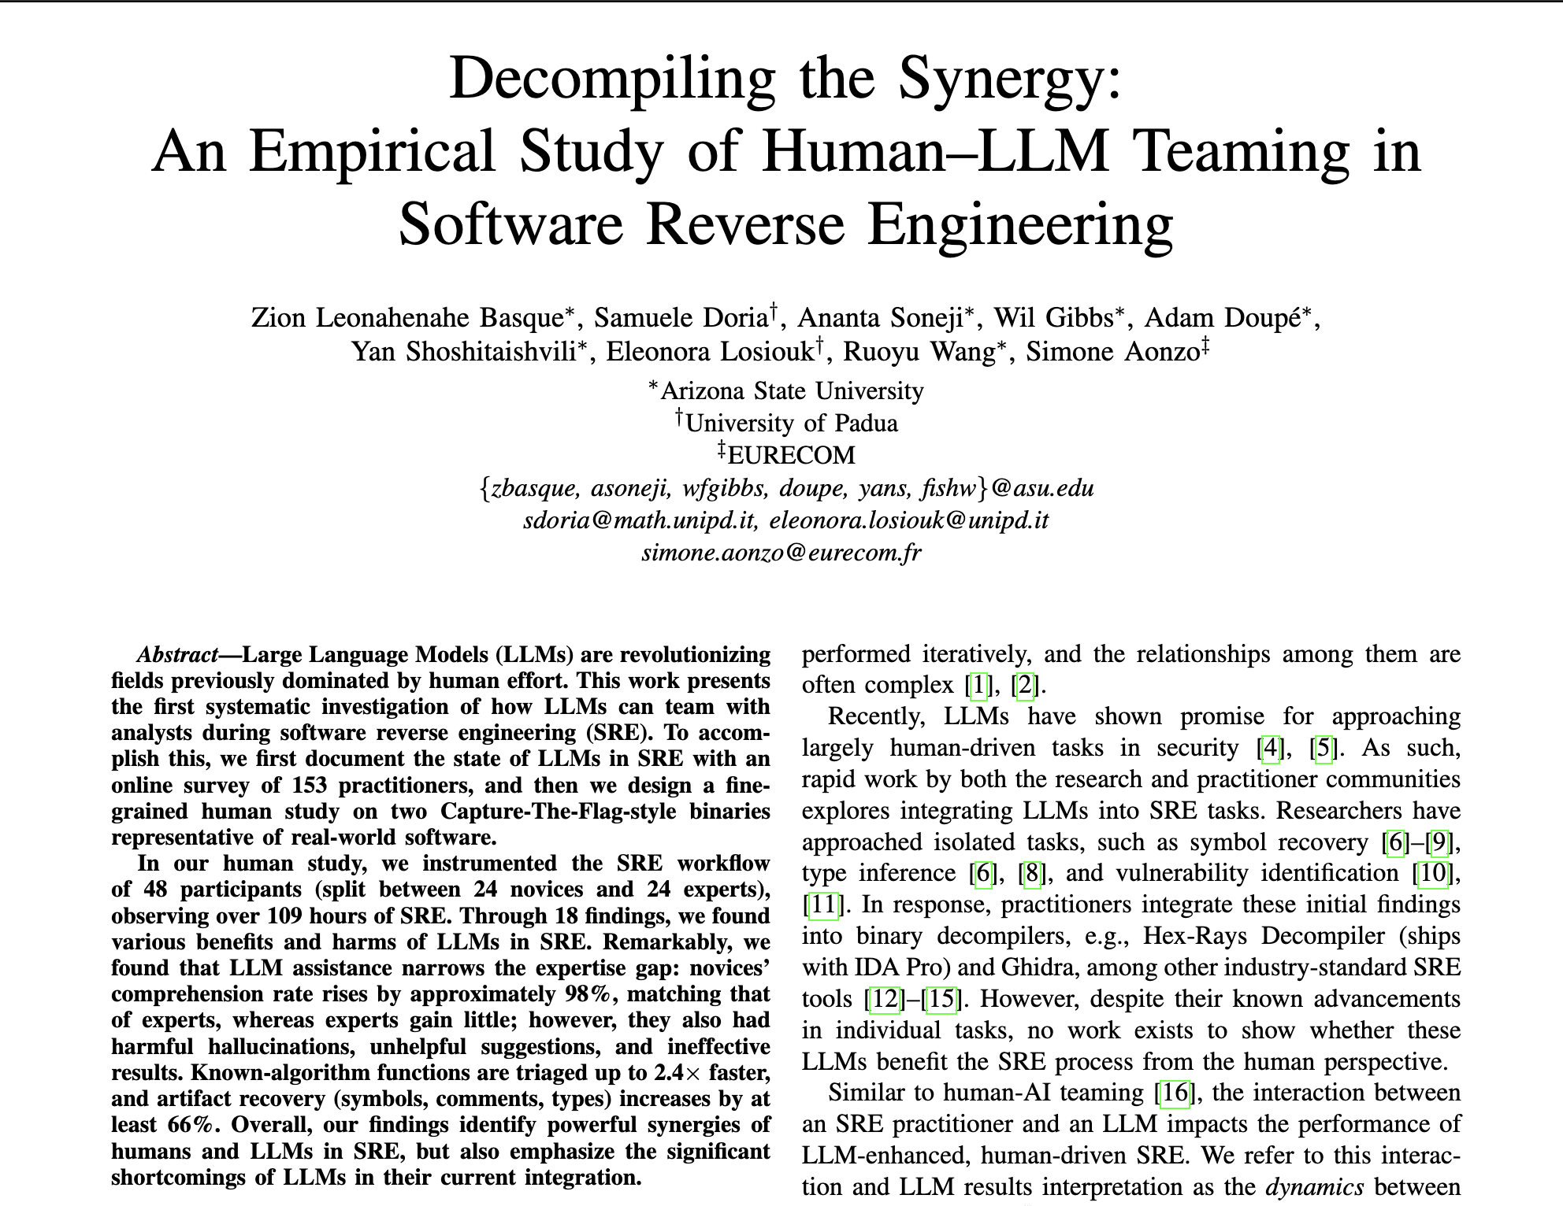
How: Years of Research Work
And… about 15 other papers from more researchers!
https://decompilation.wiki/#decompilation-paper-list

Slide 31
Starting with Known Features
Attributed Source of Kuna’s Developed Features
Self | Ghidra | angr | Hex-Rays | Binja
217 | 44 | 39 | 24 | 2

Slide 32

Starting with Known Features
Attributed Source of Kuna’s Developed Features
Self | Ghidra | angr | Hex-Rays | Binja
217 | 44 | 39 | 24 | 2

Slide 33
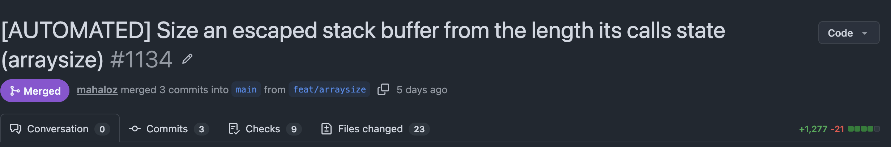
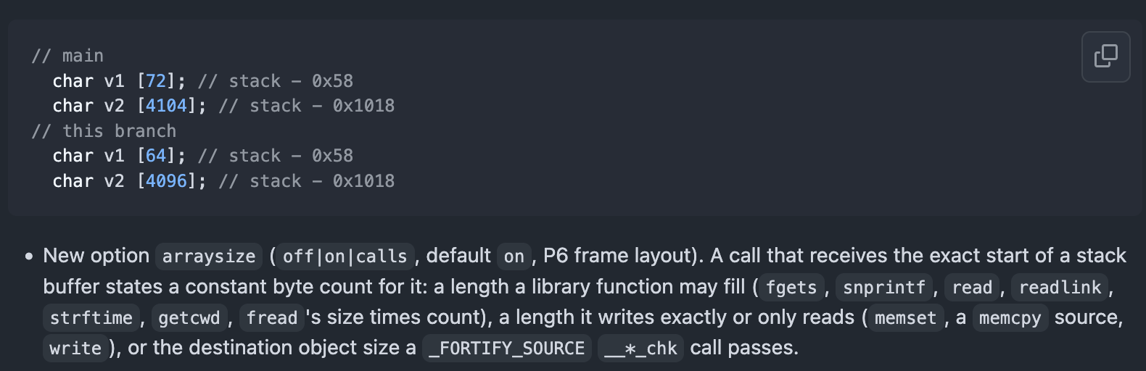
Stacking Small (Novel) Wins
Across 15+ PRs, improve type accuracy by x2
https://github.com/Noelo-Lab/kuna/pull/1134
https://github.com/Noelo-Lab/kuna/pull/771
claude-opus-4-8, 5, 5.5

Slide 34
Where are the Fundamental Wins?
LLMs have avoided serious changes
Foundational problems:
  Inlining
  Deep Multi-Language Support
  Boolean Simplification
  …

Slide 35
Next Phase: Investigating Foundational Changes
Maybe formally proven decompilation can solve this!

Slide 36

Mahalo(z)!
Zion Leonahenahe Basque
Assistant Professor, University of Georgia
https://decompile.run/
https://github.com/noelo-lab/kuna
https://zionbasque.com
Check them out!

Slide 37
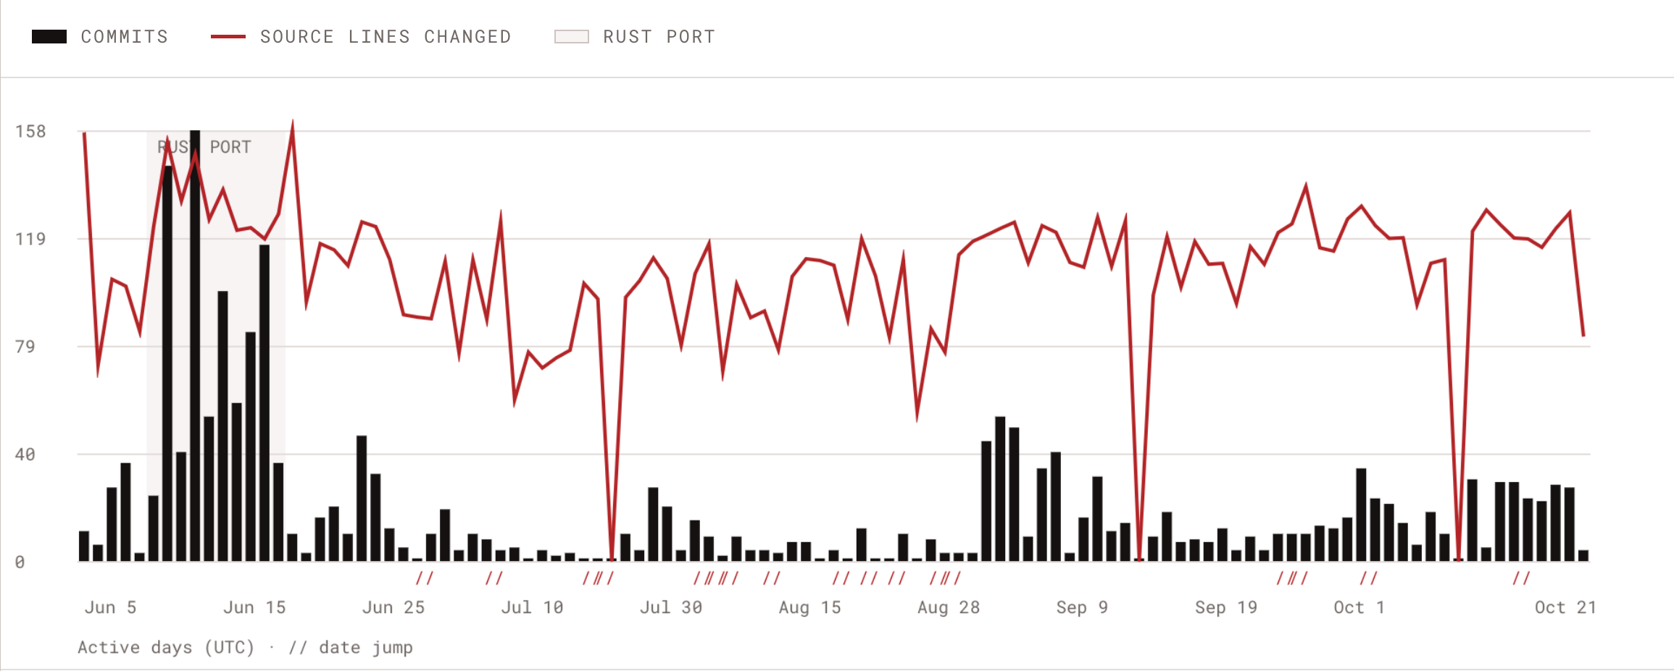
Climbing: Commits
claude-opus-4-8, 5, 5.5

Slide 38
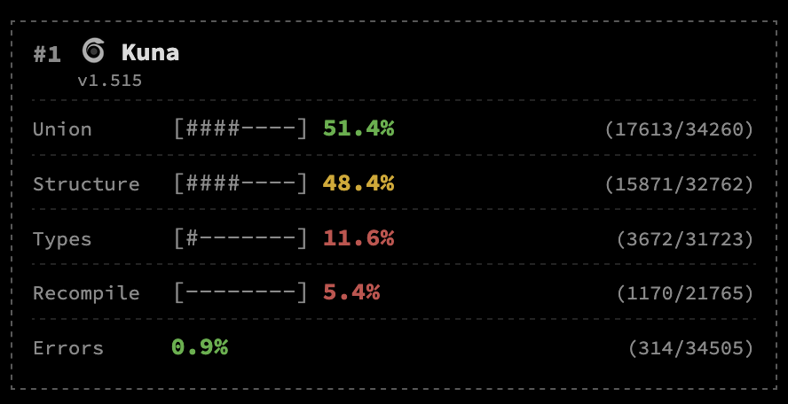
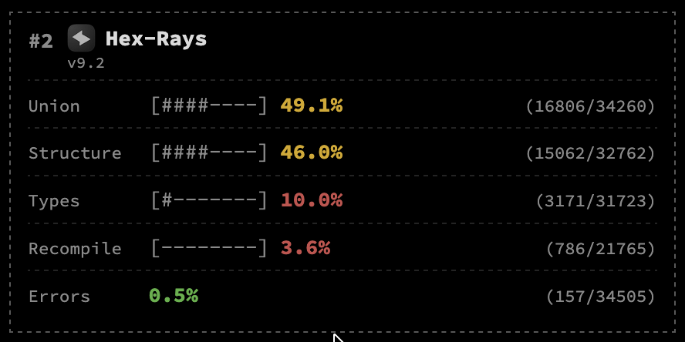
Climbing: All Metrics
claude-opus-4-8, 5, 5.5

Slide 39
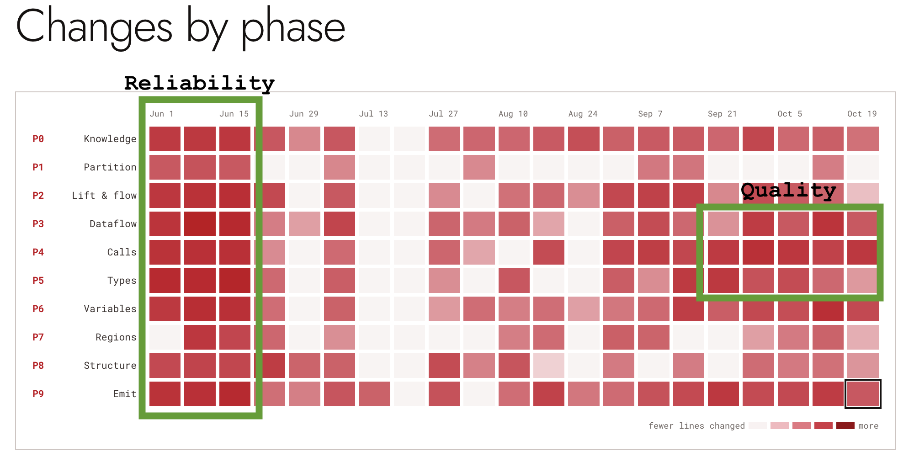
Changing Focus Over Time
claude-opus-4-8, 5, 5.5

Slide 40

Why Is It Still Unsolved?
Low Developers
Engineering Hard
Scientifically Hard

Slide 41
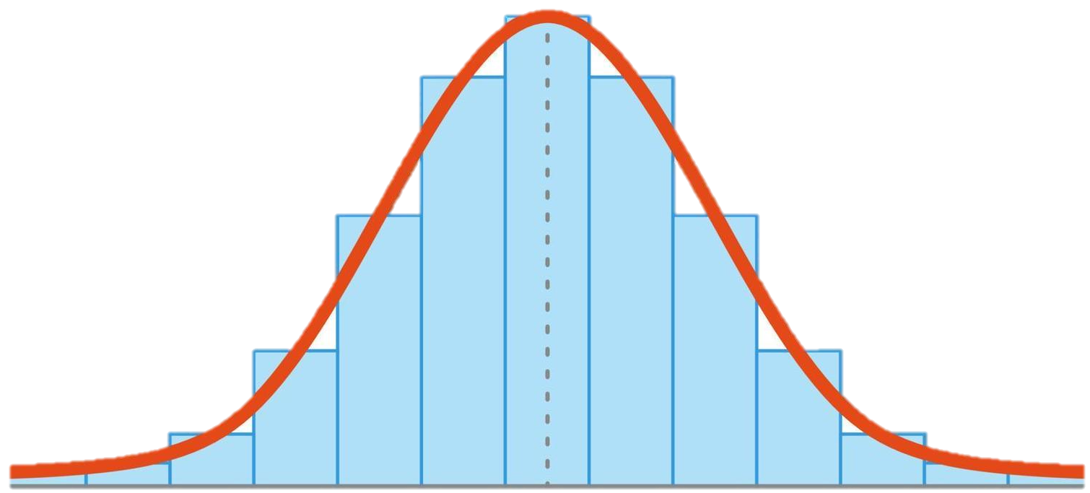
What LLMs are trained on
(Open Source Software)

Slide 42
What LLMs are trained on
(Open Source Software)
Decompilation

