Slide 1
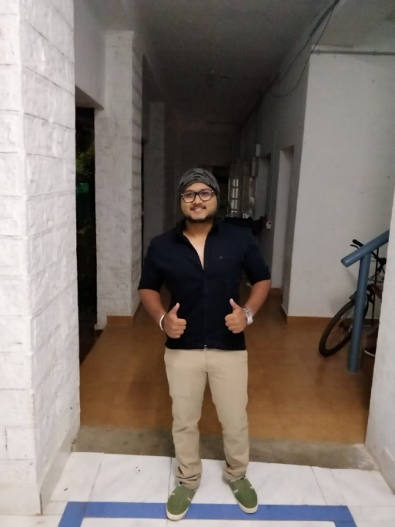
Coursera Capstone – “School-Classification”
Foursquare APIs and Dataset of York schools are used
Idea is to Classify the schools based on the nearby venue
-by
Rupesh Mahal
Project will aim to benefit all the parents who are looking for safe school for their child

Slide 2
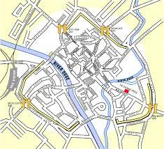
Problem Statement
In today’s world, it is a headache for parents to decide which school is good for their children. It is very important for a child to have his/her education at a better place so that he/she should be influence by bad things nearby. The mission of this project is to use Foursquare location data and regional clustering of venue information to determine what might be the ‘best’ school in York for a child. My proposal, then, is an analysis of the neighborhoods of schools in York for the consideration of safe place for children. The objective is to evaluate the neighborhoods of schools and analyses whether there is any venue nearby which can be harmful for a child.
This project will be interesting for parents those are willing to send their children to school and yet little bit of confuse about which school will be safe for their children.

Slide 3
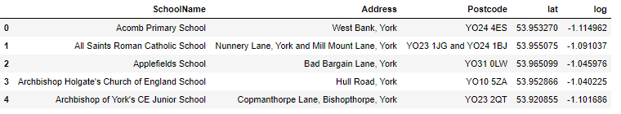
Cleaned Data
The data that we will use for this analysis is a combination of a CSV file that has been prepared for the purposes of the analysis from multiple sources (schoolslist.csv) and the location/venue information in foursquare. Schoolslist.csv has list of schools in York along with their latitude and longitude. Using foursquare APIs, we can get the details and category of the neighborhood venues and using this we can classify the schools whether it is safe or unsafe for a child using SVM linear classification algorithm.

Slide 4
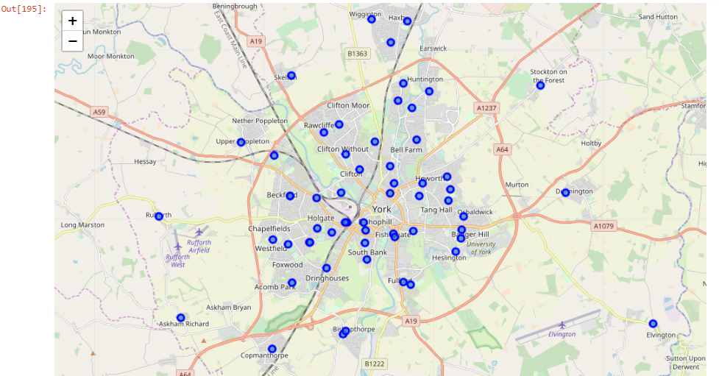
Initial Mapping of schools

Slide 5
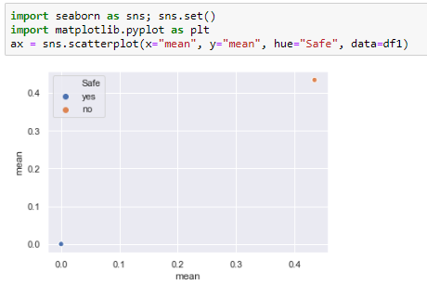
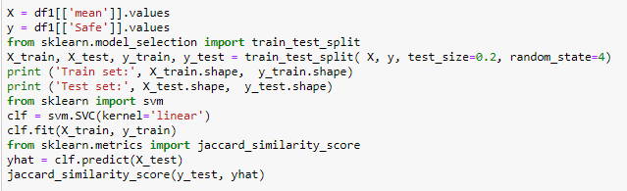
Classification model (SVM)

Slide 6
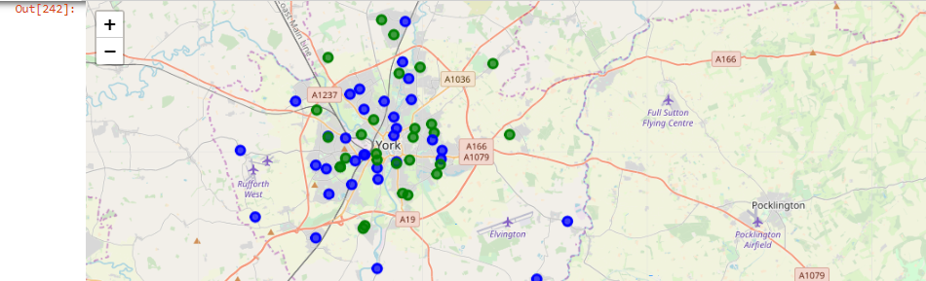
Mapping classified schools on the York map
Unsafe School
Safe School

Slide 7
Result
From the above result, it shows some schools with green color and some schools with blue color. By using SVM linear model, I have classified all the unsafe schools by labelling them with blue color and all the schools with green color label are safe for children as there is no harmful venue around the school.

