Slide 1
FINAL YEAR PROJECT DEFENSE PRESENTATION
Adaptive Traffic Signal Control
Using GCN-Based Multi-Agent
Reinforcement Learning
PRESENTED BY
Maham Shahid
Roll No: FL-21506
Supervised by:
Dr. Hasan Humayun
Amna Tanveer
Roll No: FL-21533
Session 2022–2026 · Department of Software Engineering

Slide 2
Introduction:
Why Reinforcement Learning?
RL agents learn by interacting with the environment, monitoring traffic states, selecting actions
Rewards guide agents to reduce congestion and optimize flow
Self-learning and adaptable to constantly changing traffic conditions
Proposed Solution, Core Architecture
Compares three algorithms: MAQL, MADQN, and MAPPO
Why GCN?
Traditional RL = agents only see their own local data
GCN allows agents to see:
Their own intersection state
Upstream & downstream traffic dependencies
Same GCN backbone used across all three algorithms for fair comparison

Slide 3
Research Problem:
Research Scope:
This research inspects ATSC (Adaptive Traffic Signal Control) using MARL (Multi Agent Reinforcement Learning).
Assess and compare three Reinforcement Learning (RL) learning algorithms i.e, MAQL, MADQN, and MAPPO.
The research is conducted in 4 x 4 SUMO (Simulation of Urban MObility) Grid network replicating Manhattan.
Compare these algorithms across different traffic densities (Off-Peak, Medium, Peak).
Research Objectives
1. To evaluate the results in terms of traffic efficiency and travel time of vehicles?
2. To assess adaptability of the three comparison models in different traffic densities?
3. To evaluate the best models for RL (Reinforcement Learning) in TSC (Traffic Signal Control)?
Research Questions:
1. To identify results achieved from this comparison research?
2. To identify how the three comparison models, make system adaptive?
3. To determine the five best models for RL (Reinforcement Learning) in TSC (Traffic Signal Control)?

Slide 4
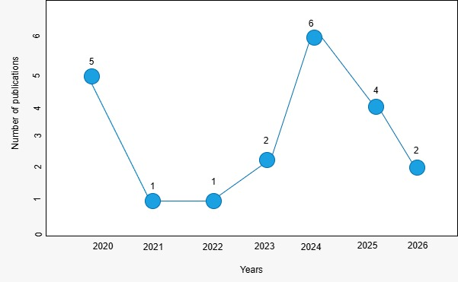
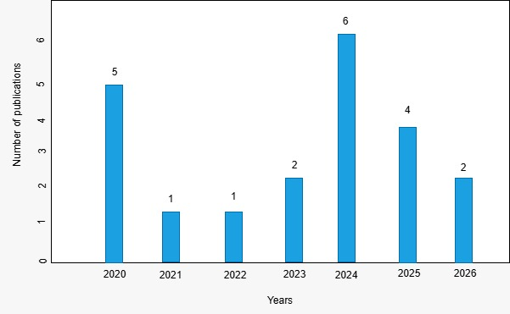
Literature Review
Traditional TSC Methods
1. Fixed Time Control 2. Actuated Control
Key limitation: rely on human-written rules, making them inflexible in dynamic, real-world conditions
Isolated / Single-Agent RL
Q-Learning 2. SARSA & PPO (single agent) 3. DQN
Multi-Agent RL (MARL) Scalability Solutions
Decentralized A2C (MARL) 2. SAC (single agent)
Research Gap & Motivation
Most existing systems use single-agent RL, which fails as network size grows
Real-world traffic = multiple intersections (MARL is essential for scalability)
This research compares MAQL, MADQN, and MAPPO in a 4×4 SUMO grid to evaluate grid-wide coordination and performance

Slide 5
Methodology:
GCN
Q Learning
Graph Convolutional Network, Base architecture for spatial traffic modelling.
A GCN is a type of deep learning model designed to work on graph-structured data
Q-Learning is a model-free, value-based RL algorithm.
Decisions by learning the value of taking actions in certain states
DQN
PPO
Deep Q-Network combined with GCN for value-based signal control.
PPO directly learns the policy (what action to take) rather than learning Q-values.
PPO strikes the perfect balance between simplicity and performance

Slide 6
GCN ARCHITECTURE AND MULTI-AGENTS FRAMEWORK
GCN – Base Architecture
GCN - MA-PPO Multi-Agent Framework
It is a 3-layer Graph Convolutional Network (GCN) that models the Manhattan traffic grid as a graph
The MAPPO follows the CTDE (Centralized Training with Decentralized Execution) paradigm.
The GCN Encoder is the shared spatial intelligence backbone used by all three traffic signal control algorithms MAPPO, MA-DQN, and MA-Q-Learning making it a fair baseline for comparison.
The Actor (3-layer MLP), while the Centralized Critic (4-layer MLP) takes the concatenated global state as input and outputs a scalar value.
MAPPO directly learns a stochastic policy, probability distribution over actions, for each traffic light junction.
Rather than having each traffic light agent make decisions purely based on its own local lane data, the GCN allows every junction to "see" the traffic conditions of its neighbors.
PPO Algorithms: Generalized Advantage Estimation (GAE) - PPO Clipped Objective - Entropy Regularization - Critic (Value) Loss -
State Representation: Vehicle density, queue length, waiting time per lane.
12 agents, one per signalized junction. Each agent is an instance of MAPPO Agent and manages its own decentralized Actor network. All 12 agents share a single centralized Central Critic.
Layered Architecture: 1-Layer (Spatial) 2-Layer (Communication) 3-Layer (Compressed)
GCN Centralized Critic Shared PPO Update
Decentralized Execution

Slide 7
LEARNING ALGORITHMS · GCN-MADQN & GCN-MAQL
GCN - MADQN · Multi-Agents Deep Q-Network
GCN – MAQ Learning · Multi-Agents Q Learning
It is a value-based RL, it learns Q-values Q(s, a), NO centralized critic
MA-Q-Learning (Multi-Agent Q-Learning) is the simplest of the three algorithms implemented in this system
Each agent has its own Online Q-Network, Target Q-Network, and Replay Buffer. All 12 agents share a single Multi-Layer GCN encoder.
It is a value-based reinforcement learning algorithm
MA-Q-Learning in this implementation is its single-layer linear Q-network no hidden layers, no non-linearities
It has 3 layers network architecture. It can model non-linear traffic interactions that Q-Learning cannot represent.
The Q-networks are trained independently with their own replay buffers. This is fully decentralized execution AND training.
It has linear approximator that’s why it is expected to underperform DQN and MAPPO in congested scenarios
Beyond what the GCN provides, agents do not communicate during action selection. The GCN embedding is the only cross-junction information channel.
Each agent has its own Linear Q-Network (one-layer, no hidden units). All 12 agents share a single Multi-Layer GCN encoder
GCN Independent Q-Network Shared Epsilon
No Inter-Agent Message Passing at Decision Time
GCN Fully Decentralized Q-Learning Shared Epsilon Decay Online Updates Only

Slide 8
REWARD & System Features:
Reward = -(0.5 x NormQueue + 0.3 x NormDelay + 0.2 x NormWait)
Training Details:
1 hour Simulation = 3600s = 900 s for warm-up and 2700s for Training
Signal: Yellow for 3 s, Green 10 s, Red as per the adaptive requirement.
Novelity: GCN + MAPPO.
Usefulness: Cooperative Adaptive TSC, density-based curriculum training, in SUMO, achieving progressive reward convergence.
Strengths: Graph-aware spatial reasoning, Curriculum generalization, Simulation fidelity, Decentralized execution.

Slide 9
SYSTEM OVERVIEW
Traffic Turning Ratio
Vehicles Information
Direct | Straight | Right | Left
North | 65% | 20% | 15%
South | 65% | 20% | 15%
East | 65% | 20% | 15%
West | 65% | 20% | 15%
Parameter | Value
Vehicle type | LTV, HTV, Motorbikes
Vehicle size | 5 m (LTV), 13 m (HTV), 2.2 m (motorbikes)
Vehicle min gap | 2.5 m, 3.0 m, 1.5 m
Speed on Streets & Avenues | 13.9 m/s (50 km/h) 16.8 m/s (60.48 km/h)
Sumo Network Information
Parameter | Value
Grid size | 4 × 4 intersections Total 16 junctions (16-Nodes & - Edges)
Lane width | For One direction bound 3.2 For Avenues/Dual-Carriage Way 3.5
Edge width | 7.0 m per direction
Spacing between intersections | 300 m across Vertical 500 m across Horizontal
Road type | Urban multilane
Lanes per direction | 2 lanes for Streets and 4 lanes for Dual-Carriage Way & 3 lanes for Avenues
Directions | 4 (North, East, South, West)
Avenues | 4 Avenues total including i.e. 6th Ave, 7th Ave, 8th Ave, and 9th Ave
Streets | 41 St, 42 St, 43 St, 44 St
Vehicle Density Distribution For Training
Stage | Density | Vehicles/Hour
Stage 1 | Low (off-peak) | 824 veh/hr
Stage 2 | Medium (mid-day) | 1,685 veh/hr
Stage 3 | High (peak hour) | 3,376 veh/hr

Slide 10
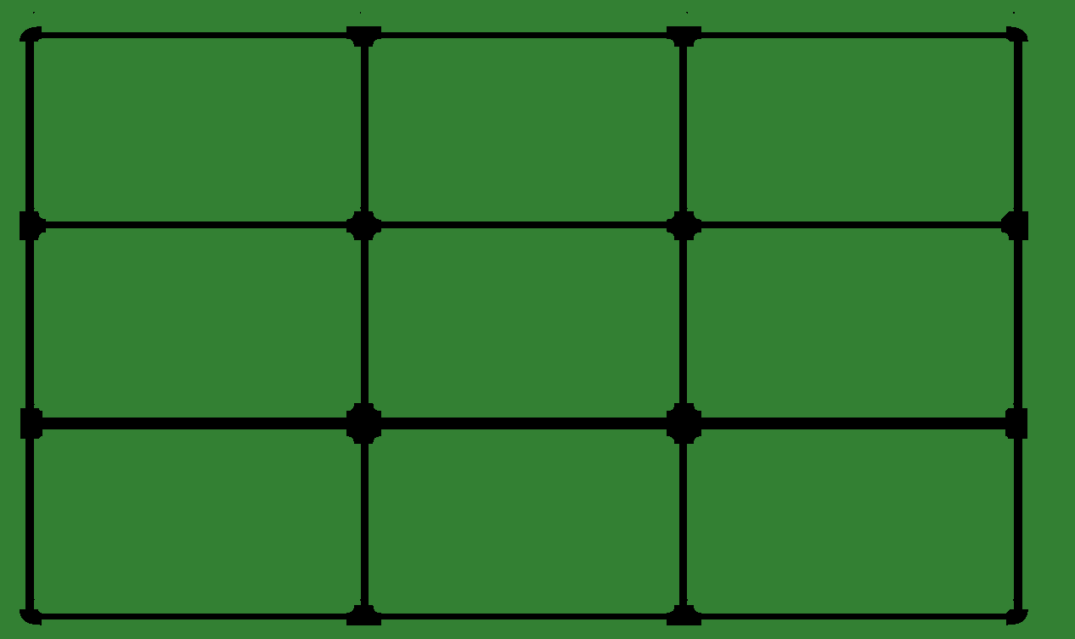
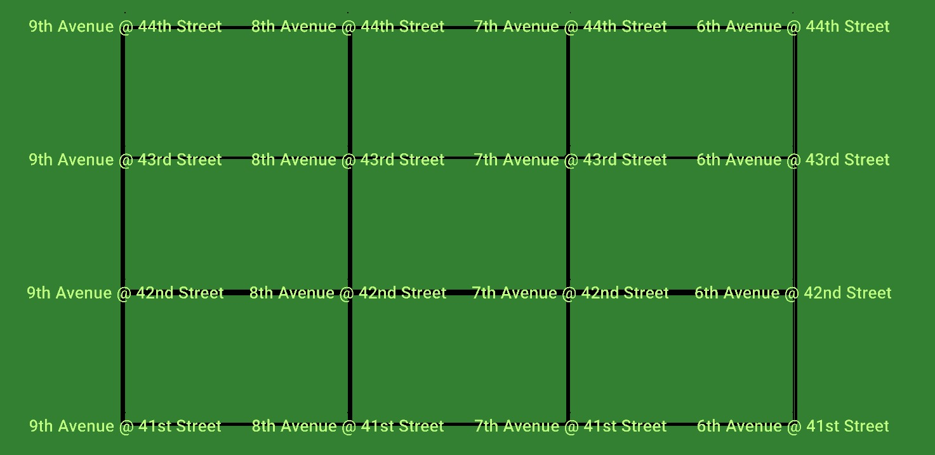
SYSTEM OVERVIEW
Simulation Network: Manhattan
4 × 4 Grid · 16 Intersections · SUMO Simulator

Slide 11
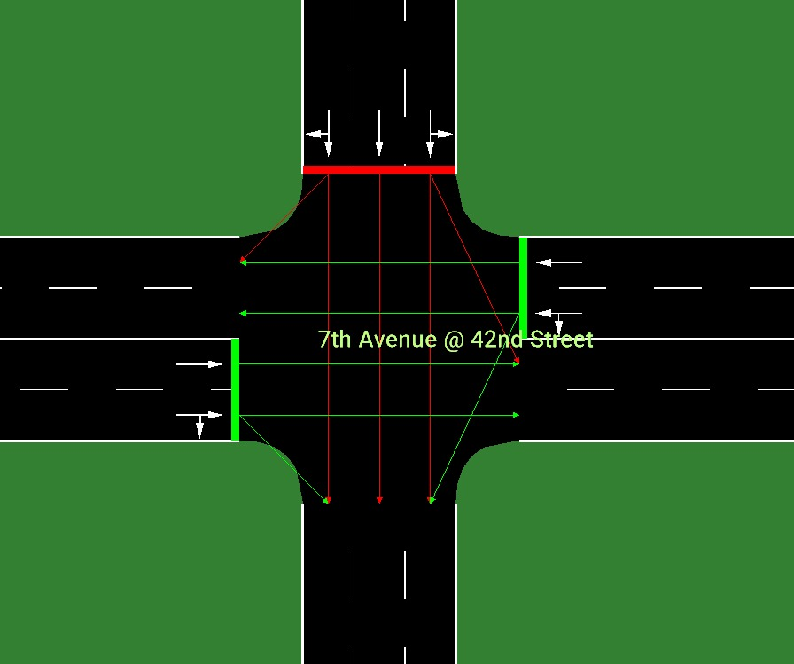
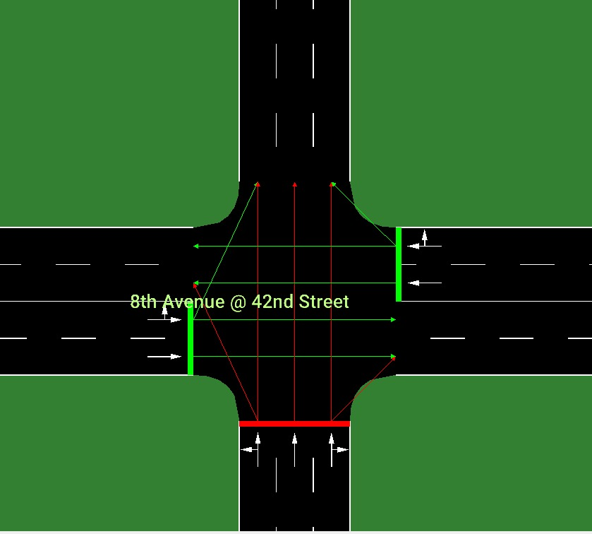
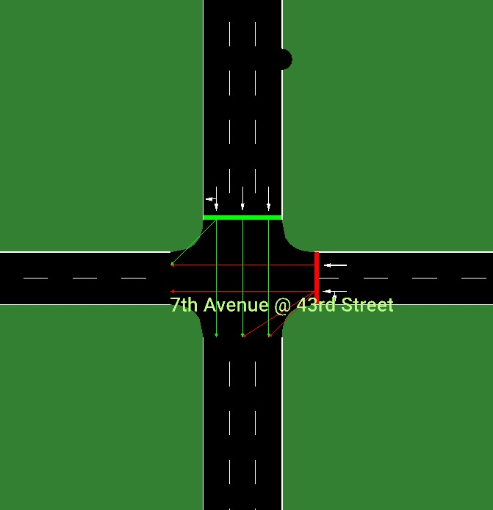
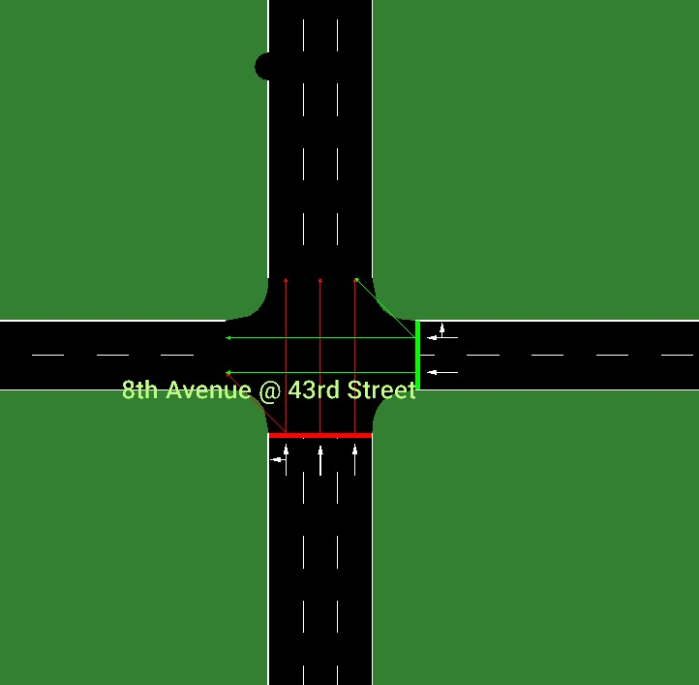
SYSTEM OVERVIEW
Simulation Network: Manhattan
Junctions Details, Turning Points, & Lanes Connections

Slide 12
TRAINING RESULTS · PERFORMANCE COMPARISON TABLE
Discussions:
The Training Data Shows that MAPPO Reinforcement Learning Algorithm Performs well across other two Learning Algorithms.
Traffic Density | MAQ-Learning | MADQN | MAPPO | Best Result
Low | 133.00 | 131.76 | 127.78 | MAPPO (127.78 s)
Medium | 134.63 | 133.79 | 126.30 * | MAPPO (126.30 s) *
High | 137.94 | 137.10 | 125.51 * | MAPPO (125.51 s) *

Slide 13
TRAINING RESULTS · PERFORMANCE COMPARISON TABLE
The Training Data Shows that MAPPO Reinforcement Learning Algorithm Performs well across other two Learning Algorithms.
Low Traffic Density
Medium Traffic Density
High Traffic Density
Metric | MAQ-Learning |  | MADQN | MAPPO
Travel Time Metrics (seconds)
Initial Travel Time |  | 133.81 s | 133.70 s | 133.47 s
Best Travel Time ↓ |  | 133.00 s | 131.76 s | 127.78 s
Final Travel Time |  | 133.92 s | 132.71 s | 129.21 s
Travel Time Improvement |  | 0.81 s | 1.94 s | 5.69 s*
Last-20% Avg Travel Time |  | 133.74 s | 132.52 s | 129.00 s
Metric | MAQ-Learning |  | MADQN | MAPPO
Travel Time Metrics (seconds)
Initial Travel Time |  | 135.59 s | 136.15 s | 131.08 s
Best Travel Time ↓ |  | 134.63 s | 133.79 s | 126.30 s
Final Travel Time |  | 135.62 s | 134.85 s | 132.29 s
Travel Time Improvement |  | 0.96 s | 2.36 s | 4.78 s*
Last-20% Avg Travel Time |  | 135.56 s | 134.56 s | 131.77 s
Metric | MAQ-Learning |  | MADQN | MAPPO
Travel Time Metrics (seconds)
Initial Travel Time |  | 138.13 s | 137.90 s | 126.70 s
Best Travel Time ↓ |  | 137.94 s | 137.10 s | 125.51 s
Final Travel Time |  | 137.72 s | 137.90 s | 128.30 s
Travel Time Improvement |  | 0.19 s | 0.80 s | 1.19 s*
Last-20% Avg Travel Time |  | 137.94 s | 137.54 s | 126.30 s

Slide 14
🏆 Predicted Best Model: GCN-MAPPO
Research Objectives:
O1: Evaluate traffic efficiency and travel time Results are measured using key metrics such as average vehicle waiting time, queue length, and throughput at intersections. MAPPO consistently records the lowest waiting times and highest throughput, followed by MADQN, then MAQL
O2: Assess adaptability across traffic densities MAPPO demonstrates the strongest adaptability, maintaining stable performance even under Peak traffic. MADQN shows moderate adaptability, while MAQL's performance drops noticeably as traffic density increases due to its limited state representation.
O3: Identify the best RL model for TSC Across all evaluation criteria, MAPPO is identified as the most suitable algorithm for Traffic Signal Control, offering the best balance of stability, efficiency, and scalability in a multi-agent urban traffic environment.
Research Questions:
RQ1: Results from the comparison MAPPO achieves the best overall performance, MADQN performs moderately, and MAQL works adequately only in low-density scenarios.
RQ2: How models make the system adaptive MAQL adapts via Q-table updates, MADQN through neural network generalization, and MAPPO through cooperative centralized training with decentralized execution (CTDE).
RQ3: Best model for RL in TSC MAPPO is the best-performing model, consistently outperforming the other two across all traffic densities and evaluation metrics.

Slide 15
Research Scope:
S1: ATSC using MARL This research investigates Adaptive Traffic Signal Control (ATSC) by applying Multi-Agent Reinforcement Learning (MARL), where each intersection in the network is treated as an independent agent that learns to optimize signal timings through interaction with the environment.
S2: Three RL algorithms, MAQL, MADQN, MAPPO The study implements and compares three MARL-based algorithms. MAQL extends classical Q-Learning to a multi-agent setting, MADQN scales DQN using deep networks for state representation, and MAPPO adapts PPO's stable policy gradient approach for cooperative multi-agent control.
S3: 4×4 SUMO Grid replicating Manhattan The simulation environment is built in SUMO, configured as a 4×4 intersection grid modeled after Manhattan's urban road layout, providing a realistic and reproducible test bed for evaluating all three algorithms under controlled conditions.
S4: Comparison across Off-Peak, Medium, and Peak traffic densities Each algorithm is evaluated under three distinct traffic load scenarios to assess not just peak performance but also consistency and adaptability across varying real-world conditions.

Slide 16
CONCLUSION & FUTURE WORK
Summary & Next Steps
GCN-MA framework successfully integrates graph-based spatial encoding with multi-agent RL for traffic signal control
Three algorithms (DQN, Q-Learning, PPO) evaluated under identical Manhattan grid simulation conditions
GCN-MAPPO expected to outperform others : delivers stable, cooperative, and adaptive signal control
Significant reduction in average waiting time and queue length vs. fixed-cycle baseline
Future Work
Real-world Islamabad traffic data integration once datasets become available
Transfer learning from Manhattan to irregular city topologies
Edge-AI deployment for embedded traffic controller hardware
Thank You · Questions?

