Slide 1

Technest
Back-End Development
Project: Jobstack vacancy system
Mahammad Mustafayev
RNet-102

Slide 2




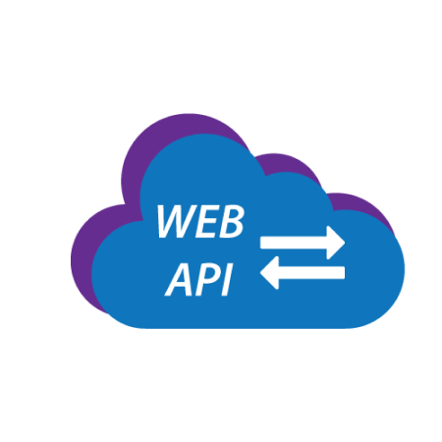




Technologies

Slide 3
Thanks

