Slide 1

BRITISH AIRWAYS
An In-depth Look at Passenger Reviews

Slide 2
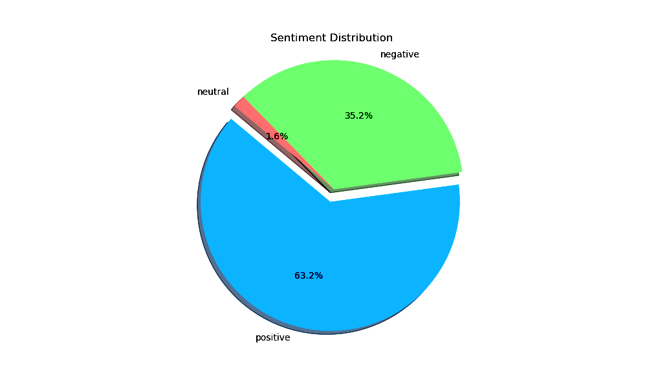
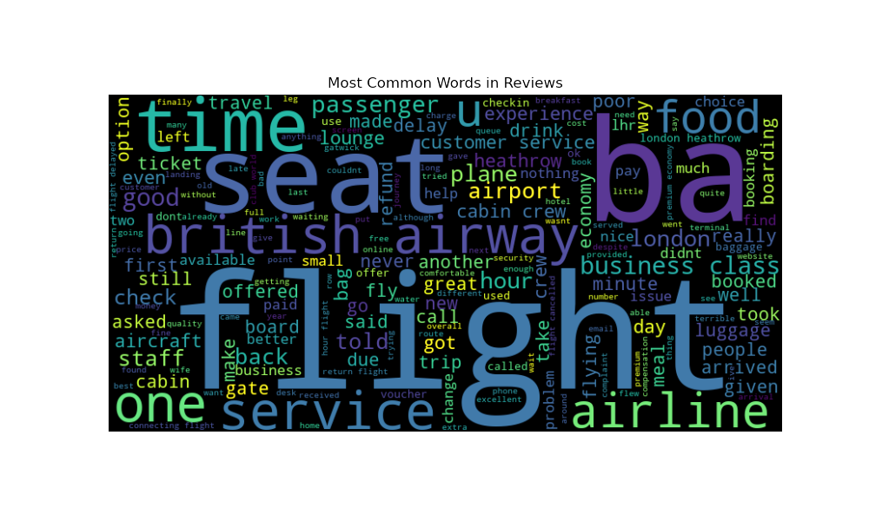
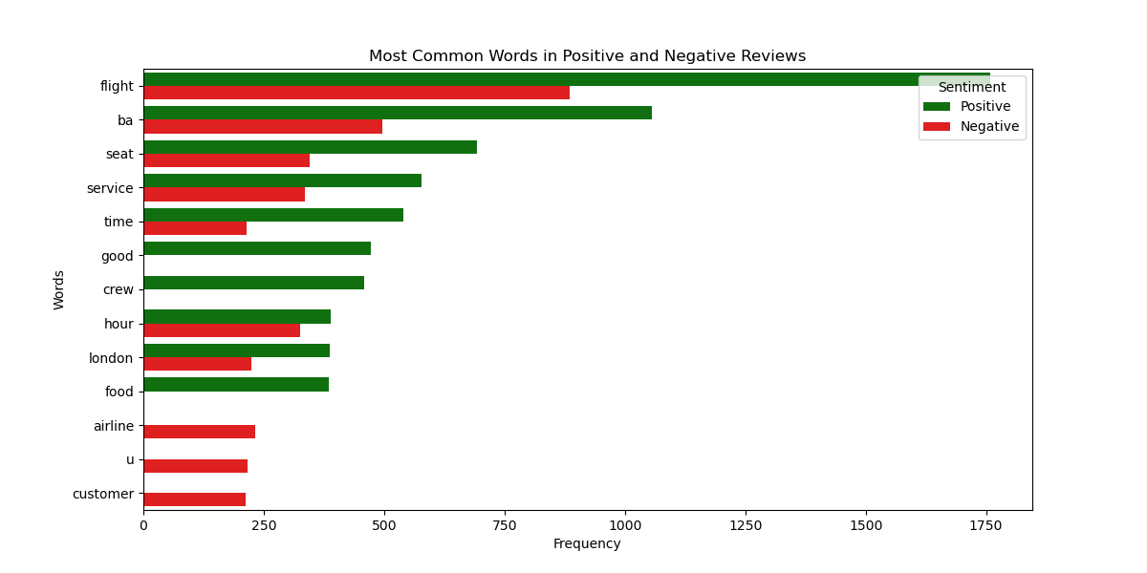
Analysing Passenger Sentiment
Positive : Flight, BA and Seat are key positive touchpoints
Positive Sentiment : 759
Negative Sentiment : 422
Neutral Sentiment : 19
Negative : Flight, Seat and Service indicate critical areas like delays and comfort

