Slide 1

BRITISH AIRWAYS
Understanding Key Drivers Behind Customer Booking Behaviour Through Machine Learning

Slide 2
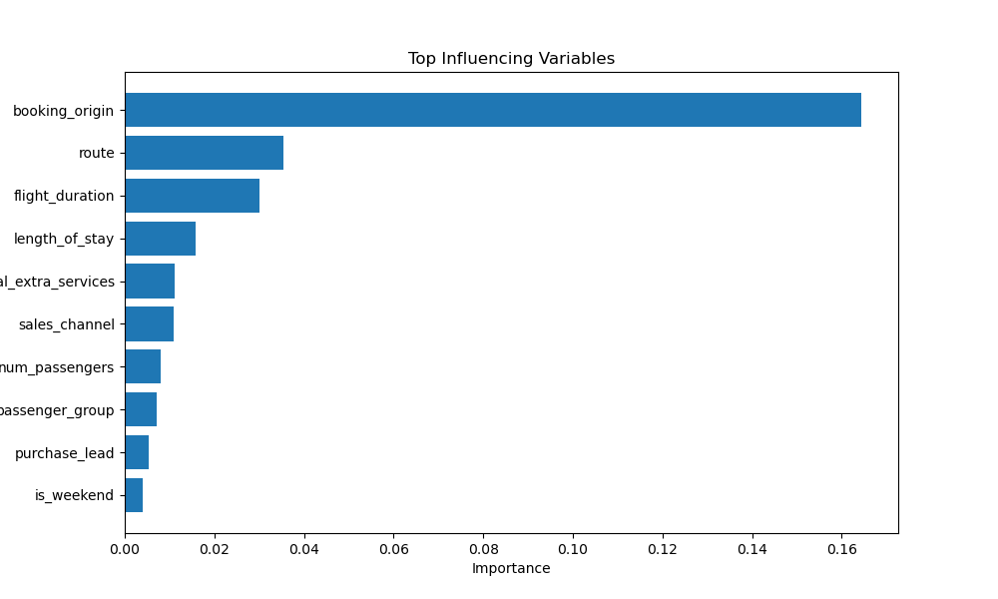
Top Variables Influencing Customer Booking Predictions
Booking Origin: The country where the booking was made significantly affects completion rates.
Route: Certain flight routes have higher booking completion tendencies.
Flight Duration: Longer flights show varied completion behaviour.
Length of Stay: Longer stays at the destination positively influence booking completion.
Total Extra Services: Customers opting for extra services(baggage, meals, preferred seats) are more likely to complete bookings.
Model Performance:
Best Performance achieved using LightGBM:
Accuracy: 85%
Roc-Auc Score: 78%
Actionable Insight:
Other models (Random Forest and XGBoost) performed well, with only minor difference in metrics.
Focus marketing efforts on popular routes, specific origins, and customers opting for extra services to maximize booking completion rates.

