Slide 1
CO2 EOR Modeling and performance prediction in conventional oilfield
Mahammad Valiyev, Tianwei Li
27.04.2022

Slide 2
Contents
Slide 2
Problem statement
Literature review
Overview of workflow
Results
Discussion and conclusion
CO2 EOR Modeling and performance prediction in conventional oilfield, Tianwei Li, Mahammad Valiyev

Slide 3
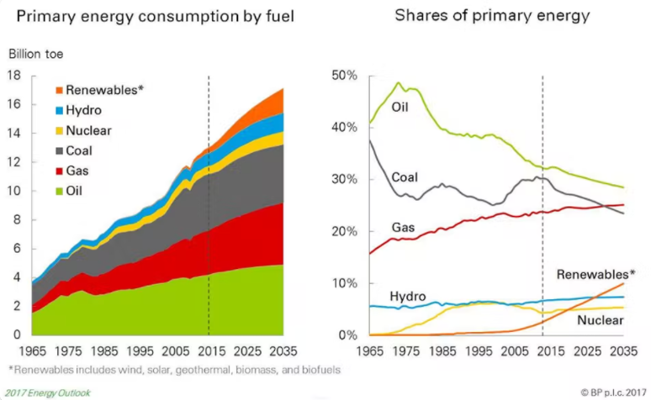
Problem statement
Slide 3
Oil & gas are still predicted to be dominant source of energy in 2035
Prediction of an increased demand in Oil & gas
Up to 50% of hydrocarbons can be recovered by the of primary & secondary recovery methods
EOR techniques are the most effective for producing the rest
CO2 injection is one of the most commercially successful tertiary recovery methods & helps with greenhouse gas emission reduction
CO2 EOR Modeling and performance prediction in conventional oilfield, Tianwei Li, Mahammad Valiyev
Notes:
History matching and sensitivity analysis

Slide 4
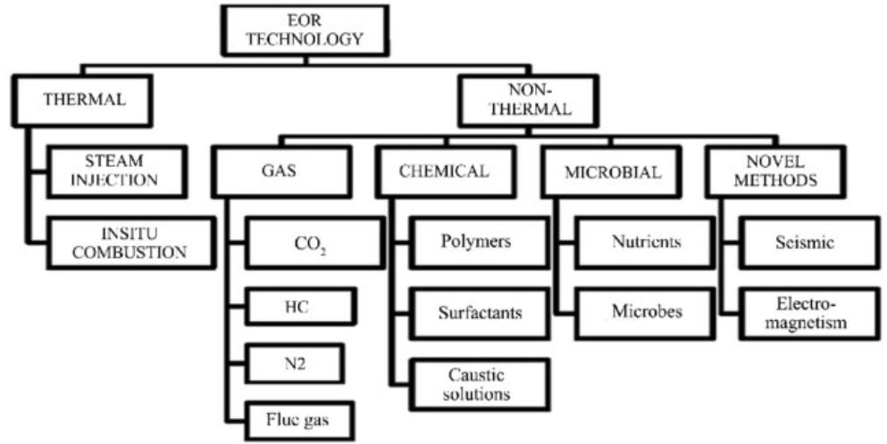
Literature review
Slide 4
Jenkins et al., 2019
CO2 EOR Modeling and performance prediction in conventional oilfield, Tianwei Li, Mahammad Valiyev

Slide 5
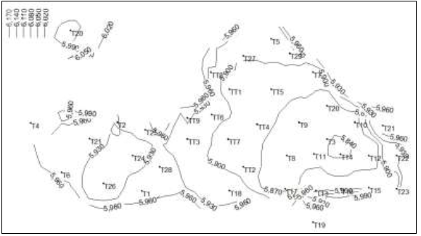
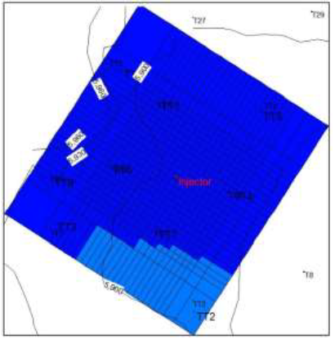
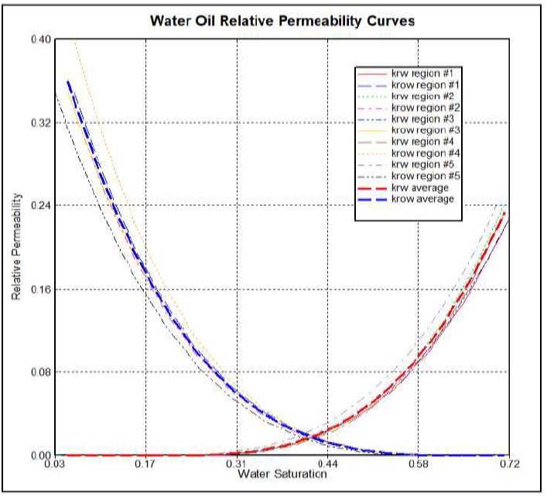
Workflow overview
Slide 5
Definition of structure and dimensions
Gridding
Rock & fluid properties
Well modeling & Initial conditions definition
Simulation of case 1 & case 2
CO2 EOR Modeling and performance prediction in conventional oilfield, Tianwei Li, Mahammad Valiyev

Slide 6
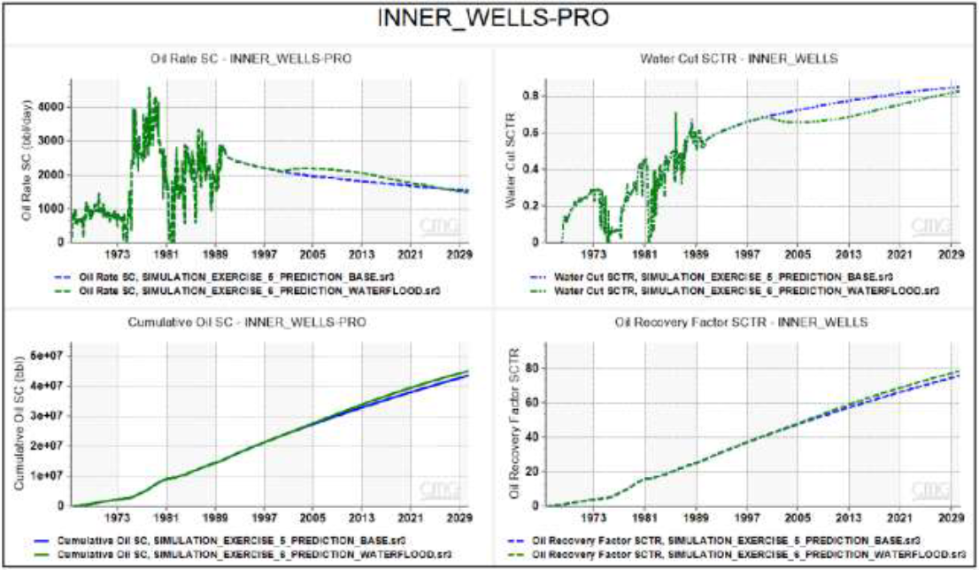
Results
Slide 6
Oil rate, water cut, cumulative oil rate and oil recovery for case 1 (waterflooding only)
CO2 EOR Modeling and performance prediction in conventional oilfield, Tianwei Li, Mahammad Valiyev

Slide 7
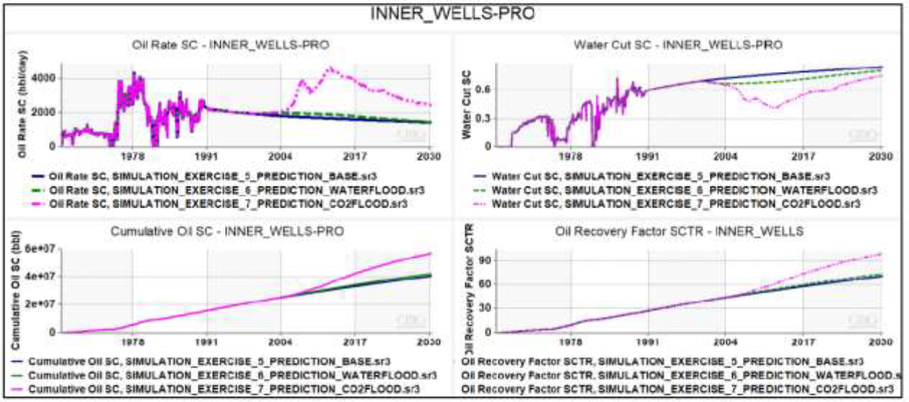
Results
Slide 7
Oil rate, water cut, cumulative oil rate and oil recovery for case 2 (waterflooding & CO2 injection)
CO2 EOR Modeling and performance prediction in conventional oilfield, Tianwei Li, Mahammad Valiyev

Slide 8
Discussion and conclusion
Slide 8
In this study, a structured workflow for reservoir modeling, waterflooding and CO2-EOR injection is presented.
Performance differences between cases without any improved oil recovery methods, waterflooding only and waterflooding & CO2-EOR injection processes have been demonstrated.
Both waterflooding and CO2 injection can lead to an increased oil rate and cumulative recovery, while having lower water cut levels
Potential gain from CO2 injection is much higher compared to water flooding
To make this study even more comprehensive and insightful, economic analysis can further be conducted.
CO2 EOR Modeling and performance prediction in conventional oilfield, Tianwei Li, Mahammad Valiyev

Slide 9
Slide 9
Thank You
Questions???

