Slide 1
Hydrogen Supply Chain Optimization
Final presentation
Mahammad Valiyev
05.01.2025

Slide 2
Contents
Introduction
Rule-based control approach
MPC workflow components
Results
Conclusion and Future work

Slide 3
1. Introduction

Slide 4
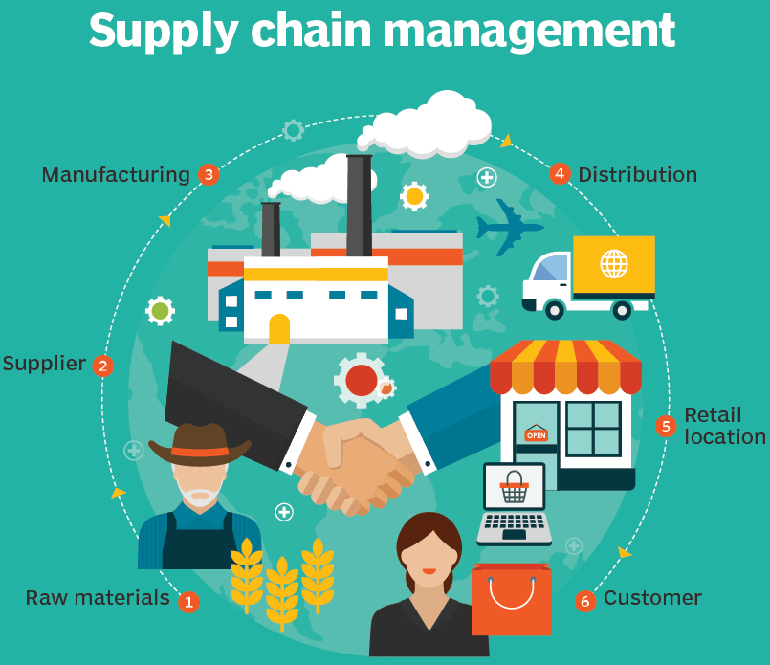
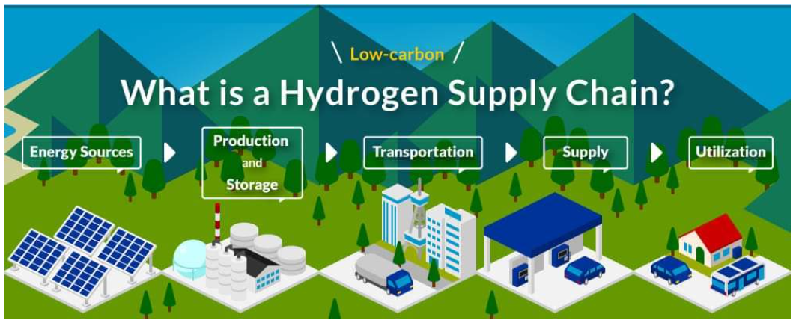
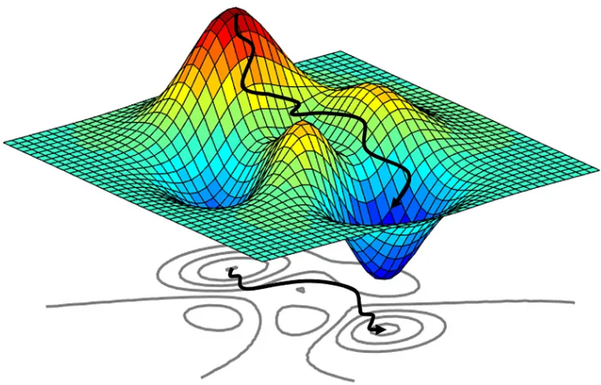
Introduction
What is a supply chain?
Flow of materials, energy, information across production, storage, and delivery
Integration of suppliers, processes, logistics from source to end-user
Hydrogen supply chain
Energy sources, hydrogen production
Storage, distribution, export, utilization
3. Need for optimizing the hydrogen supply chain
High production/storage cost, variable renewables, dynamic demand
Improve efficiency, minimize emissions, ensure reliability, reduce waste
Notes:
A supply chain is the entire network of individuals, organizations, resources, activities, and technologies involved in the creation and delivery of a product or service
Hydrogen supply chain is one example of a supply chain tailored for hydrogen: covers everything from the production of energy for hydrogen generation technologies to export
Supply chain optimization: optimize costs, balance supply and demand, improve efficiency, minimize emissions, reduce waste

Slide 5

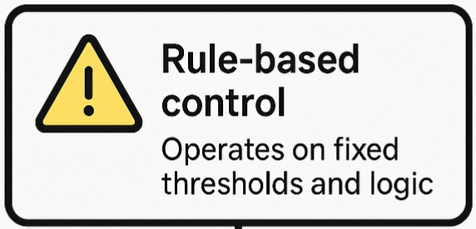
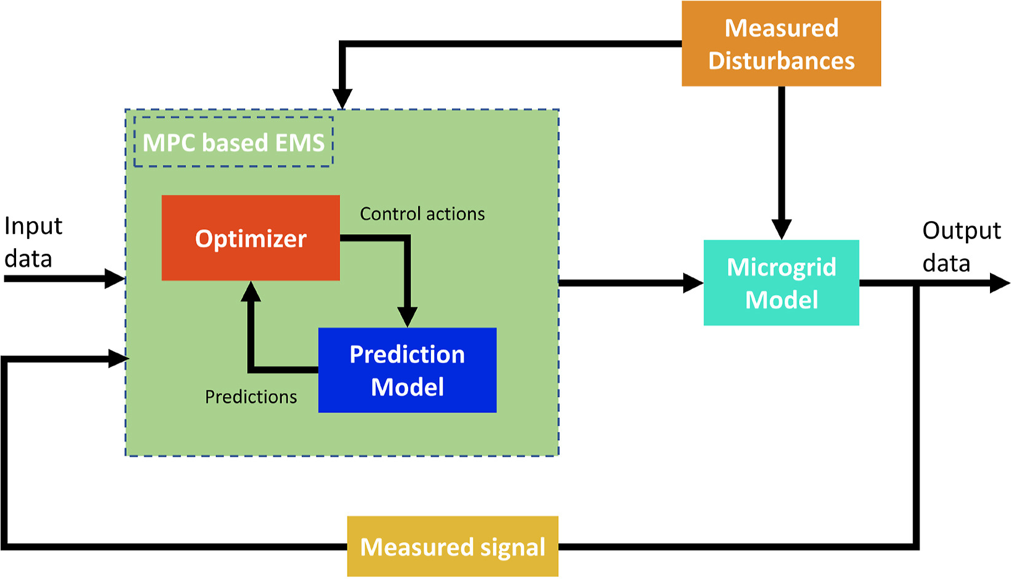
Solution Strategies for Hydrogen Supply Chain Optimization
1. Overview of approaches
Rule-based: predefined logic for operation
Heuristic methods: empirical decision-making
Optimization-based: mathematical cost optimization
2. Simplistic benchmark approach for study
Rule-based control: Operates on fixed thresholds and logic
Reactive adjustments: no forecasting, responds to current state
No optimization: simple logic, easy to implement
3. Optimization-based approaches: MPC, MILP
Data-driven and model-based, more rigorous approach
Incorporate constraints
Strategic and tactical planning for large, complex supply chains
Notes:
Definition: Operates using if-then logic and fixed thresholds.
Characteristics:
Predefined rules (e.g., “If inventory < X, reorder”).
Simple, interpretable, and easy to implement.
No foresight or cost balancing.
Use Case: Baseline control or in systems with limited data or flexibility.
🔹 Heuristic Methods
Definition: Use experience-based techniques or rules-of-thumb.
Often domain-specific and flexible.

Slide 6
2. Rule-based control approach

Slide 7
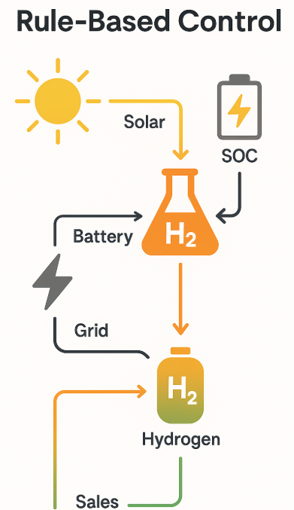
Rule-Based Control Logic (If, else logic)
Solar Usage Priority
Use solar first for the electrolyzer
Excess solar → battery if SOC < 70%
Battery Charging
Charge battery only when SOC < 80%
Stop charging if SOC ≥ 80% or battery limit reached
Battery Discharging
Discharge if SOC > 20% and solar is insufficient
Only discharge to help meet unmet hydrogen demand
Grid Use
Use grid only if solar + battery can't meet demand
Limit grid power to electrolyzer max − solar − battery
Electrolyzer Operation
Run at max using available power (priority: solar → battery → grid)
H₂ → meet demand first, then store excess
Hydrogen Storage Logic
Store only if storage < 90%
Discharge storage only if production < demand
Notes:
Operation based on simplistic if then logic and fixed thresholds: pre-defined rules, simple interpretable and easy to implement
Rules for operating each component in the system

Slide 8
3. MPC workflow components

Slide 9
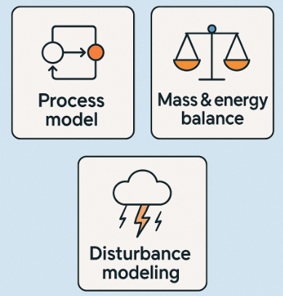
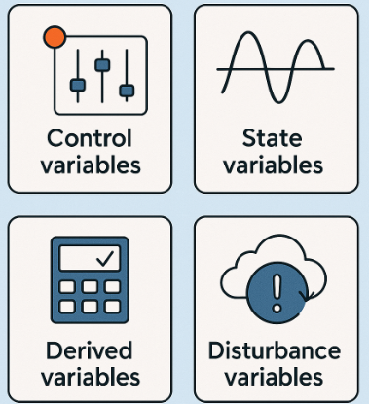
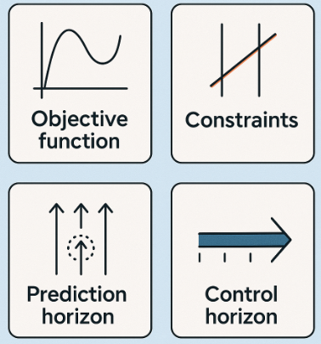
MPC workflow components
System modeling:
process model, mass & energy balance
disturbance modeling
System variables:
control, derived and state variables
disturbance variables and measured outputs
Optimization formulation:
objective function and constraints
prediction and control horizons
Notes:
Grouped MPC workflow components into 3 parts

Slide 10
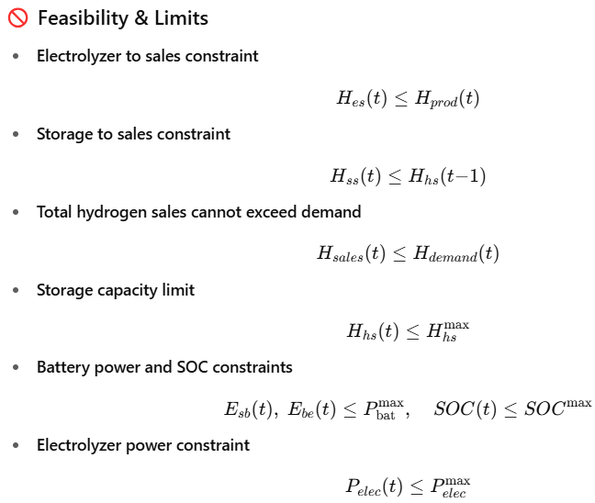



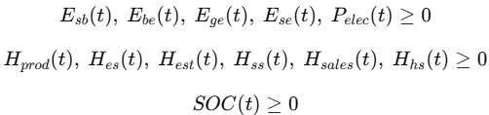
Process model, mass & energy balance, feasibility & limits
Solar
E_se
E_sb
E_be
Electrolyzer
H_es
Hydrogen sales
Battery
H_est
H_hs
H_ss
E_ge
Hydrogen storage
Grid
Notes:
Energy sources: solar as the main source, grid as auxiliary, batter is also auxiliary
Production: electrolyzer is main source
Storage and sales
Feasibilities, limits and non-negativity constraints

Slide 11
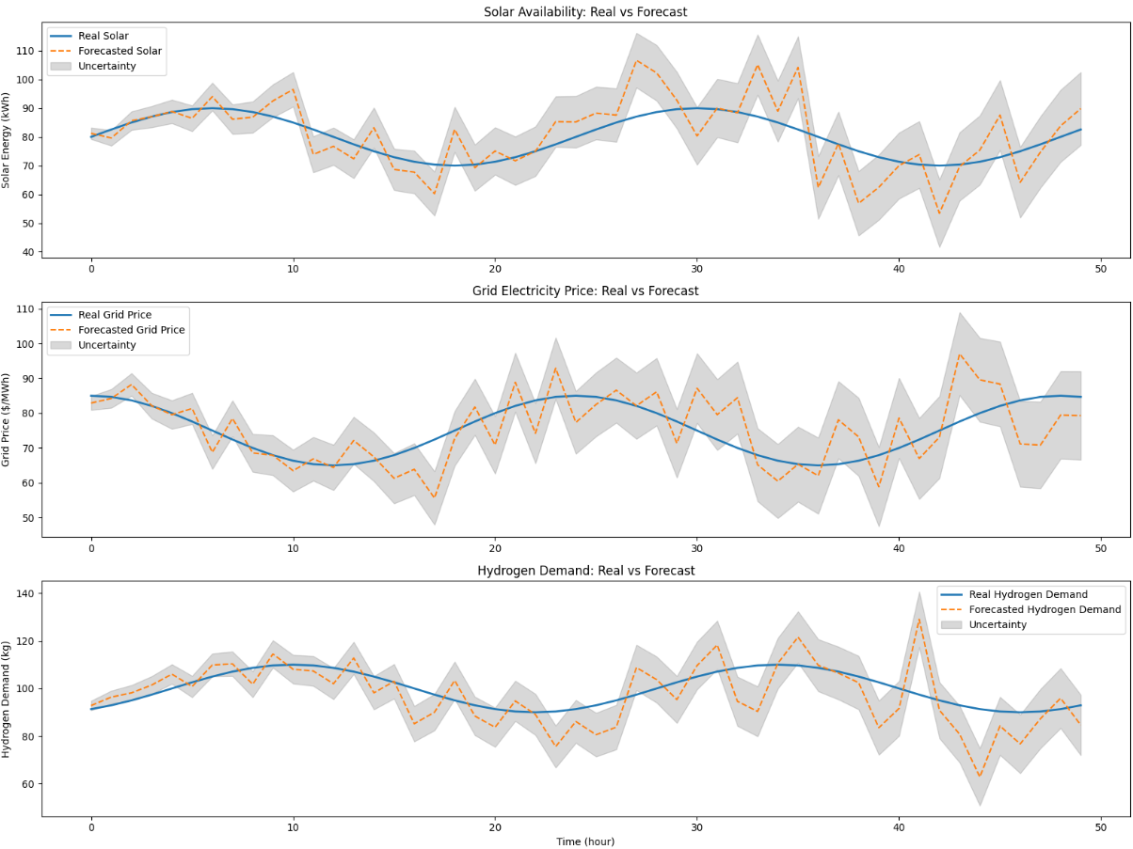
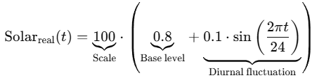

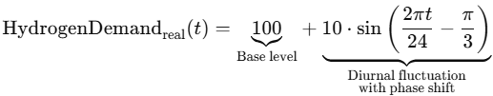


Disturbance modeling
Notes:
Disturbance modeling: simple models: base level + some fluctuation, based on position of sun, time of our, etc
General forecast: real data + Gaussian error with increasing variance

Slide 12

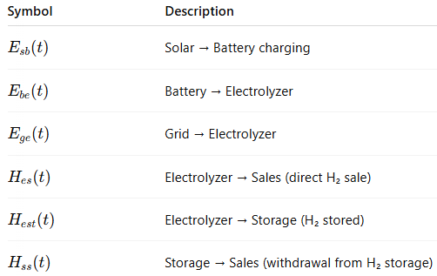
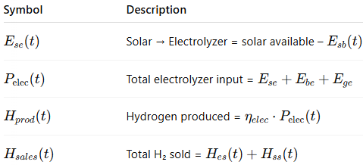
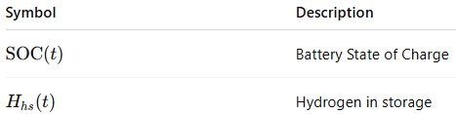
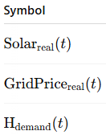
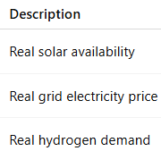
System variables
Solar
E_se
E_sb
E_be
Electrolyzer
H_es
Hydrogen sales
Battery
H_est
H_hs
H_ss
E_ge
Hydrogen storage
Grid
Notes:
6 control variables across energy production, energy storage, hydrogen production, hydrogen storage – covering entire supply chain, we have a control over entire supply chain
Some derived variables
State variables: battery state and hydrogen storage state
Disturbance variables: solar, grid price, hydrogen demand

Slide 13

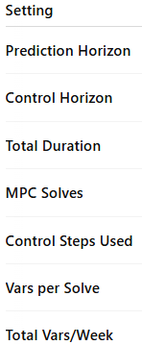
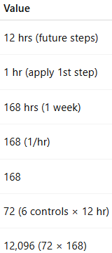




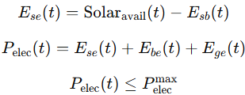
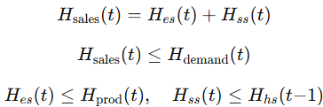
Optimization formulation
Notes:
Optimization formulation: OPEX costs and revenue from hydrogen sales: grid electricity cost, batter operation cost, electrolyzer operation cost, H2 storage cost
Constraints across the whole supply chain
Horizon settings: prediction horizon: 12 hours, control horizon 1 hour, duration 1 week

Slide 14
4. Results

Slide 15
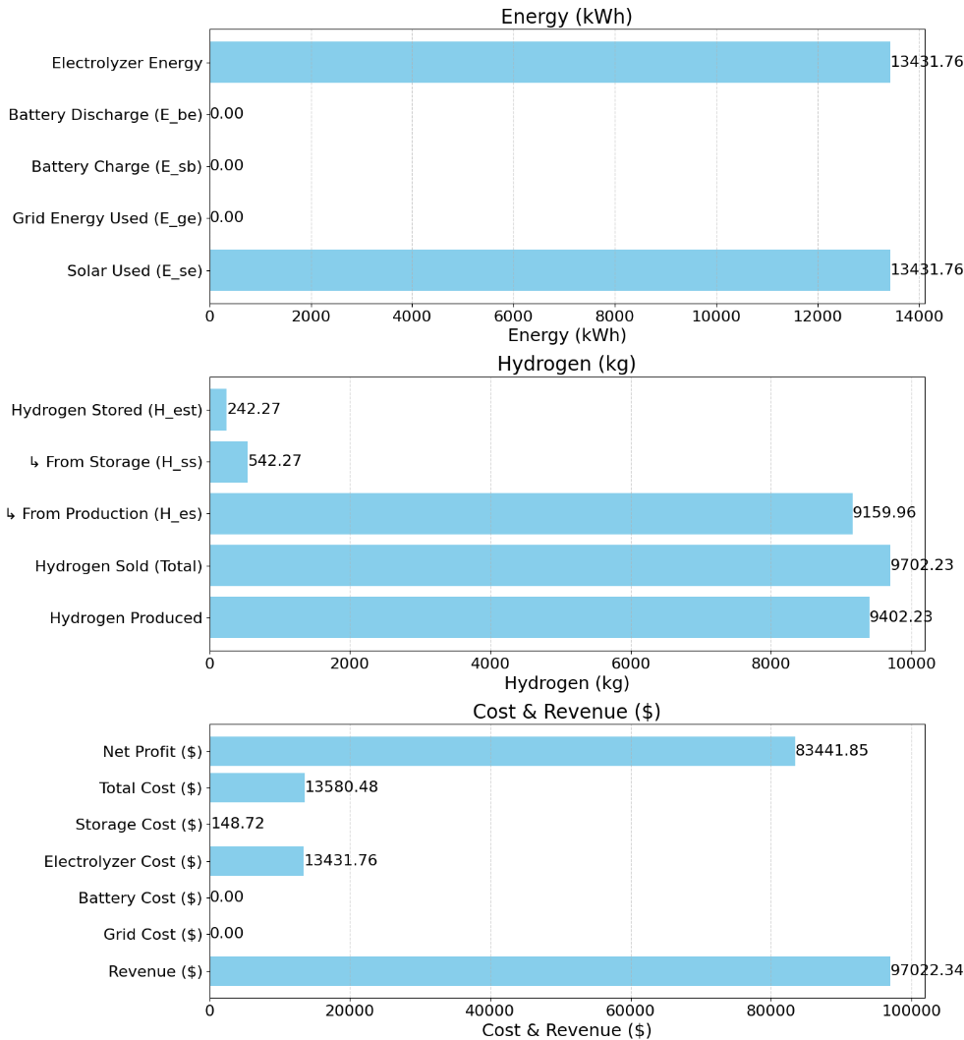
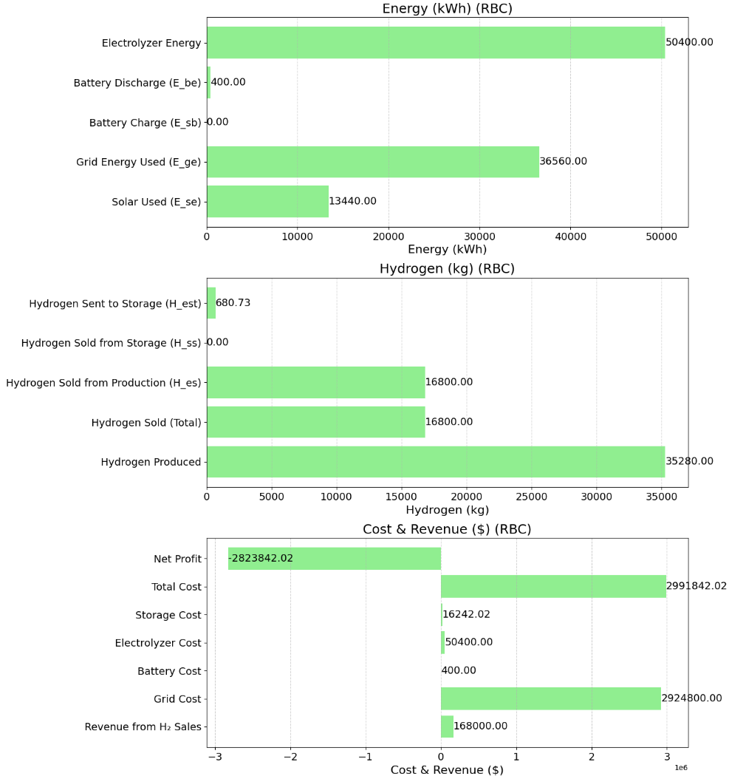
MPC results 2:
Notes:
Energy Metrics
Solar Use:
Both MPC and RBC utilized solar power similarly (~13,300–13,400 kWh), indicating solar was prioritized.
Grid Usage:
MPC: 0 kWh – completely avoided costly and carbon-intensive grid electricity.
RBC: 36,560 kWh – heavy reliance on the grid, which drastically increased cost.
Battery Usage:
MPC: Used battery charging (197 kWh) but no discharging, possibly due to a conservative strategy or high SOC.
RBC: No charging; only discharged 400 kWh, likely from initial SOC – not using the battery for energy smoothing.
Hydrogen Metrics
Production:
MPC: Produced 9,273 kg; almost all sold with some storage use.
RBC: Produced ~3.8x more hydrogen (35,280 kg) but only sold 47% – rest likely overproduced due to no forecasting/optimization.
Cost and Revenue
Revenue:
MPC: $57.4K from hydrogen sales.
RBC: $100.8K – higher, due to more total sales.
Total Cost:
MPC: $133.5K (mainly from electrolyzer).
RBC: $5.27M, overwhelmingly driven by grid energy cost ($4.75M).
Net Profit:
MPC: –$76K loss, but still relatively lean.
RBC: –$5.17M massive financial loss due to uncontrolled grid usage and poor efficiency: 1) Unncessary grid usage 2) Overproduction 3) Storage

Slide 16
Conclusion and Future work
Conclusions
MPC achieves high cost-efficiency, selling hydrogen without relying on costly grid power
RBC suffers from overproduction and poor utilization, due to heuristic, reactive logic
MPC’s forecasting and optimization enable smarter energy allocation
RBC overproduces hydrogen, wasting energy and leading to low system efficiency
Battery usage remains low in both
MPC supports economically sustainable operations, leveraging solar while minimizing waste
Future work
Explore reinforcement learning for hydrogen supply chain optimization, offering adaptive, data-driven control beyond fixed rules and forecast-dependent MPC
Investigate multi-agent RL frameworks to enable decentralized coordination and improved scalability
Notes:
- MPC significantly outperforms RBC in cost-efficiency, achieving reasonable hydrogen sales without expensive grid power
- RBC results in overproduction and waste, driven by lack of foresight and fixed heuristics
- Battery usage is minimal in both cases, suggesting room for better SOC-based dispatch strategies
- MPC’s forecasting and optimization enables smarter trade-offs, using only solar and avoiding cost spikes, making it superior for economically sustainable hydrogen systems

Slide 17
Thanks for attention

