Slide 1
Review week 1-11

Slide 2
Review week 1 – Simple linear regression
Definition of ML, Supervised (reg, clas), Unsupervised (clustering, dimensionality reduction, anomaly detection), Reinforcement Learning
Linear regression: 1) model y=ax+b; 2) parameters: a,b 3) Cost or objective function= 1/2m sum (y-ax-b)^2 4) gradient descent to optimize the cost function (simultaneous update)

Slide 3

Review week 2 – Multilinear regression
Multilinear regression: define for ease x0=1 to vectorize model as y=x*theta
Feature normalization (x-min(x))/(max-min) so 0-1 vs stardardize (x-mu/sigma so range -3 to 3) to speed up gradient descent; both are linear transformations, so that the shape of distribution does not change. We do feature normalization because θ will descend quickly on small ranges and slowly on large ranges, and so will oscillate inefficiently down to the optimum when the variables are very uneven.
Diagnostic for learning rate alpha- plot of J vs N of iterations, if J oscillates or increases that means we are using large value of alpha, J should decrease on every iteration, if alpha is too small then decreases very slowly
Feature eng and polynomial regression: plot data if detect non-linear relationship add features like x^2,3 or x1*x2- need to feature scale
Normal equation: analytical way of finding optimal parameters for regression (derivative wrt to each var=0)
Normal eq vs grad desc: no alpha to choose, no iter, slow for large data (inverse)
Non-invertibility of X (redundant features or n>m, delete them and make n<=m)

Slide 4



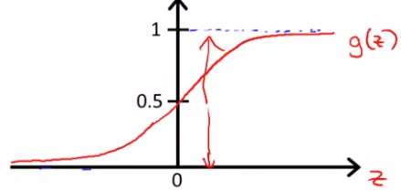
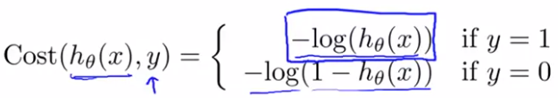
Review week 3 – Classification, logistic reg, regularization
Key concepts: classification, logistic regression cost function, multi-class classification, regularization (prevent overfit)
For classification we want a function outputting 0 or 1
For logistic regression we just apply sigmoid function to output of Linear regression
H(x) is interpreted as probability of outputting 1 based on input x,So hypothesis function outputs values between 0 and 1, so we need a way to map between probabilities to 0 and 1, thus we should decide on decision boundary (say 0.5)
Sigmoid h(x) outputs >0.5 when x>0, so we need theta’*x>0
So, decision boundary z looks like -3+x1+x2>0; we can also fit non-linear decision boundaries by adding polynomials
Cost function is different, because if we plug Log res into LR cost func -> non-convex
We can use adv algos other than grad descent, just need J and its gradient, advantages of advanced algos: no alpha to specify, converge faster, but more complex implementation
Multiclass classification, treat like n-1 binary classifications, train separate classifiers one vs all, and then given new data, fit classifiers individually and see which outputs higher probab

Slide 5

Review week 3 – Classification, logistic reg, regularization
To prevent overfit 1) reduce features or 2) regularization: idea is to keep all the features, but reduce magnitude/values of parameters theta_j and it works well when we have a lot features, each of which contributes to predicting y (a lot of slightly useful features)
general idea for regularization is to use small values for all parameters of theta
It leads to a simpler hypothesis and it is less prone to overfitting
Putting high values in front of par in cost function, so its value is low then
So, lyamda-reg par- is a trade off betw overfit (low lyam) and underfit (high lyam)

Slide 6
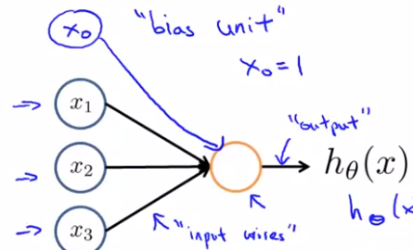
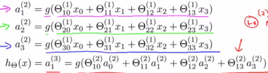
Review week 4. Neural nets representation
The reason for using neural networks are complex non-linear hypotheses (large data-complex boundary problems- data greedy algorithm)
For problems with large N of features and complex boundaries, we need logistic regression with polynomials at least power of 3 or more, for that it makes a lot of features (5000+), it is comp expensive to train and if we use just subset of features then underfit
Computer vision problem ( 50x50 pic-2500 features, RGB-7500 features), if we include polynomial features even more features ,So we need better algorithm that can fit non-linear hypothesis with less number of features (large original number of features)
Each node is like Logist reg h(theta’*x); parameters of NN- weights
Different activation functions can be used other than sigmoid
Each layer has theta matrix (from i-1 layer to ith layer)
Z(i+1)=theta(i)*a(i); a(i+1)=g(Zi+1) this we forward till the final layer
By combining simpler functions in hidden Layers, neural nets can
compute more complex functions
So as forward propagate the network, we
get more and more complex functions

Slide 7




Review week 5. Neural nets Learning
Backpropagation is used for training neural nets
In multiclass classification we have n outputs in final layer, we need to transform one true label into n dimensional vector with 1 and 0s
We sum cost function over all outputs (when k>1) and train examp, whereas for regularization part for each layer we sum for all thetas in all units and layers
We need to find optimal values for all theta’s, for that we need J and grad_J, so 1st we need forward propagation
To backpropagate we start from final layer, find h-y and then backprog errors to earlier layers
We use theta matrix linking current and previous layer, error terms in current layer and derivative of cost f wrt to weight in layer (previous) where we propagate
As we filled out all error terms we then find deriv wrt to each theta:
We sum up gradients for all training ex and at the end /m and add reg gr
So we do FP and BP for each sampl and then repeat these steps for next sample
To use adv optim algos we need: 1)Cost function 2) gradient 3)init_theta as vectors
So, we unroll initial theta pass it to algo, then roll compute grad, then unroll grad

Slide 8
Review week 5 - Neural nets Learning
As backprop algo is involved, we can use gradient checking (finite diff) to diagnose the algo
We compute grad wrt to each theta: (J(thetai+e,theta…)-J(thetai-e,theta…)/2e
We should turn off gradient checking before training, as grad check is slow
Random init for theta’s is needed to break the symmetry (not all 0s but rand values around 0)
Picking a NN archit: 1) Inputs=dimension of features xi 2) Outputs=1 or k if classif, but convert k to [1,0,0] or [0,1,0] etc 3) hidden usually 1, if >1, pick same N of units for each hidden layer, better to pick N comparable to input feature size
Training neural net: 1) random initialize weights 2) forward prop to get activations a, h(x) 3) compute cost function 4) backprop to compute partial derivatives 5) do this for all training samples 6) Use grad checking to compare output from backprop and numerical est of grad 7) Once we see it is correct, disable num grad and use grad descent or other adv optimization method with backprop to minimize cost function
Cost function for NN is non-convex, however, we can get to a reasonable minima

Slide 9
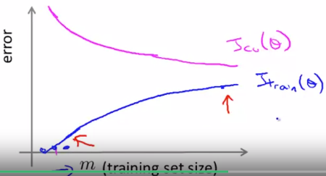
Review week 6- Advice for applying ML
Content is about 1) systematically improving your learning algorithm, 'best practices' for how to 'debug' your learning algorithm and improve performance 2) machine learning system design -where the biggest improvements can be made
What can we do to improve the model? 1) get more training data (not always a solution, works when high variance algo, but not high bias 2) try smaller sets of features (when overfitting 3) try additional or polynomial features (when underfitting) 4) try decreasing lyamda (when underfitting) 5) try increasing lyamda (when overfitting)
Standard way of evaluating algo is to train on training set, choose model based on cross validation set and report error based on test set (this is more realistic option)
If algo is not performing good, then it is either overfitting or underfitting problem, so to optimize algo we need to determine what setting we are in (compare train and cv error), graph of error vs flexibility (U shape); if underfit both train and cv errors are high, if overfit test is low, cv is high
To pick optimal reg par we try different values and choose model with lowest cv error
Learning curve (Jcv, Jtr vs training size) useful for 1) checking whether model
Is performing good 2) when we want to improve the performance

Slide 10
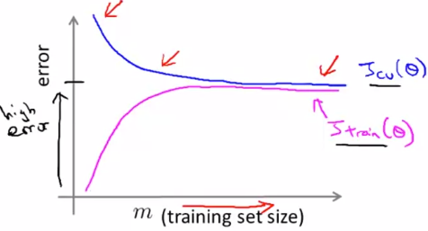
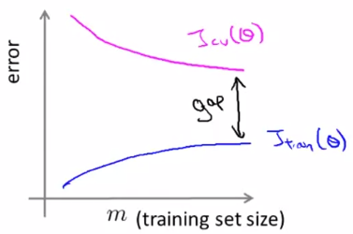
Review week 6- Advice for applying ML
As we increase sample size on which we train on, training set accuracy decreases, as it becomes more diff. to fit to more data, but cv error decreases as our model general. Better
Jtrain and Jcv in high bias case converge, as additional
Data don’t help to improve model
In high var case our train error will increase but we
Still have a room for optimization, so CV error decreases (gap between CV and test errors)
So, our further actions depend on whether we overfit or underfit. If we have high variance problem,overfitted- 1)reduce features 2) use simpler model 3) get more data 4) increas lyam
To overcome underfit 1) more complex models 2) lower lyam 3) add new features
Recommended approach for building a ML model: 1) start with a simple algo that can be implement quickly and test it on CV set 2) plot learning curves to see if more data/more features can help
So, it is hard to tell in advance what is needed for a good model, 1st simple implementation can give clues. Error analysis is useful (analysing manually examples misclassified in CV set can help to detect where problem is and give ideas to come up with new features

Slide 11


Review week 6- Advice for applying ML
For skewed data misclassification error is not the best metric (predicting always 1s or 0s achieves better performance than any algo, so instead precision (of cases predicted as 1, what fraction is truly 1 and recall (of data that is 1, what fraction is we found to be 1)
We can play with
Threshold values ( 0.5) to balance between precision and recall, depending on a problem type, also we can decide to keep both of them high by introducing F1 score
Usually, using more data help gets more performance than using more advanced algo
However, not for all problems we need more data
To use effectively large data we need 1) enough features (can based on input human predict y 2) algo is flexible (neural net, LR with many features)

Slide 12
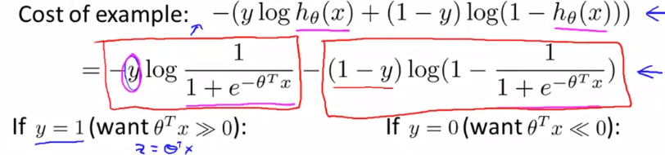
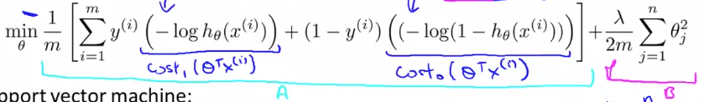

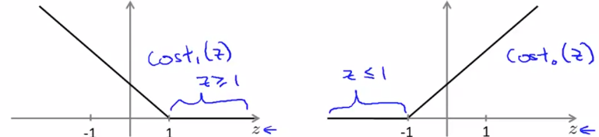

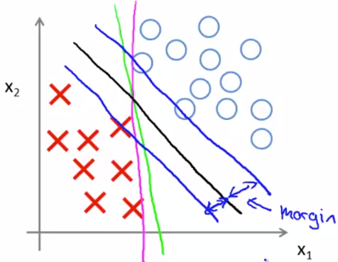
Review week 7- Support vector machines
Compared to both logistic reg and neural nets SVMs sometimes gives cleaner and more powerful way of learning complex non-linear functions
Cost function for logistic regression
For SVM we change terms in log reg
Also multiply cost by m and divide by lyam
So, instead of lyam, C is used
To balance cost and regul term
High lyamda -low C
Overall cost function is:
In SVM we have stricter boundaries 0 vs 1, -1
Solving this optim prob we get
Large margin dec boundary (far

Slide 13

Review week 7 - Support vector machines
So, when C is large we penalize heavily wrongly predicted outputs, and that leads to large margin classifier and overall, SVM can be thought of as large margin classifier and this idea more of true when C is too large
Kernels. We define n (say 3) landmarks (centroids) and construct new features f1, f2, f3 based on similarity between landmark and feature vector x (so our n dimensional feature vector gets translated to number of landmarks), as similarity function we can use Gaussian kernel (outputs 1 if x1 is close 1, otherwise 0
So, earlier we said we predict 1 if theta’*f>0; so depending on value of theta and similarity to centroid we predict 0 or 1
Now, we are interested in question of location and N of landmarks… we should have m landmarks and put them exactly on location of training samples, then our features f will measure how close new examples are to our existing samples (f1=similarity (xnew1,l1)…
So, feature vector f will have values betw 1 and 0 and fi for xi=1, as li was placed at xi
So, given new x, we compute new features for each training set and predict 1 if thet’*f>0
So, we use fs as features instead of x, and dimension of theta is also m, so square matrix

Slide 14
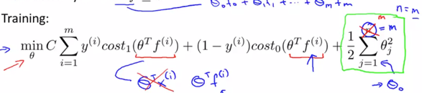

Review week 7 - SVMs
SVMs and kernels tend to go well together
And lead to optimization computation, compared
To Logistic regression.
When using SVM, one of parameters we need to choose is C=1/lyam and sigma^2 in Gaussian
Similarity kernel, when C is high, lyam low so high var algo,
Large std in kernel means value of f (similarity) decreases slowly, so smoother dec boundary
To use SVM in practice we need to specify 1) parameter 2) kernel (sim function) and other parameters based on choose kernel (e.g sigma for gaussian kernel
We can use linear kernel (does not use any similarity function), which leads to linear dec boundary (low m, large n) or Gaussian kernel when m>>n to fit more complex models
Mostly Guassian and linear kernels are used
We can also do multi-class classif using SVM using existing packages or one vs all method
Logistic reg vs SVM depends on number of n vs m 1) n>m – use log reg or linear kernel 2)n is small m interm- SVM with Gaussian kernel 3) n small m large – create add more features, then use log reg as train with Gaussian kernel—slow; SVM cost is convex

Slide 15

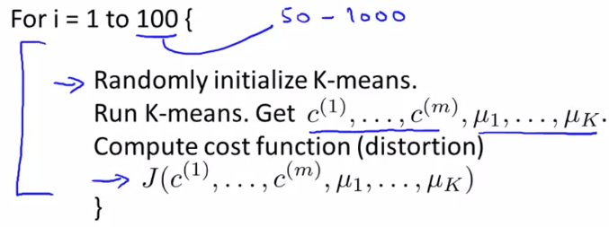
Review week 8 – Unsupervised learning (k-means, PCA)
Unsupervised learning- clustering (K-means) (market or other segmentation), dimensionality reduction (PCA) for 1) easy of visualization 2) speed up training 3) memory, anomaly detect
In the clustering problem we are given an unlabeled data set and we would like to have an algorithm automatic group the data into coherent clusters for us. (K-means popular clust)
Algo of K-means: 1) Initiate random centroids 2) for i=1:m Assign each training ex to the closest cluster (min J by varying c(i)) 3) for j=1:k Update centroids once all tr ex have been assigned (min J by varying mu_k) 4) Continue until no update in centroids
For K-means, optim objective is to minimize the squared distance betw data points and cluster centroids for all ex and groups by carrying cluster centroids and cluster assignments
Depending on random initialization, k-means may
Stuck at local minima, so running k-means multiple times may help (pick one with the lowest J)
We usually initialize based on K randomly picked training examples
Choosing K: 1) elbow method (Cost vs K) – break in slope
2) Choose based on insight on problem (T shirt sizing –should be 3)
Choosing K based on problem insight may be a better option

Slide 16

Review week 8 – Unsupervised learning (k-means, PCA)
PCA applic: 1) data compression, to speed learning algos 2) visualization of high-dim datasets
1) Data compression- e.g. from 2D to 1D (m*2 to m*1) 2)Visualization e.g. R^50 to R^2 – in 2D we can easily visualize, how, we lost meaning of feature (these 2 feat- integrate diff featur)
PCA- projects onto lower dim hyperplane, so that mean sq. error between points in Rd and hyperplane is minimized (feature scaling is needed so that we penalize each dimens equally)
From 2D to 1D it is like fitting best line in plane (PCA vs reg, however, vert vs inclined distance, obj f is different, applications: prediction vs projection)
So in PCA we do 2 things: 1) find direction vectors, spanning new space 2) Project data into that space. To apply PCA we 1) compute cov matrix (sigma) n*n of data 2) compute eigenvec of sigma – columns in U (n*n( are what we need (pick 1st k columns)
Z=X (m*n)* U(reduced) (n*k) ; reverse X= Z (m*k) * U(reduc) (k*n)
So, algo is : 1) feature scaling 2) compute cov(x)=sigma 3) SVG of sigma and pick U 4) new z
In real data usually many features are highly correlated, so even significantly reducing the number of dimensions still makes it possible to retain most of the variance

Slide 17




Review week 8 – Unsupervised learning
Avg squared projection error total variation in data
We choose k to be the smallest value so that , variance retained >99,95
Algo for choosing N of principal components: 1) try PCA with k=1, compute all the necessary variables (U,z,x) 2) check if variance retained >99 3) if yes stop if not increase the k
This is not the best computationally efficient method, another way is to use the entries of diagonal matrix S and compute the following up to k
If k is not enough then increase k
We can use PCA in CV problems: say 100*100 pic, 1st unwrap into vector, 10000*1 then apply PCA to reduce dimension, apply the same mapping to test and cv set and speed up training
Misuses of PCA: 1) using it to prevent overfitting- by reducing N of features (less features, less likely to overfit) – by doing this we throw away useful info – use regularization instead
2) Using PCA where it shouldn’t be used – before using it try to avoid, if only there is strong reason for using it (slow training or memory requirements) then use it

Slide 18




Review week 9- anomaly detection, recommender systems
Anomaly detection (which data points deviate from mean significantly, given e.g. Gaussian distribution), is widely used in fraud detection (e.g. ‘has this credit card been stolen)
Recommender systems look at patterns of activities between different users products to produce these recom(algos collabor filtering algorithm and low-rank matrix factorization)
In anomaly detection given a dataset x1,…,xn we assume that it is not anomalous and construct a model p(x), then given xtest we test whether
Parameter estimation- given a dataset x1…xn we assume that data generating prob distrib and then estimate parameters of distrib using MLE (for Gaussian, sample mean and var)
We fit param for each feature and given xtest we calc joint PDF of features
So, overall algo: 1) choose features x that might be indicative of anomalous examples 2) fit parameters of distrib (mu, sigma) 3) given xtest compute p(x) prob of observing this sample, joint pdf (as product of p1..pn if indep) 4) check if p(x-test)> or < eps to decide anom or not)
We use only normal exampl in train set (6000 ex) to fit parameters mu, sig
In cv (2000-10) and test (2000-10) we use both normal and anom samples, overall 10 000 – 20
After fitting in tr set, we calc px (><eps), and compare to true labels, use F1 score, as skewed

Slide 19

Review week 9- anomaly detection, recommender systems
We use cv set 1) to tune eps based on F1 score 2) choose which features to incl, then report final perf value based on test set, so having 1 number eval metric enables fast decision mak.
Anomaly det vs superv: small N of pos ex and different range of anomalies, so hard to train as supervised problem; for superv –balanced dataset
Feature sel has huge effect on perf of anomaly detection algo; if we are fitting Gaussian model, features need to be Gaus (plot hist of feat, if not G, apply transforms
For feature sel. we can use error analysis, manually look up ex. that algo classif incor, with the aim to come up with a new featur that helps to detect this (large p for normal, low p –anom)
When features are not indep (separately both samples are not anom, but indiv,
They are; in this case we use multivariate G (mu, cov_matrix), when indep MG=product of G
So, we fit par of MG and then calculate p(x)<>eps, G is a special case of MG when cov is diag
Original model (p1*p2..pn): 1) in case of correl betw features, we need to manually create new features (x3=x1/x2) to detect unusual occur x1 >>, x2<< 2) comput cheaper
3) Works fine when m is small. Multivariate G model: 1) autom captures correl betw features in cov matrix 2) comput more expensive ( invert cov matrix in PDF) 3) m=10n ore more and no redundant features so that covariance matrix is invertible

Slide 20
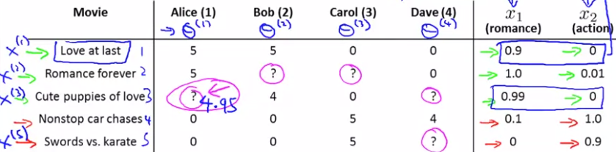
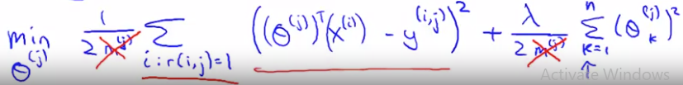
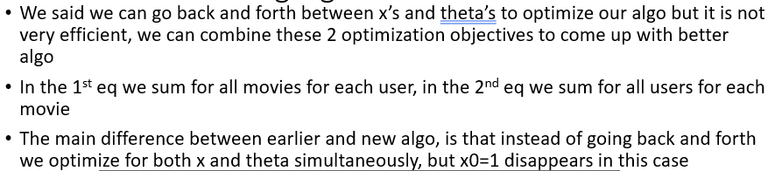
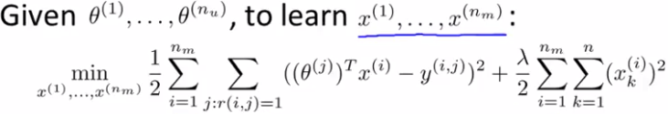


Review week 9- anomaly detection, recommender systems
In recom system we have scarce matrix (rows-products, col-users), goal is to fill matrix (1-5 sc)
r(I,j)=1 if user j rated movie I, y(I,j)=score; theta_j-par of user
Content-based rec s: fit diff reg models for each user (r==1)
(features of movies [1 x1 x2]- y scores of user) – min the diff betw y’s and pred (where r=1)
In reality, it is hard to get features for all movies
Collaborative filtering – no need to know values for features, it learns by itself
Here instead we ask users to rate their preferen (theta’s), we also have y’s (scores for movies)
So, given theta and y, predict x (features) for each movie
Here, we minimize the cost f, by altering x’s
So, in content-based (learn theta-user pref, given x), in collab f, (learn x-learn feat given theta)
In collab f, we can randomly guess theta, predictX, then improve theta
Going back and forth betw x’s and theta’s is not efficient, we can combine these 2 optim obj.
And optim x and theta simultaneously

Slide 21

Review week 9- anomaly detection, recommender systems
So, overall algo: 1) initialize x’s and theta’s to small rand values 2) min J(x’s, theta’s) using gradient descent (or adv optim algos) for both x and theta simultaneously 3) for a user with (learned) theta and movie with (learned) x, predict a star rating theta’*x
Y=X (feature matrix m (movies) n (features) * theta’ ( n(features)* (j users)
Collab. Filt algo= low rank matrix fact (y is low rank m)
Low rank approximation is minimization problem, in which the cost f measures the fit betw a given matrix (data) and approx. matrix (optim variable), subject to constraint that the approximating matrix has reduced rank
Usually, after algorithm learned some features x, it is hard to interpret these features in human understandable form, but usually they are meaningful; similar movies
Mean normalization for user ratings are needed so that for movies with no ratings we predict mean score for each movie for new user (so 1st we subtract from movie ratings the mean of each movie, then optimize parameters and at the end we add again the mean) – pre-processing step

Slide 22
Review week 10: Large scale ML
Machine learning works best when there is an abundance of data to leverage for training, so important to know how to handle ‘big data’
ML achieves best performance when we use large data on complex algorithm
Large datasets require more efficient computational systems
Summing over m terms that we have in batch grad descent is not efficient when m is large
2 solutions: 1) more computationally eff method (stochastic grad descent) 2) Map reduce
In batch grad desc we sum over m train example just for 1 update in each theta
In stochastic grad desc we shuffle data and use 1 train ex for 1 update (so much faster updates, but accuracy is affected- not always cost decreases, rather than reaching global min in wanders around this region; also overall several iterations over all train ex needed
Mini-batch grad desc uses b examples in each iter (b-2-100) is sometimes faster than stoch grad descent, when we can vectorize the implementation
To know when grad desc is convergent in batch we made plot of Jcost vs N iter (break in slope)
For stoch gr desc we plot avg cost over 100/1000 iter vs every 100/1000 N iterations

Slide 23
Review week 10: Large scale ML
Plot of Jcost vs N iter for stoch gr desc: 1) by reducing alpha we might get slightly lower cost 2) by increasing N of train samp over which we avg we can smooth out curves 3) if graph fluctuates inc train size to see if there is at least slow decrease, if not reduce alpha 4) if increases (diverges) decrease alpha
Learning rate is typically held const, however, we can decrease alpha over time if we want theta to converge to global min by decreasing it slowly
We need play with const1 and const 2. Diagnostic plot J cost vs N of iter is useful for 1) checking that our algo is doing fine 2) to tune learning rate alpha
In online systems, we have continuous stream of data, so we use it once and then discard
Shipping service website: user x (origin-destination-cost..) y(agree to ship or not), here we want to learn func that given features will output probability of y=1
So, basically while true: get new data; update theta’s in classifier and then discard sample
We can then see for which x’s y is close to 1? So that we sell
Adv of online learning: 1) algo can adapt to changes in data 2) no need to save examples
Map reduce even more eff than stoch gr d. Idea is to split work between diff machines; we need to find work that can be splitted (summing over 400 samples 100-100-100-100); multicore comp

Slide 24

Review week 11- Photo OCR
Idea of ML pipeline (different parts of complex system)
For Photo OCR problem pipeline:
Total performance of system is based on performance of individual systems
When allocating resources it is important to evaluate which component is performing poorly (manually supply ground truth labels and see how overall performance is affected)
Photo OCR: 1) text/pedestrian detection (choose aspect ratio, pixel steps and collect supervised data and run algo with increasing or decreasing the patch size (detection rectangle)
2) 2nd stage is cutting detection region into separate pieces, at this stage we can again use supervised learning approach, collect data where letters split and where not (y=0). Having collected data, use sliding window approach again
Last step is character classification A -> A; collect labeled data and train
Artificial data generation: 1) from scratch (pick some font, background) you have data 2) amplify from existing (change the training data little bit (different background, rotate etc) –modifications made should be representative
Ceiling analysis for choosing which part to prioritize on (detect the worst perform parts)

Slide 25
Summary
1. Supervised learning :
Linear (also multivariate) regression (regression), logistic regression (classification), neural networks (reg and clas), SVM (reg and clas)
2. Unsupervised learning:
K-means (clustering), PCA (dimen reduct), Anomaly detection (might use y labels)
3. Special applications / special topics:
Recommender systems (content-based, collaborative filtering), large scale machine learning (Map reduce)
4. Advice on building a ML system:
Improving performance/diagnostics: Bias/variance trade off, regularization,
deciding what to work on next: evaluation of learning algorithms (performance metrics based on type of problem), learning curves (bias vs variance), error analysis, ceiling analysis

