Slide 1
Machine Learning week 1

Slide 2
Definition of ML
The field of study that gives computers the ability to learn without being explicitly programmed." This is an older, informal definition
A computer program is said to learn from experience E with respect to some class of tasks T and performance measure P, if its performance at tasks in T, as measured by P, improves with experience E.“
Supervised Learning
In supervised learning, we are given a data set and already know what our correct output should look like, having the idea that there is a relationship between the input and the output.
Supervised learning problems are categorized into "regression" and "classification" problems. In a regression problem, we are trying to predict results within a continuous output, meaning that we are trying to map input variables to some continuous function. In a classification problem, we are instead trying to predict results in a discrete output. In other words, we are trying to map input variables into discrete categories.

Slide 3
Unsupervised Learning
Unsupervised learning allows us to approach problems with little or no idea what our results should look like. We can derive structure from data where we don't necessarily know the effect of the variables.
Two of the main methods used in unsupervised learning are principal component and cluster analysis also minor (anomaly detection)
We can derive this structure by clustering the data based on relationships among the variables in the data.
With unsupervised learning there is no feedback based on the prediction results.
Clustering: Take a collection of 1,000,000 different genes, and find a way to automatically group these genes into groups that are somehow similar or related by different variables, such as lifespan, location, roles, and so on.
Non-clustering: The "Cocktail Party Algorithm", allows you to find structure in a chaotic environment. (i.e. identifying individual voices and music from a mesh of sounds at a cocktail party).

Slide 4
Reinforcement learning
Reinforcement learning (RL) is an area of machine learning concerned with how software agents ought to take actions in an environment in order to maximize the notion of cumulative reward. Reinforcement learning is one of three basic machine learning paradigms, alongside supervised learning and unsupervised learning
Reinforcement learning differs from supervised learning in not needing labelled input/output pairs be presented, and in not needing sub-optimal actions to be explicitly corrected. Instead the focus is on finding a balance between exploration (of uncharted territory) and exploitation (of current knowledge)
The environment is typically stated in the form of a Markov decision process (MDP), because many reinforcement learning algorithms for this context utilize dynamic programming techniques

Slide 5
Linear regression

Slide 6

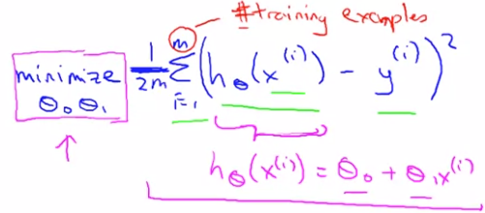
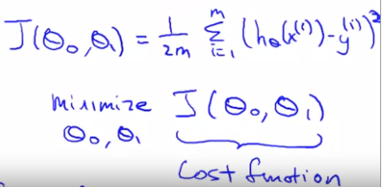
x(i)- input variables, y(i) output variable, (x(i), y(i))-training example
Training set is (x(i), y(i)) for i=1,…m
Our goal is given a training set, to learn a function h: X-> Y
Here our model h= theta_o+theta_1*x – linear regression model with 1 var
Here we aim to select parameters of linear regression, such that the output from our model and from training data is similar
We aim to minimize the function on the right
By tuning theta_0 and theta_1
We want the avg difference be minimum, but for
The ease of derivative we put square and then divide by 2
So J(theta_0, theta_1) is cost function or objective
Function. We measure the accuracy of model by cost f.

Slide 7
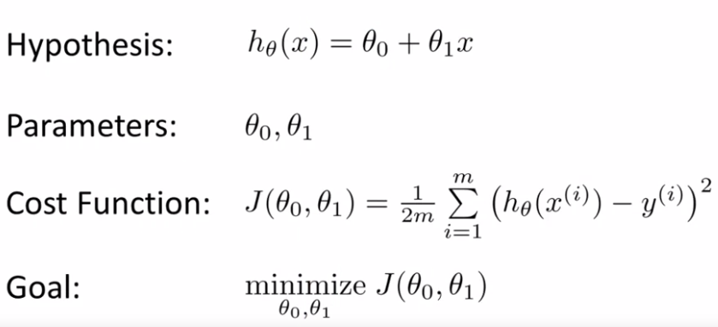
For fixed theta_1 function h(x), whereas J- cost function if function of theta_1

Slide 8
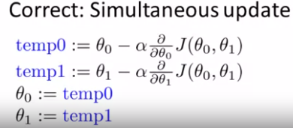
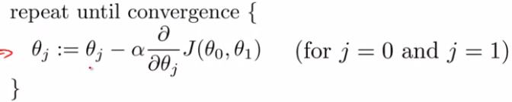

Parameter Learning
We have some function J(theta_0, theta_1), and we want to minimize this function
We start with some parameter, theta_0 and theta_1 and evaluate J at this point and then we keep changing these parameters so that the value of J reduces
We stop until J does not change/reduce
Gradient descent
it is because as we approach min slope gets smaller

Slide 9
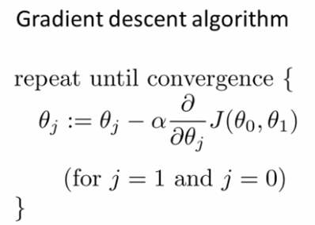
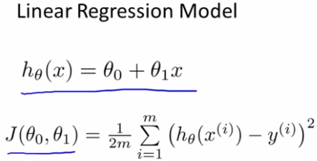

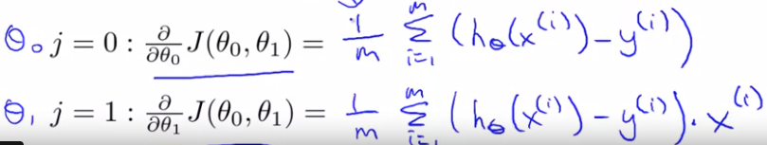
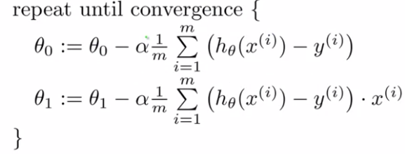
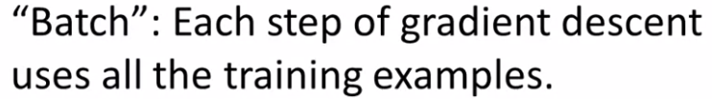
Gradient descent for linear regression
Key term for computing gradient descent is derivative term

