Slide 1
Week 10 Large scale Machine Learning
This week, we will be covering large scale machine learning. Machine learning works best when there is an abundance of data to leverage for training. With the amount data that many websites/companies are gathering today, knowing how to handle ‘big data’ is one of the most sought after skills in Silicon Valley.

Slide 2

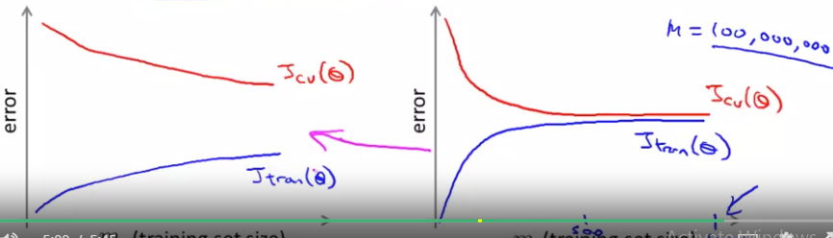
Learning with large datasets
One of the best ways to get high performance ML system is to take low bias (complex) algorithm and train it on a lot of data
The one with more data wins always over the best algo
Large data sets require more efficient computational problems
When m is large say 100 000 000, we to sum 10^6 times
Clearly it will take a lot of computational effort
2 solutions: 1) may be even we do not need so many training examples, if for given problem our algo is high bias, then using large train examp wont give better results
2) if algo is high var, using large training examples will help, but we need to develop new computationally efficient methods 1) stochastic gradient descent 2) MapReduce

Slide 3
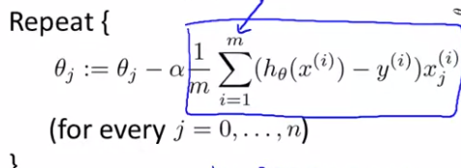
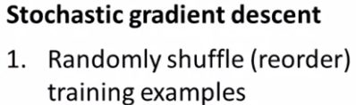
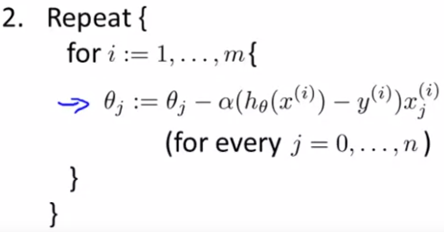
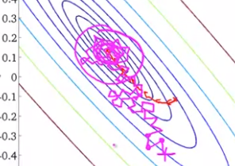
Stochastic gradient descent
For algos like LR, log R, neural networks, we came up with cost function, then used some optimiz technique (gradient descent) to find optimal parameters
This version of gradient descent is called batch grad d,
Because at each step we use all training examples
So 300 000 000 sums just for 1 step of gradient descent for only 1 theta
In stochastic gradient desc we 1) shuffle data 2) use grad d using only 1 tr ex at a time
Stochastic grad descent performs each step faster, however, it does not reduce the cost function at each step, and also does not converge, but wander around optimal region (acceptable for most prob) and overall it takes more steps than batch gradient descent
Outer loop needs to be performed around 1-10x depending on m (if m is large, less loops)

Slide 4
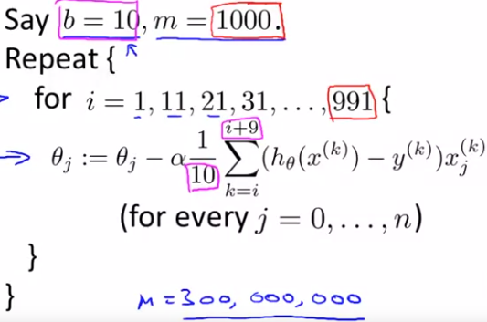
Mini batch gradient descent (another variation of these ideas
Mini batch even sometimes works faster than stochastic gradient descent
Batch grad. descent: use all m examples in each iteration
Stochastic gradient descent: use 1 example in each iteration
Mini-batch gradient descent: use b examples in each iteration (b ranges 2-100)
Mini batch is faster than batch always, and stoch when we can vectorize the implementation and parallelize computations (Usually use b=10)
So, choose good value of b and
vectorize and get faster results

Slide 5

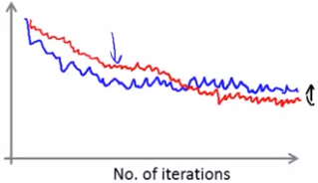
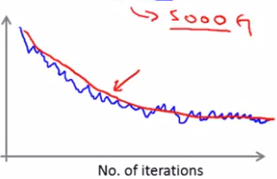
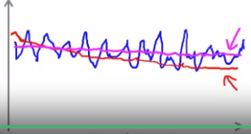
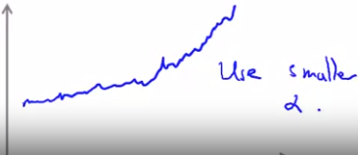
Stochastic gradient descent convergence
How do we know that stochastic gradient descent converged and how do we tune alpha while using SGD?
Batch gradient descent: Plot cost function as a function of the number of iterations of gradient descent (computer cost, go over entire training set and optimize theta by 1 step then compute cost again)
Stochastic gradient descent: compute cost after every step before updating theta’s. but plot average Cost (avg over 1000 iter) vs N of iterations for every 1000 iterations
1- blue cost over 1000 tr ex; red when alpha is reduced a bit (might get slightly less cost)
2-red when we avg over 5000 training samples; graph is smoothed out (delay in feedback
3- either decr slowly, we see it by incr train size (red) or problem (decr alpha or other pr)
4 divergin (dec alpha)

Slide 6
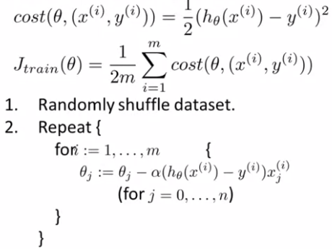

Choosing learning rate alpha
Learning rate is typically held constant, however,
we can slowly decrease alpha over time if we want
Theta to converge to global min by decr it slowly
E.g. alpha=const1/(N_of_iter+const2); alpha -> 0
If we choose to decrease alpha, we end up spending
time with extra parameters const 1 and const 2.
Decreasing learning rate helps to achieve global min (usually we are content with approx. min rather playing with extra parameters)
So diagnostic plot (J vs N of iterations is useful for both 1) checking our algo is doing fine and 2) to tune learning rate alpha

Slide 7
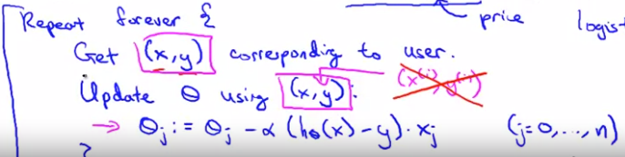
Online learning- another large-scale ML setting
In online systems (websites) we have continuous stream of data and when we have continuous large stream of data we use data once and then discard it
Let’s say we have a shipping service website, where user comes, specifies origin and destination and we offer to ship package for some price and user either chooses to ship a product (y=1) or not (y=0)
Features x capture properties of user, origin/destination and asking price and we want to learn to optimize the price, that is given features what is probability of y=1?
Our algo is as following : repeat forever { 1) get (x,y) for user; 2) update theta’s using (x,y)
That is for all }
This algo can adapt to changing user preferences

Slide 8
Other online learning example
Product search (learning to search)
User searches for ‘Android phone 1080p camera’
We have 100 phones in our store and we will return 10 results
X=features of phone, how many words in user query match name of phone, how many words in query match description of phone, etc
Y=1 if user clicks on link, y=0 otherwise, we learn probability of clicking given data and our learned parameters
Then based on model we choose 10 phones they are most likely to click, that is 10 phones with the highest probability
Other examples of online learning: 1) choosing special offers to show to user 2) customize selection of new articles; product recommendations
Advantages of online learning algo: 1) adapt to user preferences 2) no need to save
This is similar to stochastic gradient descent, using 1 example at a time

Slide 9




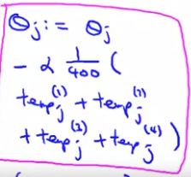


Map Reduce and data parallelism
This enables to scale ML algo to even bigger data than stochastic gradient descent
Basic idea of map reduce is to split the training data between different machines, compute the variable on each of those pieces and then combine
To use map reduce approach we need to ask: can an algo be expressed
as a summation over training set (many actually can be expressed)
E.g for logistic regression:
We can apply map reduce for both cost and grad terms
We can also apply this method in 1 multicore computer

