Slide 1
Week 2 Multivariate regression

Slide 2

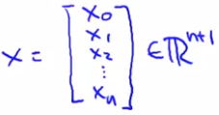
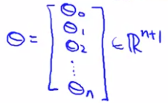


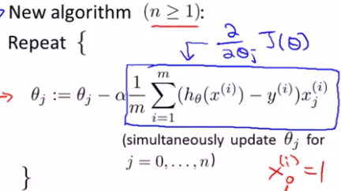
Now, we have more features, n-number of features, m- number of training examples

Slide 3
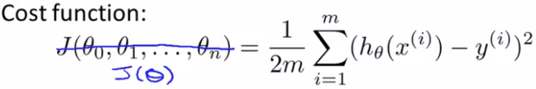



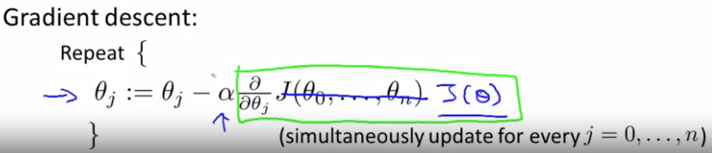
Multilinear Regression

Slide 4
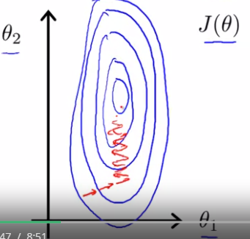
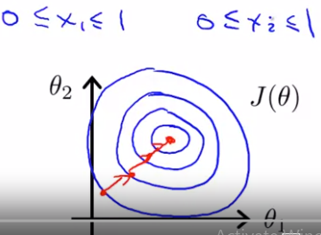
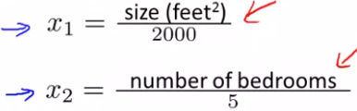


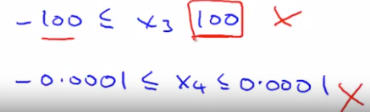


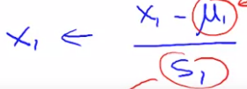
Practical tricks to make gradient descent work better (faster): Feature scaling
The idea is to make sure that features are in a similar scale
As range for x1>x2, the cost function is more sensitive to
Theta 1, that is small changes in theta1 results in larger changes
In cost function rather than theta_2
This range of between -1 and 1 is not strict,[0,3], [-2, 0.5] are ok
To feature scale we can 1) Divide by maximum
2) use mean normalization (substract mean and divide by max or range or std)

Slide 5

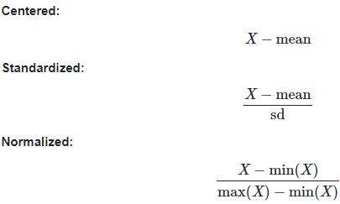
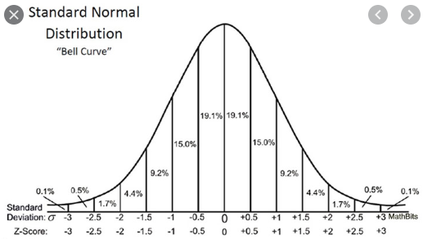
Normalizing rescales data to the unit interval
That is between 0 and 1
Standardizing turns data into z scores
Centering makes mean of data equal to 0
It is worth to note that all of these 3 methods are
linear transformations, so they do not Change the shape of distribution
We can speed up gradient descent by having each of
our input values in roughly the same range.
This is because θ will descend quickly on small ranges and
slowly on large ranges, and so will oscillate inefficiently
down to the optimum when the variables are very uneven.
Two techniques to help with this are feature scaling and mean normalization. Feature scaling involves dividing the input values by the range (i.e. the maximum value minus the minimum value) of the input variable, resulting in a new range of just 1. Mean normalization involves subtracting the average value for an input variable from the values for that input variable resulting in a new average value for the input variable of just zero.

Slide 6
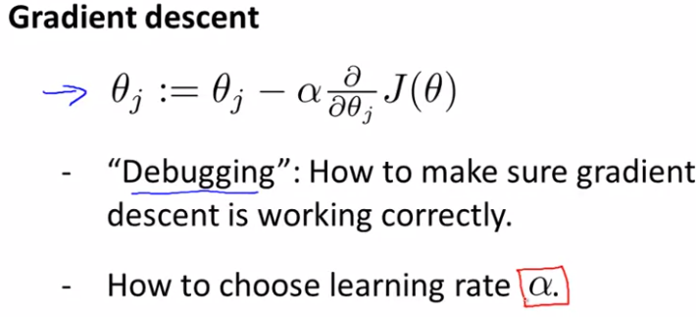
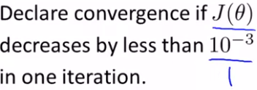
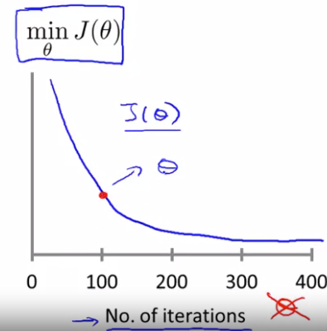
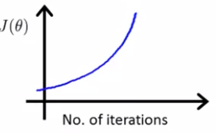
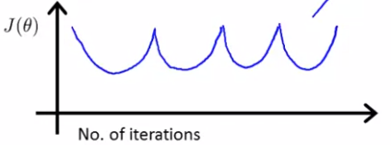
Another trick is about the learning rate –alpha
We can plot J(alpha) as gradient descent runs
If gradient descent is working properly J should decrease
By looking at curve J-N of iterations we can also judge
Whether gradient descent converges or not (graph flattens)
We can also use an automatic convergence test
However, choosing threshold for value of
Convergence is hard so it is better to look at graph
If we have a graph like on the right, meaning
Cost function value increases per iteration, that
May mean we are using large value of alpha
If the value of cost function fluctuates then again we should decrease
The learning rate

Slide 7
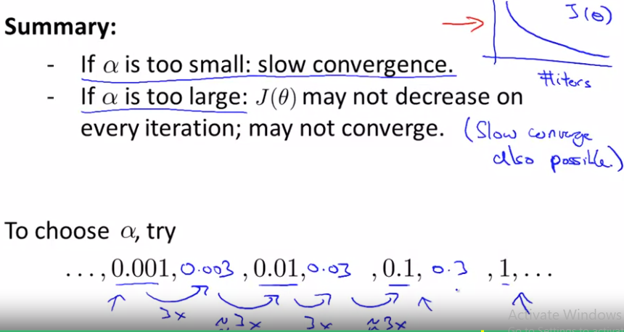
Plotting J as function of number of iterations is always good idea
We need the value of learning rate that causes a sharp decrease in the value of cost function
So we should experiment with alpha (large and low values first, then smth in between) and choose the one just slightly less than the one causing fast decrease

Slide 8
Normalization is a good technique to use when you do not know the distribution of your data or when you know the distribution is not Gaussian (a bell curve). Normalization is useful when your data has varying scales and the algorithm you are using does not make assumptions about the distribution of your data, such as k-nearest neighbours and artificial neural networks.
Standardization assumes that your data has a Gaussian (bell curve) distribution. This does not strictly have to be true, but the technique is more effective if your attribute distribution is Gaussian. Standardization is useful when your data has varying scales and the algorithm you are using does make assumptions about your data having a Gaussian distribution, such as linear regression, logistic regression, and linear discriminant analysis.

Slide 9
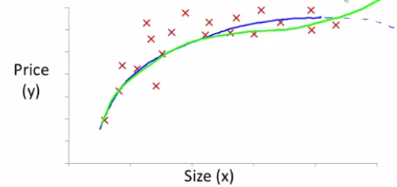
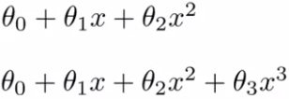


Feature engineering and polynomial regression
Sometimes by defining new features we can get a better model
For example, we might be given a frontage and depth of house, we can multiply them and get the area of a house as a new feature
We might have a data looking as on the right
We can fit quadratic function (eventually goes down)
Or cubic (does not go down)
we can fit cubic polynomial as linear regression by using
And here feature scaling becomes even more important

Slide 10
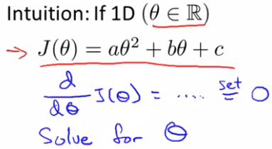
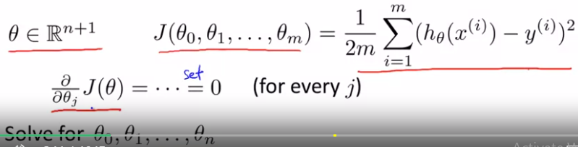
Normal equation
Normal equation is a method to solve for theta used in linear regression analytically (in one step)
In calculus, in order to find min of function we find derivative wrt to parameters and equate it to 0
In our problem, theta is not a single parameter but
rather a vector of parameters, so we need to take derivative
Wrt to each parameter, equate to 0 and solve them

Slide 11
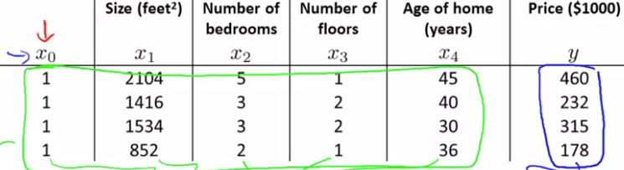

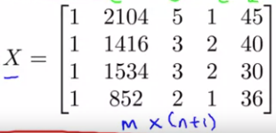
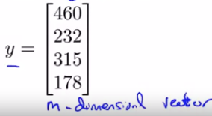
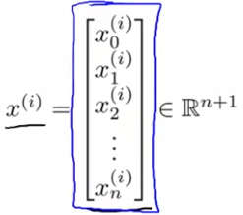
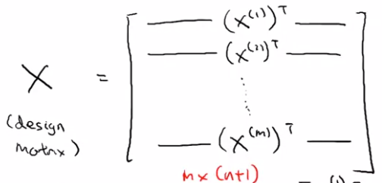

Let’s say we have 4 training examples, m=4
We add 1st column for x0
Then we have a matrix X and vector y
We can find theta by
In the case we use normal equation, there is no need for feature scaling
When finding optimal values for theta we have equation =0, here we can neglect m and xj, so h(x)-yi should be 0, so h(x)=y, whereas h(x)=x0*theta_0+x1*theta_1 etc for all the i’s, that is training samples so h(x)=X*theta=y, we multiply both sides XT*X*theta=XT*y and then we invert equat

Slide 12
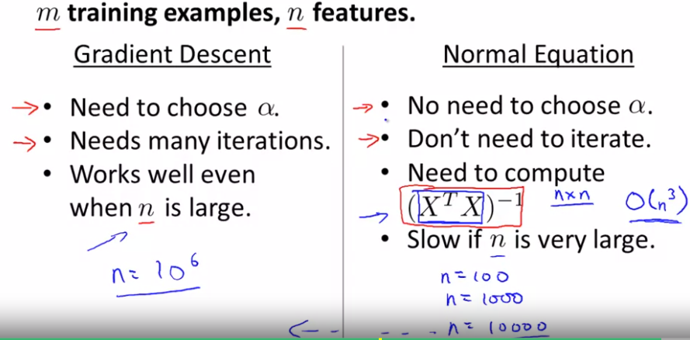
Here we compare using gradient descent to normal equation for finding the values of vector theta
Gradient descent: Disadv: 1) need to choose alfa 2) needs many iterations Adv:works well even when n is large (greater than 10 000 features)
Normal equation: Adv: 1) no need to choose alfa 2) don’t need to iterate
Disadv: 1) need to compute inverse of XT*X, so it is slow when n>10 000
So, criteria for choosing between gradient descent and normal equation is n

Slide 13
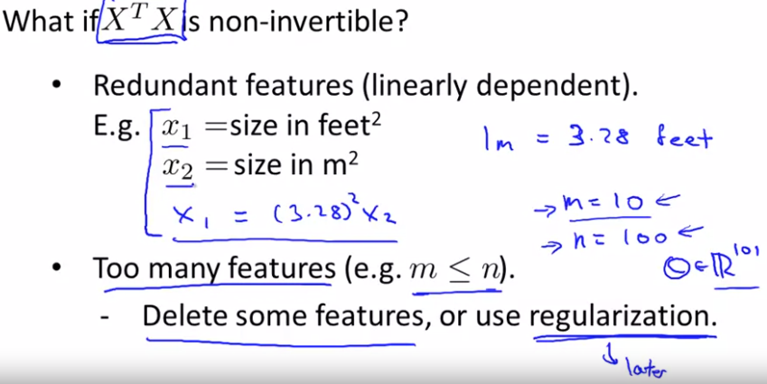
Issue of non-invertibility in normal equation
This happens very rarely, and if even happens matlab/octave does the job
Non-square matrices does not have inverse
So XT*X is non- invertible if 1) we have redundant features (meaning linearly dependent columns, then we should delete those redundant columns or
2) We have too many features (m<n), compared to number of training samples
In this case we either delete some features, or use regularization

