Slide 1
Week 3: Logistic regression

Slide 2
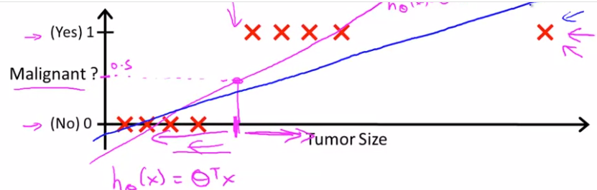
Logistic regression is a method for classifying data into discrete outcomes. For example, we might use logistic regression to classify an email as spam or not spam. In this module, we introduce the notion of classification, the cost function for logistic regression, and the application of logistic regression to multi-class classification.
We are also covering regularization. Machine learning models need to generalize well to new examples that the model has not seen in practice. We’ll introduce regularization, which helps prevent models from overfitting the training data.
So in classification problem y takes value of 0 (negative/absence) or 1 (positive/presence), however this is arbitrary. Binary classification
Multiclass classification is also possible, where y takes value of 0,1,2,3 etc
We can try linear regression here, by fitting line
And putting threshold at value of h(x) 0.5
If h(x)>0.5 then predict y=1, if h(x)<0.5 predict
Y=0. But putting additional example spoils algorithm. Also it can output y>1 y<0, which is clearly unreasonable. So we use Logistic regression which has outputs between only 0 and 1

Slide 3
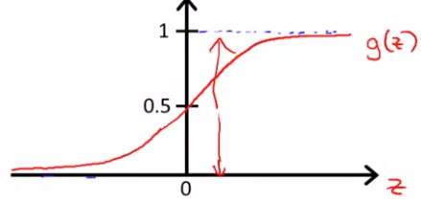






For classification we want a hypothesis function that outputs values between 0 and 1
Hypothesis function for linear regression was h(theta)=theta’*x
For logistic regression we apply g function to h, where g is logistic or sigmoid function
So we need to find parameters for theta
H(x) is interpreted as probability of outputting 1 based on input x
So hypothesis function outputs values between
0 and 1, so we need a way to map between probabilities to 0 and 1, thus we should decide on decision boundary

Slide 4
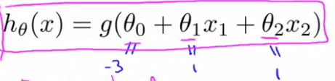
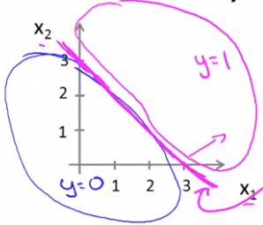
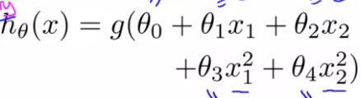
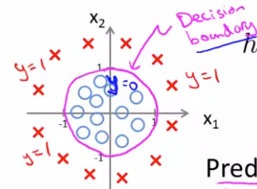
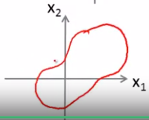
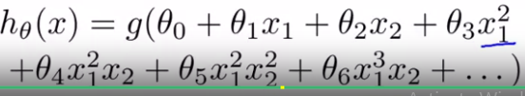
In sigmoid function h(z)=1/(1+exp(-z)), h(z)>0.5 and outputs 1, when z>0 and in our case z=theta’x, so for outputting 1 we should have theta’*x>0
Let’s try to get an intuitive understanding of how
Hypothesis function works
Earlier we said for hypothesis function to output 1, h(x)>0.5 and z>0, so for particular parameter vector [-3, 1, 1], z looks like -3+x1+x2>0, so x1+x2>3 it is an equation of line and separates the parameter space into 2
Halfplanes and once we determine theta’s it does not depend on data
We can also fit non-linear decision boundaries with logistic regression
We can do this by adding extra polynomial features

Slide 5
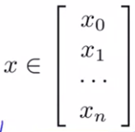


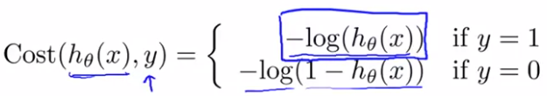
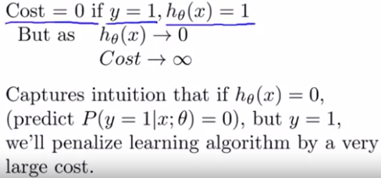
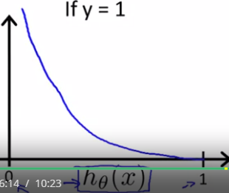
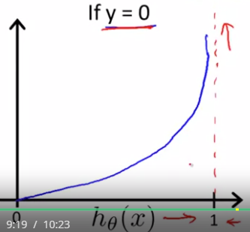
We are given a training set (x1,y1,…, xm,ym) m examples and n features,
Where y is either 1 or 0
So question is how find parameter theta for h
For Linear reg we had cost function:
If we plug h for logistic regression in that cost function resulting J will not be a convex function, so we would better to use another cost function that will give us convex function
This is for y=1
But this is the cost function for single training example

Slide 6
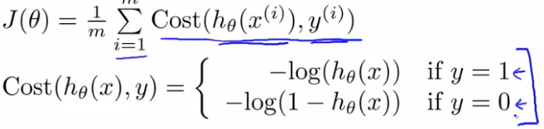
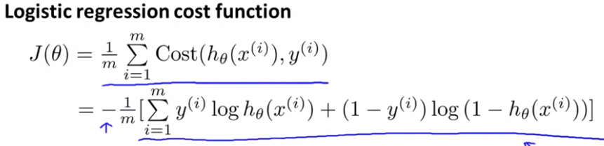


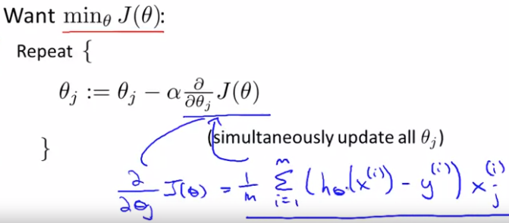


After changing the expression for cost func
And integrating it into one expression, our
Aim is to minimize it
Also Feature scaling useful here

Slide 7
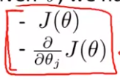
Advanced optimization algorithms
For gradient descent to work we need to compute the cost function J(theta) and its gradient
We can use other algorithms: 1) Conjugate gradient 2) BFGS 3) l-BFGS
Are better at computing both J and its derivative
Advantages 1) they converge faster 2) no need to pick manually learning rate
Disadvantage is that they are more complex

Slide 8
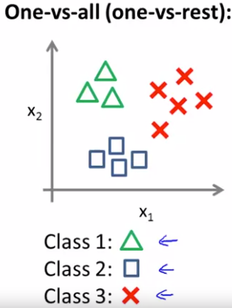



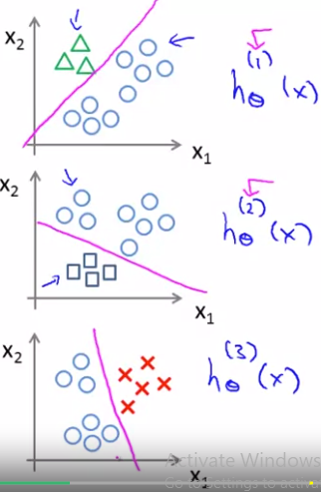
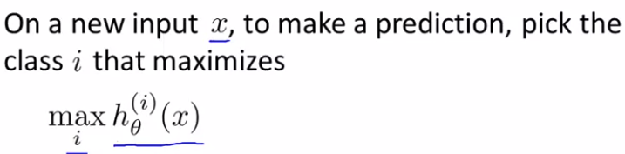
Multiclass classification (y=1,y=2,y=3 etc) can start with 0 or 1, does not matt
For example: weather classification: sunny, cloudy, windy, rainy.
We will turn the problem into 3 separate binary classification prob
We can start with class 1, we create fake training set, 2 and 3 neg
Whereas 1 is positive
We do the same in the 2nd case, class 2 is positive the other ones are
Negative and we fit different classifiers
So based on training data, we create n fake datasets, and train logistic
Classifier for each case, then save this classifiers.
When given new data we try each of the classifiers and see which outputs
The highest probability and choose that class

Slide 9
The problem of overfitting

Slide 10
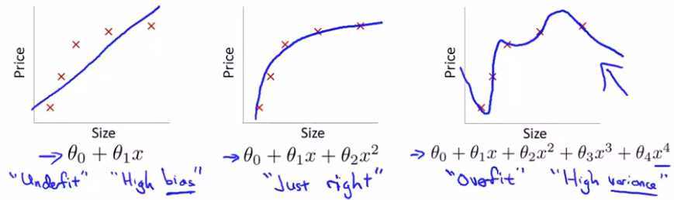
High bias (given even the data/evidence model has bias (e.g it wants to fit a certain model)
High bias vs high variance
We can have underfitting (simple model), when model does not fit very well on training set, we can also have overfit (too many features) when model fit very well to training set (cost function eq to 0, but does not generalize beyond the training set very well
When have a lot of features and little training data then overfitting may become a problem
Options to address overfitting: 1) Reduce the number of features: either by manually selecting which features to keep or using model selection algorithm which decided which features to keep. However disadv of this option is that we throw away potentially useful data
2) Regularization: idea is to keep all the features, but reduce magnitude/values of parameters theta_j and it works well when we have a lot features, each of which contributes to predicting y (a lot of slightly useful features)

Slide 11
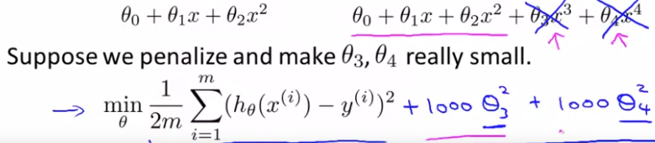


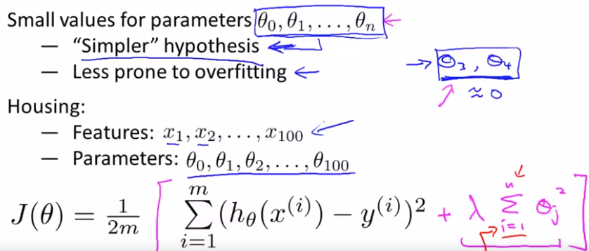


Suppose we have model with theta 1,2,3,4
If on top of linear regression cost function we
Will add additional terms like 1000*(theta3)^2 +1000* (theta4)^2, while optimizing cost function we will get around 0 for values of theta 3 and theta 4, so it will look like as if we do not have them
So general idea for regularization is to use small values for all parameters of theta
It leads to a simpler hypothesis and it is less prone to overfitting
Lyamda- regularization parameter
So in the equation above we have 2 goals
First part for finding optimal parameters
Making sure values for theta are not big, so lyamda here controls the trade off (if it is low then we can overfit, if it is high we can underfit; all parameters except theta_0 will be 0)
We need to choose lyamda smartly

Slide 12
Regularization for linear regression
Why do we divide by m the regularization term?
If we have more training samples we want to penalize less, so with more training samples we need less regularization
Dividing the regularization term by the number of samples reduces its significance for larger datasets. And, indeed, since regularization is needed to prevent overfitting, its impact should be reduced (in favor of the impact of the data itself) if a larger amount of data is available.

Slide 13

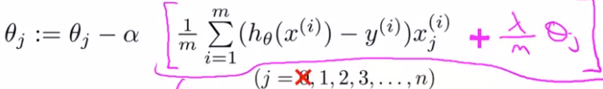



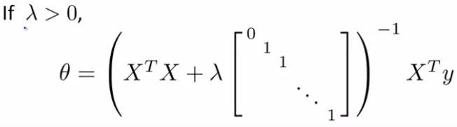
If we take deriv of:
For j=0 we do not have regularization term
Thus we update the following implement
For the gradient descent algorithm
We can reorganize the update equation and
Write it in the following form:
Where term for small lyam and large m is around 0 so overall value is around 0.99
That means in each update we 1st decrease each theta by 0.01 and then subtract the usual term
We also can apply regularization to normal equation
For the case if m<n, that is N of samples
Is less than the number of features
(X’*X) matrix is not invertible, but if we use
Regularization then it is not a problem, it is guaranteed that above matrix is invertible

Slide 14
Regularization for logistic regression

Slide 15
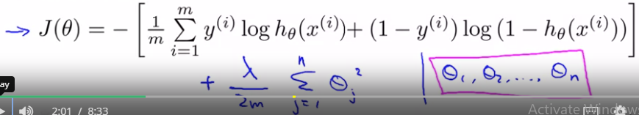
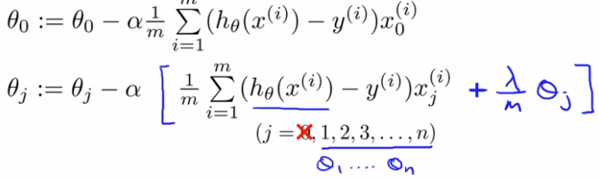

Cost function for Logistic regres
Using regularization
Gradient descent for logistic regression using regularization, this is same as in the case of linear regression,
However, the hypot function is different

Slide 16
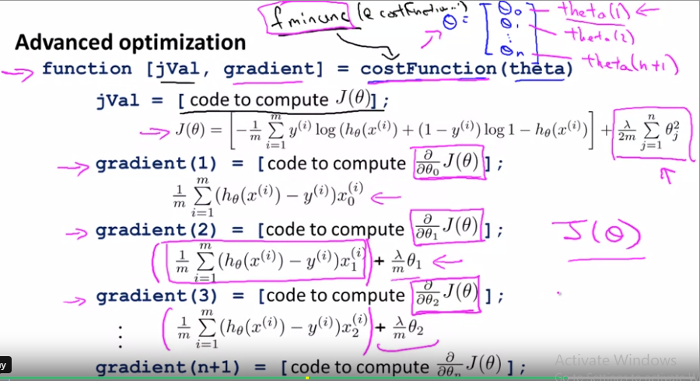

Slide 17
Matrix calculus
Derivation of normal equation for linear regression
https://eli.thegreenplace.net/2014/derivation-of-the-normal-equation-for-linear-regression
https://eli.thegreenplace.net/2015/the-normal-equation-and-matrix-calculus/
Derivation of normal equation for linear regression with regularization
https://explained.ai/matrix-calculus/
https://www.comp.nus.edu.sg/~cs5240/lecture/matrix-differentiation.pdf

Slide 18

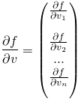

Matrix calculus (scalar by vector derivative)
Say we have f(v)=aT*v=a1*v1+a2*v2+…+an*vn
We want to compute df/dv. We derive by each component of the vector separately and combine the results into a new vector
In other words df/dv=a
Algorithm for computing scalar-by-vector derivatives:
Figure out dimensions of all vectors and matrices
Expand the vector equations into their full form. Ending up with a scalar
Compute the derivative of the scalar by each component of the variable vector separately
Combine the derivatives into a vector
We want to find where
3rd component does not theta so it does not contribute anything

Slide 19


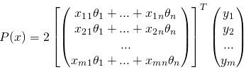

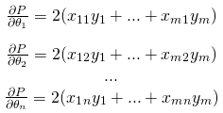








So we are left with
Let’s start with the 2nd term
so thus we have the derivative of 2nd term
we go back to the 1st term

