Slide 1
Week 4 Neural Network: Representation
This week, we are covering neural networks. Neural networks is a model inspired by how the brain works. It is widely used today in many applications: when your phone interprets and understand your voice commands, it is likely that a neural network is helping to understand your speech; when you cash a check, the machines that automatically read the digits also use neural networks.

Slide 2
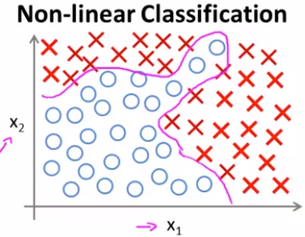
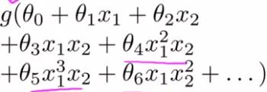
The reason for using neural networks are complex non-linear hypotheses
If we consider the problem on the right, non-linear classification prob,
We can fit logistic regression with polynomial features
This can work if we have say 2,3 features, however, in a case when we
Have 100 features, if we include polynomial features of order 2, say x1^2,
X1x2, x2x3, etc we will end up with 5000 features, and we may end up
Overfitting the training set and it can also be computationally expensive
One solution is to use subset of polynomial features say x1^2, x2^2 …;
Then the number of features is smaller (only 100), but this is not enough features for fitting such a complex non-linear hypothesis
If we include 3rd order polynomials of form x1x2x3, x1^2x2 etc we will end up with (O^3) number of features. So with logistic regression we either underfit with using low number of features or overfit with a large number of features
For many machine learning problems n is going to be large

Slide 3
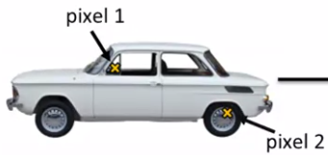
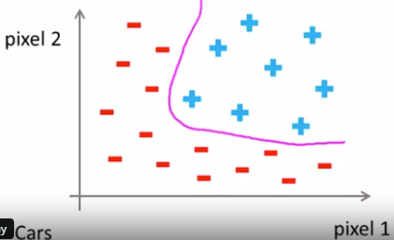
Suppose we are working on computer vision problem, say car classification problem
If we analyze only 2 pixels at indicated points for many training sampl
We may end up with a non-linear classification problem
However, here we just used 2 pixels, if we use just 50*50 pixels, for
Only gray scale pictures we will have 2500 pixels, and 7500 for RGB
So that means a lot of features and if we are going to include
Polynomial feat (x^2) we will end up with more than 3000 000 features
So we need better algorithm that can fit non-linear hypothesis with less number of features (large original number of features)
Neural nets try to mimic the brain, its popularity increased recently
They are computationally more expensive, and recently computers became fast enough to run large scale ML problems
One learning algorithm hypothesis (cut wire from ear-ear signal processing part of brain and connect to eye’s part; it turns out it will learn) so may be 1 universal algo is enough, instead for writing/using different algos for different tasks

Slide 4
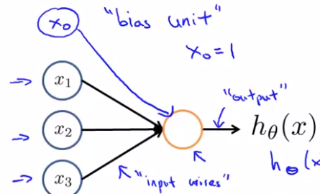

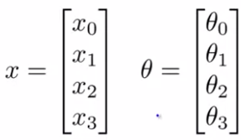
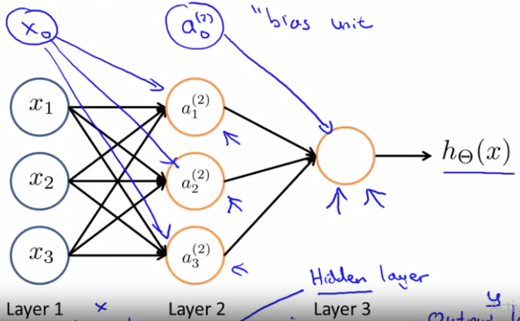
Neural networks model representation
On the right we see a single neuron, that gets an input and outputs
a value
X0, which equals to 1 is called a bias unit, parameters of a neural net
Are called weights
Here activation function used is a sigmoid
On the right we see an example of neural networks
There we have 1 input, 1 hidden and 1 output layer, we
May also draw bias units that always have value of 1

Slide 5
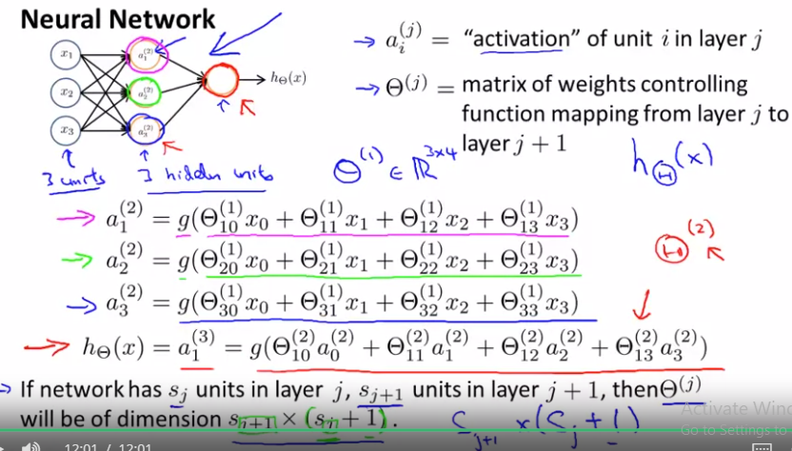
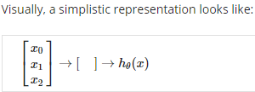

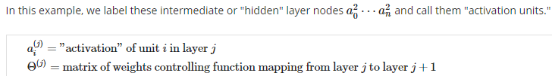
ai(j) – unit I in layer j; that is just number
theta(j) matrix of weights representing a mapping from layer j to j+1; dim Sj+1*(Sj+1)
so rows in thet are weights for each I’s unit
a

Slide 6
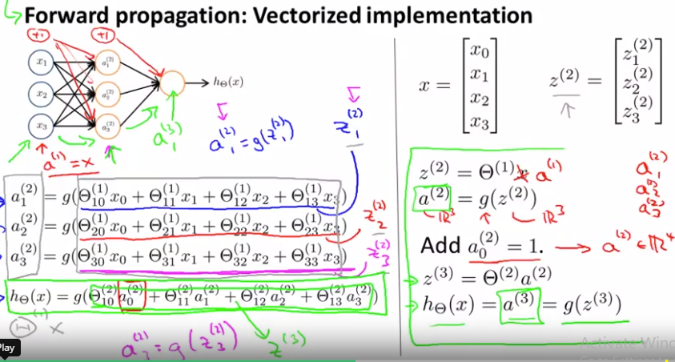
Forward propagation: vectorized implementation
Z(i+1)=theta(i)*a(i);
a(i+1)=g(Zi+1)
Adding all these intermediate layers in neural networks allows us to more elegantly produce interesting and more complex non-linear hypotheses.

Slide 7
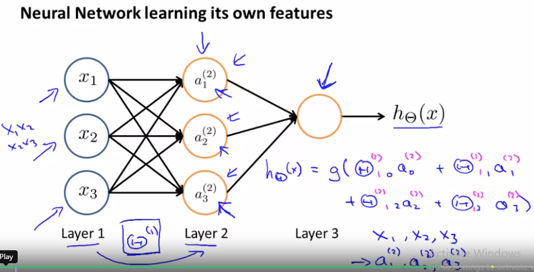
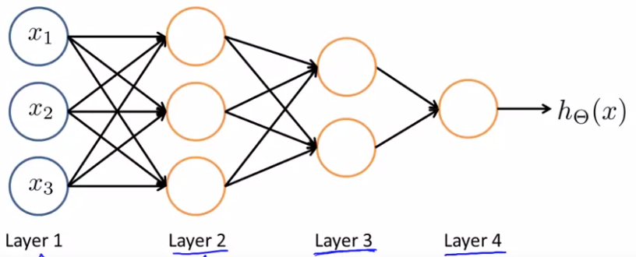
if we ignore the input layer, we can see that
hidden layer and output layer can be seen as
as just logistic regression with 1 output 1
So, neural nets are learning its own features
(units in hidden layers) based on provided
features (x) and learned weight matrix
We could have different neural net archit. As well

Slide 8
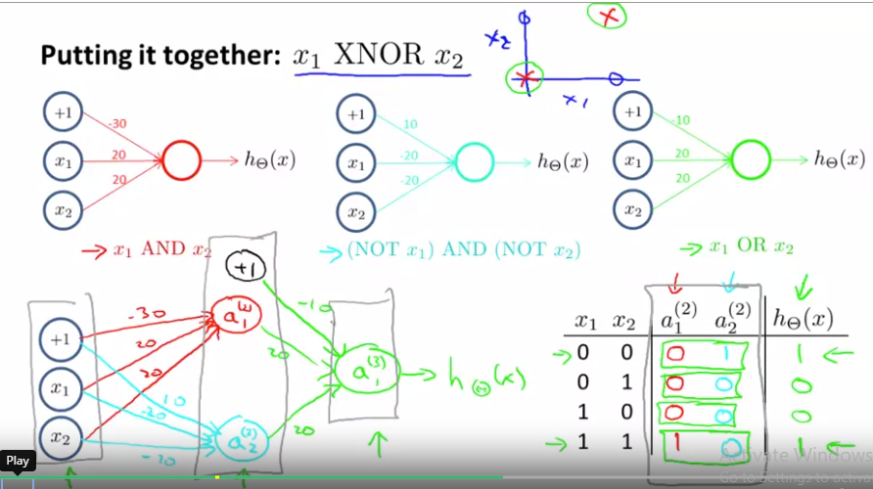
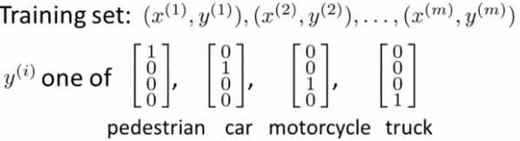
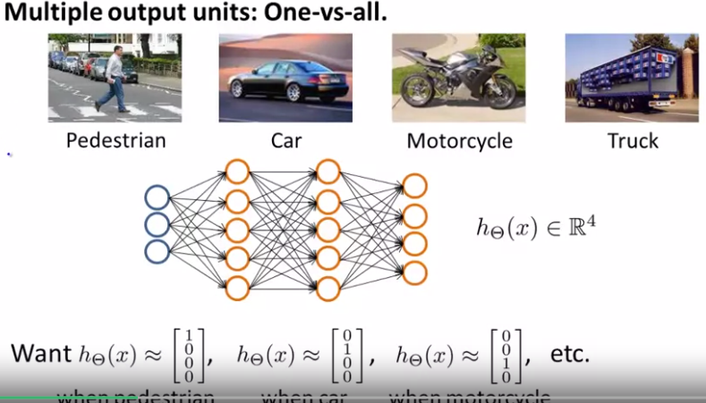
By combining simpler functions in hidden
Layers, neural nets can compute more
Complex functions
So as forward propagate the network, we
Get more and more complex functions

