Slide 1
Week 6 Advice for applying Machine Learning
In Week 6, you will be learning about systematically improving your learning algorithm. The videos for this week will teach you how to tell when a learning algorithm is doing poorly and describe the 'best practices' for how to 'debug' your learning algorithm and go about improving its performance.
We will also be covering machine learning system design. To optimize a machine learning algorithm, you’ll need to first understand where the biggest improvements can be made. In these lessons, we discuss how to understand the performance of a machine learning system with multiple parts, and also how to deal with skewed data.
When you're applying machine learning to real problems, a solid grasp of this week's content will easily save you a large amount of work

Slide 2

Deciding what to try next
Suppose we have implemented regularized linear regression to predict housing prices
However, when we test our model on test data, we find that
It performs poorly. So, what can we do to improve the model?
We will develop systematic methodology on what exactly we should try next, and what is likely to work and what is not
Get more training data – however, this is not always a solution
Try smaller sets of features- to avoid overfitting
Try getting additional features – to avoid underfitting
Try adding polynomial features – try to avoid underfitting
Try decreasing lyamda – avoiding underfitting
Try increasing lyamda – avoiding overfitting
We will talk about machine learning diagnostic: A test that we can run to gain insight what is/isn’t working with a learning algo and gain guidance as how to improve performance before randomly picking a new avenue and wasting time

Slide 3



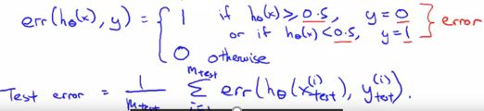
Evaluating hypothesis/model
Standard way of evaluating a hypothesis is to split (randomly) the data into 1) training set (70%) and 2) test set (30%)
Training/testing procedure for linear regression is as follows:
Learn parameter theta from training data (by minimizing training error)
Compute the test error
For logistic regression procedure is similar, only computing test error is different:
or by calculating misclassification
Error, that is computing fraction of test points
That are mislabeled

Slide 4
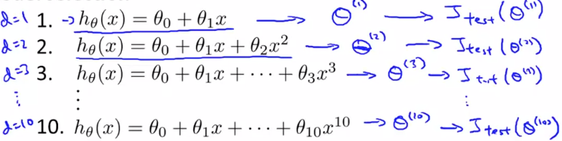
Model selection and train/validation/test sets
Suppose we let to decide what degree polynomial to fit to a dataset (what features to include into a dataset) or choosing regularization parameter, these are model selection problems
Once parameters were fit to some set of data (training set), the error of the parameters as measured on data (training error) is likely to be lower than the actual generalization error and is not a well predictor how our model will perform on a new unseen data
Suppose we have a choice of selecting polynomials of degree 1 to 10 (like on top of theta having also parameter d (degree of polynomial) to select)
We can do the following: 1) for each model find the optimal parameter theta and then compute the test error and pick the model with the lowest test error
Suppose we have chosen 5th order polyn
Based on Jtest and report test set error

Slide 5




Model selection and train/validation/test sets
The problem with report test set error is that it is likely to be an optimistic estimate of generalization error
This is because we have chosen this parameter d (degree of polynomial) based on test set, as we have fitted d to test set, it is unlikely that our model will fit to unseen data with the same level of success
Like this is similar to what we did when we were fitting parameters on training set
Now, the solution is to split the data into 3 groups: 1) training set (60%) 2) test set (20%) 3) cross validation set (20%)
This way, we optimize the theta’s based on training set, choose the model based on cross validation set and report the error based on test set
So, main difference lies in the fact that we report the error from test set

Slide 6
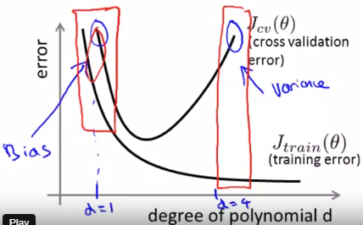
Diagnosing bias vs variance
If algo is not performing good, then it is either overfitting or underfitting problem
Determining which problem we have (high bias-underfit vs high variance-overfit), will give a strong indicator what to do next to address the issue
Suppose our learning algorithm is performing less well than
We hoped for (J_cross_v or J_test is high), in this case we
Want to determine whether we have bias or variance problem
We can answer this question by looking at the graph on the
Right.
So, in the case of underfit both training and cross validation (or test) errors will be high, whereas in the overfit case, training error will be low, only cross validation error will be high
Ideally, we need to find a golden mean between these two.

Slide 7
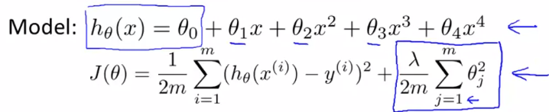
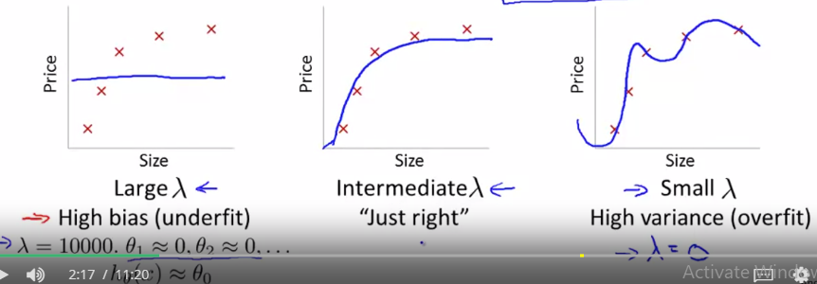

Regularization and bias/variance
Regularization helps to prevent a problem of overfitting
Suppose we have the regression model on
The right and we use regularization
Depending on what value for lyamda (regularization parameter) we use, we may run into overfitting vs underfitting problem
If we use high value for lyamda, then our model will be very simple (underfit), if we use low value for lyamda, then our model will be very complex (overfit)
We explore question of autom choosing
we try diff values (0-10) for lyamda and for
Each value we find optimal theta’s and compute
Jcv and choose the model with the lowest value
For cross valid error and then report error on test set
So, pick lyamda that gives lowest cross valid error

Slide 8
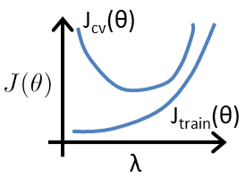
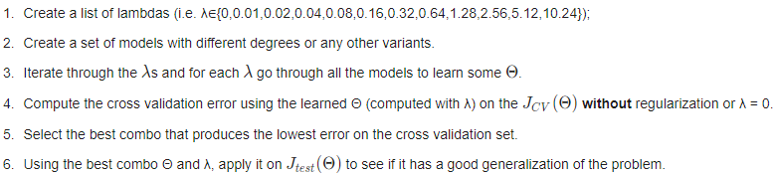
Regularization and bias/variance
When we trying to pick the regularization parameter for ML
Algo, making the plot similar to the one on the right is useful
So how do we choose our parameter λ to get it 'just right’ ?
In order to choose the model and the regularization term λ, we need to

Slide 9
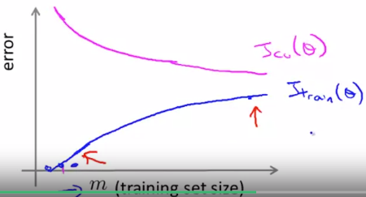
Learning curves
Learning curves is often useful plot to make when 1) checking whether model is performing good or 2) when we want to improve the performance of our model
Suppose we have 100 training samples and we want to plot how our training error and cross validation error changes as we start from a case when we use only 1 data point for training up to 100 in steps
Initially, as we use very low number of training samples, our training error is either 0 or very small (depending on complexity of our model), because we fit the data well
However, as number of data points increase, we get more training error
However, the opposite is happening with cross validation error
When we use low number of training samples, our model just fits the data and generalizes poorly, however, as we use more data, our model starts to feel the data and improves on generalization resulting in lower cross validation error

Slide 10
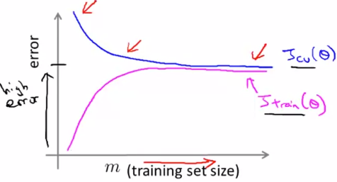
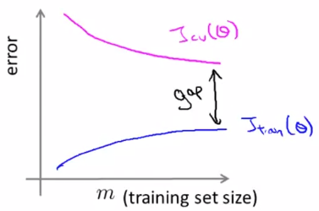
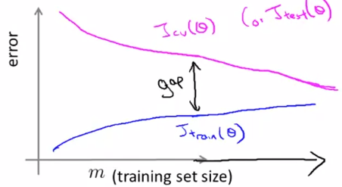
Learning curves: High bias vs high variance
Jtrain and Jcv vs N of training samples in high bias case
In this case, as we use simple model, after using
Certain number of training examples, we reach the peak
Of performance because we have so few parameters
Here, both plots flatten out and for high bias case, we have high error for Jtr; Jcv
So, getting more data will not help by itself, because parameters have already been established, they will change only slightly
In high variance setting, with increasing N samples
Our training error increases, but overall it is still low
In contrast, Jcv is going down but there is a large gap between Jcv and Jtr
In high variance, setting (Jcv>Jtr), getting more data helps
So, when we want to improve the performance of algo, we need to plot these plots

Slide 11
Deciding what to do next
Getting more training examples works for high variance case (make good use of complexity of our model
Try smaller sets of features- we have more parameters than needed for given size of training data, so we overfit- fixes high variance problem
Try getting additional features- with given number of parameters/complexity we do not do well, so we decide to increase complexity – fixes high bias problem
Try adding polynomial features- same as above- fixes high bias problem
Try to decrease lyamda- (high lyamda-underfit)- so it means increasing complexity- fixes high bias problem; trying to increase lyamda- fixes high variance problem
This discussion is also relevant to choosing the complexity of neural nets: 1) small network (low N of hidden layers and units) – has fewer parameters, computational cheaper but prone to underfitting; 2) large network (high N of layers and units) – has higher N of parameters, computationally more expensive, prone to overfitting (we may use regularization).
We can decide on complexity of neural net (N of units/layers) by making diag plots or Jcv

Slide 12
Takeaways from programming assignment
However, for the cross validation error,you should compute it over the entire cross validation set.
In learning curve so, as function of m, but for calculating cross validation error we use all the data, but for training error only m at each step
Think about how regular works, why do we compute Jtrain without regularization term
Procedure for plotting learning curve is the following: 1) find (train) theta based on i training samples and lambda 2) Use that theta to compute training and validation errors (lambda=0)
Lyamda is the key for finding optimal model (not overfit, not underfit)
Automated method for finding lyamda (computing train and cross valid error as function of lyamda)
However, to get a better indication of the model's performance in the real world, it is important to evaluate the final model on a test set that was not used in any part of training (that is, it was neither used to select the lyamda parameters, nor to learn the model parameters theta ).

Slide 13
Machine Learning System Design
To optimize a machine learning algorithm, you’ll need to first understand where the biggest improvements can be made. In this module, we discuss how to understand the performance of a machine learning system with multiple parts, and also how to deal with skewed data.

Slide 14
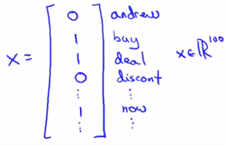
Prioritizing what to work on
Let’s say we have labeled training set of spam vs non-spam emails (y=1;0)
How do we build a spam classifier? It is a supervised problem
Given a data set of emails, we could construct a vector for each email.
Each entry in this vector represents a word
We need to come up with feature vector (X) and label (y).
Features can be 100 words that are indicative of spam or not spam (deal(1), buy(1), discount(1), Andrew(0), not(0).
Value of feature for vector for particular email gets 1 if the word is present, 0 otherw
In practice the feature vector is much bigger (10 000 to 50 000)
And we do not pick words manually but take most frequently occurring
ones

Slide 15
Ways to improve the performance of spam classifier
Collect lots of data (honeypot project)
Develop sophisticated features based on email routing information (from email header)
Develop sophisticated features for message body (should discount and discounts be treated as the same word?
Develop sophisticated algorithm to detect misspellings (e.g. m0rtgage, med1icine)
It is difficult to tell which of the options will be most helpful.

Slide 16
Error analysis- systematic way of choosing the curse of action to improve the performance of model
Recommended approach for building a ML model or application
1) Start with a simple algorithm that you can implement quickly (in a day or 2). Implement it and test it on your cross-validation data
2) Plot learning curves to decide if more data, more features, etc will likely to help.
So, it is hard to tell in advance what is needed for a good model, to decide on this we need to first implement something simple and then see (let evidence guide our decisions)
3) One useful thing to do is error analysis: manually examine the examples (in cross validation set) that your algo made errors on and see if you can spot any systematic trend in what type of examples it is making errors on
This can give an inspiration with coming up with new features or just any other new ideas

Slide 17
Error analysis
Say from 500 training examples in cross validation set, algorithm misclassifies 100 emails. We can then manually examine the 100 errors and categorize them based on:
What type of email it is (pharma, replica, steal passwords). Say most of 100 misclassified emails that are aimed at stealing passwords, then we can analyze carefully those emails to see may be we can come up with new set of features, so that to improve the performance of our algorithm
What cues (features) you think would have helped the algorithm classify them correctly (for example most of correctly classified emails were detected with the help of feature on unusual email routing. Then we can spend more time on this cue to optimize this feature detection or come up with more sophisticated and detailed features to detect them.
We can also try some approaches like ana vs Ana whether to group as one these words or different. We can try them separately and see results on cross valid error.
Hence, we should try new things, get a numerical value for our error rate, and based on our result decide whether we want to keep the new feature or not.

Slide 18
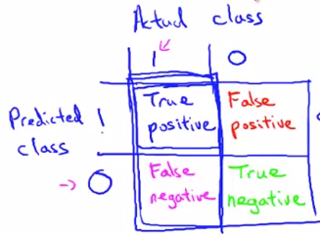


Error metrics for skewed classes
In skewed classes setting, coming up with error metrics is tricky
Skewed classes setting refers to cases when we do not have a good balance between 2 type of training examples (that is we have y=1 in 99% of all training examples and just 1% of 0s)
In this case if use an algorithm which always returns just 1 would perform even better than any learning algorithm based on our misclassification error metric
Then the idea of choosing misclassification error metric in skewed classes cases do not seem like a good idea, so want to come up with a better metric: precision/recall
Precision (of all patients where we predicted y=1, what fraction
actually has cancer?
Recall (of all patients that actually have cancer, what fraction
Did we correctly detect as having cancer?
So precision/recall is better metric, and algo reaching balance in both those metrics is better

Slide 19

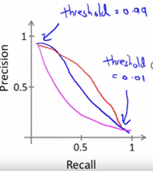

Trading off precision and recall
Precision and recall is better performance metric for classification problems with skewed data
Say, we are training logistic regression and we need
To set the threshold (0.5) for classification, so that it knows whether to assign 0 or 1
If we predict 1 when 0.7 or 0.9 then our algorithm has high precision, it assigns 1 only if it is very confident that 1 is correct, whereas if 0.3 -> high recall (we want to avoid missing too many cases of cancer (avoid false negatives)
So, based on our data we will have different curves for trade-off betw P-R
Now, question is whether there is a way to choose the threshold automatic?
Or, if we have different algos with different P-R values how do we decide
Which one is better? We want to have a single number evaluation metric
We might use the average value of P-R but it gives higher values at extreme classifiers (reject or accept always), instead better choice is using F1(0-1) score(it ensures both high)
Choosing value of threshold is better by looking at F1 score in cross validation set

Slide 20
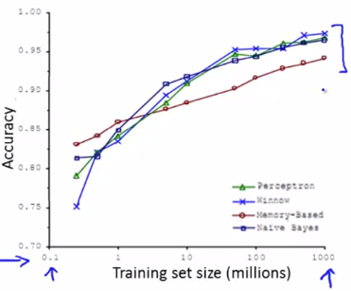

Data for Machine Learning
Important question for ML system design is with how much data to train on?
Under certain conditions with certain algos getting and training on a lot of data is effective
Study comparing perform of different algos vs diff training set sizes
As we see even less effective algo when given more data can signif
Outperform more advanced algos with less data (who has more data!)
But at what conditions this works?
1st assumption is that we have sufficient info to predict y accurately
That is enough features. Good way to check this asking given input x, can human predict y?
2) 2nd assumptions is that we use algo with many param (logistic/linear regression with many features; neural net with many hidden units) – less bias algo-complex small
3) We have a very large training set, so that with highly complex model we do not overfit and both J_train and J_test are low; so that we have low variance with complex algo
So, overall for high perf model: 1) Enough features (human) 2) Complex model 3) Data

