Slide 1
Week 7 Support Vector Machines
Welcome to week 7! This week, you will be learning about the support vector machine (SVM) algorithm. SVMs are considered by many to be the most powerful 'black box' learning algorithm, and by posing a cleverly-chosen optimization objective, one of the most widely used learning algorithms today.
SVM is found to have better performance than LR practically in most cases
SVM is computationally cheaper O(N^2*K) where K is no of support vectors (support vectors are those points that lie on the class margin) where as logistic regression is O(N^3)
Classifier in SVM depends only on a subset of points . Since we need to maximize distance between closest points of two classes (aka margin) we need to care about only a subset of points unlike logistic regression.

Slide 2

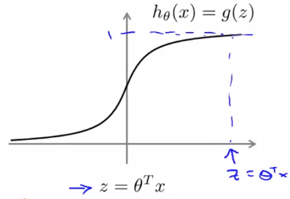


Optimization objective
With supervised learning, the performance of many supervised learning algorithms will be pretty similar, and what matters less often will be whether you use learning algo a or b, but what matters more will often be things like the amount of data you create these algo on, as well as your skill in applying these algos.
Things like choice of features you design to give to the learning algorithm, and how you choose your regularization parameter
But there is one algo that is used often in both industry and academia called support vector machine, that is compared to both logistic reg and neural nets sometimes gives cleaner and more powerful way of learning complex non-linear functions
In case of logistic regression, h(x) is our hypothesis function, when z is
>>0 we have h(x) around 1 when y=0 we want z <<0, h(x) around 0

Slide 3
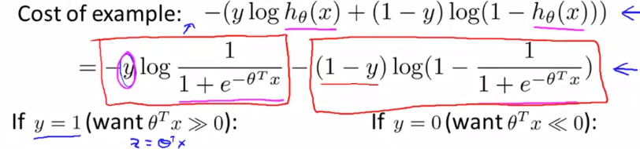
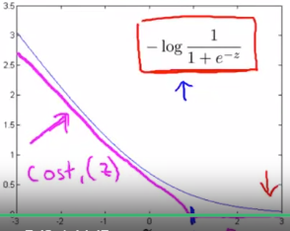
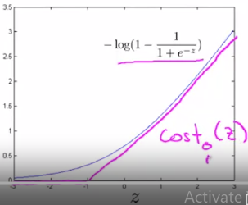
Continued
On the right we can see the cost
Function for the logistic regression
It has 2 parts and depending whether in our training sample has y=1 or 0, one part of equation goes away
Based on whether we have 1 or 0, we have different cost functions and thus different graphs (dependence of cost function vs z)
When y=1, and z>>0 we want cost
Function to output value near 0, as the
Prediction is good and respectively, when
Y=0, and z<<0, we want the cost function
To output value near 0, as prediction is good

Slide 4
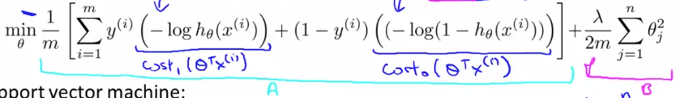




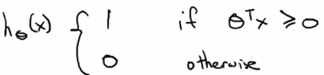
Continued
Our cost function for
Logistic regression is as above, for SVM we just replace 2 terms that were shown previously, multiplier of y and 1-y
Also we multiply the cost function by m and replace lyamda, so that
We multiply the 1st term by C, we can think of as if multiplying by c=1/
This overall does not change much optimization function, as the same theta is found when we multiply the obj function by some constant
So, instead of , C will be used to trade off between A and B
So that high lyam corresponds to low C that is for heavy penalize case (avoid overfit)
So, overall cost function is:
Finally, SVM does not output probability, but directly 0 and 1

Slide 5

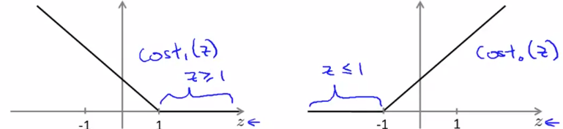




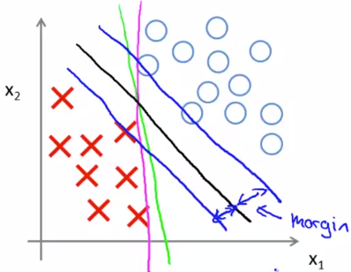
Large margin intuition
Sometimes people talk about support vector machines, as large margin
Classifiers, we will make clear what this means
In SVM we have cost function of 0, when
Y=1 and z>1 or when y=0 z<-1
-1 and 1 are stricter boundaries than just 0
If we set C very large in obj function we are
Left with the term
To have A=0 we need to have and
So overall we will have above objective function with 2 constraints depended on valueof y
If we solve this optimization problem we will get interesting decision boundaries
SVM outputs large margin decision boundary (farther from both training s.
This is a consequence of obj function

Slide 6
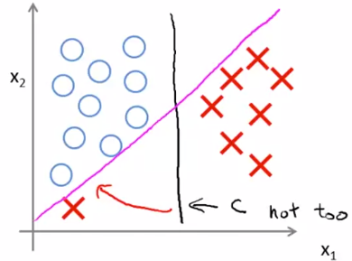
Continued
Depending on value of chosen C (too large, not too large)
We may end up with magenta vs black line
Intuition of large margin classifier fits better when C is too large
So C is similar to 1/lyamda, so when C is too large we overfit
So, overall SVM can be thought of large margin classifier, and this picture more of true when C is too large

Slide 7
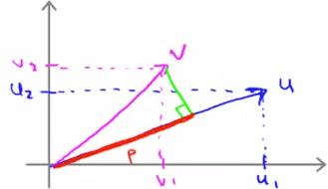
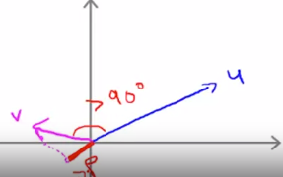

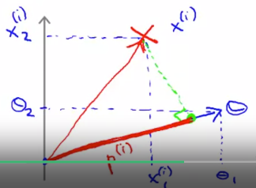


Math behind the large margin classification
Here we discuss 2 ways of computing inner products (dot)
1st one is geometric (p*norm(v)) where p is the length of
Projection of vector u on v and it can be pos or neg depending
On angle between u and v (whether it is > or < 90 deg)
2nd way is just multiplying the respective coordinates
Let’s revisit our optimization function:
2nd part is
While in the 1st part
We assume and as discus. Prev.
We look for proj of data onto theta vector

Slide 8



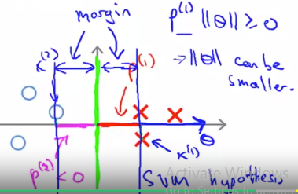
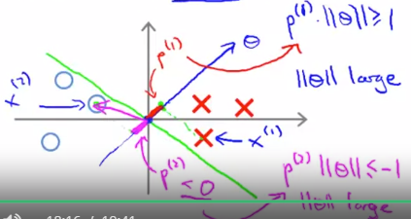
Continued
So our optim function is made up of 2 parts, in the 1st part we try to get high values of z when y=1 and low values of z when y=0, and in the 2nd part of optimiz function we have
In the 1st part of obj f. we have and
Where p(i) is the projection of x(i) onto the vector theta, so when y=1 we want to have high value of p and when y=0, low value, at the same time in both cases we want to have low values of norm of theta (length), so ideally we want a decision boundary that leads to high value of p when y=1 and low p when y=0
Let’s see graphs on bottom right, based on constraints described above our algo will try to draw a decision boundary that maximizes p when y=1 and min p when y=0

Slide 9
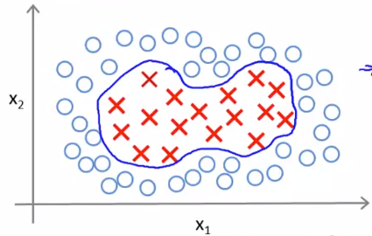


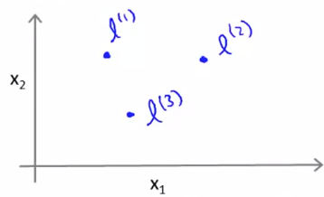

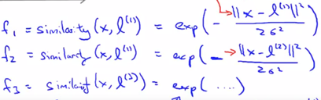
Kernels
Earlier we discussed adding polynomial features for representing
Non-linear hypotheses
And we said the following
Now, we also introduce new notation, so instead x’s we use f’s and we explore the question whether we can have better choices for the features f1,f2…
Now we talk about kernels
We define 3 landmarks
And given x, we want to compute new features dep. on prox to l1,l2,l3
We can also represent kernel functions as and we can see
The equations for the Kernels below. In this case our Kernels are Gaussian kernels

Slide 10

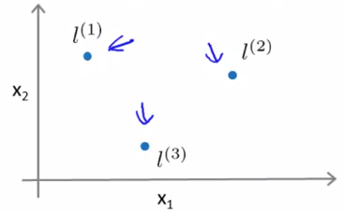



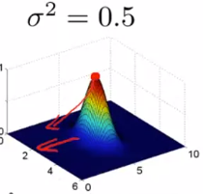
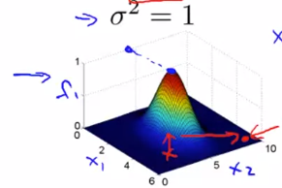
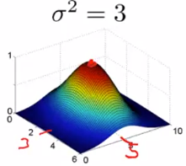
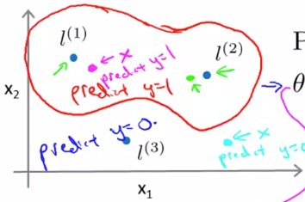
Continued
Our similarity functions are:
If x’s are close to l(1) we have
If x is far from l(1) we have
So, by computing new f’s we get new features f1,f2,f3
Now we examine how the function f1,f2,f3 work
For it to work we need to input l(3,5) e.g ad sigma^2, so when our feature x(3,5) we get value 1 for f. We also examine effect of changing sigma^2 on f1, as it increases function becomes more variable and wider
Let’s see how hypothesis func works
We predict 1 when
Suppose we have then depending on
Where our point is on graph we predict 1 or 0, so for ex. If we close
To l1 we have >0, so we predict 1
Similarly we predict 1 if we are close l2, so we have the fol dec. bound

Slide 11
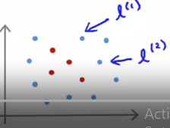



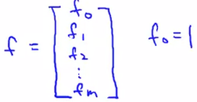
Kernels 2 (used to define new features)
Now we are interested in question of how we can choose the location of landmarks and for complex problems may be we want choose to have more than 3 of them
Way to go to answer both questions above (number and location of landmarks) is to put landmarks exactly on the location of data points and thus have m(#train samp landmarks
Then our features f are going to measure how close new examples to
The location of data points in our training set
So, we have
Given an example x then we have
That is given a training example x we then have a feature vector of the form
So, feature vector f will have values between 0 and 1 and at i coordinate it
Will have value 1 as this l was based on value of xi

Slide 12
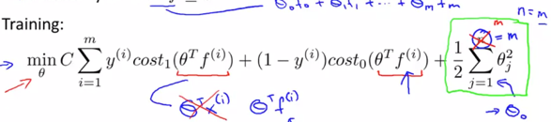






Kernels continued
So, given x, we compute new features for each training set
We then train our algorithm and
Instead of x’s we use fs and on the
Right our term sums up to m inst of n
One other detail is about computing the term on the right
There, instead of we use to speed things up
Rescaled version of it , depending on kernel, this way we have faster computation, so reason for that is computational efficiency
So, SVMs and kernels tend to go well together, which is not the case with logistic regression
When using SVM, one of the parameters we need to choose is and

Slide 13

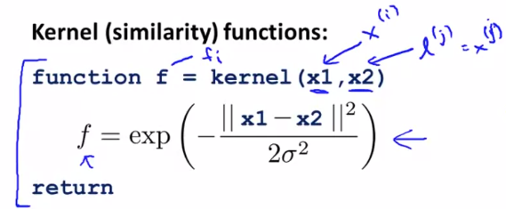


Using a SVM in practice
In practice do not write optim routines ourselves, instead use software packages to solve for parameters
However, we need to specify 1) choice for parameter C 2) choose the kernel (similarity function) and other parameters based on our choice of kernel
We might choose a linear kernel that is not using any similarity function at all, which leads to linear decision boundary and can be used when we have large number of features and but low number of training sets
Or we can use Gaussian kernel where when m is large, n is small, to fit more complex non-linear functions, in this case we need to specify
When using SVM we can be asked to provide implementation for Kernel function
For Gaussian kernel we have and we need to perform
Feature scaling if features are of different scales
it is because the func
Will be dominated by 1st term

Slide 14

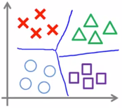
Continued
Most widely used kernels are Gaussian and linear kernels, but others can also be used
However, they need to specify the technical condition called Mercer’s theorem to make sure SVM packages’ optimizations run correctly, and do not diverge
We also have different less widely used kernels such as polynomial kernel
With 2 parameters constant and degree and other esoteric kernels such as string, chi-square and histogram intersection kernels
We can also do multi-class classification with SVMs
Many SVM packages already have built-in multi-class classification functionality
Otherwise, we can use one vs all method that is choose y=i say 1, and convert all other ys to 0, train SVM and get theta, and do this for all K groups
As we do this for all K groups we get k different classifiers, and when we get new data we compute for all k classifiers and see which gives us the largest value

Slide 15
Logistic regression vs SVM
We have 3 cases for n-number of features and m-#of training examples
1)If n is large relative to m (more features than data)
It’s better to use logistic regression or SVM (linear) without a kernel, avoid overfit
2)If n is small, m is intermediate (low number of features, moderate #of train ex.)
It is better to use SVM with Gaussian Kernel
3) If n is small, m is large (low n of features, large data), it is better to create/add more features, then use Logistic regression or SVM without a kernel, as training on Gaussian kernel will be slow
Neural nets will work in all 3 of these settings, but may be slower to train, especially in the 2nd regime
SVM optimization function is convex

