Slide 1
Unsupervised learning
This week, you will be learning about unsupervised learning. While supervised learning algorithms need labeled examples (x,y), unsupervised learning algorithms need only the input (x). You will learn about clustering—which is used for market segmentation, text summarization, among many other applications.
We will also be introducing Principal Components Analysis, which is used to speed up learning algorithms, and is sometimes incredibly useful for visualizing and helping you to understand your data.

Slide 2
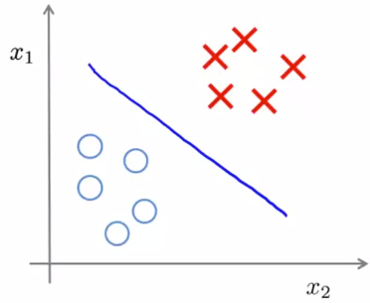
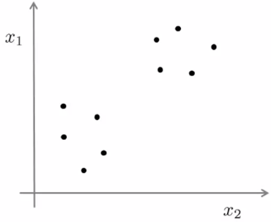
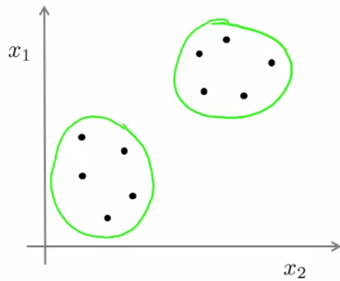
Introduction
In supervised learning we have labeled data
In unsupervised learning we do not have labeled data, just inputs
In unsupervised setting we are interested in finding a structure in the data
One thing we can do is to cluster the data

Slide 3
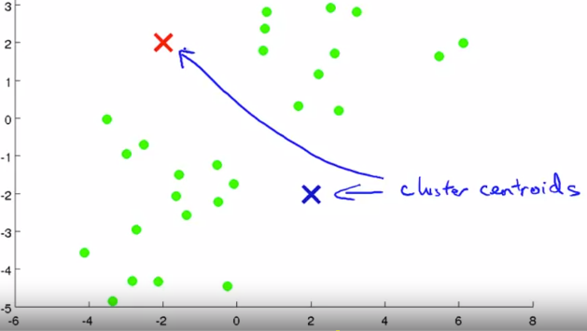
K-means algorithm
In the clustering problem we are given an unlabeled data set and we would like to have an algorithm automatically group the data into coherent subsets or into coherent clusters for us.
K-means popular and widely used clustering algorithm
Let’s say we have data and we want to group our data into 2 clusters, then procedure is:
Randomly initialize 2 points, called centroids.
K-means is an iterative clustering algo, involving 2 steps: 1) cluster assignment and 2) move centroid step
In cluster assignment step, after we have centroids
Algorithm will assign each data point to some 1 of the
Cluster based on distance between data and clusters
Once all the points are assigned to one of the clusters,
Then we calculate the avg coordinate for points and move cluster centroid to avg point

Slide 4
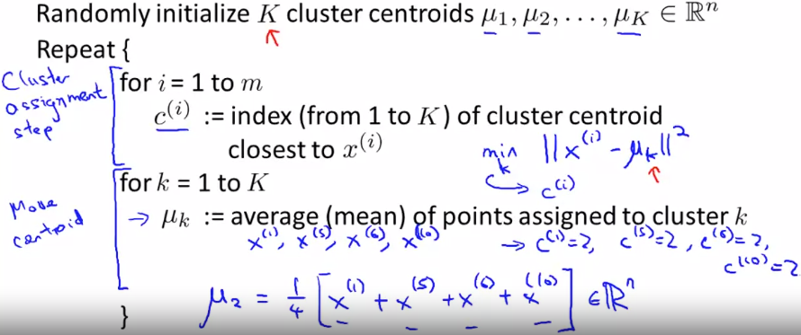
K-means continued
As we did 1 cycle of cluster assignment of points and centroid calculation, we then repeat this cycle and as cluster centroids have changed, our previous assignment will also change
We keep repeating the steps till centroid does not move
So, K means algo have 2 inputs: 1) k-number of clusters 2) unlabeled data (excluding x0=1)
If there is cluster with no points assigned to it, then either 1) we delete this centroid 2) randomly reinitialize the centroids

Slide 5
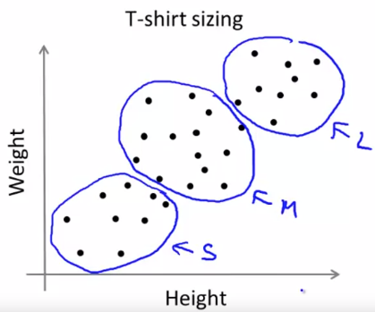
K-means for non-separated clusters
K-means can also separate the non obviously separable data into clusters

Slide 6


Optimization objective
Knowing what is the optimization objective is useful for:
Debugging the learning algorithm, and making sure it runs correctly
We can use this knowledge to find better clusters
K-means optimization objective
C(i)-index of cluster (1,2,..K) to which example xi is currently assigned
cluster centroid of kth cluster
cluster centroid of cluster to which example xi has been assigned
Objective function is
Here we try to minimize the squared distance between a point and cluster centroid by varying the cluster to which a sample is assigned and cluster centroids

Slide 7
Optimization algorithm structure
1) Randomly initialize K cluster centroids
2) Repeat: cluster assignment and centroid computation steps
for i=1 to m (over all training examples)
c(i)=index(from 1 to K) of cluster centroid closes to xi
(in this step we assign all training examples to some cluster based on distance, that is we minimize J function by varying parameters c1 to ck, holding mu’s fixed
For k=1 to K
Mu_k=average of points assigned to cluster k, here we update cluster centroids, that is we minimize J function by altering mu1 to mk, holding c1 to ck fixed

Slide 8
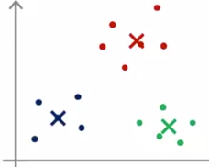
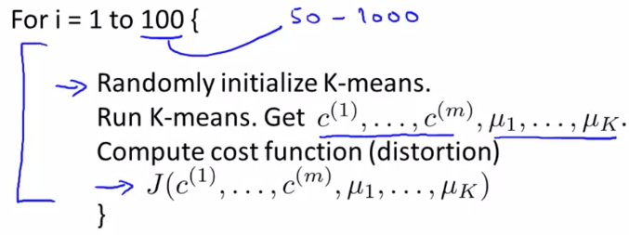
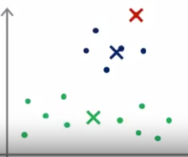
Random initialization
Depending on random initialization, K-means can converge to different results (centroids) and can stuck in local optima
Recommended way for random initialization is to assign k centroids to randomly picked k training examples out of m, here k<m, so mu1=x1, mu2=x2
Solution to avoid on stucking in local optima is to multiple times
Initialize the centroids (however if k is large >10, then multiple
Random initializations will not differ much in value of J (cost func)
Specifically, we can 100 times randomly initialize k-means and run
It then compare cost functions and pick the lowest one

Slide 9
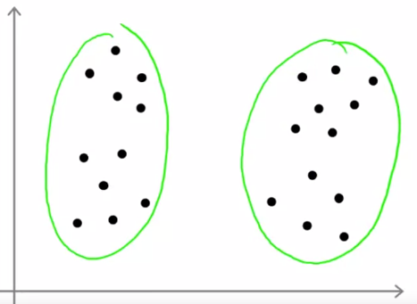
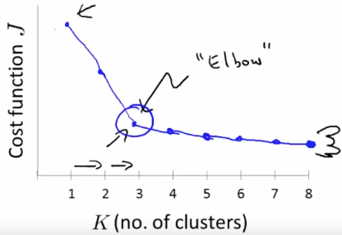
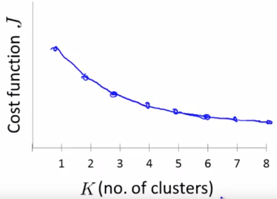
Choosing the number of clusters
There is a not a really good way of doing this, automatically
Common way is manually: visualizations, looking at output of algo
It is difficult, because it is generally ambiguous (2 vs 4 on right)
One option is to use elbow method, and if it outputs the graph
Resembling elbow then we can use it, if not then we can’t
One other of choosing the k is based on problem we are solving
(T shirt sizing is 3 or 5 sizes we want, image compression – quality vs memory)
Deciding number of clusters based on problem is a better choice

Slide 10
Dimensionality Reduction
In this module, we introduce Principal Components Analysis, and show how it can be used for 1) data compression to speed up learning algorithms as well as for 2) visualizations of complex datasets

Slide 11
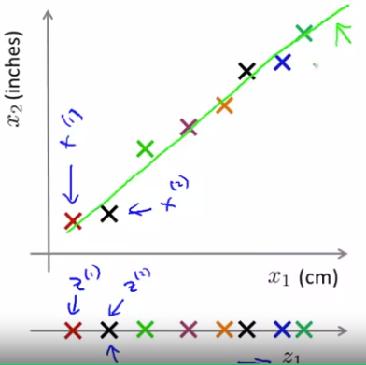
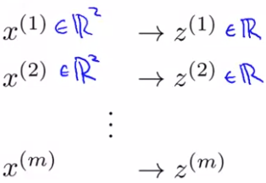
Motivation 1. Data compression
1st use case of dimensionality reduction is data compression
For example, we want to compress 2D data to 1D data, that
Is we project from R^2 to R, instead of 2 coordinates, we need
Just 1 coordinate to specify the location of the point
Even more important application of data compression is speeding
Up algorithms rather than reducing memory requirements
From 3D to 2D, we go from R^3 to R^2, that is instead specifying points
In space, we represent points on a plane

Slide 12
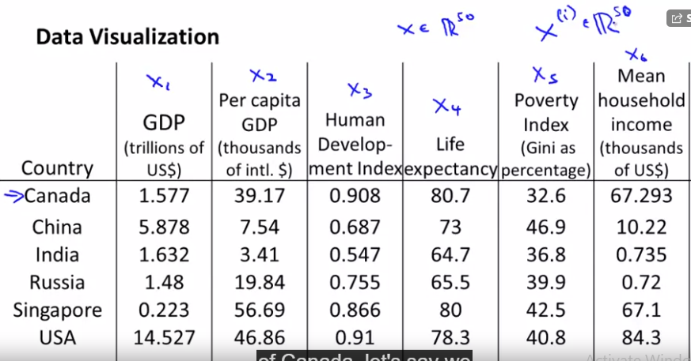
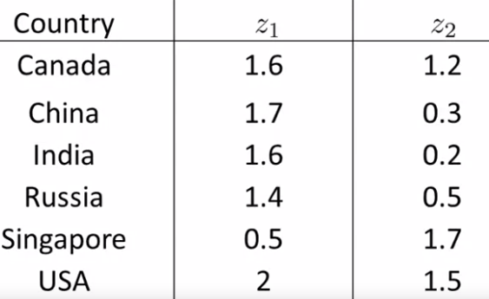
Motivation 2. Visualization
For example we can have data of GDP,GDP per capita, life expectancy etc up to 50 features for each country
Now we want to transform these 50 features to 2 features z1 and z2, so that we can make plots, but after doing this we can lose track what each feature represents
These 2 axes of variation, may represent the main integrated features (like z1-size of country, z2-overall development)

Slide 13
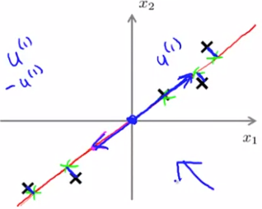
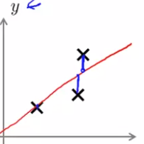
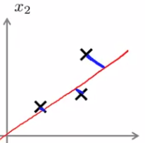
PCA-principal component analysis
By far the most widely used dimensionality reduction algorithm is PCA
PCA tries to find a lower dimensional hyperplane, so that mean squared error between points in Rd and the hyperplane is minimized
Before applying PCA, we need to do feature scaling and normalization
When we go from 2D to 1D we go from points in plane to a line, so
We are interested in finding a direction (vector) onto which to
Project the data so as to minimize the projection error
Generally, when we reduce data space from n to k dimensions we
We need to find k vectors that span the space, onto which we
Project the data, so as to minimize the projection error
PCA is not linear regression (vertical bar vs inclined line)
So optimization objectives are different, also applications are
Different, prediction vs projection (no need for y’s)

Slide 14
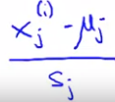

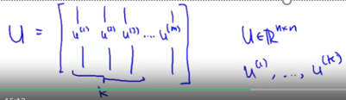

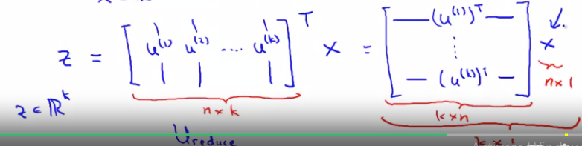
PCA algorithm
Before applying PCA we need to preprocess the data: 1) mean normalization (replace all xi’s with xi-mu) and scale them, divide by range or std
So in PCA, we need to do 2 things: 1) find direction vector (e.g. if from 3D to
2D, then u -> R^2) 2) find a way to represent a point in 3D in 2D, that is find new coordinates of points)
To apply PCA 1) compute covariance matrix
Compute eigenvectors of matrix sigma (cov matrix)
Then columns of U will be what we need , if we go from m dimension to k, we just need to extract 1st n columns of U matrix
So, we go and we also
Need to a way to transform x to new x

Slide 15
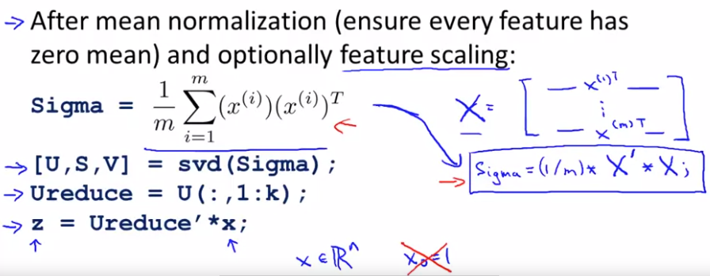
PCA summary

Slide 16

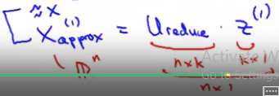
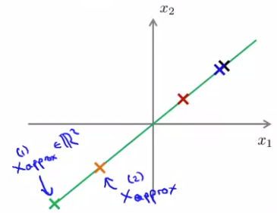
Reconstruction from compressed representation
Forward step is reverse step is:
We get approximate vector/matrix X

Slide 17



Choosing the number of principal components
In PCA, say we go from n dimensions to k dimensions
We want to explore the question of how do we choose this number k
In real data sets usually many features are highly correl, so even significantly reducing the number of dimensions, still makes it possible to retain most of the variance
Some notation 1st : avg squared proj error
Total variation in the data:
We typically choose k to be smallest value so that
Some desired fraction of variance is retained (99,95,90 etc)

Slide 18
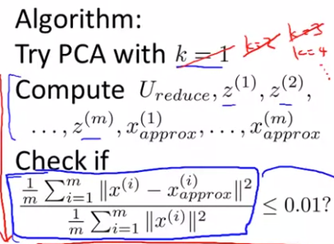
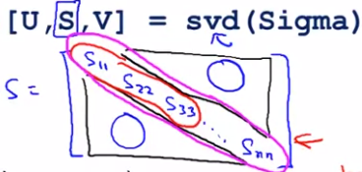
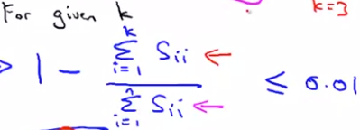
Choosing the number of principal components
Algorithm for choosing the number of principal components
1) try PCA with k=1 compute U reduced z1…zm, x_approx1…x_approxm
2) check if variance retained is >=99% if yes stop if not increase the k . See the procedure below:
However, in this case we run PCA many times and it
Is inefficient, we can do this in some other way
When we compute SVD we get diagonal S matrix which
Have entries that help us to calculate the quantity of interest
If k is not enough we can increase it and compute again
Even if we choose manually we can compute and see
how much variance is retained in
our case

Slide 19
Advice for applying PCA
We can use PCA in supervised setting to speedup learning
Say we have computer vision problem and we have pics of 100*100 pixels/features, we can reduce this from 10 000 to 1000
We can do this 1st by unwrapping the pixel matrix into feature vector in R^n
We can the apply PCA to map from x to z to reduce dimension only on training set
And then we can apply the same mapping to test and cross validation set
This way we can reduce the dimension of feature vector and thus speed up training
To summarize the applications of PCA are:
Data compression (reduce memory and speed up learning- choose k based on variance retained
Visualization – k is either 2 or 3

Slide 20

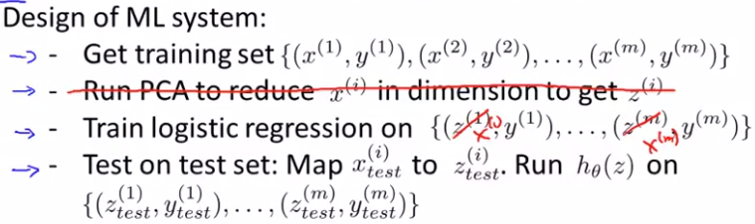
Misuses of PCA
Using it to prevent overfitting- use z(i) instead of x(i) to reduce the number of features to k<n, with goal that fewer features, less likely to overfit
Reason to classify this application as bad, is that PCA throws away some useful information about data, and when applying it does not make any use of y’s
If we want to prevent overfitting, instead a better way is to use regularization
2) Using PCA where it shouldn’t be used
Before deciding to use PCA try to avoid it, and only if there is strong reason to use it like slow training or memory requirements, then use it

