Slide 1
Anomaly detection and Recommender systems
This week, we will be covering anomaly detection which is widely used in fraud detection (e.g. ‘has this credit card been stolen?’). Given a large number of data points, we may sometimes want to figure out which ones vary significantly from the average. For example, in manufacturing, we may want to detect defects or anomalies. We show how a dataset can be modeled using a Gaussian distribution, and how the model can be used for anomaly detection.
We will also be covering recommender systems, which are used by companies like Amazon, Netflix and Apple to recommend products to their users. Recommender systems look at patterns of activities between different users and different products to produce these recommendations. In these lessons, we introduce recommender algorithms such as the collaborative filtering algorithm and low-rank matrix factorization.

Slide 2


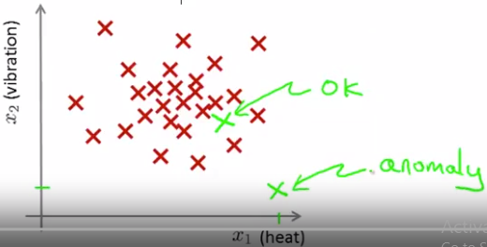
Problem motivation
Anomaly detection example
Say we have some aircraft engine features (x1-heat generated, x2- vibration intensity etc and we have m training examples
We are given new test data x, and we aim to know whether this example is anomalous or not
Formally, given a dataset we normally assume that it is not anomalous and construct a model p(x), then when given a xtest we test whether
or
Applications of anomaly detection:
Fraud detection based on anomalous joint distribution of
User’s activities
2) Manufacturing
3) Monitoring computers in a data center based on features like 1) memory use 2) CPU etc

Slide 3

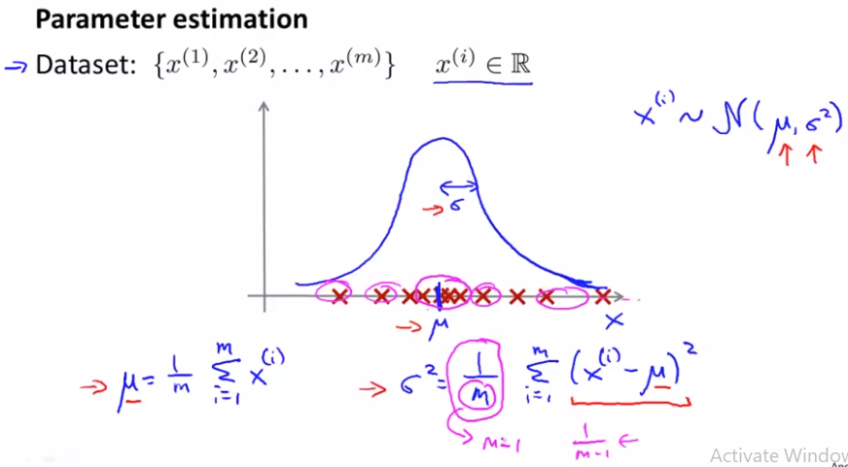
Gaussian distribution
Parameter estimation problem is given a dataset
We assume some data generating probability distribution and try to estimate the parameters of distribution by using maximum likelihood estimation
For Gaussian distribution, sample mean and sample variance are MLE estimators
In practice, for sample variance unbiased estimator is the one with 1/(m-1), however, when m is large, it does not make much difference whether we use m or m-1

Slide 4




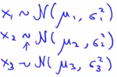




Algorithm
In density estimation, given a training set where each example
We calculate p(x) (joint distribution) of features
Anomaly detection algorithm
Choose feature xi that you think might be indicative of anom examples
Fit parameters
Given a new example x, compute p(x) (probability of observing x)
It is anomaly if

Slide 5


Developing and evaluating an anomaly detection system
The importance of a real-number evaluation
When developing a learning algorithm (choosing features, etc) making decisions is much easier if we have a way of evaluating our algorithm
Assume we have some labeled data of anomalous and non-anomalous examples (y=0 normal, y=1 – anomalous)
Training set (assume normal examples/ not anomalous)
Also, we have cross validation and test set also with y=1 (an)
Specific example: say we have 10 000 normal engines and 20 flawed (anomalous)
Then we can split as: training 6000 good; CV: 2000 good (y=0), 10 bad (y=1), test 2000 good engines, 10 bad
We then use train set to fit parameters to construct model

Slide 6

Algorithm evaluation
Fit a model p(x) on training set x(1), x(m) (like these are normal examples)
On a cross validation/test example x, predict
As the data will be skewed better evaluation metrics are 1) true/false positives 2) true/false negatives 3) precision/recall 4) F1 score
We can use cross validation set 1) to tune parameter epsilon, that is adjust it, based on F1 score, 2) choose what features to include and then report the final performance values based on test set
So, having 1 number evaluation metric enables fast decision making

Slide 7
Anomaly detection vs supervised learning
We discussed previously that, labeled examples were used to fit the model and then evaluate the performance, so question arises whether we can use supervised classification algos such as logistic regression and neural nets
We will discuss in which settings it is better to use anomaly det vs supervised algos
In anomaly detection problem, often we have small number of positive examples that it is not possible for learning algo to learn, so rather we can train anomaly detection algo px based on negative examples
So in anomaly detection: 1) we have very small number of positive examples (y=1) – 0-20 an large number of negative (y=0) examples. We can have many types of anomalies, that have not been seen earlier, so they are difficult to predict for supervised algo
For supervised learning we have 1) large number of positive and negative examples, that is we have enough positive examples for algo to get a sense of what positive examples are like, future positive examples are likely to be similar to ones in training set
Applications for anomaly det algo: fraud detection, manufacturing, monitoring machines in data center; supervised learning: email spam classif, weather pred, cancer classif

Slide 8
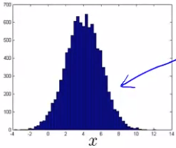
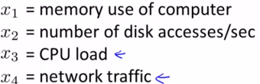

Choosing what features to use
Feature selection has huge effect on performance of anomaly detection algorithm
Before fitting an anomaly det algo, we should plot histogram for the features and if they don’t look like gaussian, we can transform them, so that they look like gaussian
We can use tranforms like log(x), sqrt(x), log(X+c) etc
Feature selection
For feature selection we can use error analysis, that is, manually
Look up the examples that algo classified incorrectly, with the aim
To come up with a new feature that helps to detect this
We normally want large p(x) for normal examples, and low for anomalous ones
So, we aim to come up with features that might take on unusually large/small values in the event of an anomaly

Slide 9
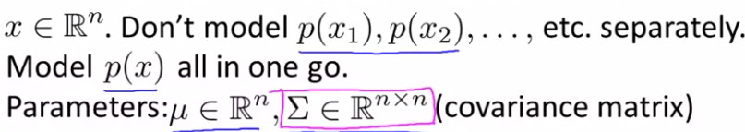

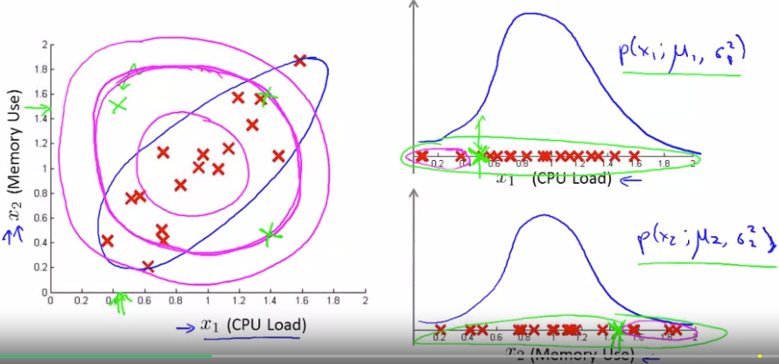


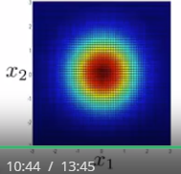
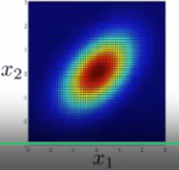
Multivariate Gaussian distribution
Separately based on feature x1 and x2 the probability of sample x is not anomalous, but when used jointly its probability is low
So, in this case we will use a modified version of anomaly detection algo, using multivariate gaussian distribution
In correlation case, that means when x1 is large, x2 also large, so low prob of 1 large, 2 low

Slide 10


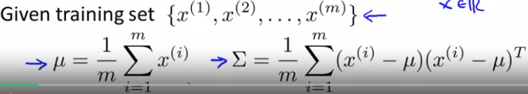

Anomaly detection using the multivariate Gaussian distr
When variables x1,x2,xn are independent then their joint distribution equals to product of individual pdfs, whereas when they are dependent, we model them as random vector, that is multivariate random variable, e.g as multivariate normal gaussian, and thus, also consider their covariance in cov matrix
There 2 parameters of MGD
We fit parameters by using eqs:
Given a new example x we compute
Fitted P(x) and if then it’s anomaly
Original model is a special case of MGD, where covariance matrix contains only individual distributions, so that they are independent

Slide 11


Anomaly detection using the multivariate Gaussian distr
Original model use case:
In case there are some dependencies between features we need to manually create features (e.g. x3=x1/x2) where x1,x2 take unusual combinations of values
Computationally cheaper (scales better to large datasets (n= 10 000+)
Works fine even if m (training size) is small
Multivariate Gaussian model use case:
Automatically captures correlations between features in cov matrix
Computationally more expensive (we need to invert cov matrix)
We must have m>n (m=10n and more) and no redundant features, so that we can invert matrix

Slide 12
Recommender systems One of important applications of ML Here also feature engineering can be automatic

Slide 13
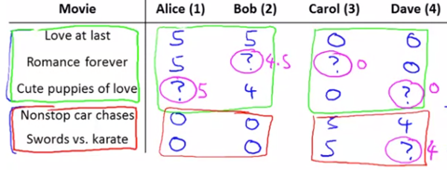
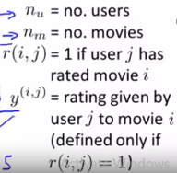
Problem formulation
We discuss recom. systems application based on ex. Of predicting movie ratings
In recom. Systems problems we have matrix, where e.g rows are products and columns are users, and usually we have scarce matrix, and our goal is to fill the matrix, that is to predict what score a user will give to unwatched movie (1-5 scale)

Slide 14
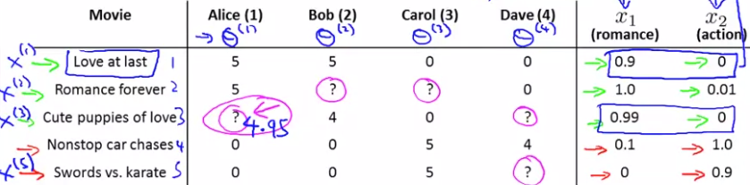

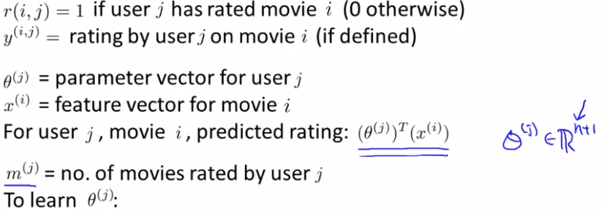

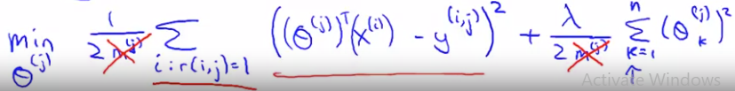
Content based recommendations
We fit different regression mod
For each of the users
We have movie ratings by users
As output (y)
As x, we have movie features [1 x1 x2] e.g. Love at least for Alice x=[1 0.9 0] y=5, and by using other y’s in Alice and other movie features for Alice we train theta (vector)
as m is const we can eliminate it

Slide 15
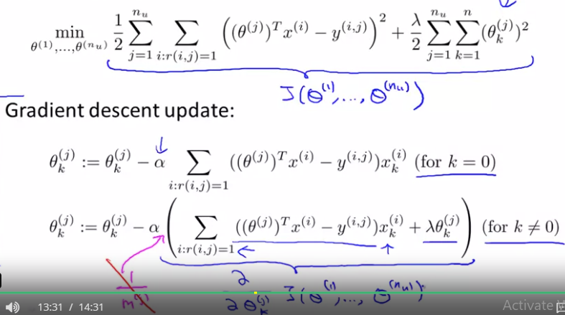
Optimization objective
This is almost same as for linear regression, except we do not have 1/m term
This is for content-based approach, because we assume we know features for movies (features capture content of movies)
In reality it is difficult to
Get these features for all
Products/movies

Slide 16
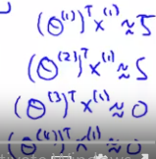
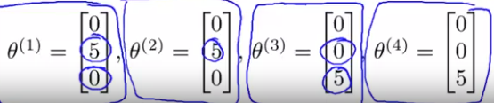
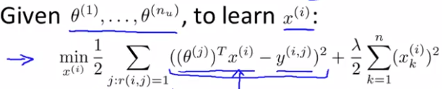
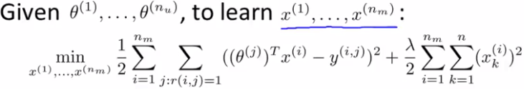

Collaborative filtering
Does not require knowing features, it learns by itself what features to use
In this setting, we assume that we do not know the values of features for movies
Here instead, we ask users to rate their preferences, that is how much they like particular genre (that is theta) and we also have y’s (scores of each user for movie)
So, given theta and y we want to predict x’s for each movie
So, optimization algorithm becomes
So, in content-based recommendations, we predict user ratings given features of movies, while in collaborative filtering we learn features of movies, given user preferences
What we can do, we can randomly guess theta, then predict X, then improve theta and we can contin doing this back and forth –collab filtering

Slide 17
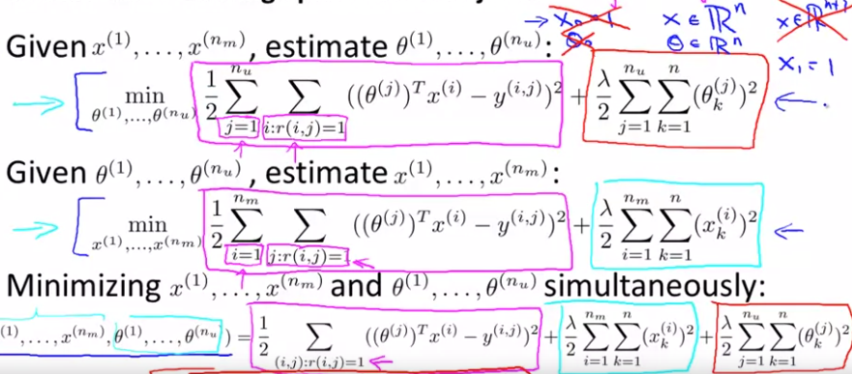
Collaborative filtering algorithm
We said we can go back and forth between x’s and theta’s to optimize our algo but it is not very efficient, we can combine these 2 optimization objectives to come up with better algo
In the 1st eq we sum for all movies for each user, in the 2nd eq we sum for all users for each movie
The main difference between earlier and new algo, is that instead of going back and forth we optimize for both x and theta simultaneously, but x0=1 disappears in this case

Slide 18
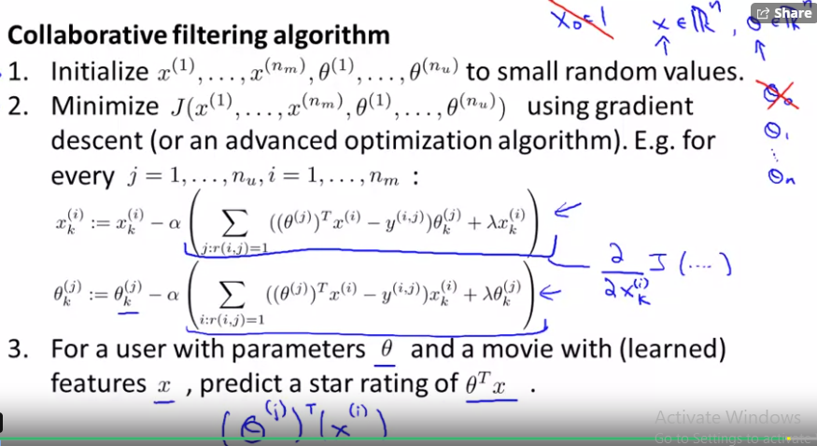
Overview of collaborative filter algorithm
So, this algo will simultaneously learn parameters for users and movies

Slide 19

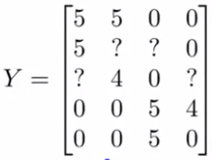
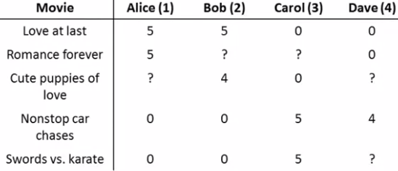

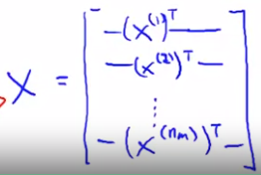
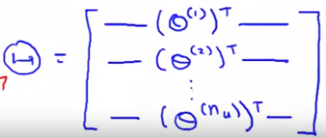
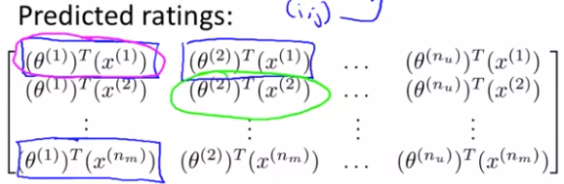

Vectorization. Low rank matrix factorization
We group the data into matrix
Y=
Collab filter algo =low rank m f
Y is low rank matrix
Usually, after algo learned some features, it is difficult to interpret these features in human understandable format, but usually they are meaningfull
To find a movie j similar to i, we find a movie with a smallest distance to it
Low-rank approximation is a minimization problem, in which the cost func measures the fit between a given matrix (the data) and an approximating matrix (the optimization variable), subject to a constraint that the approximating matrix has reduced rank

Slide 20

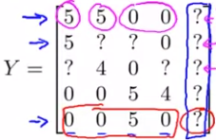
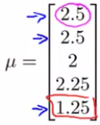

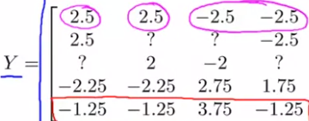
Implementation detail: Mean normalization
Our optimization objective: if we do not have ranking by user then y is 0 for all j’s
Then we skip the 1st term and also 2nd one and only need to minimize the 3rd term and to minimize it algo will choose theta=[0,0], if we have 2 features and thus predict 0 for all
However, it is not useful…
We take our matrix and subtract the mean of each row from corresponding row (mean normalization) – mean score of each movie
Then we learn theta and x vectors based on modified y’s
But when we predict we add mu so
Which means for movie with no rating we assign mean value
So, mean normalization is a pre-processing step

