Slide 1
Part A
Functions of 2 variables, tangent approximation and opt

Slide 2

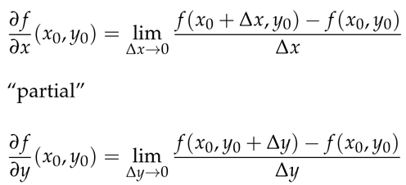

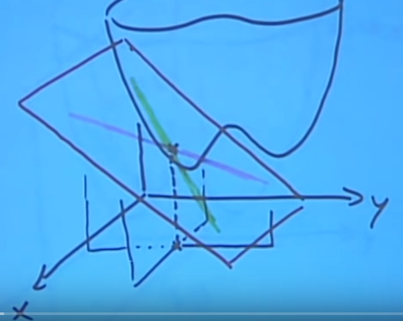
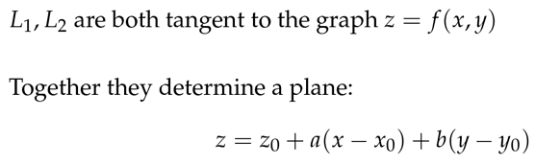
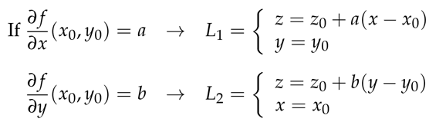
Partial derivatives
Approximation formula

Slide 3


Application of partial derivatives (optimization problems)
Finding minimum or maximum of a function
X0,Y0 is the critical point of f, if fx(x0,y0)=0 and if fy(x0,y0)=0
Critical point can be 1) max 2) min 3) saddle point (can be interpreted as both max or min, depending on which direction you look at it)
Least squares problem
Given some experimental data (x1,y1), (x2,y2), (x3,y3), we are aiming to find the best line of form y=ax+b
Question is to find the best a and b, that will minimize the misfit between function x,y and observations

Slide 4
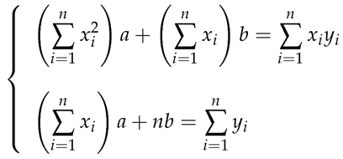







Least squares

Slide 5
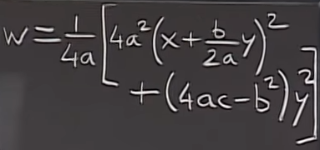

How do we decide whether crit point is max, min or saddle
How do we find global max/min? – these occur either at 1) critical point or 2) boundary or 3) infinity
Determining type of critical point: Second derivative test
For quadratic functions, we have the form as above. 1st term is positive, 2nd term depends on (4ac-b^2)
1) if 4ac-b^2<0 -→ saddle point
2) 4ac-b^2=0 → 0, w=x^2 – degenerate crit. Point
3) 4ac-b^2>0, if a>0 min, if a<0 max

Slide 6
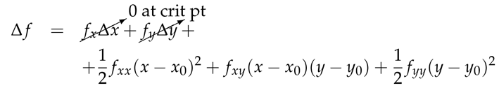
How do we decide whether crit point is max, min or saddle
We look at 2nd derivatives
A=fxx(xo,yo), B=fxy(xo,yo), C=fyy(xo,yo)
Conditions
If AC-B^2>0 and A>0, local minimum
If AC-B^2>0 and A<0 local maximum
If AC-B^2<0 saddle
If AC-B^2=0 can’t conclude
We can reduce any higher order function to quadratic by using Taylor series and so general case for the 2nd derivative will be same as for quadratic case.
If we replace function with its approx type of crit points remain the same
In degenerate case, what happens depends on higher order derivatives

