Slide 1
Chain rule, gradient and directional derivatives

Slide 2


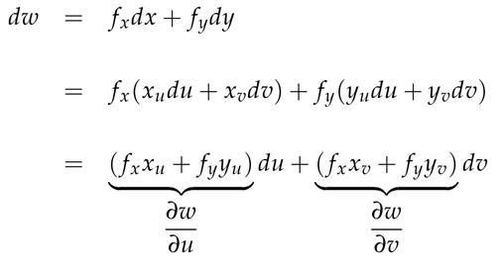
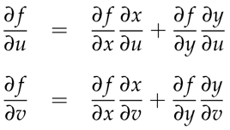
Implicit differentiation: Y=f(x); dy=f’(x)*dx
Total differential:
Df is not delta f
It can encode how changes in x, y, z affect f
Chain rule can be got by dividing total differential formula by dt
Chain rule with more variables

Slide 3



Gradient
Gradient vector points in the direction
Of the steepest ascent
To prove that gradient is perp to the level
Surfaces and thus is the direction of the steepest descent, we can write w=a1x+a2*y+a3*z, this is the equation of plane and normal vector to it has coordinates (a1, a2, a3).
This can be done to higher order dimensions, there, we will have approximate level surface by their tangent planes and thus they will be as above

Slide 4


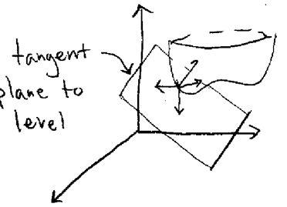
Proof of the fact that gradient is perpendicular to the level surface/curve
Let’s take a curve on level surface and move along it with
By the chain dw/dt=grad(w)*v=0, it means gradient is perp to velocity vector
This is true for any motion along the surface w=c, so v can be any vector perp to the level surface
Therefore grad(w) is perpendicular to the tangent plane to the level surface
Finding the slope of the level curve in 2D it is given by f(x,y)=c, so we can write y as function of x. Next to find the slope we calculate dy/dx.

Slide 5
Gradient is perpendicular to level set and also its tangent plane
Let’s say we are given x^2+y^2-z^2=4, this is the level set given w=x^2+y^2-z^2=4
We find gradient let’s say it is (2,1,1) so eq of tangent is 2x+y+z and to find to what it equals we multiply grad to the given point, as it is on the tangent plane or we can interpret as 2 perp vectors: grad vector and (x-xo; y-yo, z-zo)
So there are 2 ways of finding tangent plane 1) tangent approximation formula 2) finding gradient
Directional derivative

Slide 6




Directional derivative
In mathematics, the directional derivative of a multivariate differentiable function along a given vector v at a given point x intuitively represents the instantaneous rate of change of the function, moving through x with a velocity specified by v. It therefore generalizes the notion of a partial derivative
The directional derivative is also often written in the notation

