Slide 1
Part 1-C
Lecture 6

Slide 2
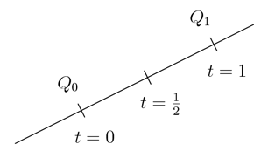
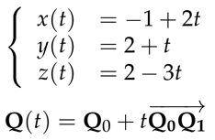
Equation of line
We can think of a line as a trajectory of moving point- “parametric equation”
We can be given 2 points on a line Qo and Q1
Equation of line can be set as Q(t)= Qo+ t*(Q(1)-Qo)

Slide 3
Intersection of line and plane
We are given an equation of plane x+2y+2z=5 and 2 points on a line
We first find parametric equation of line x=1+t, y=2-t, z=3+2t
Then we plug eq of line to eq of plane and find t
Then we plug back t into equation of line and find coordinates of points

Slide 4
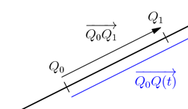
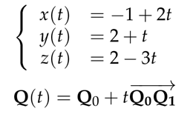
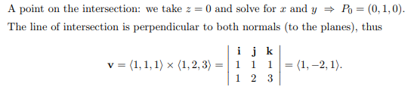

Parametric equation- any set of equations that express the coordinates of the points of a curve as functions of one parameter or that expresses the coordinates of the points of a surface as functions of 2 parameters

Slide 5


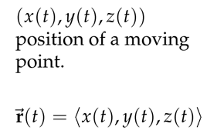


General parametric equations
Parametric curve is the idea that a point is moving in the space traces out a path and we can use a parameter to describe this motion
Often, we use t as the parameter and think of it as time.
Since, the position of the point depends on t we write
Here, we call t as a parameter, and x,y,z are called parametric equations

Slide 6

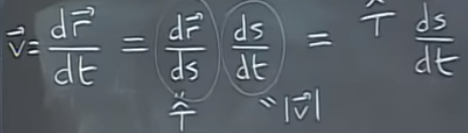




Velocity and arc length
S (arclength)- distance traveled along the trajectory;

Slide 7
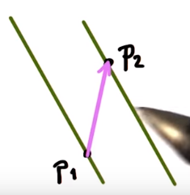
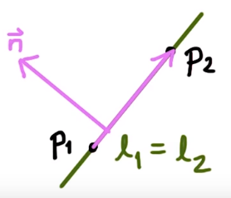
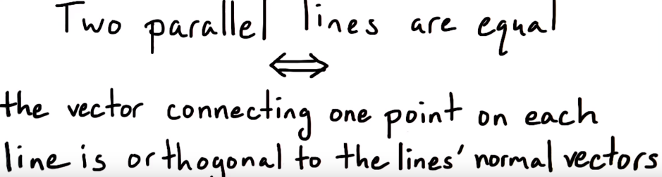
Udacity Linear algebra refresher
If 2 lines are parallel, how can we compute whether they are equal?

