Slide 1
Lagrange multipliers and constrained differentials
In this part we will study a new type of optimization problem: that of finding the maximum (or minimum) value of a function w = f(x, y, z) when we are only allowed to consider points (x, y, z) which are constrained to lie on a surface. The technique we will use to solve these problems is called Lagrange multipliers.
In other optimization when variables are not independent

Slide 2
Goal is to maximize or minimize f(x,y,z) when x,y,z are not independent e.g g(x,y,z)=constant
One method is to solve for one of the variables in g and substitute in f
2nd method is using Lagrange multipliers
Let’s say we want find the minimum distance between hyperbola xy=3 and origin. So function to minimize is f(x,y)= x^2+ y^2 given the constraint xy=3
At the minimum point, hyperbola xy=3 (level curve of g(x,y)=3) is tangent to the level curve of f(x,y)
So we are interested in finding x,y where 2 level curves are tangent, which means they have the same tangent line
Gradient vectors are perpendicular to tangent line so the gradient vectors to tangent lines should be parallel (could be in the opposite directions)
So grad(f)=lyamda*grad(g)

Slide 3
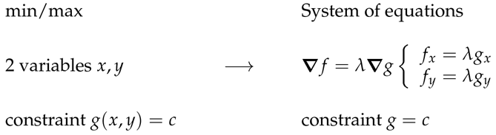
By reframing the problem we transition from min/max problem involving 2 variables and a constraint to system of 2 equations with 3 unknowns and 3rd equation g(x,y)=c:
We then get system of linear equations and solve it.
We set det(A)=0 means linear system will have non-trivial solution and solve for lyamda
Lyamda is Lagrange multiplier
When finding min or max points we need to check also boundaries on top of the solution derived from Lagrange multipliers

Slide 4
Proof of Lagrange multipliers
By Alon Amit: we have function f and constraint g=c, and we are allowed to move along function f in directions tangents to g=c curve. Moving in the tangent directions of g=c does not change the value of g and tangent directions are perpendicular to grad c direction. At local max or min of moving in tangent direction of c is also tangent direction of f so at that point grad f is perp to that tangent direction which is perp to grad c, so grad c and grad f are parallel

Slide 5
at unconstrained min/max points, partial derivatives in any direction are 0
At constrained min/max points, partial derivatives in any direction that satisfies g=c is 0
So at max, min of f df/ds(in dir of u)=0
Df/ds (dir u)=grad(f) * u, any u that is tangent to surface so grad f is perp to the level set of g.
Grad f is also perp to the level set of g, so grad f and grad g are perp
Geometric proof
2 level curves touch- grads of both perp to level curves, so they are parallel

Slide 6



Constrained differentials
say we are given some function g(x,y,z)=c
And we want to find how changing x or y affects z
We take differentials from both sides and relate dz to dx and dy
When being interested only in dz/dx we keep y constant
Warning
When taking partial derivatives, we keep all other variables as constants
For example let’s take the same function expressed in 2 different forms f(x,y) and f(u,v). Although x might equal to u, df/dx wont be equal to df/du, as v does not equal to y
New notation

Slide 7
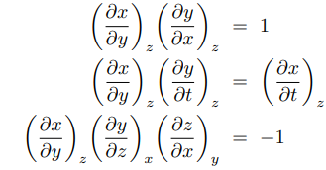

Partial derivatives
For example we are given A(x,y,z) and also constraint x(y,z)
We are interested to calculate dA/dz
First, we find total derivative dA=partialA/partx*dx (or Ax)+ Ay*dy+Az*dz
Then we differentiate dx in terms of y and z and we get dx=xy*dy+xz*dz
Then we use our condition that dx=0 and as we are interested in dA/dz, we substitute expression for dy and get relation for dA/dz

