Slide 1
Green’s theorem

Slide 2
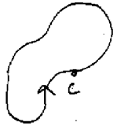



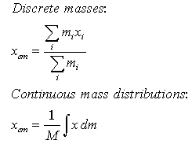
Vector field is given by F(x,y)=(M,N), curl is given by Nx-My
If curl =0 then this vector field is conservative and line integral along the closed curve is 0, whereas if curl is not 0, then we need to evaluate it
One option is doing it directly and 2nd one is the Green’s theorem
Green’s theorem: If C is a closed curve, enclosing a region R, counter
Clockwise, F a vector field defined, differentiable in R then
Green’s theorem only works for closed curves
Simple way to calculate the integrals if they resemble to calculation of coordinates of center of mass: x’=double integral of x dA/Area

Slide 3

If curl is 0, then it means vector field is conservative and both line and double integral evaluate to zero
Line evaluates to 0 because it is closed curve, double evaluates to 0 because the integrand is 0
We can’t apply Green’s theorem to the vector field if it
Contains regions where it is not differentiable

Slide 4


Proof of Green’s theorem
we can do separately for M’s and N’s and then add
We identify small rectangular region with boundaries for x say a,b for y c,d
Then we evaluate both sides separately and we should see that they are equal
Having proved that, if we want to proof the theorem for a region that has some odd shape, we can divide it into small rectangles and find the sum of them
Here we assume that every shape can be approximated by the sum of infinitesimally small rectangles

Slide 5





Flux in 2D – another line integral, C- plane curve and F- vector field
N is unit normal vector to C, taken in clockwise direction
Basically we dot vector field with the unit normal vector and
Multiply with small segment of a curve and add up these through the
Whole length of the curve
In case of work we are summing the tangential component of F
What flows across C left-to-right is counted positively, r-to-l ( - )

Slide 6


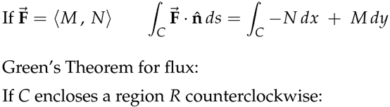

We can evaluate flux geometrically if it is perpendicular to curve or parallel, however, if geometric calculation is not possible, we can use components
We have a formula for dr=Tds, for nds, we rotate T by 90 deg

Slide 7




Green’s theorem in normal form
As the flux evaluation also involves line integrals
We can apply Green’s theorem to it and write it
In double integral form
Let’s say
Green’s theorem in tangential form had the following form
But here N=M and M=-N, so it becomes:
Interpretation of divergence
Measure how much flow is expanding
“Source rate”= amount of fluid added to the system per unit time and area

Slide 8






If F is continuously differentiable, then div F is a continuous func,
Which is approximately constant if the rectangle is small enough
So assuming the integrand is small enough we get
If the total flux over the sides of the small rectangle is positive, this means there is a net flow out of the rectangle.
According to conservation of matter, the only way it can happen is if there is a source adding fluid to the rectangle, similarly a net flow into the rectangle implies there is a sink withdrawing fluid from the rectangle

Slide 9




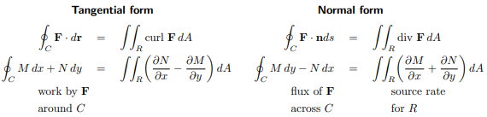
Previous slide continued

Slide 10


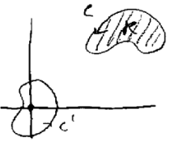

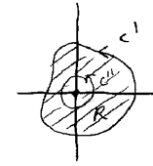
More about validity of Green’s theorem
We have seen 2 forms of Green’s theorem:
In tangential form and in normal form
For the left side to work the field should be defined at all points on the curve, whereas for the right side to work vector field needs to be defined at any point inside the curve, therefore overall the Green’s theorem works if vector field F is defined everywhere in R
So the for the picture on the right, it is defined for the zone on top right
But not to the one on the center, because it contains the point where curl is
Not defined
In this case we can apply the Green’s theorem for the zone in between the
Curves C1 and C2

Slide 11
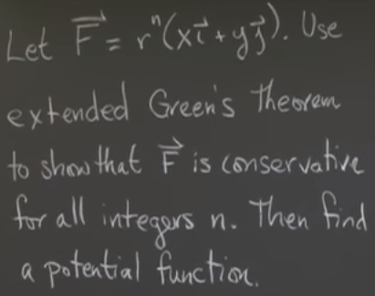
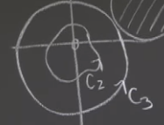
Problem
Curl(F)=My-Nx=0
For negative integers n, we divide by r, so the vector
Field is not defined at the origin, so for curves that
Also include the origin it is not enough that curl is 0
Therefore, we need to show that for any closed
Region the line integral is 0
So we have 2 type of curves, 1) does not contain origin 2) contains origin
For the region that include origin, we can apply Green’s theorem
So we curve C3, and inside it line integral is 0, because vector field is radial
So the dot product of R and dr is 0
So, as curl is 0 and vector field defined everywhere for the region in
Between C2 and C3 is 0 and equals to the difference of line integrals
So the line integral along C2 should also be 0, and that what need to prove

Slide 12
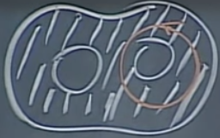

Connected regions
A connected region in the plane is simply connected if the interior of any closed curve in R is also contained in R
On the picture on the right it is not simply connected region, because not
All the drawn circle on the right is contained within the region R
So if domain of F is defined and differentiable, is simply connected, then we can always
Apply Green’s theorem

Slide 13

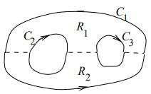
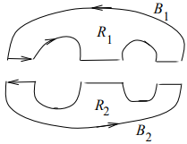

Green’s theorem also applies to regions with several boundary curves, provided that we take the line integral over the complete boundary, with each part of the boundary oriented so the normal n points outside R.
If curl F=0, it does not mean that F is a gradient of some function f
We want to show that if curl F=0, then for any closed
Curve lying in R
But we can’t use Green’s theorem to the curve C, because the
Interior of C is not entirely contained in R (it does not contain the hole)
Similar case can be made to the Green’s theorem in normal form. If the flow field satisfies div F=0 everywhere except at one point, that doesn’t guarantee that the flux through every closed curve will be 0, this spot might be a source

Slide 14


Therefore, to conclude that if curl F=0 leads to F being a gradient, we define R to be simply-connected
Definition: A 2D region D of the plane consisting of one connected piece is called simply-connected if it has this property: whenever a simple closed curve C lies entirely in D, then its interior also lies entirely in D
Regions with holes are said to be multiply-connected
The following 4 statements are equivalent, if anyone is true for F, so are the other three

Slide 15

Finding area inside the curve by using the Green’s theorem
so here we need to do in a way that Nx-My
Should equal to 1. One option is for line integral M=-y N=x

