Slide 1
Part A Triple integrals

Slide 2

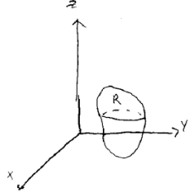

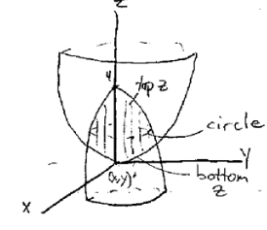
Triple Integrals
dV= dx dy dz, or different expression, depending on the coordinate system.
Basically, in triple integral we multiply the value of function by little dV volumes over some region in space
It is usually easier to set dz in the inner part, it is in betw 4-x2-y2,
And x2+y2, then for dx and dy we find shadow in xy plane
Cylindrical coordinates

Slide 3


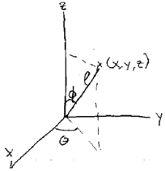
For finding mass we sum small masses dm, over volume
For finding an average value of function over some region R in space, we integrate the value f over the volume dV and then divide by volume
After having discussed cartesian and spherical coordinates, we pass to spherical
We have 3 parameters to define a point in spherical coordinates
Rho (distance from origin), phi (angle down from +z axis
And theta as usual, counterclockwise angle from x

Slide 4









Triple integral in spherical coordinates
Gravitational force exerted by delta M at x,y,z on a mass at the origin is:
So, F becomes
To get the total value of we should integrate over the whole mass
To make the evaluation of integral easier, we place the solid so that z-axis is an axis of symmetry
Newton’s theorem: Gravitational attraction of a spherical planet with uniform density is equal to that of a point mass (with same total mass) at its center

