Slide 1
Flux and divergence theorem

Slide 2

Vector fields in space
At every point F, vector pointing is a function of x,y,z so F(P,Q,R)
One example of a vector field is a gravitational attraction, e.g of a solid mass M at (0,0,0) on a mass m at (x,y,z)
This force can be expressed as a vector directed to the origin
We say F is continuous in some domain D of a 3D space, if M, N and P are all continuous in that domain and we also say F is continuously differentiable in the domain D if all 9 1st partial derivatives exist and continuous in D
Examples are force, flow, velocity fields

Slide 3

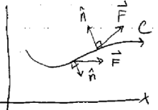
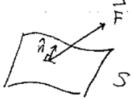

Flux
In 2D we were integrating the dot product between vector field F and vector normal to the curve and adding them up along the curve
In 3D, flux happens through the surface, not a curve, so we
Need a surface integral
This a how a flux in 3D looks like
But we have 2 choices for n, either inside or out
So for surface integral, we integrate over the region S, which
is now double integral over surface area element

Slide 4


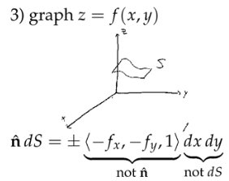
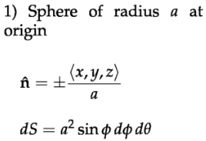
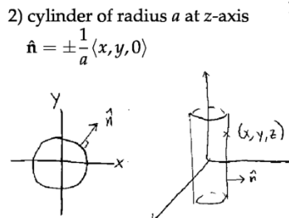
We have to figure out how to integrate over surface S
Here surface is a surface of sphere
We can describe the surface of sphere by using phi and theta
In horizontal plane z=a, we have dS=dxdy and normal is +/- k, while in vertical plane parallel to yz plane x=a, we have dS=dydz and normal is +/- I
Geometric interpretation of double integral F*ndS is area of base, which is dS multiplied by perpendicular component of F, which gives volume, if F is a velocity field

Slide 5

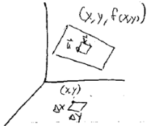


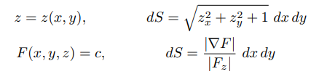

So flux of F through the surface S is
Let’s analyze the case when surface S is a graph of z=f(x,y)
We said ndS=+/- (-fx, -fy,1)dxdy
We can express ndS as a cross product of vector U and V
Vector U varies from (x,y,f(x,y) to (x+delta_x, y, f(x+dx)
Where f(x+dx)= (approx.) f(x)+f’(x)*dx
So, U= (dx,0,f’x*dx); V=(0,dy,f’(y)*dy
So ndS=UxV=

Slide 6
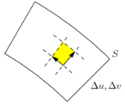





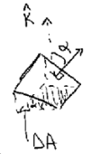




General formula for ndS
Given some parametric description of S in terms of 2 independent variables u,v
(x,y,z)=r=r(u,v), then ndS=….du dv
Sides now equal to
So ndS=
If we know a normal vector to some surface S
So dA=dS*cos(alpha), as one side is mutual, the other is a=s cos(alpha)
We can find angle alpha, by finding angle between 2 normal k and N
if we multiply this by n

Slide 7
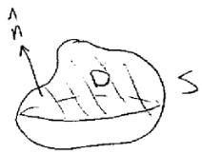



Divergence theorem (‘ Gauss- Green theorem’)- 3D analogue of Green for flux
It works for closed surfaces, where S is a closed surface enclosing a region D oriented with n outwards and F is defined and differentiable
Everywhere in D
The surface integral represents the mass transport rate across the closed surface S, with flow out of S considered as positive, flow into S as negative
Whereas the value of div F at (x, y, z) can be interpreted as the source rate at (x, y, z): the rate at which fluid is being added to the flow at this point. (Negative rate means fluid is being removed from the flow.) The integral on the right of (2) thus represents the source rate for D
So, Divergence theorem says that the net flow outward across S is the same as the rate at which fluid is being produced (or added to the flow) inside S.
But at this point, we have to show that source rate at x,y,z equals to div F

Slide 8

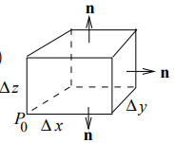
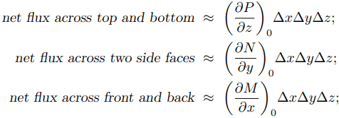

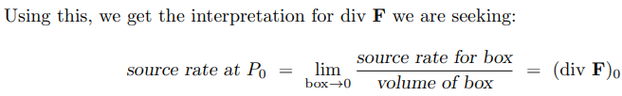
To complete the argument we have to show that
So we take a small rectangle
Flux across the top:
Flux across the bottom
Net flux across 2 faces:
Combining x,y, z
Adding up these 3 net fluxes and using top right eq we see

Slide 9



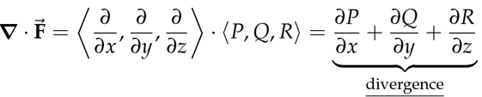

Divergence theorem, F is velocity vector
On the left we sum all the flowrates that either go into or out of the closed surface, when we dot F and n we get the length of portion of F that is perpendicular to the small dS and when we multiply F by dS we get infinites flowrate and after summing everything up, we get net flowrate over the whole surface. So the the left side is amount of fluid leaving per unit time
We assume incompressible flow, that is density is constant
So net flow either positive or negative should equal to the net source or sink inside the region S and we find that by summing up all the sources and sinks inside the region D. and thus div(F) should equal to source rate per unit volume

Slide 10

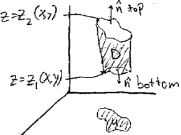


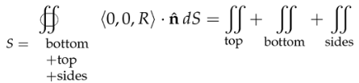
Proof of divergence theorem
We prove it 1st for only the case when vector field has z component, but can do this for both x and y and then, so then we will have a general case
Then we make a 2nd simplification by assuming a region D is vertically simple, that is bounded by 2 functions without any interruption in between
We start with the right hand side (triple integral), as we
Assumed that D is bounded by z2 and z1
So integral of Rz is just R and then we evaluate it at z2 and z1
Whereas we split he LHS into 3 pieces, namely top, bottom and sides
On top we have n=k; on bottom n=-k

Slide 11





Now, we do the LHS
So we said for the surface integral involving the surface for which we know its function, we have the formula (-dz/dx;-dz/dy,1) and on top we have z=z2(x,y)
But as we only have z component R it is
We can plug z2 in top surface int
In the bottom part the orientation of n is the opposite, so
so we get –R
For the sides, the normal does not have vertical component but F(0,0,R) is only made of the vertical component, so dot product is 0
If we sum up top and the bottom we get +
And on RHS we had: so we proved it
If D is not vertical simple, we decompose
It into simple pieces; DONUT

Slide 12



Diffusion equation- heat equation (instead of u we have T (temp) )
It governs the motion of smoke in immobile air or dye in solution
It is a partial differential equation, the unknown is a function and equation will relate the partial derivatives of that function to each other
u (concentration at a given point) is an unknown. U(x,y,z,t)
this is diffusion equation
Laplace operator or Laplacian is a differential operator given by the divergence of the gradient of a function, gives the sum of 2nd order derivatives
F ( velocity field) gives us direction and magnitude of motion of smoke
2 things needs to be understood: 1) how flow will flow from a region with high smoke to a region with low smoke (that we will always go in direction where concentration decreases the fastest –grad_u dir 2)
Now we know the dir of F, but how big it should be, easiest thing is to assume that they’re proportional. Steeper the difference in concentration, the faster flow will be

Slide 13






The 2nd thing to understand is once we know the flow is going, how does that affect the concentration, it should decrease from where it goes, and increase where it go
So it is the relation between F and partial u/t
Let’s understand the 2nd part more carefully
the RHS measures the amount of smoke passes through S per
unit time; it equals to net change of total smoke in D
If we integrate the amount of smoke per volume over whole volume we
Get the total amount of smoke and we take derivative to see how it changes with time
Flux us counted positively when we go out of region so u1>u2 and thus we have min sign
so we replace surface integral with triple integral
and we can switch order of integration and derivative
Summing volumes and taking deriv wrt = summing changes of small volumes wrt to time
Derivative of sum is sum of derivatives and also here dt is not a variable of integration and that is why it is possible. So it means

Slide 14
So and so –k div

Slide 15


Partial differential equations
Partial differential equation (PDE) is a differential equation that contains unknown multivariable functions and their partial derivatives. PDEs are used to formulate problems involving functions of several variables.
A special case is ordinary differential equations (ODEs), which deal with functions of a single variable and their derivatives.
In general a solution of a partial differential equation is a differentiable function that satisfies it
In general, PDE’s have many solutions, far too many to find all of them. The problem is always to find the one solution satisfying some extra conditions, usually called either boundary conditions or initial conditions depending on their nature.
Our 1st important PDE is the Laplace equation in 3 dimensions
If in the temperature model we include also heat sources and sinks in the region, unchanging over time, the temperature function satisfies the closely related Poisson equat
Where f is some given function related to the sources and sinks

