Slide 1
Line integrals in space and Stokes’ theorem

Slide 2





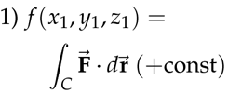
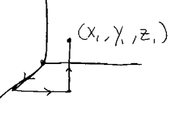
Line integrals in space
Everything is same as before, except we have z coordinate
So for line integrals in space, we will be given F and
Will need to parametrize the curve
If F is a gradient field F=grad(f) then when can evaluate line integral by plugging values of f at endpoints
How do we test whether the given vector field is a gradient field or not
F=(P,Q,R)=?(fx, fy, fz). For that to happen Py=Qx; Pz=Rx; Qz=Ry
Also if F is grad field then Pdx+Qdy+Rdz
Is exact differential df
2 ways to find potential- f from vector field 1) using line integral of F from (0,0,0)
to (x,y,z) 2) using antiderivatives

Slide 3



Criteria for the field to be gradient field, another criterion is curl F= 0
Curl in 3D is a vector field, not scalar
Div F= del*F; curl F = del x F
Exact differentials
The expression in integrand is called differential
If f(x,y,z) is a differentiable function, then its total differential is defined to be:
The differential is said to be exact, in some domain D
Where M,N,P are defined and if it is the total differential of some differentiable function f(x,y,z) in this domain

Slide 4










Del operator
Divergence and Stokes’ theorem
2 important relations

Slide 5

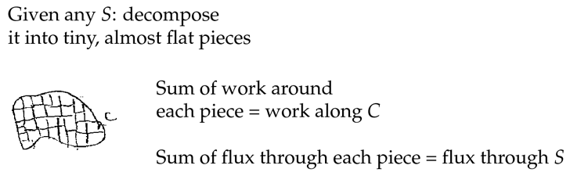
Stokes theorem
Curl measures the rotation part of a vector field, if it is velocity field, the direction of curl F shows the axis of rotation and magnitude = 2*angular_veloc
Stokes theorem, C closed curve, S any surface bounded by C
And F should be defined everywhere in S
We need to clarify the orientation of C and S, rule is that for the counterclockwise direction of curve, n points upwards
Proof of Stokes’s theorem

Slide 6
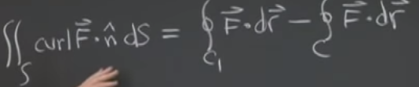
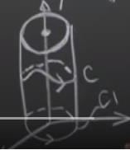
a

Slide 7




Simply connected regions; Topology
Definition of simply connected region: a region is simply connected if every loop inside it bounds a surface inside it
A space with origin removed is simply connected region, as even with loop surrounding the origin, we can find a surface that does not contain origin, by bypassing the origin
However, space with z-axis removed is not simply-connected, as for a loop that contains z axis, a surface needs to pass through z-axis, which is not in a region
If vector field F=grad(f), then curl F=0, as 2nd derivatives are equal
Theorem: if F is defined in a simply connected region and curlF=0, then F is gradient field and line integral of
Proof: assume curl F=0, then the difference between 2 line integrals should be 0. Using Stokes theorem

Slide 8
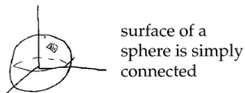
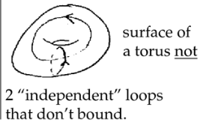
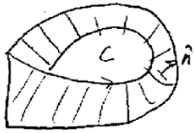
Topology classifies surfaces in space
For non-orientable surface, flux
Cannot be defined.
A domain D in 3-space is simply-connected if each closed curve in it can be
shrunk to a point without ever getting outside of D during the shrinking.

Slide 9
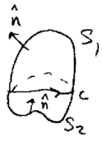


Stokes theorem and surface independence
Know we explore why Stokes theorem is surface independent
For that we write Stokes theorem for a same curve but with different surfaces S1 and S2 and by definition of Stokes theorem they should be equal
Now we need to check whether their difference is 0
When we substract surface integral over S2 from S1, we can write it
As sum of surface integrals of S1 and S2 but change orientation of S,
So that both of their normal are directed outside, and surface is bounded
This way we can express as volume integral by using divergence theorem where F now becomes curl F
Div of curl F is 0

Slide 10
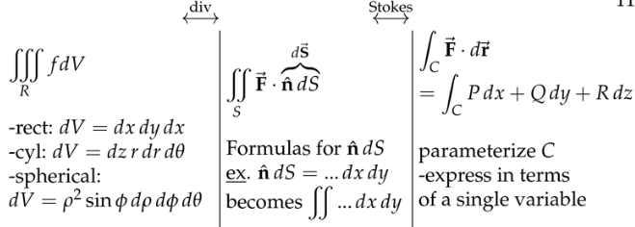


Summary of multiple integration
We have triple, double and surface, and line integrals and we have some theorems that relate those and allow to go back and forth between them
We also have some applications
Of multiple integrations such as
Mass (rho dV or dA
Avg value of f (f dV or dA / V or A
Moment of inertia dI=R^2(distance) dm
Gravitational attraction on mass at origin dF=Gm0*dm/R^2
For surface integrals we have formulas for surface 1) rectangle 2) sphere 3) cylin
And for general cases
Divergence, Stokes and Green’s theorems in some way all express the idea of fundamental theorem in calculus

Slide 11
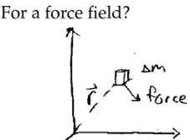
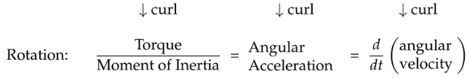
Physics applications
Curl V= 2 *angular velocity vector (rotational part of the motion), v-vector field
Torque=F*d;
If curl F=0, then F does not induce any rotation motion

Slide 12
a

