Slide 1
Multivariable Calculus

Slide 2
Lecture 1

Slide 3
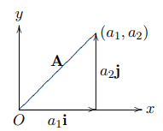
Lecture 1 Vectors
we can view vectors in two different ways: geometrically and algebraically
A vector is defined as having a magnitude and a direction
We represent it by an arrow in the plane or in space
We will refer to the start of the arrow as the tail and the end as the tip or head
Magnitude- |A|.-length or norm
It is often useful to think of vectors as displacements.
In this way, A + B can be thought of as the displacement A followed by the displacement B.
The special vectors i, j and k are unit vectors, , e.g., u.

Slide 4


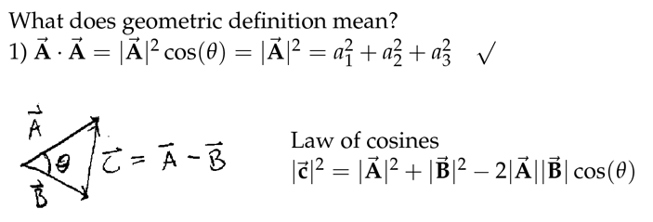
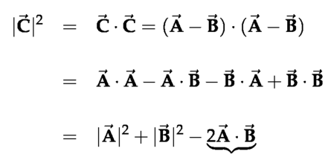

Vectors can be decomposed into unit vectors A=a*i^+b*j^+c*k^= (a1,a2,a3)
Dot product (2 definitions-algebraic and geometric)
Algebraic- Geometric-
This formulas can be related to each other by the law of cosines
Orthogonality implies that A*B=0

Slide 5
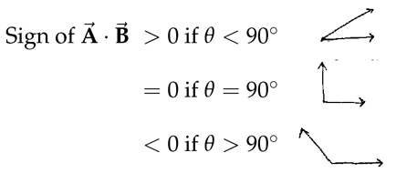


Applications of dot products
1) Computing lengths and angles cos(theta)=(a*b)/(abs(a)*abs(b))
If A*B>0 then theta <90; if 90 then 0; if theta>90 then >0
2) Detect orthogonality
3) Component of vector A along direction u ( unit vector)

Slide 6
Lecture 2

Slide 7
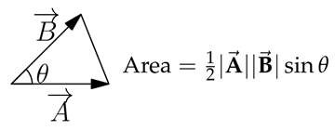
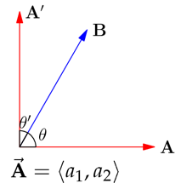
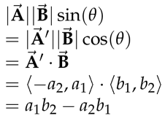
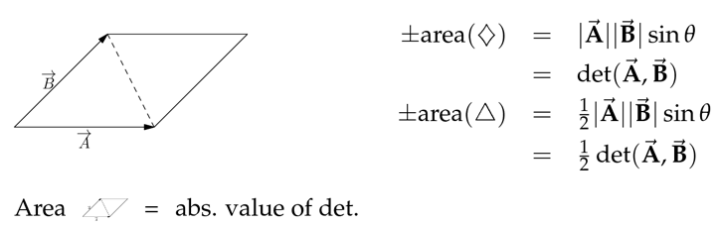
Lecture 2. Area and determinants
Area of triangle equals to but we do not know sin
We can replace A by A’ as their length is equal
And sin(theta)=cos(theta’) therefore we get area
And this the determinant
Recap

Slide 8
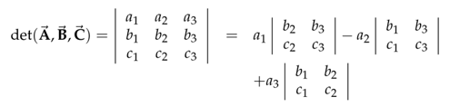
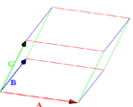


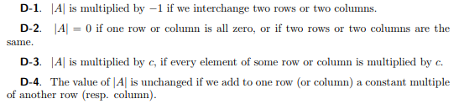
Determinants in space
Determinant in space- put coordinates of every vector in a row
Geometrically, det (A,B,C)=+/- volume of parallelepiped formed by A,B,C
Cofactor is minor multiplied by 1 or (-1)

Slide 9
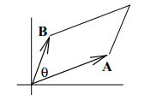




This means origin vectors lie in a plane

Slide 10
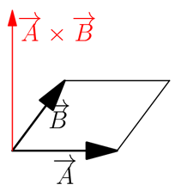
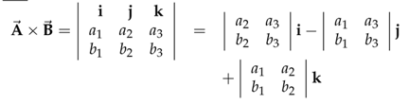
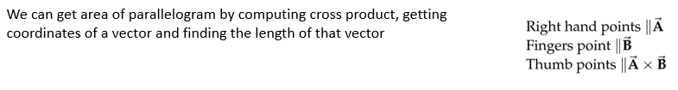
Cross product A x B
cross product of 2 vectors in 3D space, it gives us a vector
Formula
Geometrically
Cross product of 2 vectors give a vector, which is perpendicular to the plane of parallelogram formed by those 2 vectors and whose length is equal to the determinant of those 2 vectors

Slide 11

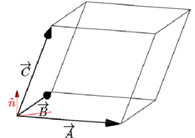
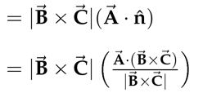

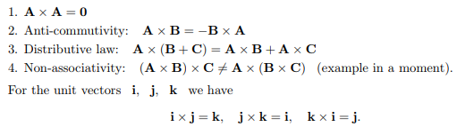
How to compute the volume without determinants
Area equals to the length of A*B, whereas the height equals to C*n
Vector C dot n, where n is a unit vector that is perpendicular to plane of A and B
We can find n by finding cross product A and B and dividing by length
Of cross product to make it unit vector
After simplifying the formula we get triple product, which says
That

Slide 12

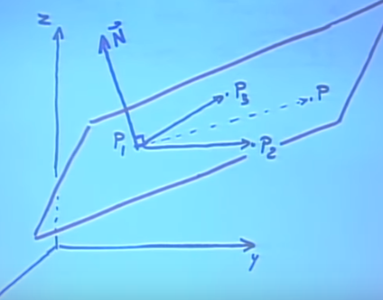
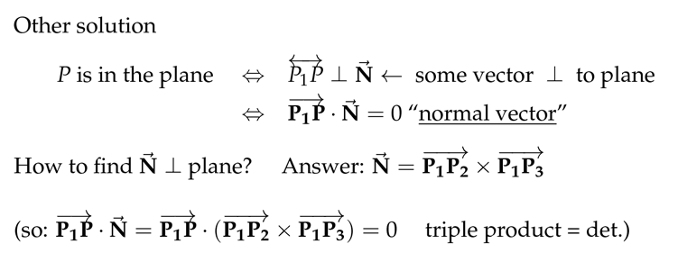
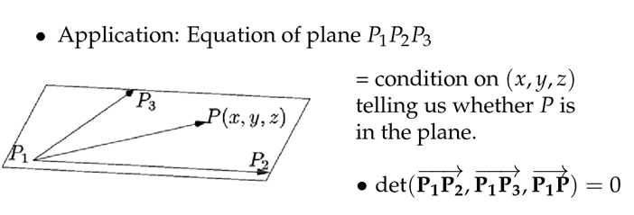
Equations of plane
We have 3 vectors and we want to know whether these 3 vectors lie in the same plane.
To determine that, we can check whether determinant of vectors (P1P3, P1P2, P1P) is 0 or not
If det=0 then they are lying in the same plane
Another solution
To check whether P is in the plane, we can check whether vector P1P is
Perpendicular to vector that is perpendicular to the plane defined by P3P1 and
P2P1 – we can take dot product of vector P1P*N=0 if yes then good
How do we find vector N that is perpendicular to plane? We take cross
Product of vectors P1P3 and P2P1, so N=P1P3XP2P1
Det of 3 vectors =0, so det is triple product

