Slide 1
Lecture 3

Slide 2

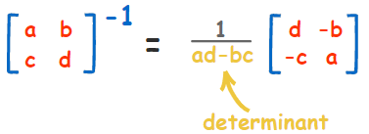
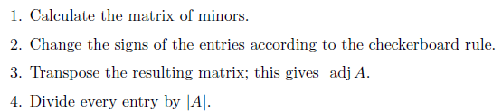
Matrices, meaning and inverse
Matrices represent transformations in space
Multiplication by matrix B and then A – (AB) means, we 1st transform the space by B then A
Inverse of A, such that AM=I, needs to be square matrix
Formula for inverse: AX=B; A(-1) A X= A(-1) B; X=A(-1)*B
Inverses are used to solve system of linear equations

Slide 3
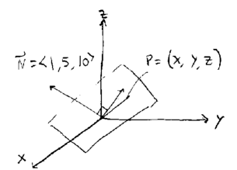


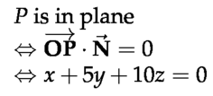

Equation of plane
In order to define an equation of plane when we are given coordinates of vector that is perpendicular to that plane.
We take the dot product of normal vector and another vector that is on plane and equate it to 0

Slide 4

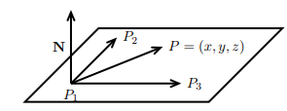

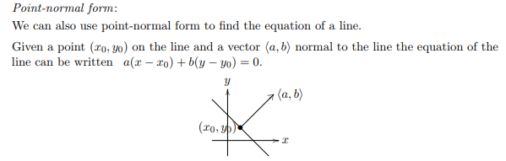

Slide 5
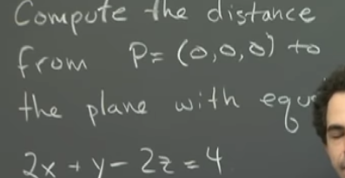
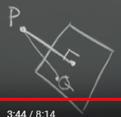
First we can find a normal vector to plane (2,1,-2)
Then we can any point say Q ( 2,0,0) on plane and then find coordinates of the vector PQ
Finally, we can find the dot product of vector PQ and normal vector to find the component of PQ on normal vector (projection). (PQ*N)/ abs(N)

Slide 6
Linear systems and planes
2 planes intersect at a line
3rd plane can be parallel to this line, then there is no solution ( 2 contradicting equations)
3rd plane can contain this line, then solution is infinite number of points ( 2 exactly same equations )
3rd plane can intersect this line then there is 1 solution ( 3 unique equations)

Slide 7



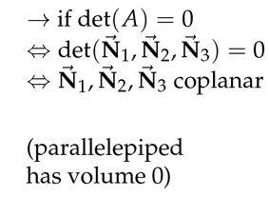

If det(A)=0, A is not invertible
1)
2)
A is matrix of coefficients, so coefficients represents normal to plane and if det(A)=0, then normal are on 1 plane
3)
N’s are on the same plane

Slide 8
Homogeneous and inhomogeneous systems
Ax=b is called homogeneous if b=0, otherwise it is inhomogeneous
Ax=b has unique solution if det(A) not 0, x=A(-1)*b, if b=0, Ax=0, only trivial sol
Det(A)=0, Ax=0 has non-trivial solutions, Ax=b usually no solutions, but has solutions for some b
For Ax=0, given det(A)=0, it means x is perpendicular to rows of matrix A and is any vector (line of vectors is solution) is perpendicular to the plane containing rows of matrix A

