Slide 1
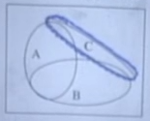
Independence
Knowing that some event happened does not affect the probability of the required event
Generally if
Independence also holds true in conditional universe
P ((A and B)/C)= P(A/C)*P(B/C)
Conditioning affects the independence, after we know C occurred,
It will affect our knowledge on probability of A and B as small
Parts in A, B intersection with C are disjoint
Opposite is also true. Concretely, if A and B are independent given C, they may not be independent without conditioning
Pairwise independence does not imply independence

