Slide 1
Lecture 12
Iterated expectations; sum of a random number of random variables

Slide 2
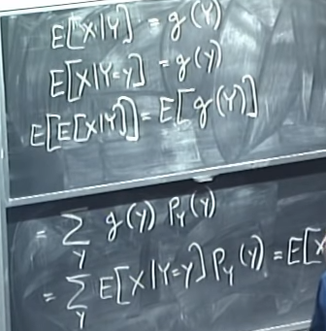


E[X/Y=y]=y/2, here it equals to specific number
E[X/Y]=Y/2 so expectation of this expression itself is a random variable
E[E[X/Y]]=E[Y/2]=sum over y (y/2*pmf(y) )
Alternatively, E[ E[X/Y] ] = sum over y E[X/y=y] pmf(y) = E[X]
This formula tells that overall variability of X
Is sum of the average variabilities of random variab
It is made of + variance of averages of r.v

Slide 3

So E[X/Y] is itself a random variable and it has an expectation on its own
E[E[X/Y]]= sum over y ( E[X/Y=y] *pmf[y])= E[X]
This is because given value of Y, g(Y) is constant
An estimator (sample variance) refers to a statistic that is used to generate an estimate once data are collected

Slide 4



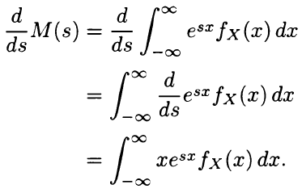


Moment generating function
In probability theory and statistics, the moment-generating function of a real-valued random variable is an alternative specification of its probability distribution. Thus, it provides the basis of an alternative route to analytical results compared with working directly with probability density functions or cumulative distribution functions. There are particularly simple results for the moment-generating functions of distributions defined by the weighted sums of random variables

Slide 5
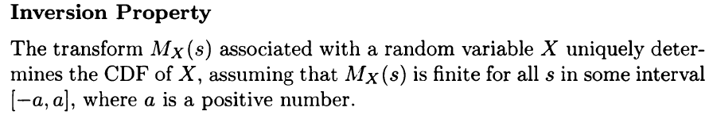




a

Slide 6
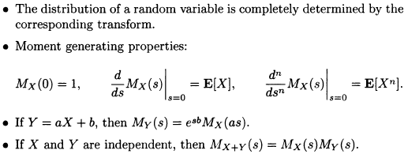
Sums of independent random variables
Transform methods are particularly convenient when dealing with a sum of random variables
The reason is that addition of independent random variables corresponds to multiplication of transforms

Slide 7





Moment generating functions

Slide 8
Transforms are useful for a variety of purposes, such as:
Knowledge of the transform associated with a random variable provides a shortcut for calculating the moments of the random variable (by taking derivative of moments when s=0)
The transform associated with the sum of 2 independent random variables is equal to the product of the transforms associated with each one of them
Transforms can be used to characterize the distribution of the sum of a random number of random variables

