Slide 1
General random variables Chapter 3

Slide 2
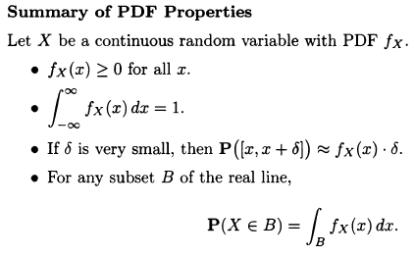
Continuous random variables and PDFs
Summary of properties of PDF:
1) function is always positive
2) sum of probabilities should add to 1
3) if region around density is small, probability can be approximated as function*length of region
4) for P(X in region B)

Slide 3
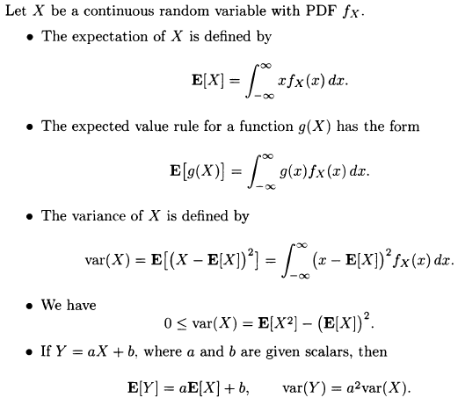
Expectation of continuous r.v and its properties
1) Expectation is defined as sum of value of random variable multiplied by its probability over the total range values
That variable can take

Slide 4



Properties of CDF
CDF is probability up to some value
If X is discrete and takes integer values, the PMF and CDF can be obtained from each other by summing or differencing
If X is continuous, the PDF and CDF can be obtained by integration and differentiation

Slide 5

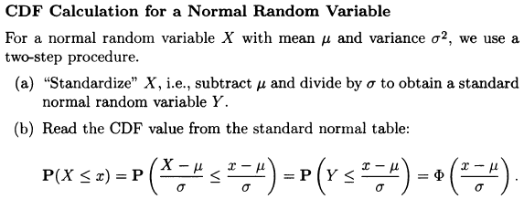
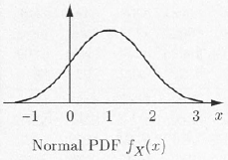
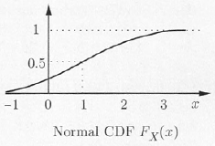
Normal random variable
Continuous random variable is normal if its PDF->

Slide 6



Joint PDFs and expectation
Let X and Y be jointly continuous random variables with joint PDF fX,Y
Then probability of X,Y being in region in B
The marginal PDFs of X and Y can be obtained from the joint PDF
We can find the join PDF from joint CDF

Slide 7





Conditioning
Conditional PDF of X given event A satisfies
PDF has the same shape, except it is scaled in
Vertical axis

Slide 8

Finding PDF, CDF of transformed random variable
X ∼ U[−1, 1] and y = exp(x)
Then bounds of y are 1) exp(-1): -1/e 2) exp(1): e so [-1/e; e]
CDF of Y: Fy(y)= P(Y<=y)= P (exp(X)<y) or P( X<ln(y) )
As CDF of X is : ½+ ½ *x ; P(X<ln(y))= ½+ ½ * ln(y) for y in range [-1/e; e]
The PDF of this random variable is derivative of CDF
So if we generalize the procedure: 1) Find CDF of X 2) Find X as function of Y 3) Find bounds of Y based on bounds of X and functional relationship 4) Insert expression of x found earlier as function of y and bounds to express CDF 5) To find PDF, take the derivative of CDF

Slide 9
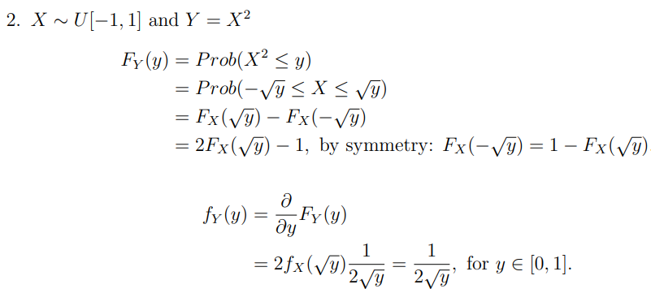
An example

